Slide 1
UML Modeling Sequence Diagrams
Notes:
Replace this with your course title and your name/contact details.

Slide 2
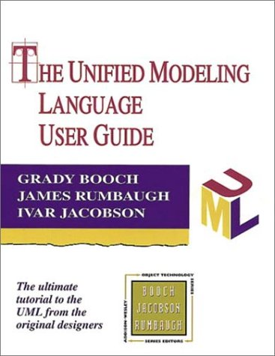
References
Materials in this educational slide deck are taken from The Unified Modeling Language User Guide.
UML stared in October 1994 when Grady Booch and James Rumbaugh worked at Rational Software Company, pioneers in software modeling.
These three were the original designers of UML, but they collaborated with partners from the software industry, including Hewlett-Packard, IBM, Oracle and others.

Slide 3
Sequence Diagrams and Interaction Diagrams
An integration diagram shows an interaction, consisting of a set of objects and their relationships, including the messages that may be dispatched among them. There are two types:
Communication diagram (formerly known as Collaboration Diagram) which emphasizes the structural organization of objects that receive and send messages
Sequence diagram that emphasizes the time ordering of messages.
A sequence diagram shows a set of roles and the messages sent and received by the instances playing the roles.
Sequence diagrams illustrate the dynamic view of a system

Slide 4
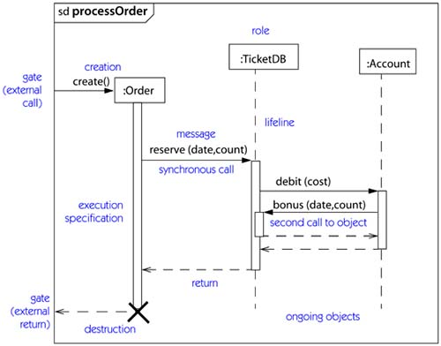
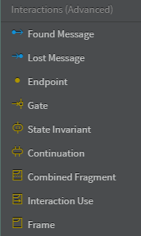
Decomposing a Sequence Diagram (1)
Sequence diagrams should focus on only one functional requirement
Each separate bit of functionality is in its own Frame, in this case – processing an order

Slide 5
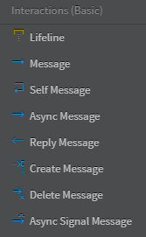
Decomposing a Sequence Diagram (2)
Lifelines represent objects that are in play for the modeled functionality
Each object is listed in the box on top of the lifeline (the role)

Slide 6
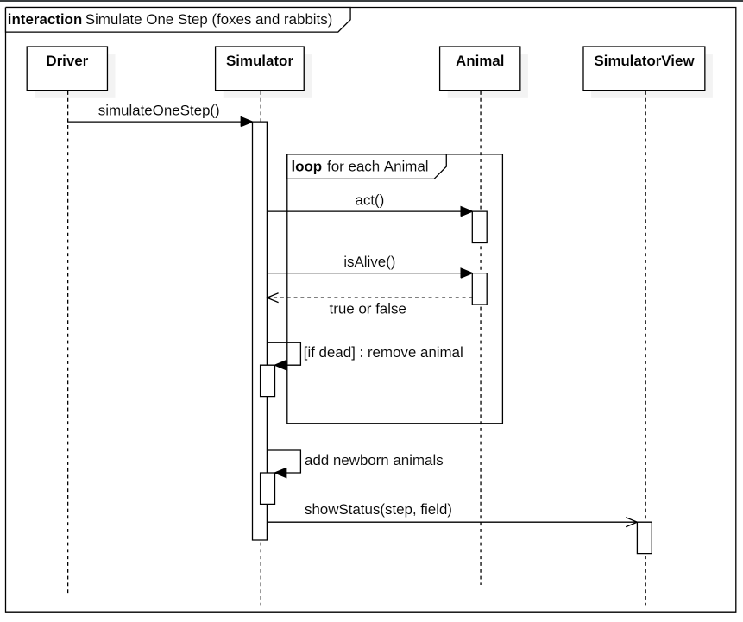
Object Lifelines for Object Oriented Applications
For OO Applications, the Lifelines are very typically classes.

Slide 7
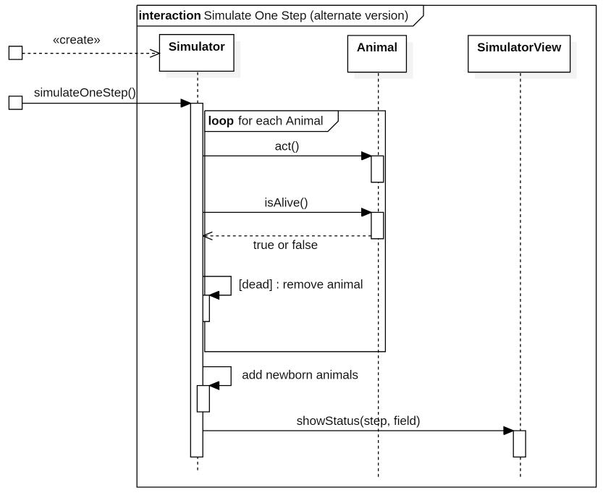
Using Gates (out of boundary messages)
Gates can be an easy way to model the passing of information between a sequence diagram and its context.

Slide 8
Decomposing a Sequence Diagram (3)
Messages indicate how objects communicate with each other, for example:
object 1 invoke a method of object 2
object 2 resturns a value to object 1
An execution specification (activation) is the execution of a procedure, including any time it waits for nested procedures to execute. Also known as the focus of control.

Slide 9
Types of Messages
(Synchronous) Message: a method call, where the calling object pauses execution until the called method completes.
Reply: the returned value from a method call. (Void methods do not have replies.)
Self Message: an internal method call, that is the object calls one of its own methods.
Asynchronous Message: the message caller does not wait for the receiver to process the message and return before sending other messages to other objects within the system.
.
Create Message: when one object creates an instance of another object.
Delete Message: when an object is deallocated from memory or is destroyed within the system we use the Delete Message.
Asynchronous Signal Message: A signal differs from a message in that there is no operation associated with the signal. A signal can represent an interrupt or error condition..

Slide 10
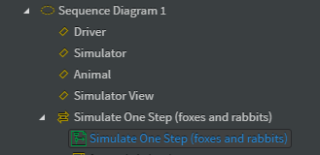
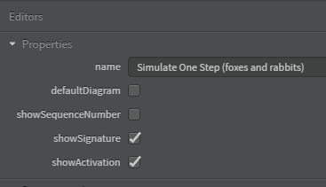
Messages can be numbered or left unnumbered
Messages can be numbered in sequence, but since they are time-ordered, these are not needed.
Use only if you want to reference a given message in another document.
In StarUML, select your diagram object and turn off showSequenceNumber

Slide 11
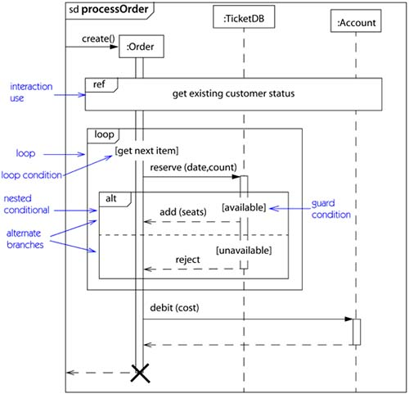
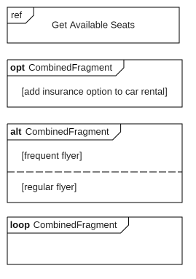
Decomposing a Sequence Diagram (4)
Control structures (interaction use or combined fragments in StarUML)
Guard Conditions (interaction use or combined fragments in StarUML)
Cross reference to another sequence diagram

Slide 12
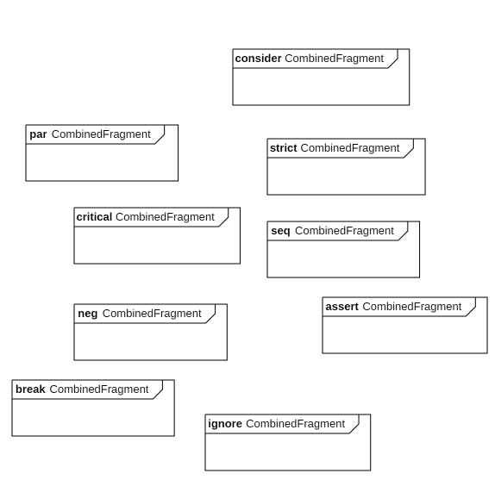
Other Control Structures
Break fragment models an alternative sequence of events that is processed instead of the whole of the rest of the diagram.
Parallel fragment (denoted “par”) models concurrent processing.
Weak sequencing fragment (denoted “seq”) encloses a number of sequences for which all the messages must be processed in a preceding segment before the following segment can start, but which does not impose any sequencing within a segment on messages that don’t share a lifeline.
Strict sequencing fragment (denoted “strict”) encloses a series of messages which must be processed in the given order.
Negative fragment (denoted “neg”) encloses an invalid series of messages.
Critical fragment encloses a critical section.
Ignore fragment declares a message or message to be of no interest if it appears in the current context.
Consider fragment is in effect the opposite of the ignore fragment: any message not included in the consider fragment should be ignored.
Assertion fragment (denoted “assert”) designates that any sequence not shown as an operand of the assertion is invalid.
https://sparxsystems.com/resources/tutorials/uml2/sequence-diagram.html

