Slide 1
UML Modeling Foxes and Rabbits Object Diagram
Notes:
Replace this with your course title and your name/contact details.

Slide 2
Rationale for Object Diagrams
If you freeze a running system or just imagine a moment of time in a modeled system, you'll find a set of objects, each in a specific state, and each in a particular relationship to other objects. You can use object diagrams to visualize, specify, construct, and document the structure of these objects. Object diagrams are especially useful for modeling complex data structures.
An Object Diagram could be very useful to describe the state of the foxes and rabbits simulation at a point in time.
The Unified Modeling Language User Guide

Slide 3
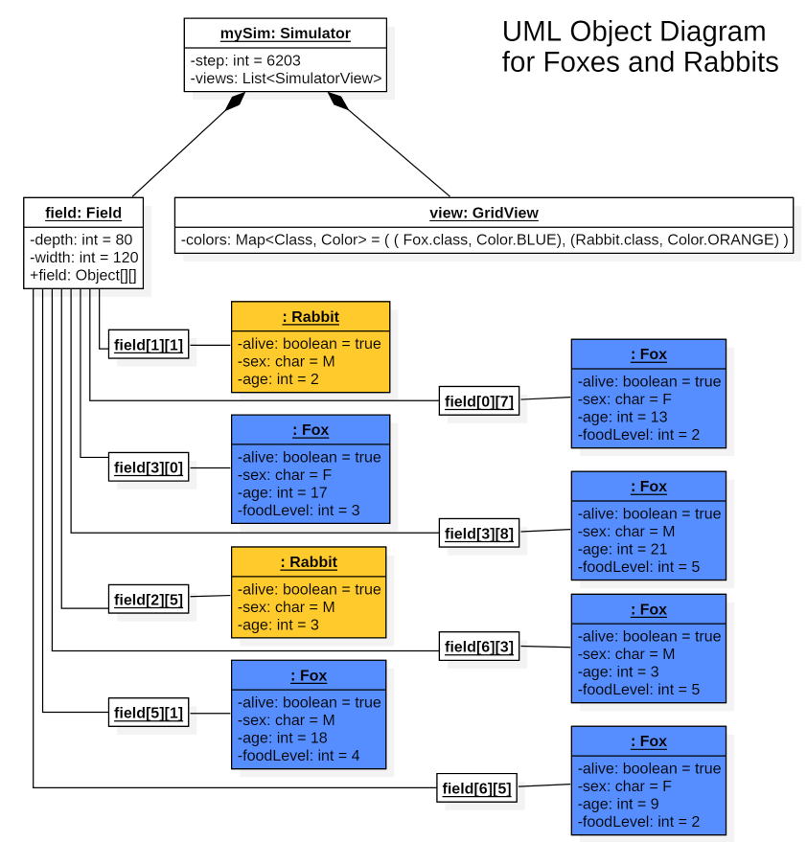
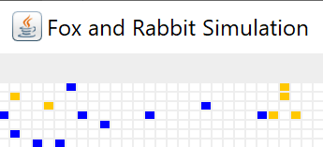
Displaying the State of a Simulation Step
At this step of the Simulation (step 6203), in this small area, we see 2 rabbits (gold) and 6 foxes (blue)
An Object Diagram can illustrate what this means by showing actual instances of objects

