Slide 1
UML Modeling
Use Case Diagrams
Notes:
Replace this with your course title and your name/contact details.

Slide 2

References
Materials in this educational slide deck are taken from The Unified Modeling Language User Guide.
UML stared in October 1994 when Grady Booch and James Rumbaugh worked at Rational Software Company, pioneers in software modeling.
These three were the original designers of UML, but they collaborated with partners from the software industry, including Hewlett-Packard, IBM, Oracle and others.

Slide 3
UML Use Case Diagrams
Use Case Diagram – Use case diagrams are important for visualizing, specifying, and documenting the behavior of an element. They make systems, subsystems, and classes approachable and understandable by presenting an outside view of how those elements may be used in context.
Use case diagrams commonly contain
  Use cases
  Actors
  Dependency, generalization, and association relationships
  Packages (optional)
Use case diagrams are used to model
  The requirements of a system
  (and thus are useful in requirements documents)
  The context of a system
  (and thus are useful in design and architecture documents)

Slide 4
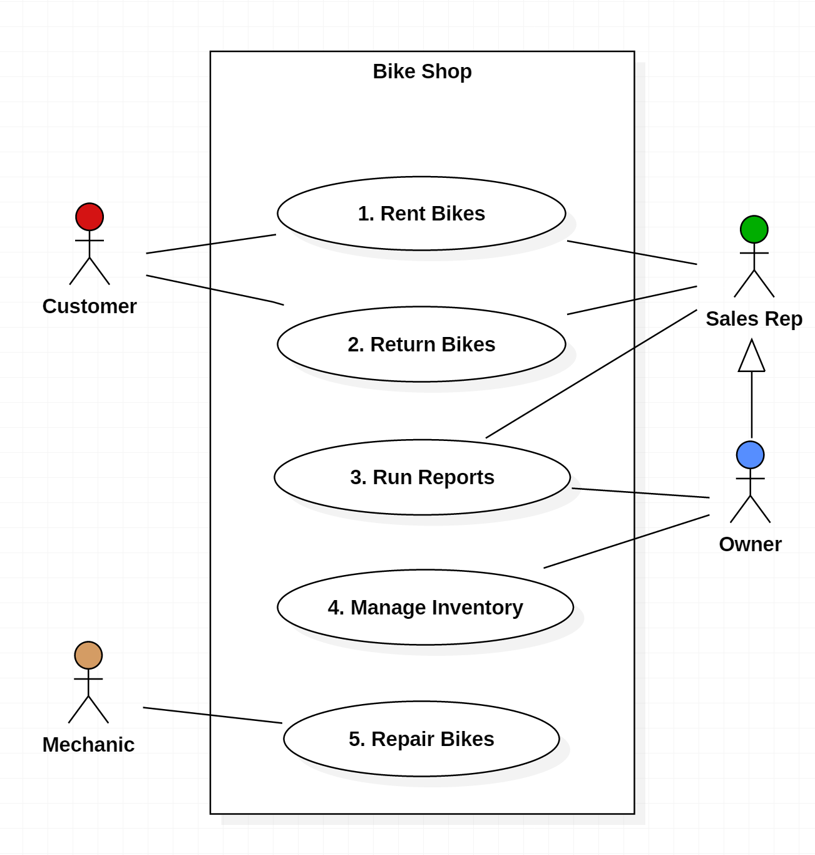
Use Case Diagrams (1)
Purpose
  Visualize the different types of roles in a system
  Show how those roles interact with the system
Usage
  Requirements Document
  (simple Use Case Diagrams)
  Design Document
  (advanced Use Case Diagrams

Slide 5
Use Case Diagrams (2)
  Boundary (aka "Use Case Subject" or "Scope"): defines the considered scope of the diagram.
  Actor: any entity that performs a role in a system. Could be a person, organization or an external system.
  Use Case: a function or an action within the system.
  Association: links an Actor to a Use Case
  Generalization: one Actor can inherit ( or "act as" the role of another Actor
Employee

Slide 6
Use Case Diagrams (3)
  Note that the Owner of the Bike Shop can act as a Employee if needed through Generalization
  Both the Employee and the Owner are associated with "Run Reports." Is this redundant?
    No, there are certain generic reports a Employee runs that an Owner could also run when he is assuming that role.
    But the separate Association between the Owner and Run Reports implies that there are some reports only the Owner can run.
Employee

Slide 7
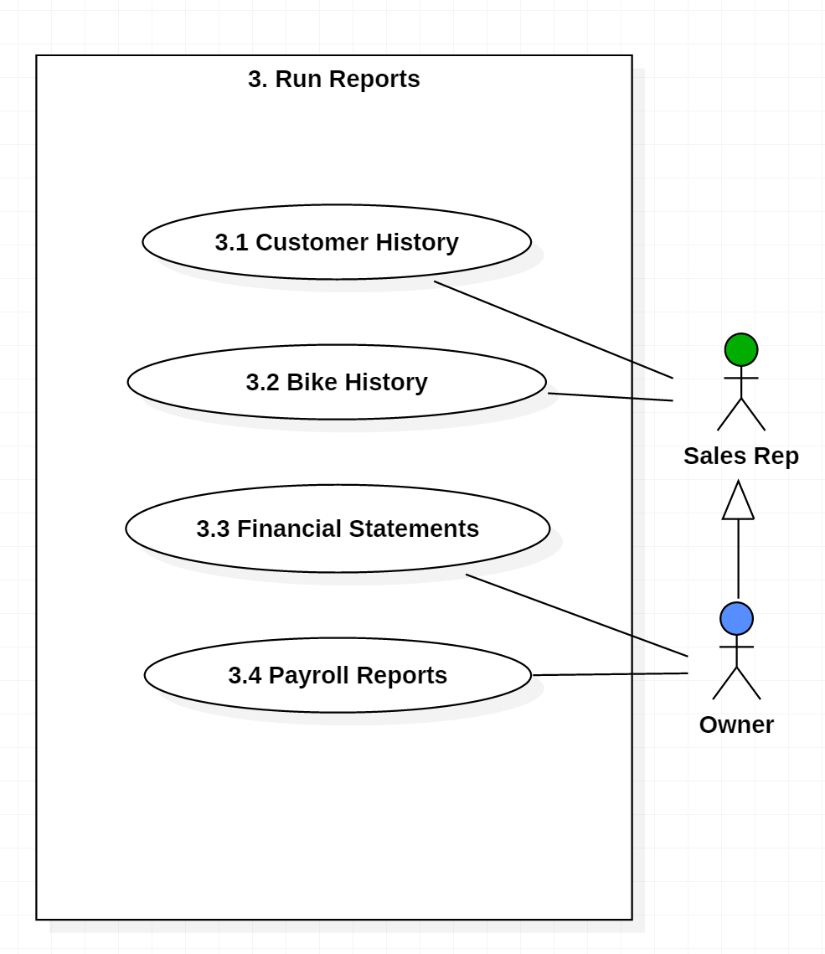
Decomposed Use Case Diagrams
Use case diagrams can be decomposed to lower levels
This is why it is a good idea to number your Use Cases

Slide 8
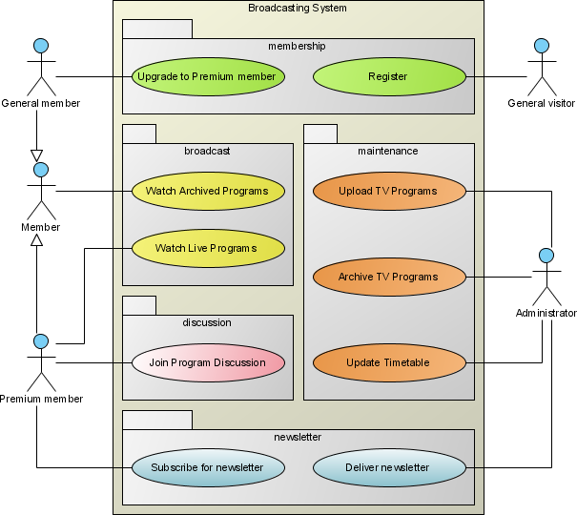
Grouping Use Cases with Packages
Package is an optional element that is extremely useful in complex diagrams. Packages are used to group together use cases.

Slide 9
Advanced Use Case
Options

Slide 10
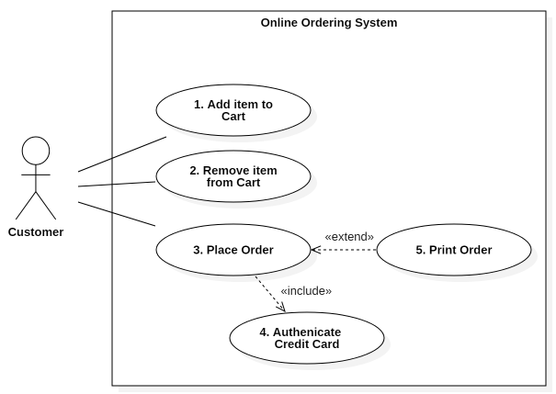
Include / extend
Required?
Synchronous?
Decision?
Extend – the insertion of
additional behaviour into
a base use case that does
not know about it.
  "Print Order" is fully
  optional
  "Print Order" is performed
  asynchronously from
  "Place Order" and is not
  of interest to "Place
  Order"
  Execution of "Print Order" is a decision of the Customer
Include – the insertion of additional behavior into a base use case that explicitly describes the insertion
  "Authenticate" must be done in order for "Place Order" to succeed
  "Authenticate is performed synchronously within "Place Order"
  Execution of "Authenticate" is not a decision of the Customer

Slide 11
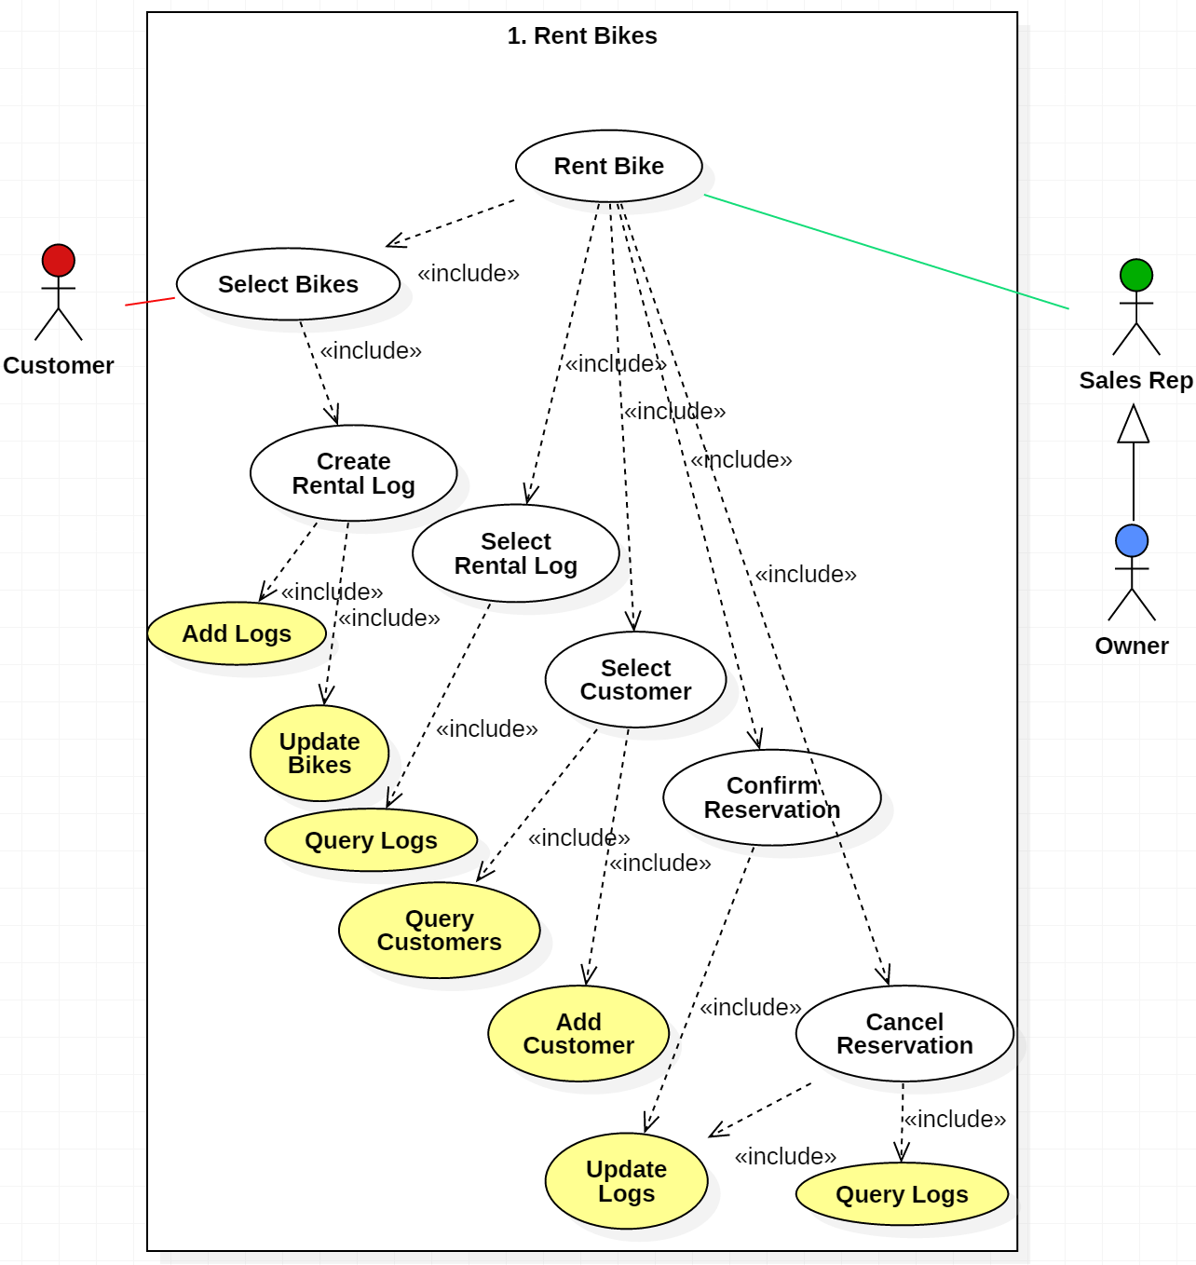
Example of includes
This Use Case
Diagram belongs in
a Design Document
The Use Cases are still functions, but only two are exposed to the Actors
The «^{include}» relationship indicates which functions are included in other functions, i.e., the behavior of the included use case is inserted into the behavior of the including use case
Represents
database functions

Slide 12
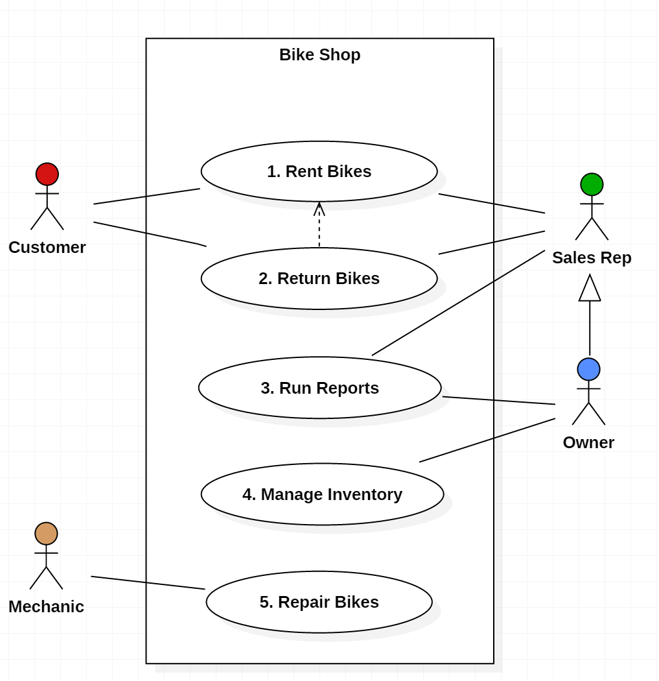
Dependencies
Dependency:
the extending use case is dependent on the base use case as a one way dependency, i.e. the base use case doesn’t need any reference to the extending use case in the sequence.
You cannot return bikes that have not been first rented, but you can rent bikes without returning them

Slide 13
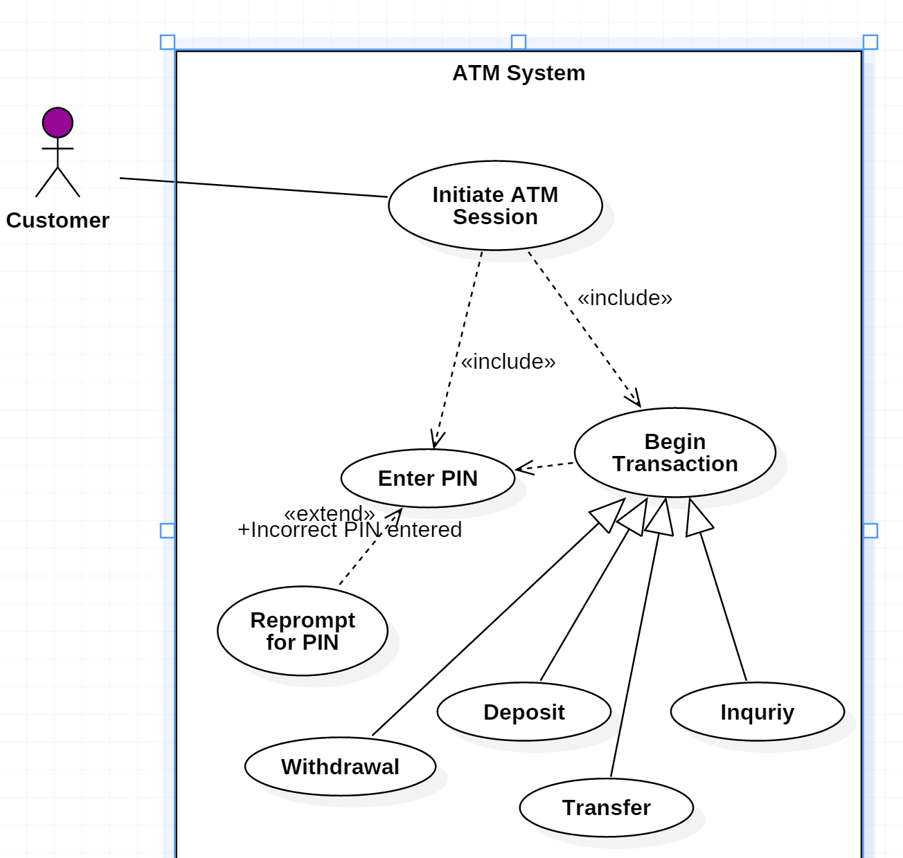
One More Example
A different example of
  Includes
  Extends
  Dependency
  Generalization

Slide 14
Supplementing
Use Case Diagrams

Slide 15
Use Cases are sometimes accompanied by textual descriptions
Use Cases are well defined by UML but, there is a methodology and language of use cases that is more textual, and goes beyond UML
Use Case Descriptions can be used to:
  further refine use case diagrams
  supplement or decompose a user story
  verify with subject matter experts (SMEs) that all possible scenarios are accounted for
  communicate what the system will be used for to development and testing teams
  elicit suggestion from the development team on technical constraints
  clearly narrate expected system responses and outcomes
  show a sequential flow of events for a proposed solution
  provide a simple representation of goals and outcomes
  give stakeholders an opportunity to see if the narrative aligns with their expectations
  provide a framework for testing
https://thebadoc.com/ba-techniques/f/use-case-description-basics

Slide 16
Use Case Description (1)
The Overview
Rent Bike Use Case
Customers have the option to browse or search the database at a customer kiosk to select available bike(s) for rental and specify the rental period for each of the selected bikes. Alternatively, they can have an employee of the bike shop browse or search the database, make customer suggestions with which the customer can agree or disagree, and record the respective rental periods. The selected bikes are then physically examined by an employee to ensure their suitability for rental. If any bikes are unsuitable, they are marked for repair (see Update Bike use case) and alternative bike selections are made by either the customer or employee. Then the system will display to the employee any special discounts that might apply to frequent customers. The employee informs the customer of the final price (including all bike rates, rental durations, rental deposits and discounts) for all bikes rented, accepts the payment for the rental and authorizes the rental. The employee will check out the bikes by either associating the bike(s) with the pre-existing customer record, or by creating a new customer record and then associating that record with the bike(s). A receipt will be printed for the customer which lists the details and cost of each bike rental. A rental request may be cancelled at any time during this process, up until the bikes are associated with the customer. After that, the Return Bike use case will apply.

Slide 17
Scenarios
In addition to Use Case Descriptions, Use Case Scenarios can be useful.
Use Case Scenarios are a structured form of user story and should include:
  A description of the starting situation;
  A description of the normal flow of events;
  A description of what can go wrong;
  Information about other concurrent activities;
  A description of the state when the scenario finishes.

Slide 18
Use Case Description (2)
The Scenarios
Rent Bike Use Case
Primary Flow “Typical rental”
(consists of subordinate use cases)
Employee Selects Bikes
Employee Selects Customer
Employee Confirms Reservation
Alternate Flow “Customer selects bikes rental”
(consists of subordinate use cases)
Customer Selects Bikes
Employee Selects Rental Log
Employee Selects Customer
Employee Confirms Reservation
Alternate Flow “Cancellation after bike selection” (consists of subordinate use cases)
Employee Selects Bikes
Cancel Reservation
Alternate Flow “Cancellation after bike selection” (consists of subordinate use cases)
Customer Selects Bikes
Cancel Reservation
Alternate Flow “Cancellation after rental log selection” (consists of subordinate use cases)
Customer Selects Bikes
Employee Selects Rental Log
Cancel Reservation
Alternate Flow “Cancellation after customer selection” (consists of subordinate use cases)
Employee Select Bikes
Employee Selects Customer
Cancel Reservation

