Slide 1
UML Modeling
State Diagrams
Notes:
Replace this with your course title and your name/contact details.

Slide 2

References
Materials in this educational slide deck are taken from The Unified Modeling Language User Guide.
UML stared in October 1994 when Grady Booch and James Rumbaugh worked at Rational Software Company, pioneers in software modeling.
These three were the original designers of UML, but they collaborated with partners from the software industry, including Hewlett-Packard, IBM, Oracle and others.

Slide 3
UML State Diagrams
State Diagrams. Using a state machine, you can model the behavior of an individual object. A state machine is a behavior that specifies the sequences of states an object goes through during its lifetime in response to events, together with its responses to those events.
A state is a condition or situation during the life of an object during which it satisfies some condition, performs some activity, or waits for some event. An object remains in a state for a finite amount of time.

Slide 4
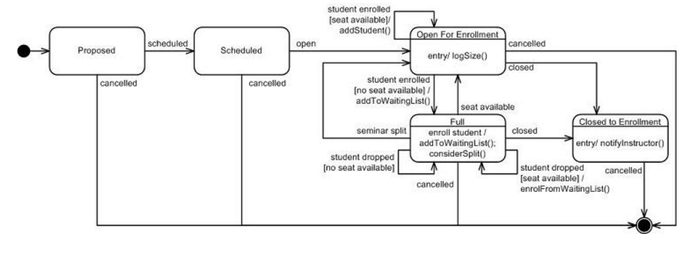
State Diagrams
Sufficiently complex objects warrant State Diagrams
Examples
  Purchased Good states
  Seminar states

Slide 5
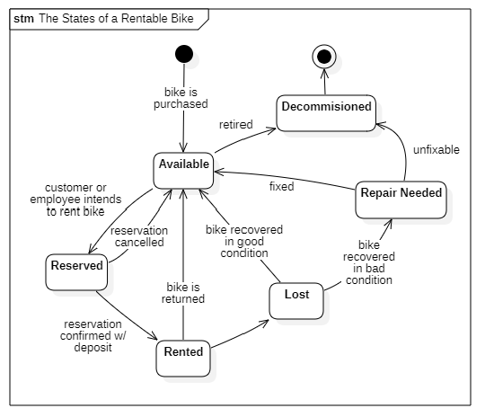
Bike Shop State Diagram

Slide 6
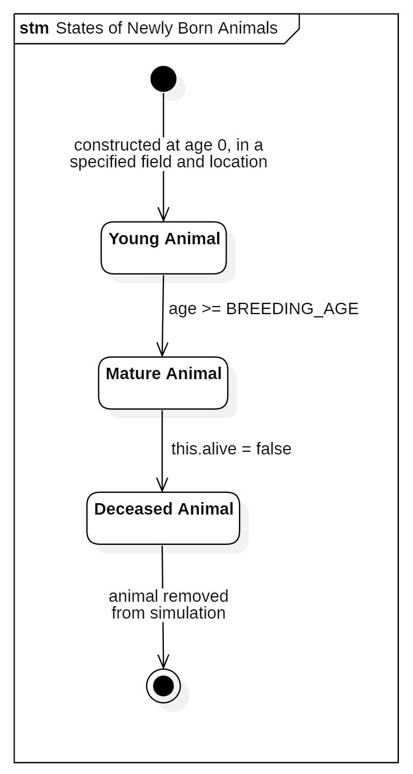

Foxes and Rabbits State Machine

