Slide 1
UML Modeling
Robustness Diagrams
Notes:
Replace this with your course title and your name/contact details.

Slide 2
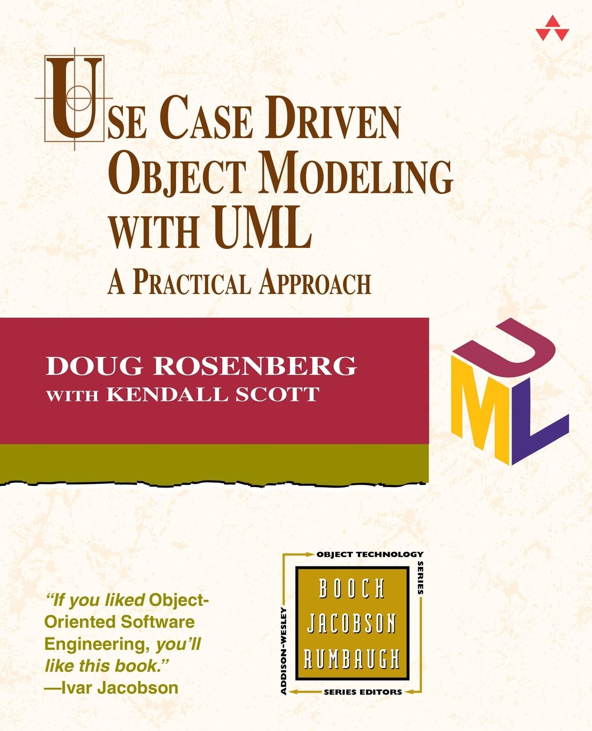
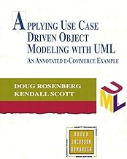
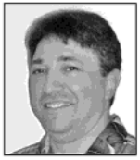
References
Robustness Analysis and the corresponding Robustness Diagrams are best described in these texts.
UML.
Robustness diagrams, however useful, are not a formal part of UML
Doug Rosenberg

Slide 3
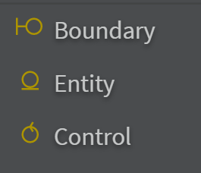
UML Robustness Diagrams
Robustness Diagram – Robustness diagrams show how classes or objects will interact with each other. It is a way to determine what you need to develop to fulfill the use cases of the use case diagrams and prepare for MVC patterns. It is considered a hybrid of the Class Diagram and an Interaction Diagram (e.g., Sequence Diagram). Sometimes Robustness Diagrams are referred to as Analysis Class Diagrams.
Robustness diagrams commonly contain:
  Actors. This is the same concept as actors on a UML use case diagram.
  Entity Classes (M). Objects representing system data or other terminating points of functionality. Entity objects "outlive" use case execution. Classes that handle automated printing, emailing or other network file transmission of data could also be considered entity objects.
  Boundary Classes (V). Objects that interface with system actors (e.g. a user or external service). Windows, screens and menus are examples of boundaries that interface with users.
  Control Classes (C). Objects that mediate between boundaries and entities.
  These serve as the glue between boundary elements and entity elements,
  implementing the logic required to manage the various elements and their
  interactions.
  Use cases (optional). Because use cases can invoke other use cases, you
  need to be able to depict this on your robustness diagrams. This functions
  as a cross reference.

Slide 4
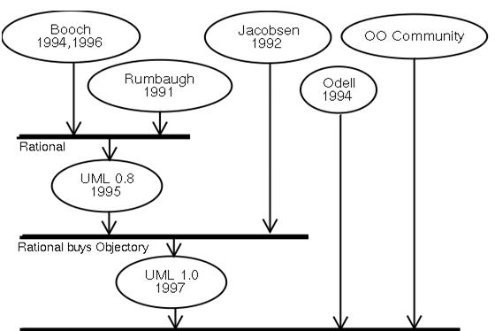
History of UML
Various OO modeling languages
started to appear between the
mid-1970s and the late 1980s.
These were the so-called "1st
generation" modeling languages.
The number of modeling languages
and methods increased from fewer
than 10 to 50+ from 1989 to 1994!!
The so-called "method wars" broke
out between various groups and
individuals, with each one hyping
their own approach.
Users began to tire of the "method wars", and long for a broadly-supported, general-purpose modeling language.
In the mid-1990s, three of the major approaches start to converge:
  The "Booch method", from Grady Booch of Rational Software
  OMT (Object Modeling Technique), from Jim Rumbaugh at General Electric
  OOSE (Object-Oriented Software Engineering), from Ivar Jacobson at Ericsson
o
The "three amigos" – the founders of UML
https://cs.smu.ca/~porter/csc/341/notes/uml.html

Slide 5
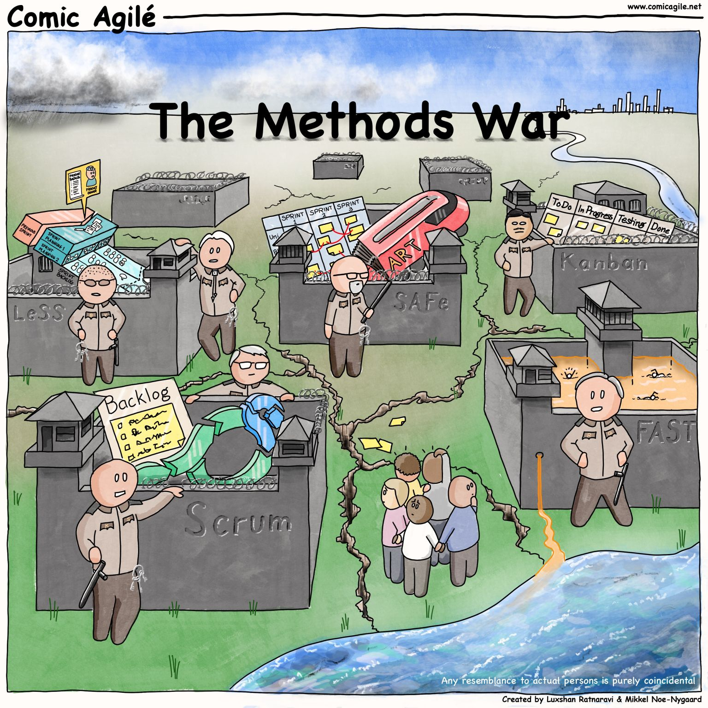
Methods Wars continue to this day
Agile vs FAST vs LeSS vs
Kanban vs ???
But UML remains pure.
"We need to move Software Engineering from primarily being a craft to primarily being an engineering discipline. That will make a huge impact on quality and cost" – Ivar Jacobson, 2003 address

Slide 6
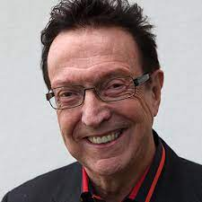
History of Robustness Diagrams (1)
In 1963, Ivar Jacobson, a Swedish computer scientist, got
his first job at Ericsson – a networking/telecom company.
Objectory was first published in 1992 in Jacobson's book
[Object-Oriented Software Engineering: A Use Case Driven
Approach], which became a classic reference in the field.
The book introduced use cases as a way to capture and
communicate the functional requirements of a system from
the perspective of its users.
In 1987, Ivar Jacobson, a Swedish computer scientist, founded Objectory Systems -- a software company based in Sweden that was instrumental in the development of Object-oriented program design.
While at Objectory, Jacobson developed robustness analysis. Robustness analysis involves examining the text or steps of each Use Case and identifying the classes that are needed for the Use Case scenario to be performed.
These classes can be categorized into a number of different types: boundary classes, entity classes, and control classes.
Ivar Jacobson
"Father of the Use Case"

Slide 7
History of Robustness Diagrams (2)
In 1992, Jacobson joined the other two amigos (Booch and Rumbaugh) on the development of UML.
In 1993, Doug Rosenberg of ICONIX Software Engineering, developed a Unified Booch/Rumbaugh/Jacobson design method in 1993 that prominently featured the Robustness Diagram.
Rosenberg is now considered to be the Father of the Robustness Diagram.
Jacobson's
Robustness Diagrams don't make the cut
"If you’ve been looking at UML literature, the robustness diagram was originally only partially included in the UML. It originated in Ivar Jacobson’s work and got included in the UML standard as an appendage. This has to do with the history and the sequence of how Booch, Rumbaugh, and Jacobson got together and merged their methodologies, as opposed to the relative importance of the diagram in modeling."
-- Doug Rosenberg

Slide 8
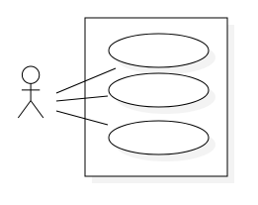
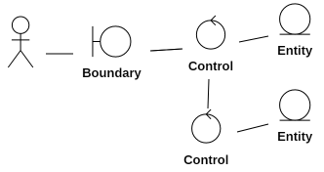
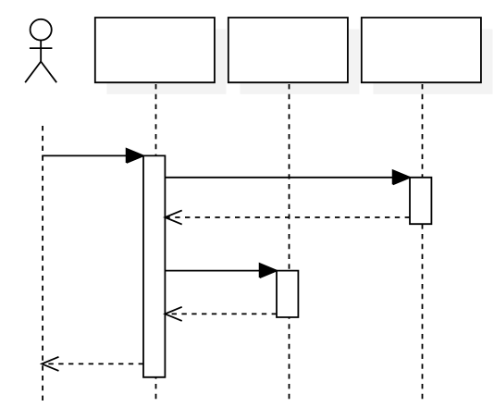
Why are Robustness Diagrams
Important Then?
"The robustness diagram was described in the original UML specs, but its definition was in an extra document called Objectory Process-Specific Extensions. What we’ve found over the past ten years is that it’s very difficult to get from use cases to sequence diagrams without this technique. Using the robustness diagram helps avoid the common problem of project teams thrashing around with use cases and not really getting anywhere towards their software design. If you incorporate this step, it will make this process and your project much easier. We didn’t invent robustness analysis, but we’re trying to make sure it doesn’t get forgotten. Robustness analysis has proven to be an invaluable aid in getting across the gap between requirements and design." -- Doug Rosenberg
Start from a requirements-
level view, where you think
only about what users need
to donwithout considering
implementation details, and
then driving that view of your
system forward into
something that's focused on
design.
In this case, on your
sequence diagram, you're
showing precisely how
runtime object instances
interact with each other as
your system is executing.
One of the most difficult problems in software development is to get from the "what" view of the world into a "how" view of the world.
Robustness analysis is a technique that helps people do this.
How
(design)
What
(analysis)
gap

Slide 9
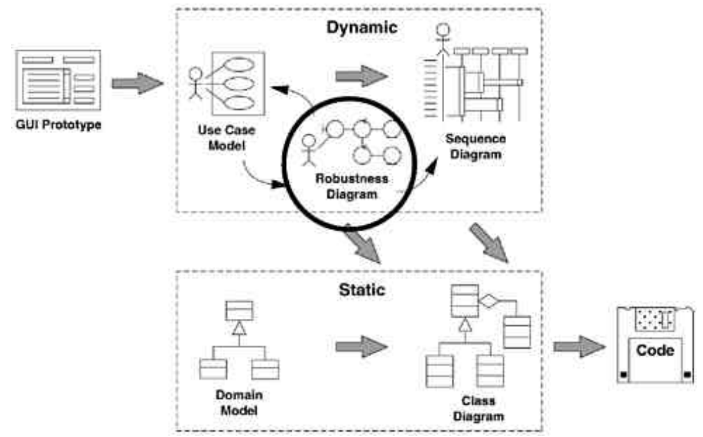
Closing the Gap
Robustness analysis sits right in the gap between what the system has to do and how it's actually going to accomplish this task. While we're crossing this gap, there are actually several different activities that are going on concurrently.
  First, we're going to be discovering objects that we forgot when we took our first guess at what objects we had in the system.
  We can also add the attributes onto our classes as we trace data flow on the robustness diagrams.
  Another important thing we'll do is update and refine the text of the use case as we work through this diagram.
Robustness Diagrams are not
only a good intermediate step
to Sequence Diagrams, but to
Class Diagrams as well.

Slide 10
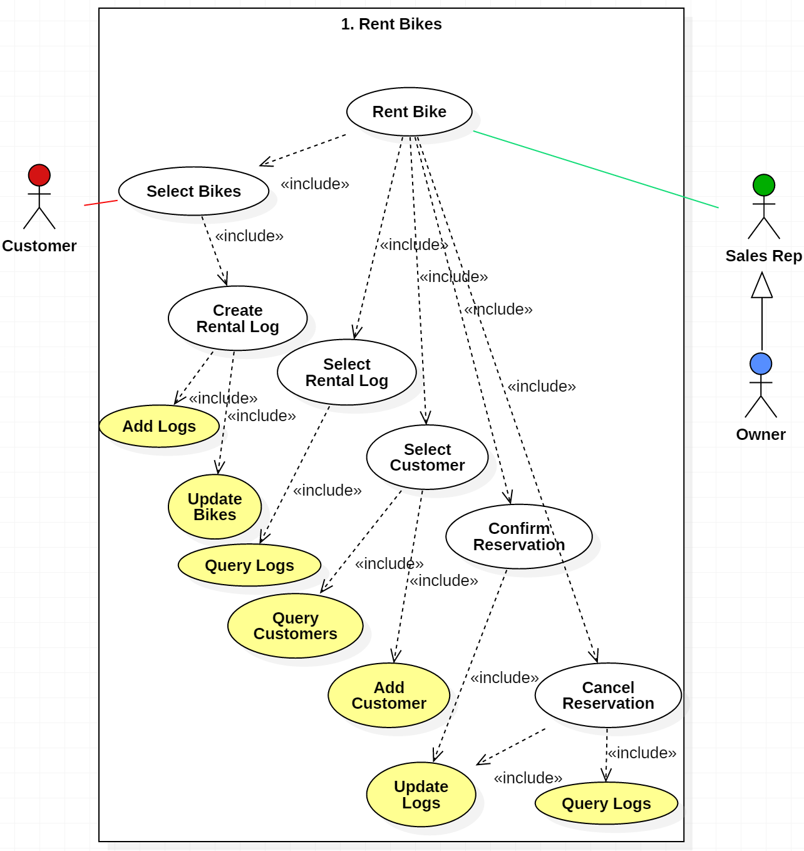
The Robustness Diagram
They resemble the more detailed Use Case Diagrams (see diagram) except the main objects in an Analysis Class Diagram are classes not use cases (or functions)
Use Case Diagram
Represents
database functions

Slide 11
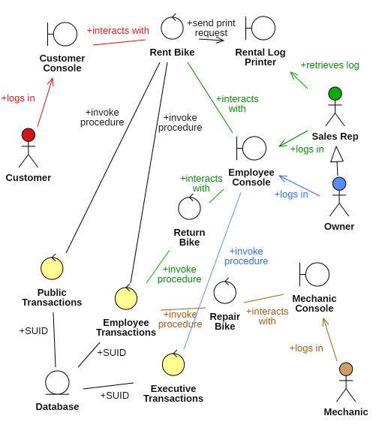
Robustness
Diagram
No longer are functions (use cases) represented, but actual classes
Robustness Diagram

Slide 12
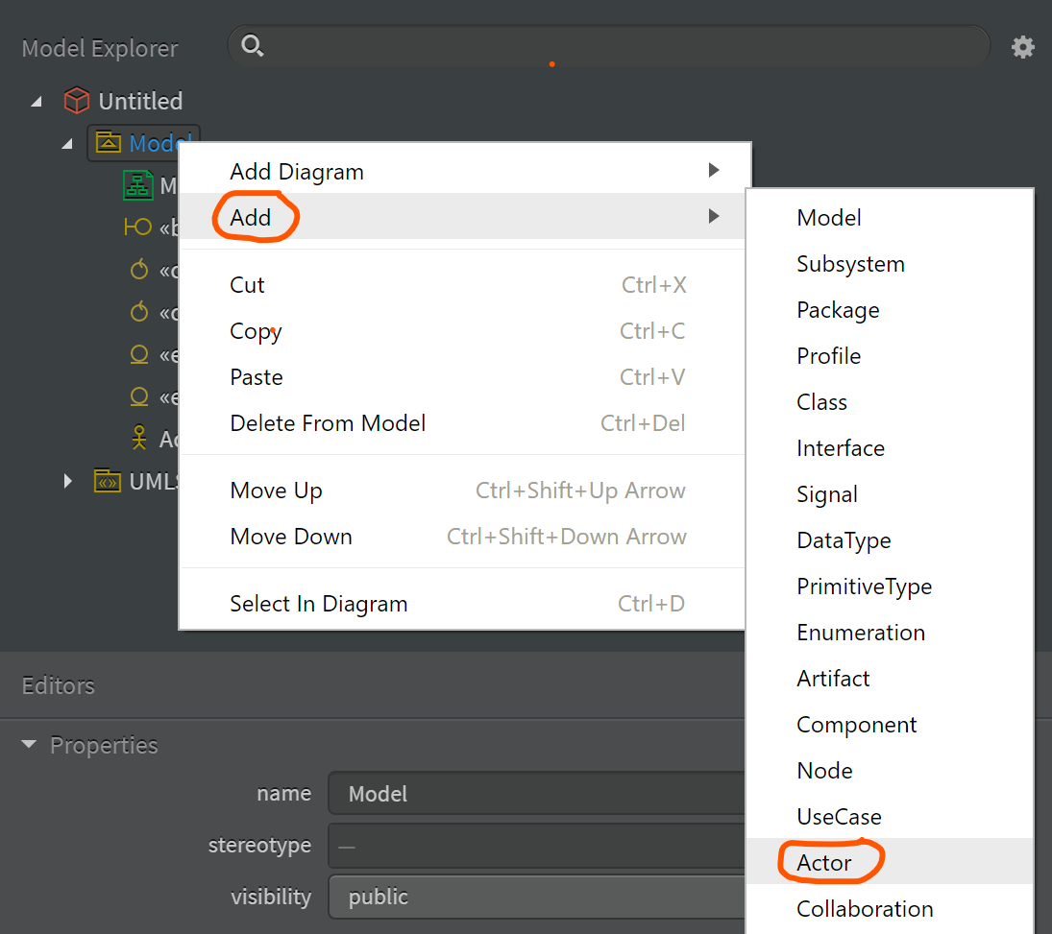
Creating Robustness Diagrams in StarUML
Since Robustness Diagrams are technically a variant on the Class diagram, start by making a Class diagram and use the Robustness section of the Toolbox
To add an Actor, right click on the Model and Add an Actor

Slide 13
Modeling rules
Robustness Diagrams are very simplified UML, but they do need to adhere to four basic rules:
  Actors can only talk to boundary objects.
  Boundary objects can only talk to controllers and actors.
  Entity objects can only talk to controllers.
  Controllers can talk to boundary objects, entity objects, and other controllers, but not to actors.

