Slide 1
UML Modeling Package Diagrams
Notes:
Replace this with your course title and your name/contact details.

Slide 2
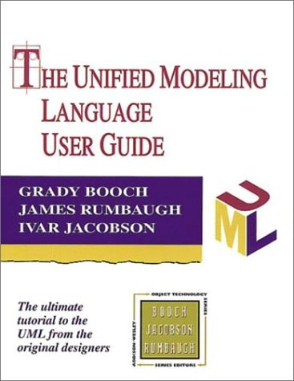
References
Materials in this educational slide deck are taken from The Unified Modeling Language User Guide.
UML stared in October 1994 when Grady Booch and James Rumbaugh worked at Rational Software Company, pioneers in software modeling.
These three were the original designers of UML, but they collaborated with partners from the software industry, including Hewlett-Packard, IBM, Oracle and others.

Slide 3
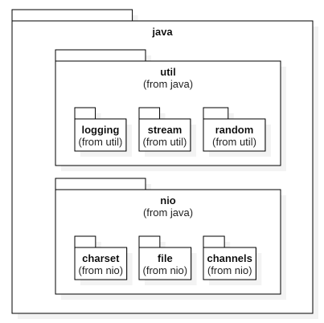
Packages
Classically, a package is a namespace that organizes a set of related classes and interfaces.
Similar to different folders on your computer where you might keep HTML pages in one folder, images in another, and scripts or applications in yet another.
Good example? The Java API
But this is how Booch, Rumbaugh and Jacobson describe a package:
A package is a piece of a model.
Every part of a model must belong to one package. The modeler may allocate the contents of a model to a set of packages. But to be workable, the allocation must follow some rational principle, such as common functionality, tightly coupled implementation, and a common viewpoint. UML does not impose a rule for composing packages, but a good decomposition into packages will greatly enhance model maintainability

Slide 4
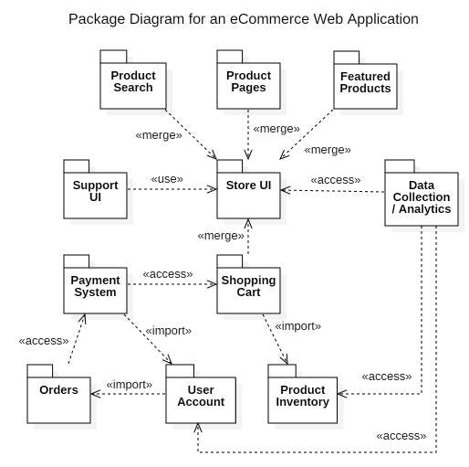
UML Package Diagrams
Package Diagram – shows the decomposition of a system model into organizational units and their dependencies.
example of more informal packages
example of "classical" packages

Slide 5
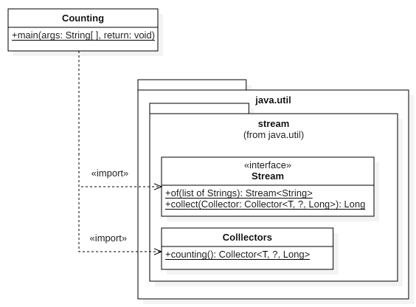
Use of Package Diagrams
Package Diagrams can be high level to show system architecture.
Package Diagrams can be low level to show system design.
d
d

Slide 6
Relationships between Packages
It is often important to show relationships between packages. In Package Diagrams, these relationships are called dependencies.
But there are many different kinds of dependencies. You will need to use stereotypes to distinguish the types of dependencies
Import dependency: a package adds public members of another package to its namespace
Access dependency: a package adds private members of another package to its namespace
Use dependency: a package adds members of another package, but not as part of its namespace
Merge dependency: a relationship between two Packages whereby the contents of the target Package are merged with those of the source Package. (Think inheritance where superclass fields and methods are merged with the subclass fields and methods.
Or…just don't use stereotypes. (Ask yourself if they add value for your particular diagram.)

Slide 7
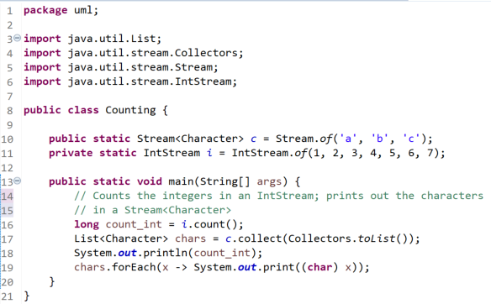

Fine, fine-grained detail
Dependency on | Stereotype | Stereotype Definition | Example use in code
Stream | <<import>> | Added to namespace Public visibility | Stream c is an element that is added to the namespace uml and its visibility is public.
IntStream | <<access>> | Added to namespace Private visibility | Stream i is an element that is added to the namespace uml but its visibility is private.
List | <<use>> | Not added to namespace | List chars, as a local variable, is an element not added to the namespace uml
Collectors | <<use>> | Not added to namespace | Use of Class Collectors does not result in any new elements.
<<use>> vs. <<access>> vs. <<import>>
Oh look! I can use a UML package to document "package uml"
import dependency
access dependency
use dependency
use dependency

Slide 8
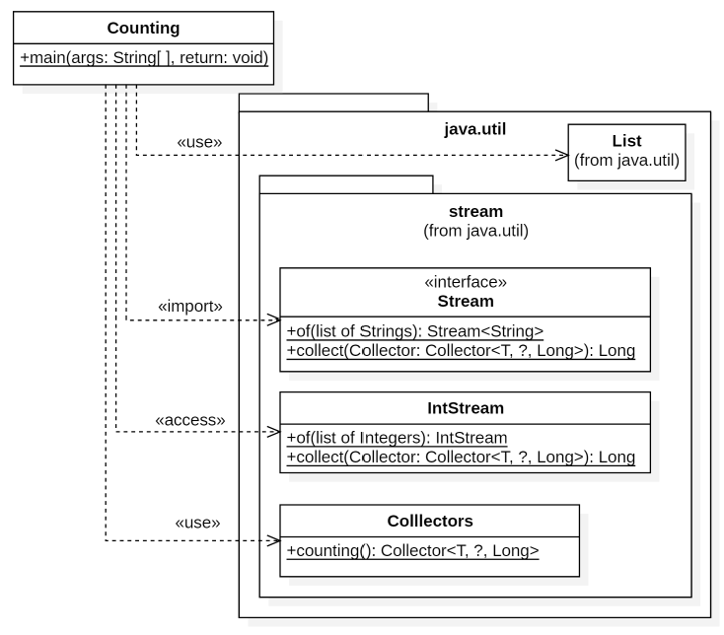
Fine, fine-grained detail
Only if needed
I would probably not use the stereotypes.
import dependency
access dependency
use dependency
use dependency

Slide 9
Package Diagrams in StarUML
Package diagrams in StarUML are easy, so long as one stays at the higher package level
Sometimes, however, you want to show objects (e.g., classes and interfaces) inside a package With my version of StarUML, even though I could add classes to a package, I was not able to drag them onto the diagram to display them.
Thus, I found it better to create a class diagram and add a package to it.

