Slide 1
UML Modeling Object Diagrams
Notes:
Replace this with your course title and your name/contact details.

Slide 2
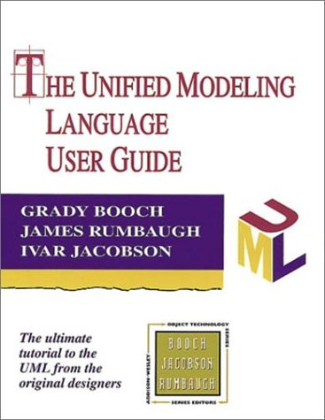
References
Materials in this educational slide deck are taken from The Unified Modeling Language User Guide.
UML stared in October 1994 when Grady Booch and James Rumbaugh worked at Rational Software Company, pioneers in software modeling.
These three were the original designers of UML, but they collaborated with partners from the software industry, including Hewlett-Packard, IBM, Oracle and others.

Slide 3
UML Object Diagrams
Object Diagram – An object diagram shows a set of objects and their relationships.
Object diagrams represent static snapshots of instances of the things found in class diagrams.
These diagrams address the static design view or static process view of a system as do class diagrams, but from the perspective of real or prototypical cases.
They can be useful as an example of the system:
To illustrate complicated data structures
To show a sequence of of snapshots over time
To convey to the reader what typical instantiation data looks like

Slide 4
Sample Object Diagram
Name of object : Type of object
Anonymous objects need not be named.
Attributes whose values are not of interest may be suppressed.

Slide 5
Choose what to highlight Not every Object, not every Attribute
For an individual class, there may be a multitude of possible instances, and for a set of classes in relationship to one another,there may be many times more possible configurations of these objects.
Therefore, when you use object diagrams, you can only meaningfully expose interesting sets of concrete or prototypical objects.

