Slide 1
UML Modeling Deployment Diagrams
Notes:
Replace this with your course title and your name/contact details.

Slide 2

References
Materials in this educational slide deck are taken from The Unified Modeling Language User Guide.
UML stared in October 1994 when Grady Booch and James Rumbaugh worked at Rational Software Company, pioneers in software modeling.
These three were the original designers of UML, but they collaborated with partners from the software industry, including Hewlett-Packard, IBM, Oracle and others.

Slide 3
UML Deployment Diagrams
Deployment Diagrams model the static deployment view of a system which primarily addresses the distribution, delivery, and installation of the parts that make up the physical system.
Deployment diagrams are used to visualize the topology of the physical components of a system where the software components are deployed.
Deployment diagrams are used by the system engineers and describe:
The physical components (hardware),
Their distribution
Their association
The purpose of deployment diagrams:
Visualize hardware topology of a system.
Describe the hardware components used to deploy software components.
Describe runtime processing nodes.

Slide 4
Elements of a Deployment Diagram
UML deployment diagrams are used to depict the relationship among run-time components and nodes
Components
Components are self-contained entities that provide services to other components or actors.
A Web server, for example, is a component that provides services to Web browsers.
A Web browser such as Safari is a component that provides services to a user.
Nodes
A node is a physical device or an execution environment in which components are executed.
A system is composed of interacting run-time components that can be distributed among several nodes.
A node can contain another node, for example, a device can contain an execution environment.
Represented by boxes containing component icons.

Slide 5
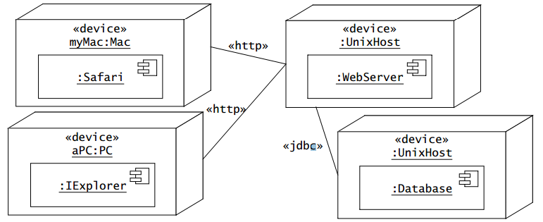
An example
Nodes are represented by boxes containing component icons.
Nodes can be stereotyped to denote physical devices or execution environments.
Communication paths between nodes are represented by solid lines. The protocol used by two nodes to communicate can be indicated with a stereotype on the communication path.

Slide 6
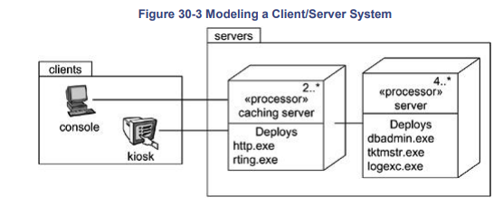
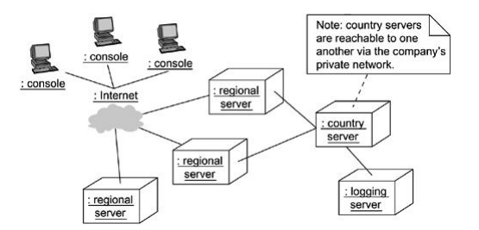
More examples

