Slide 1
UML Modeling
Object Diagrams
Notes:
Replace this with your course title and your name/contact details.

Slide 2
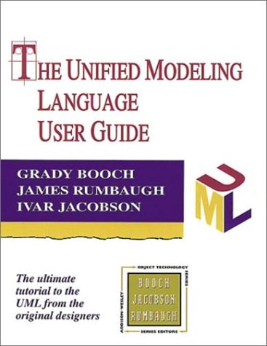
References
Materials in this educational slide deck are taken from The Unified Modeling Language User Guide.
UML stared in October 1994 when Grady Booch and James Rumbaugh worked at Rational Software Company, pioneers in software modeling.
These three were the original designers of UML, but they collaborated with partners from the software industry, including Hewlett-Packard, IBM, Oracle and others.

Slide 3
UML Component Diagrams
Object Diagram – An object diagram shows a set of objects and their relationships.
Component diagrams are one of the two kinds of diagrams found in modeling the physical aspects of object-oriented systems, also known as architectural modeling. Examples of components include:
  Executables
  Libraries
A component diagram shows the organization and dependencies among a set of components.
Component diagrams are not only important for visualizing, specifying, and documenting component-based systems, but also for constructing executable systems through forward and reverse engineering.
  Database tables
  Files
  Documents

Slide 4
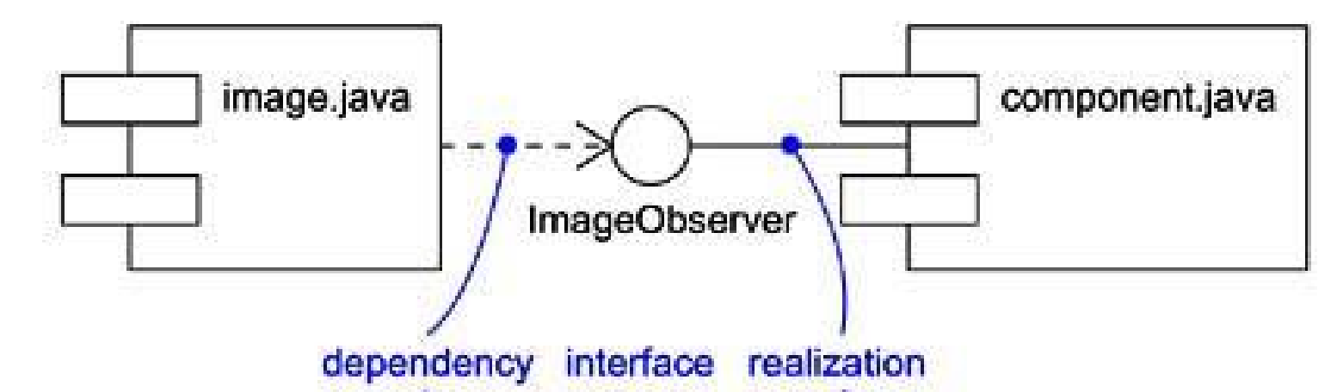
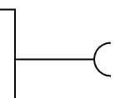

Interfaces
An interface between components is a set of operations performed by a component in the system. A component realizes an interface if it supports the interface; another component then uses (depends on) that interface.
Required interfaces: A straight line from the component box with an attached half circle (also represented as a dashed arrow with an open arrow). These symbols represent the interfaces where a component requires information in order to perform its proper function.
Provided interfaces: A straight line from
the component box with an attached circle.
These symbols represent the interfaces
where a component produces information
used by the required interface of another
component.

Slide 5
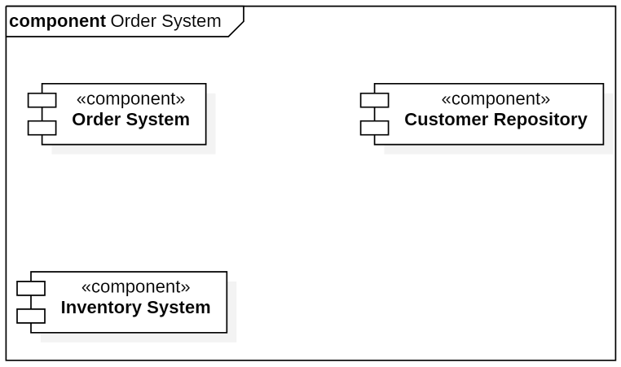
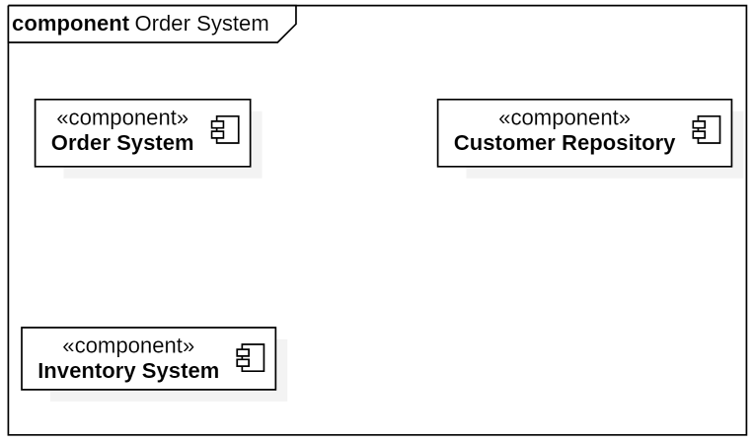
Building a Component Diagram in StarUML (1)
stereotype in guillemets
components displayed with Format "Decoration with Label"
components displayed with Format "Label"
Create a Component Diagram
Add Components to the Diagram

Slide 6
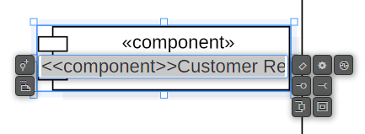
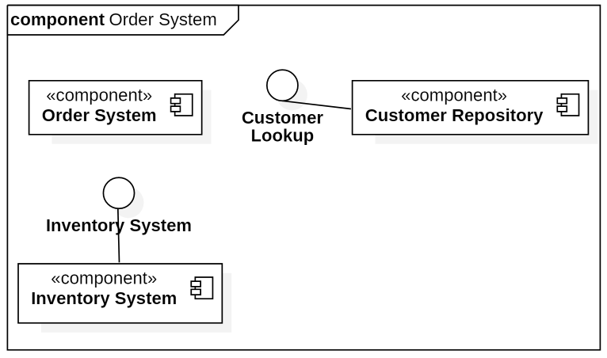
Building a Component Diagram in StarUML (2)
Double click the component
Add provided interface
interfaces
(Interface Realization)

Slide 7
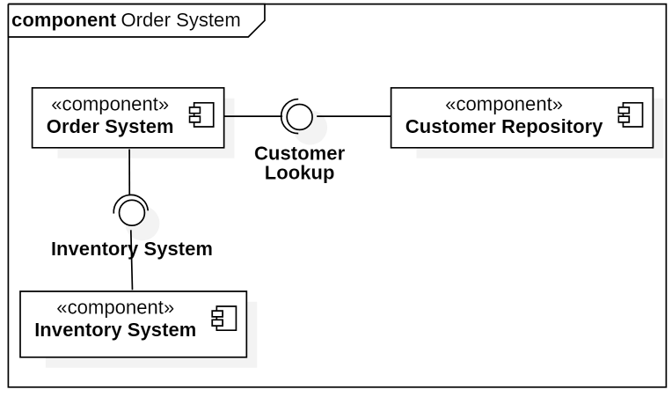
Building a Component Diagram in StarUML (3)
From the components that call the interface, connect a Dependency to the interface
The "ball and socket" motif is primarily used today to show interfaces (and their realization) and dependencies
StarUML is touchy. You might have to play with the Line Styles to create pretty balls and sockets.
dependencies

Slide 8
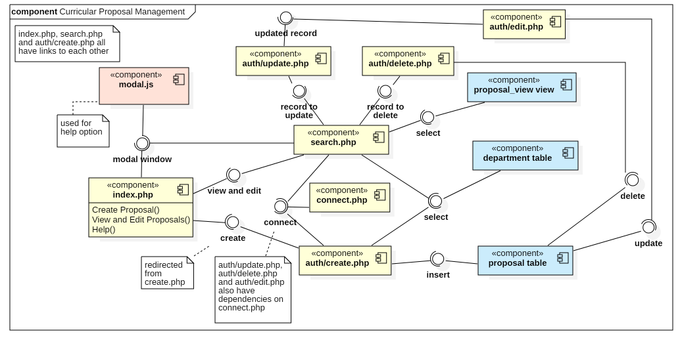
Sample Component Diagram
ss

Slide 9
Final Thoughts
A component is replaceable. A component is substitutable -- it is possible to replace a component with another that conforms to the same interfaces.
A well structured component:
  Provides a crisp abstraction of something drawn from the physical aspect of the system.
  Provides the realization of a small, well-defined set of interfaces.
  Is loosely coupled relative to other components; most often, you'll model components only in connection with dependency and realization relationships.
Ports
  Optionally, ports can be used to provide
  more information.
  In this case search.php is using port
  3306 to connect to a MySQL database.
port

