Slide 1
UML Modeling Communication Diagrams
Notes:
Replace this with your course title and your name/contact details.

Slide 2
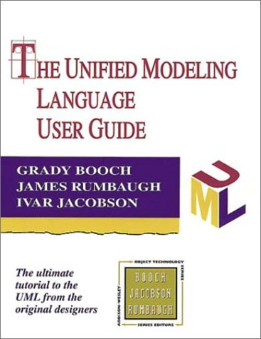
References
Materials in this educational slide deck are taken from The Unified Modeling Language User Guide.
UML stared in October 1994 when Grady Booch and James Rumbaugh worked at Rational Software Company, pioneers in software modeling.
These three were the original designers of UML, but they collaborated with partners from the software industry, including Hewlett-Packard, IBM, Oracle and others.

Slide 3
Communication Diagrams and Interaction Diagrams
An integration diagram shows an interaction, consisting of a set of objects and their relationships, including the messages that may be dispatched among them. There are two types:
Communication diagram (formerly known as Collaboration Diagram) which emphasizes the structural organization of objects that receive and send messages
Sequence diagram that emphasizes the time ordering of messages.
Communication Diagrams are semantically equivalent to Sequence Diagrams.
As a result, you can take a diagram in one form and convert it to the other without any loss of information, but both diagrams do not explicitly visualize the same information. For example, in the previous two figures, the collaboration diagram

Slide 4
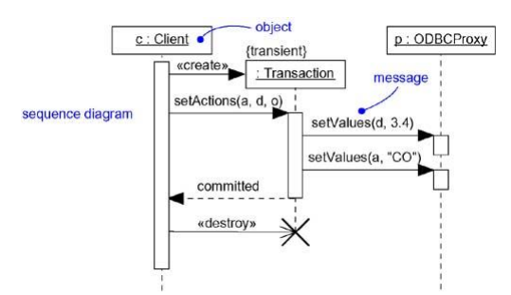
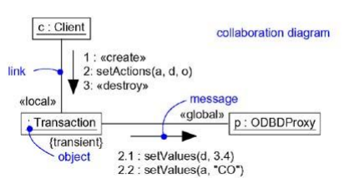
Sequence vs Communication
Communication diagrams show how the objects are linked (note the «local» and «global» stereotypes), whereas the corresponding sequence diagram does not.
«global»: the instance is visible because it is in a global scope relative to the link.
«local»: the instance is visible because it is in a local scope relative to the link.
Similarly, the sequence diagram shows message return (note the return value committed), but the corresponding collaboration diagram does not.
Sequence
Communication
communication

Slide 5
What's the Difference?
When you model the dynamic aspects of a system, you typically use interaction diagrams in two ways.
To model flows of control by time ordering. Here you'll use sequence diagrams. Modeling a flow of control by time ordering emphasizes the passing of messages as they unfold over time, which is a particularly useful way to visualize dynamic behavior in the context of a use case scenario. Sequence diagrams do a better job of visualizing simple iteration and branching than do collaboration diagrams.
To model flows of control by organization. Here you'll use collaboration diagrams. Modeling a flow of control by organization emphasizes the structural relationships among the instances in the interaction, along which messages may be passed. Collaboration diagrams do a better job of visualizing complex iteration and branching and of visualizing multiple concurrent flows of control than do sequence diagrams.
So, which one should you use? It really depends on your needs.

Slide 6
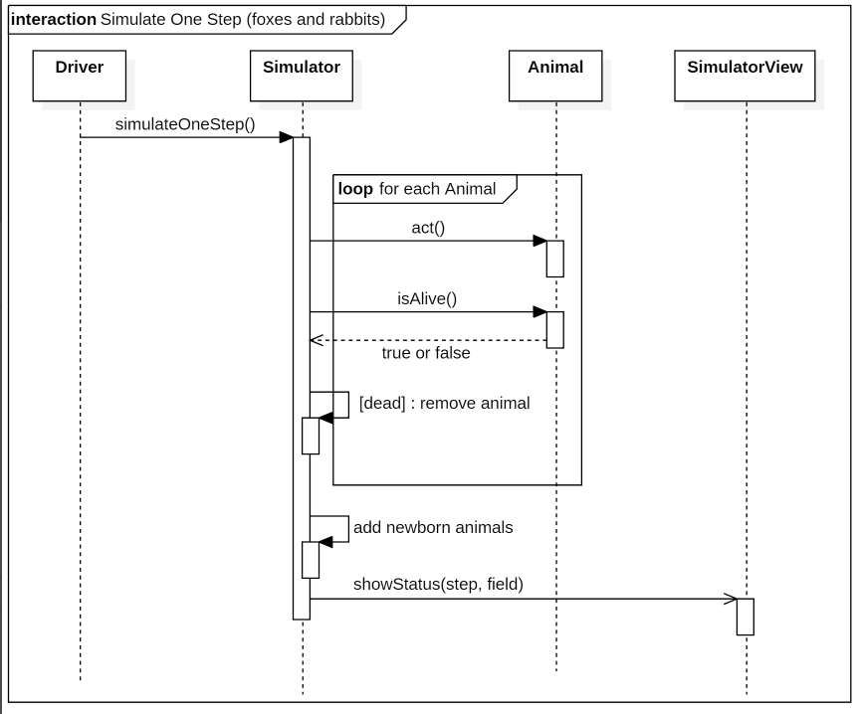
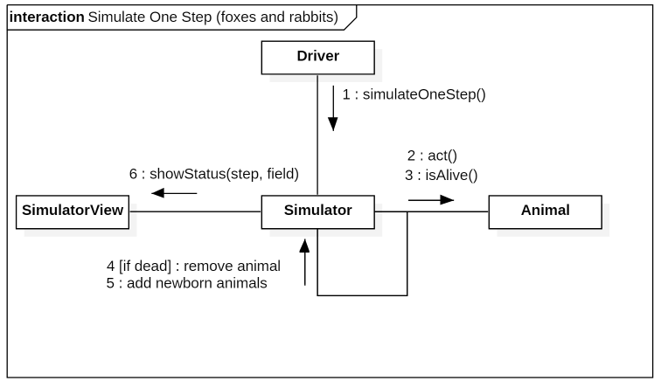
Foxes and Rabbits

Slide 7
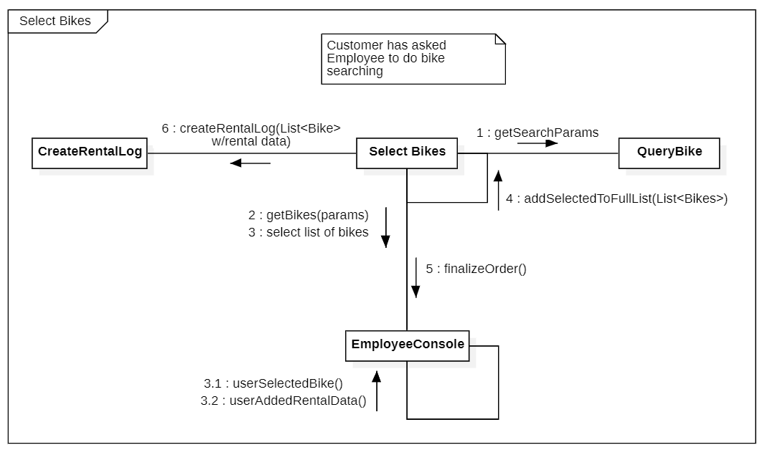
Bike Shop

Slide 8
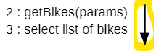
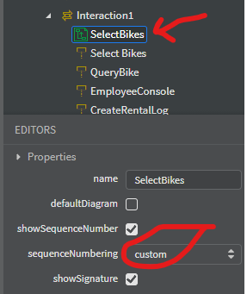
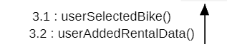
StarUML can be touchy here
StarUML wants to make a new arrow for every message. Creative dragging and dropping made the arrows overlap each other.
To show subnumbering (e.g., 3.1, 3.2) – you have to select the diagram and choose custom numbering, then set the sequence numbers manually.

Slide 9
Why the name change?
In UML 2.0, Collaboration Diagrams became known as Communication Diagrams.
Why? It's not readily known.
"In UML 1.x, these diagrams were called collaboration diagrams. This name stuck well, and I suspect it will be a while before people get used to the new name."
-- Martin Fowler, UML Distilled. 2004 -- Grady Brooch, Ivar Jacobson, and James Rumbaugh, Series Editors
Do you believe ChatGPT?
"Why was the UML Collaboration Document renamed to a Communication Document in the second version of the UML standard?
ChatGPT: "The UML Collaboration Document was renamed to a Communication Diagram in the second version of the Unified Modeling Language (UML) standard for clarity and to better reflect its purpose. The term `Communication Diagram` more accurately describes the primary focus of this diagram type, which is to illustrate the interactions and communication relationships among different elements (objects or components) within a system.
The name change aimed to enhance understanding and eliminate potential confusion about the diagram's intended use. The Communication Diagram in UML provides a visual representation of how different components or objects interact to achieve a specific functionality, emphasizing the flow of messages or communication between them. This change in terminology was part of the ongoing effort to improve the clarity and effectiveness of UML as a modeling language.

