Slide 1
UML Modeling
Class Diagrams
Notes:
Replace this with your course title and your name/contact details.

Slide 2
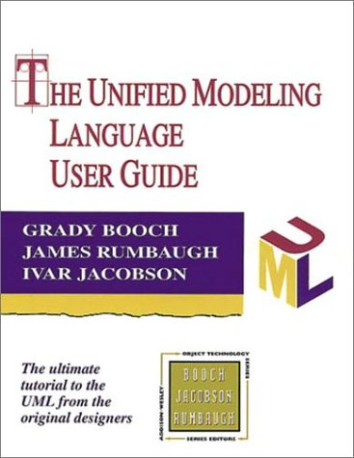
References
Materials in this educational slide deck are taken from The Unified Modeling Language User Guide.
UML stared in October 1994 when Grady Booch and James Rumbaugh worked at Rational Software Company, pioneers in software modeling.
These three were the original designers of UML, but they collaborated with partners from the software industry, including Hewlett-Packard, IBM, Oracle and others.

Slide 3

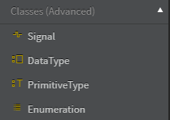
UML Class Diagrams
Class Diagrams are the most common diagram found in modeling object-oriented systems. They are a type of static structure diagram that describes the structure of a system.
Class diagrams address the static design view of a system by showing the system's classifiers, their attributes, operations (or methods), and the relationships among objects.
Classifiers model a discrete concept that
describe things (objects) having identity,
state, behavior, relationships and an
optional internal structure.
They include:
  Classes
  Enumerations
  Interfaces

Slide 4
Classifiers

Slide 5
Modeling Classes and Interfaces
Static variables
are underlined.
Variable types are placed after the variable name, separated by a colon.
Access modifiers denoted as:
+ public
  - private
  # protected
ATMTransaction
Class or Interface Name
pinNumber: Integer
# accountBalance: double
Attributes
+ ValidatePIN (in pinNumberEntered: Integer) : boolean
+ ValidateSufficientFunds (in withdrawalAmount: double) : boolean
+ UpdateBalance (in withdrawalAmount: double)
Operations
Method parameters are shown inside the parentheses using the same notation as variables.
Method return types are placed after the method declaration name, separated by a colon.
Constants are
marked Read Only.

Slide 6
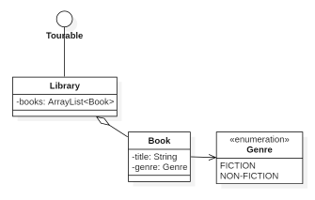
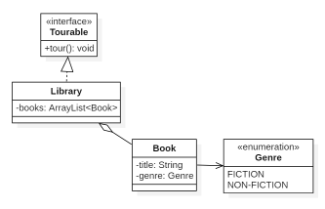
Modeling Enumerations and
Options for Interfaces
Stereotype
Graphically, an Interface is
rendered as a circle.
Here the Interface is rendered as a stereotyped class to expose its operation.

Slide 7
UML Stereotypes
A stereotype is one of three types of extensibility mechanisms in the Unified Modeling Language (UML),
A Stereotype provides the capability to create new kind of modeling elements. Stereotypes must be based on elements that are part of the UML meta-model. Some common stereotypes for a class are entity, boundary, control, utility and exception.
Stereotypes are a way to group classes under a common purpose and are represented by the stereotype surrounded by a pair of guillemets (pronounced GEE-may) « your stereotype »
« »

Slide 8
Viewing full Interface Information in StarUML
Right-click Interface
Change Stereotype Display to Label
Unselect Suppress Operations

Slide 9
Relationships

Slide 10
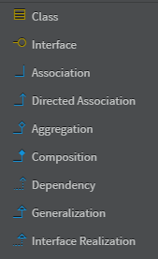
Relationships Between Classes
Generalization – the "superclass" relationship
(Interface) Realization – the "implemented contract" relationship
Association – the "has-a" relationship*
  Directed Association
  Bidirectional Association ("Association" in StarUML)
  Aggregation
  Composition
Dependency – the "uses" relationship**
* "has-a" relationships are exclusively determined by
the owning class's instance and static variables.
** later versions of UML consider Realization to be a
form of Dependency, but here it's separated out for clarity.
the "is-a"
relationships

Slide 11
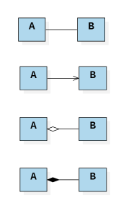
The Complications of Association
public class Apartment{ private Room bedroom; public Apartment() { bedroom = new Room(); } }
  Bidirectional Association
  ("Association" in StarUML)
  A "has-a" B; B "has-a" A
  public class Order {
  private Customer customer;
  }
  public class Customer {
  private Order order;
  }
  Directed Association
  A "has-a" B
  public class Order {
  private Customer customer;
  }
  Aggregation
  A "has-a" B - and -
  B is a part of A
  public class Playlist {
  private List<Song> songs;
  }
  Playlists and Songs can
  exist without each other
  Composition
  A "has-a" B - and -
  B is a part of A - and –
  B is a part of nothing else
public class Apartment {
private Room bedroom;
public Apartment() {
bedroom = new Room();
}
There is no Room independently created

Slide 12
Aggregation vs Composition
public class Apartment{ private Room bedroom; public Apartment() { bedroom = new Room(); } }
An aggregation is an association that represents a part-whole relationship. It is shown by a hollow-diamond adornment on the end of the path attached to the aggregate class.
A composition is a stronger form of association in which the composite has sole responsibility for managing its parts, such as their allocation and deallocation. It is shown by a filled-diamond on the composite end.
  Aggregation
  A "has-a" B - and -
  B is a part of A
  public class Playlist {
  private List<Song> songs;
  }
  Playlists and Songs can
  exist without each other
  Composition
  A "has-a" B - and -
  B is a part of A - and –
  B is a part of nothing else
public class Apartment {
private Room bedroom;
public Apartment() {
bedroom = new Room();
}
There is no Room independently created

Slide 13
Directed Association vs. Aggregation
public class Apartment{ private Room bedroom; public Apartment() { bedroom = new Room(); } }
  Bidirectional Association
Bidirectional Association is easy to spot.
Composition is fairly rare.
But distinguishing Directed Association and Aggregation is hard
  Directed Association
Is a LineItem part-of an Order? Yes.
Is a Product part-of a LineItem? Yes.
Is a Customer part-of an Order? No.
Are Books part-of a Library? Yes.
Are LibraryPatrons part-of a Library? No.
Are Librarians part-of a Library? Hmmm…
  public class Order {
  private Customer customer;
  }
  Aggregation
  public class Playlist {
  private List<Song> songs;
  }
Aggregation is a form of Directed Association, where the relationship is part/whole
  Composition

Slide 14
Are Librarians part-of a Library?
What are some common ways to think of the part/whole relationship?
  Components are part-of Objects.
  (processors and circuit boards are parts of computers)
  Stuff are part of Objects.
  (steel is part of a bike frame, rubber is part of a tire)
  Members are part-of Collections.
  (the conductor and the violinists are parts of an orchestra)
  Portions are part-of Masses.
  (a slice is part of a pizza, an allocation is part of a grant)
  Features are part-of Activities
  (running events and cycling are parts of triathlons)
  Places are part-of Areas
  (cities are part of states/provinces, state/provinces are part of countries)
So is a Librarian part-of a Library?
  Motschnig-Pitrik, R., & Kaasboll, J. (1999). Part-whole relationship categories and their application in object-oriented analysis. IEEE Transactions on Knowledge and Data Engineering, 11(5), 779–797. https://doi.org/10.1109/69.806936

Slide 15
Are Librarians part-of a Library?
"The library is composed of several sections: Acquisition Section, Cataloging Section, Circulation Section, Multimedia or I.T. Section, Reference Section, and Periodicals Section." https://arts-literature.blurtit.com/221840/what-are-the-parts-of-a-library
"Administration, Circulation, Reference, Cataloging". https://www.quora.com/What-are-the-different-parts-of-a-library-What-function-do-they-serve
What is a Library?
  A building? Then no.
  A compendium of collections? Also no.
  A collection of functions? No.
  A functioning service (like an Orchestra)? Then maybe!

