Slide 1
UML Modeling
Activity Diagrams
Notes:
Replace this with your course title and your name/contact details.

Slide 2

References
Materials in this educational slide deck are taken from The Unified Modeling Language User Guide.
UML stared in October 1994 when Grady Booch and James Rumbaugh worked at Rational Software Company, pioneers in software modeling.
These three were the original designers of UML, but they collaborated with partners from the software industry, including Hewlett-Packard, IBM, Oracle and others.

Slide 3
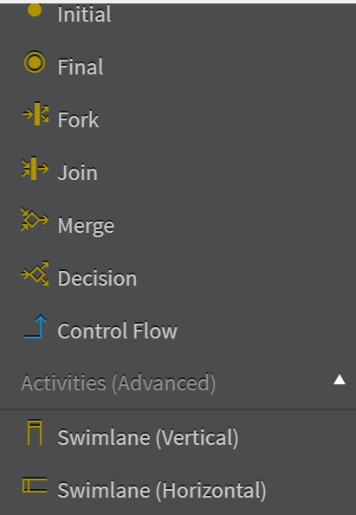

UML Activity Diagrams
Activity Diagrams show the application workflow, as te execution of a functionality progress from activity state to activity state.
An activity diagram may contain branches, as well as forking of control into concurrent processes. Concurrent processes represent activities that can be performed at the same time by different objects or persons in an organization.
There are many kinds of diagrams that depct a process, such as "flow charts" or "workflow diagrams"
The Activity Diagram is one such diagram, except it has been formalized in UML

Slide 4
Activity Diagram
Activity diagrams are used to model system behaviors, and the way in which these behaviors are related in an overall flow
  of the system
  of the data
  of control for performing a task
Describe the step-by-step workflows of activities to be performed in a system for reaching a specific goal.
The logical paths a process follows, based on various conditions, concurrent processing, data access, interruptions and other logical path distinctions, are all used to construct a process, system or procedure.
Diagrams are an oriented graph where nodes represent the activities.

Slide 5
Activity Diagrams are essentially flow charts
Diagrams are an oriented graph where nodes represent the activities.
"Check shipping status of a purchased good" example

Slide 6
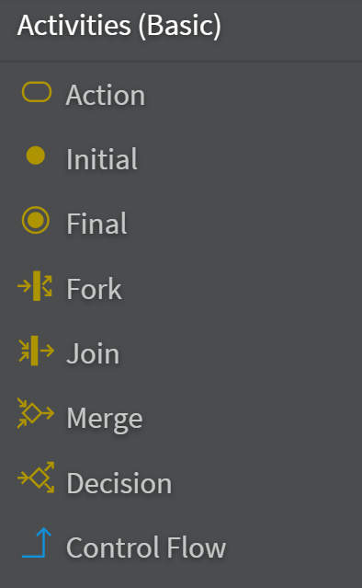
Bike Shop
Join vs Merge
  Merge automatically advances the flow
  Join requires that both Actions complete before flow is advanced,
  (example: document being approved
  by two dept heads)
"Connector"
  Repair Bike
  is an Action
  Technically,
  this is a UML
  "submachine"
  that should be
  written as
  Repair Bike()
  But I prefer to
  color it
  differently and
  add my own
  stereotype.
There can be multiple Final nodes.

Slide 7
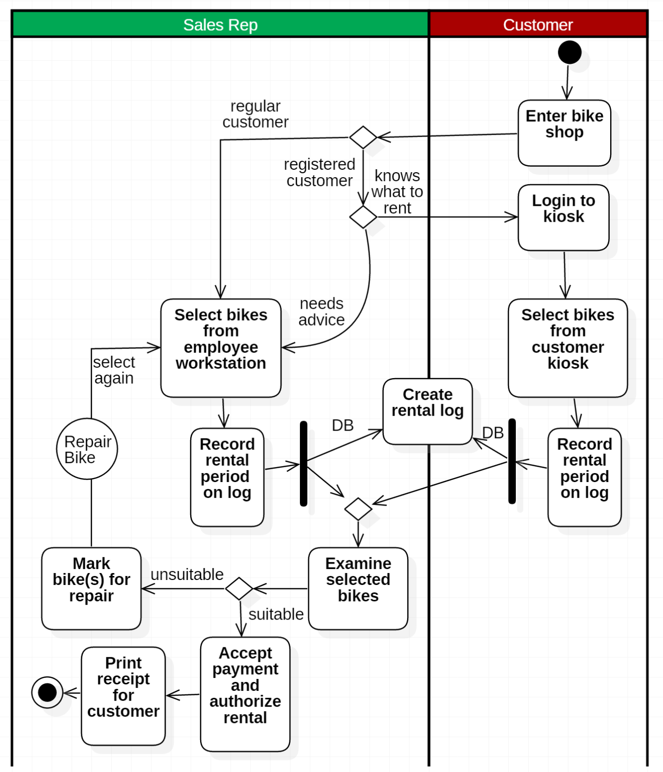
Swimlanes
Swimlanes (horizontal or vertical) can clearly differentiate which Actors are performing which function in an Activity Diagram

Slide 8
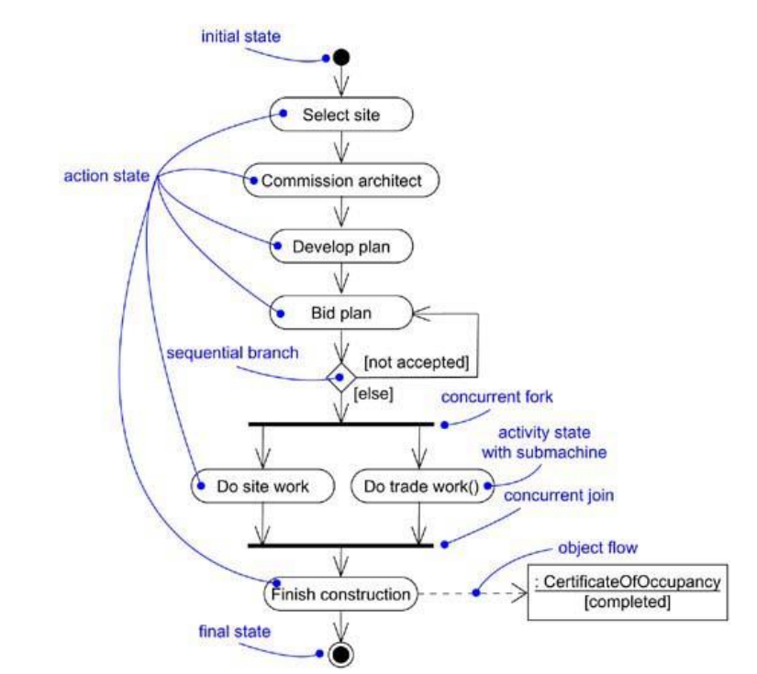
More examples
Object flows. An activity diagram can show the flow of object values, as well as the flow of control.
An object flow state represents an object that is the input or output of an activity.
For an output value, a dashed arrow is drawn from an activity to an object flow state.
For an input value, a dashed arrow is drawn from an object flow state to an activity
My preference would be to model the submachine
like this.

