Slide 1
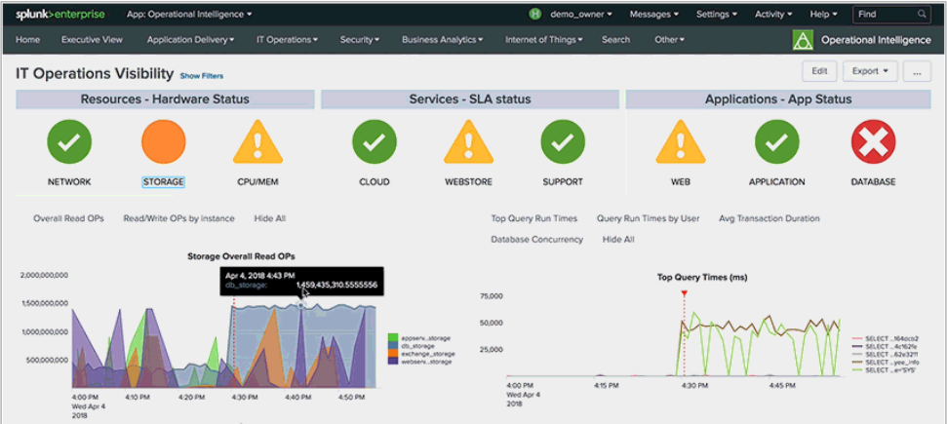
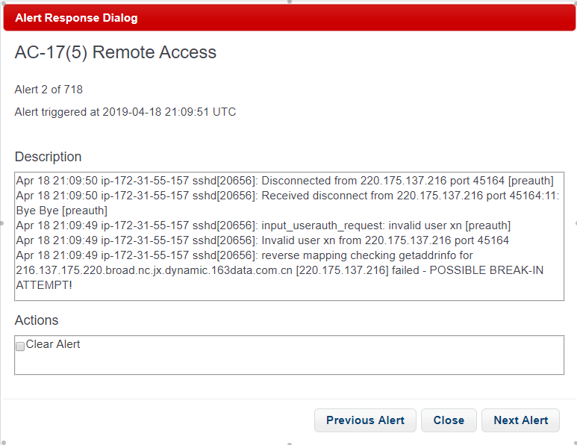
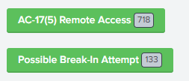
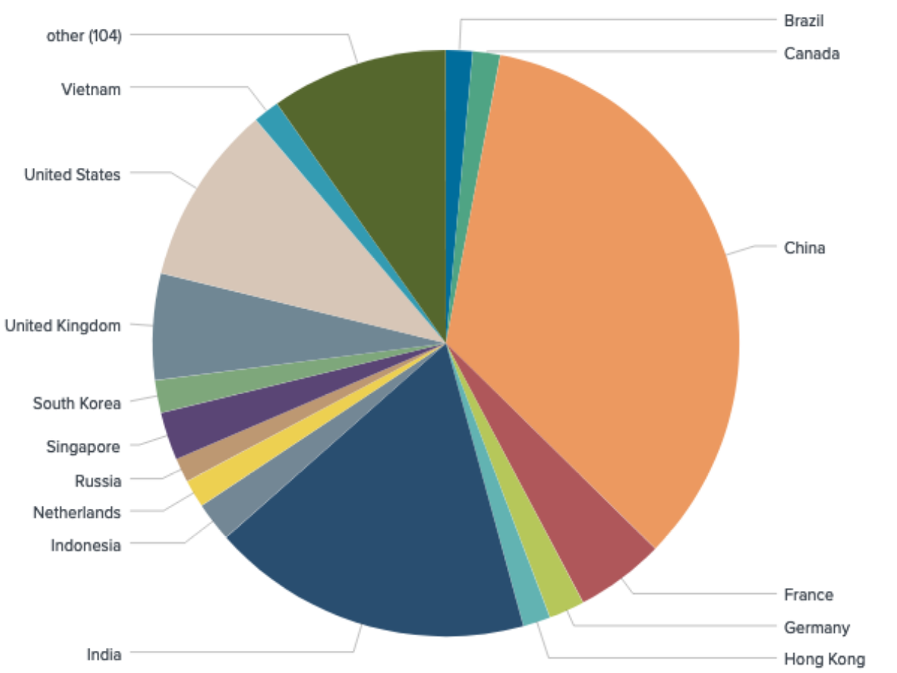
Automation of Security Information and Event Management
Kevin Malone, Jacob Dominguez, Quinn Mchugh, Zachary Miles, Daniel Vega
Rosty Hnatyshyn, Alex Lam, Dylan Chow, Eric Currie, Kyle Butera
Faculty Advisor: Jack Myers
The Problem
Cybersecurity awareness is extremely critical in today’s climate. While existing cybersecurity tools are available, they are often riddled with deficiencies that make them difficult to utilize effectively.
Mission-critical systems require real-time and actionable data analytics, event monitoring and response. Tools like SPLUNK can fulfill these needs…but…
In 2019, Cybersecurity management must be the domain of ALL employees, not just highly trained specialists.
SPLUNK:
a powerful but overly complex tool.
How can we empower regular users to perform cybersecurity operations?
The Solution
Our research examined in detail both compliance standards from the Federal Information Systems Management Act (FISMA) of 2002, the National Institute of Standards (NIST) SP 800-53 Security Controls and the underlying functionality of SPLUNK itself. We developed a cloud-based application to merge existing security capabilities with a novel security framework.
Data Visualization
Splunk enabled us to create data visualizations based upon the logs that we were monitoring, giving operators a way to quickly understand the gravity of an event that was caught by SPLUNK.
US Government IA Policy Framework
Response Dashboard
Built within Splunk using Javascript and various libraries such as jquery, jquery-ui, and notify.js.
User-friendly way to respond to alerts by presenting each alert class with a button that opens a dialog that offers responses to the specific alert.
Instead of needing to manually sift through data, operators will be able to simply view an alert’s data and make a decision quickly through a sleek user-interface.
Authorization to Operate (ATO) for IT Security Professionals
Agency ATO
OMB A-130 – the policy
NIST – the risk management framework
OMB A-130
FIPS, 200 FIPS 199
NIST SP 800-37, 800-137,
800-53
FISMA - approved by Congress: 2002 eGov Act
eGov Act of 2002 includes
Federal Information Security Management Act (FISMA)
Acknowledgement Jayson Daughtry for his contributions

Slide 2
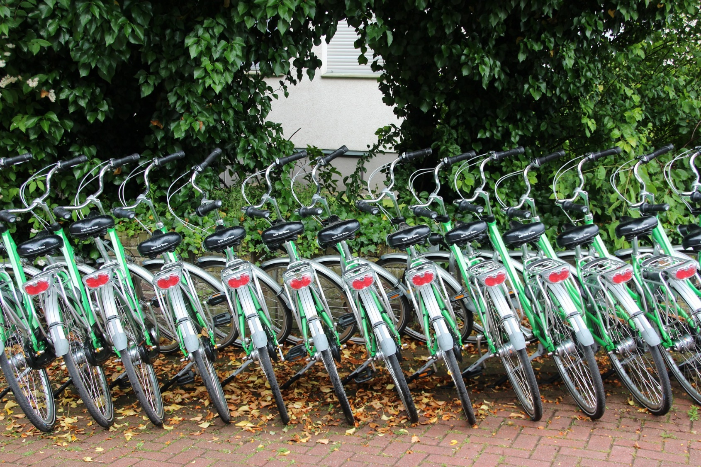
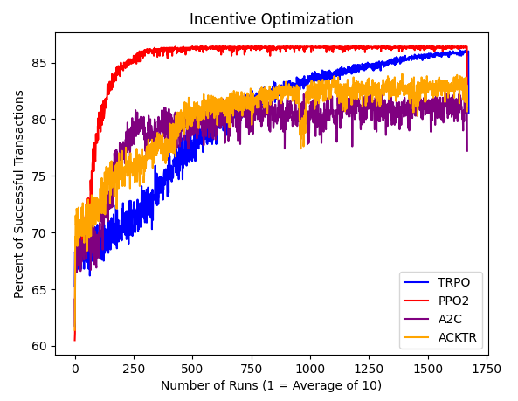
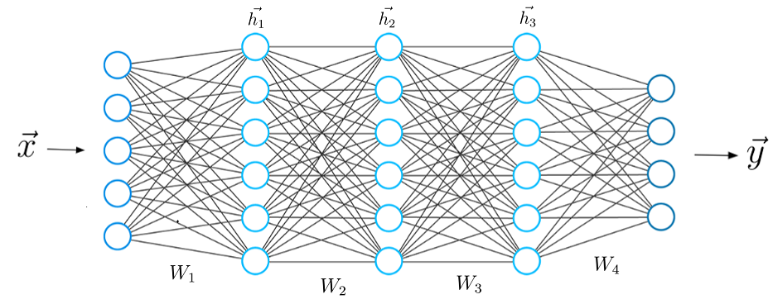
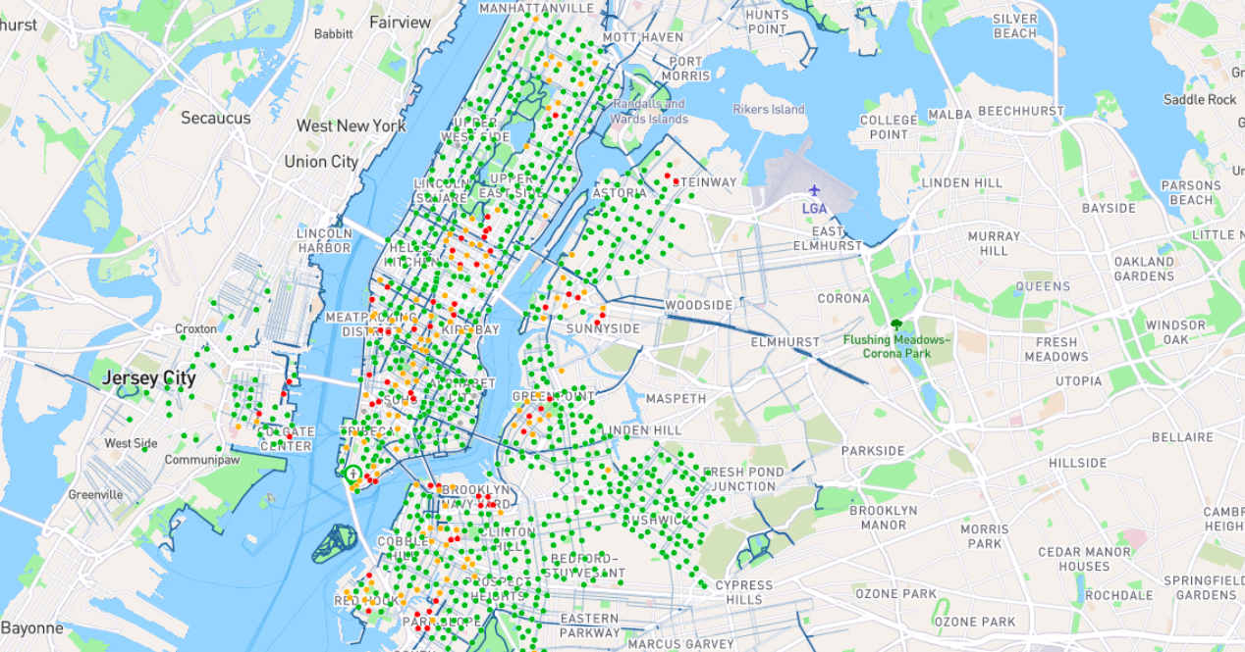
Optimizing City Bike Sharing Solutions Using Deep Reinforcement Learning
Brian Campana Faculty Advisors: Shen-Shyang Ho, Ning Wang
Introduction
Results
Growing traffic problems and pollution concerns are leading more people towards alternative transportation, like bicycles.
Services like Lyft and Citi bikes are responding to these trends by increasing the amount of rentable bikes and docking stations throughout cities.
These companies currently need to maintain stock by employing drivers to rebalance stations, however they are looking into incentivizing users to help keep stations balanced.
This project’s goal is to simulate these stations and train an agent with deep reinforcement learning to properly incentive users for rebalancing.
Before having each algorithm teach an agent the environment, we needed a baseline, no incentive success rate to compare our agents. Over the same seed, our no incentive resulted in 44 percent success rate.
Each of the four algorithms ran through nearly 17000 days, increasing the amount of successful transactions until reaching a plateau.
Proximal Policy Optimization (PPO2) reached a higher plateau, 86.4 percent, then the rest of the algorithms, as well as the quickest. This is expected, as PPO2 combines the ideas from A2C and TRPO.
Trust Region Policy Optimization (TRPO) eventually closed the success rate gap with PPO2, reaching 86.1, however it took significantly longer to reach that rate.
Actor Critic using Kronecker-Factored Trust Region (ACKTR) and Asynchronous Advantage Actor Critic (A2C) plateaus’ were less reliable compared to the previous two, having a wider range of success rates as well as preforming worse.
Deep Reinforcement Learning
Deep Reinforcement Learning (DRL) allows agents to learn from previous actions based on the reward, similar to humans.
These algorithms do so by creating artificial neural networks, inspired by the architecture of the brain, and then using a framework of reinforcement learning to improve agents.
Different training algorithms exists, and the ones we worked with include: Trust Region Policy Optimization (TRPO), Proximal Policy Optimization (PPO2), Actor Critic using Kronecker-Factored Trust Region (ACKTR), and Asynchronous Advantage Actor Critic (A2C).
While each algorithm is different, they all still use deep neural networks, with an input layer, many hidden layers, and an output layer.
Source: https://towardsdatascience.com/what-is-deep-learning-and-how-does-it-work-2ce44bb692ac
Future Implementation
Currently, the environment is one dimensional and does not completely simulate a city and its docking networks. Doing so would include adding distance between the stations and implementing a dynamic walking cost for our users.
Working with different environment parameters and studying the correlation between bikes in circulation, max number of users, and number of stations on both the one dimensional environment and the eventual two dimensional version.
Potentially Importing actual data from Citi Bikes in New York City to test our algorithms on a real city to test user incentivized bike sharing.
Map of Citi Bike Stations in New York City
Source: https://nycmap360.com/nyc-bike-map
Methods
Using the python Gym library, we created a simple dock station network to simulate users walking to stations and renting bikes.
Our environments action space is each station’s incentive, and it can be a value from 0 to 15 (represents dollars.)
Our environments observation space include the current hour, the number of bikes remaining in each station after the hour, and the remaining daily budget.
In the environment, each hour is one step, in which each trip is iterated through and determined if successful or not. A trip is not successful if there are no bikes at the users given station and the neighboring stations are either empty or not incentivized.
The environments reward is based on the success rate of each hour. We use the formula (T – F)/T, where T is the total number of trips for the hour, and F is the number of customers who failed to find a bicycle, our reward maxes out for each hour at one, and 12 for the total day.
Implemented seeding user trips to create consistent days and trips to train agents on. These seeds were saved as text files and imported in to keep consistency between the different algorithms for testing.
Finally, used the python Stable-Baselines library for deep reinforcement learning algorithms to learn from our environment.

Slide 3
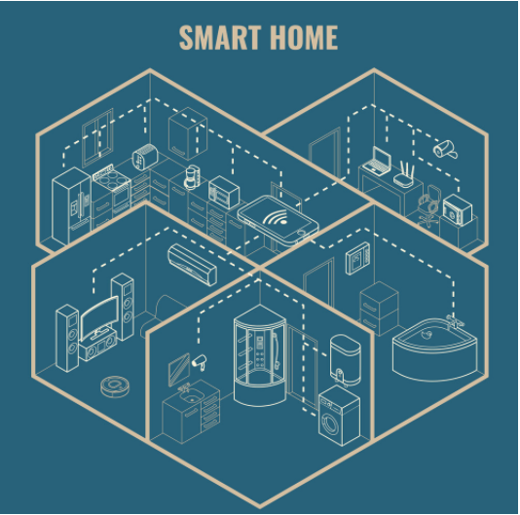
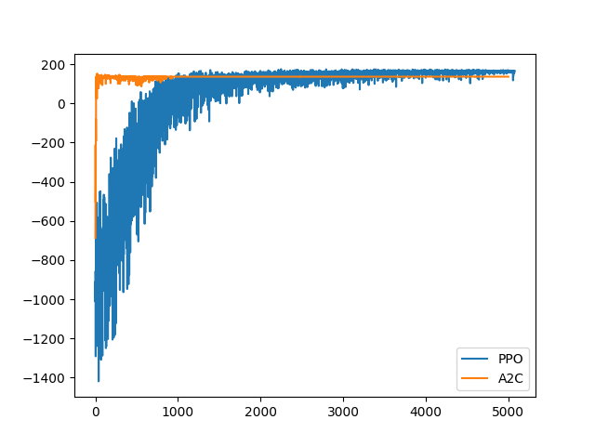
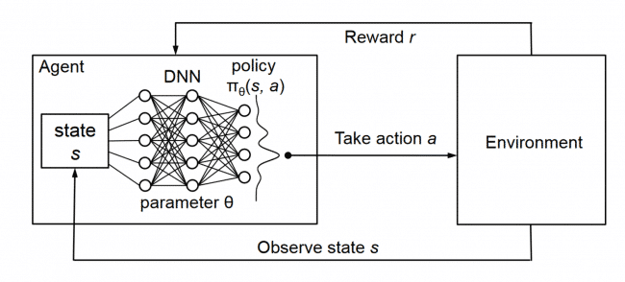
Smart Home Energy Optimization with Deep Reinforcement Learning
Dylan Perry Faculty Advisors: Shen-Shyang Ho, Ning Wang
Introduction
Methods
Internet of Things (IoT) devices are becoming more and more a part of our daily life. All kinds of devices are connected and managed directly from cell phones. From doorbells to refrigerators, the pursuit of perfect convenience drives every device to connect to each other.
According to Statista, the number of smart homes will grow by approximately 100 million homes in just 2021 alone. More and more devices will begin to be connected. Obtaining convenience from additional smart devices will become more challenging, as it increases the amount of time needed to manage all the devices. The next step in the advancement of quality of home living is finding a way to manage smart devices with a more automatic approach.
Utilizing Open AI gym’s reinforcement learning environment building API, a simulated smart home environment with various example devices is created. The Stable-Baselines library provides full support for the popular standard models in reinforcement learning. These are used to test the efficacy of the simulated environment and device structures. With these libraries and structure, optimizing environments and models becomes streamlined.
The simulated structures are designed to replicated actual conditions that would impact decision making when it comes to smart devices (ex. comfort, people are present, energy costs, priority). In the initial stage of the environment, the information the agent receives from the is the current energy usage, the designated energy limit, a value indicating how much convenience is offered by the smart devices, and the threshold with which this convenience should not go below.
The first version of the smart home environment focuses solely on providing optimal comfort with minimum energy usage based on the energy cost throughout the day. Using real-world energy usage data, the model is incentivized to use less energy demanding devices during high load times during the day, and vice versa.
Early Results and Discussions
Source: https://www.vectorstock.com/royalty-free-vector/smart-house-concept-3d-isometric-blueprint-vector-17426798
The results above show the reward value that each episode of each model receives during training. The first version of the Smart Home Environment shows promising results of the agent learning the environment with relative fast speed.
As the environment becomes more complex to accurate reflect real-world environments, the challenge becomes structuring the environment in a way that machine learning models can train and learn using it. On the other hand, environments that become too complex may reflect the real-world applications accurately but will suffer from significantly slower training times. The optimal case to pursue is thus a model that is just complex enough to simulate the real world without any unnecessary features.
Each model undergoes thousands of episodes of the device managing scenario. Throughout the training, the agent chooses from a list of possible actions while considering the reward values obtained from previous actions in other scenarios. The agent has the choice with each device to turn it off or turn it on.
Deep Reinforcement Learning
Reinforcement learning is a field of machine learning that focuses on training machine learning models through trial and error. Models are placed in simulated environments and are instructed to makes decisions based on the observation data it receives. Through making new actions each time, the model can adjust and learn what actions are the most preferred in each situation it encounters.
When it comes to larger environments, it becomes inefficient to train a reinforcement learning model for every possible scenario and every action it can take in those situations. In these situations, Deep Reinforcement Learning is used. This method makes use of Deep Learning models to generalize unexplored scenarios so that the model will not need to explore as much to reach the optimal rewards.
With reinforcement learning, models can be trained to manage many kinds of situations. In this application, it would be able to manage many smart devices without needing user interaction at many steps. The proposed purpose of this research is to understand and attempt to build a reinforcement model structure such that smart home devices can be controlled autonomously while still maintaining the user’s preferred settings. This model would also find the equilibrium point between providing the most energy-efficient control of said devices.
An example of the structure of a Deep Reinforcement Learning scenario
Source: http://people.csail.mit.edu/hongzi/content/publications/DeepRM-HotNets16.pdf
Future Applications
As more and more smart homes and smart devices are built, a need to manage these components comes into fruition. In future applications of this research, smart homes will not only take into consideration the individual home but will also assist in mitigating high-load times across the entire surrounding area.
Future applications may not just be limited to single family houses as well. Larger buildings and infrastructure in cities may also benefit from becoming more manageable, decreasing wasted energy across the board.
Source: https://gcn.com/articles/2017/03/21/philadelphia-smart-city.aspx

