Slide 1

Software Engineering I
Chapter 3
Agile SW Development plus Scrum in-depth
Notes:
Replace this with your course title and your name/contact details.

Slide 2
Plan-driven and agile development
Plan-driven development
  A plan-driven approach to software engineering is based around separate development stages with the outputs to be produced at each of these stages planned in advance.
  Not necessarily waterfall model – plan-driven, incremental development is possible
  Iteration occurs within activities.
Agile development
  Specification, design, implementation and testing are inter-leaved and the outputs from the development process are decided through a process of negotiation during the software development process.
  A cadence of multiple deliverables is better able to help a project keep progress and provide better estimates rather than having everything be "80% done"

Slide 3
Why the break from Waterfall?
On February 2001, 17 software developers met at the Snowbird resort in Utah to discuss lightweight development methods.
They published the Manifesto for Agile Software Development

Slide 4
Manifesto for Agile Software Development
We are uncovering better ways of developing software by doing it and helping others do it.
Through this work we have come to value:
  Individuals and interactions over processes and tools
  Working software over comprehensive documentation
  Customer collaboration over contract negotiation
  Responding to change over following a plan
That is, while there is value in the items on the right,
we value the items on the left more.

Slide 5
Twelve Principles of the Agile Manifesto
Our highest priority is to satisfy the customer through early and continuous delivery of valuable software.
Welcome changing requirements, even late in development. Agile processes harness change for the customer's competitive advantage.
Deliver working software frequently, from a couple of weeks to a couple of months, with a preference to the shorter timescale.
Business people and developers must work together daily throughout the project.
Build projects around motivated individuals. Give them the environment and support they need, and trust them to get the job done.
The most efficient and effective method of conveying information to and within a development team is face-to-face conversation.
Working software is the primary measure of progress.
Agile processes promote sustainable development. The sponsors, developers, and users should be able to maintain a constant pace indefinitely.
Continuous attention to technical excellence and good design enhances agility.
Simplicity--the art of maximizing the amount of work not done -- is essential.
The best architectures, requirements, and designs emerge from self-organizing teams.
At regular intervals, the team reflects on how to become more effective, then tunes and adjusts its behavior accordingly

Slide 6
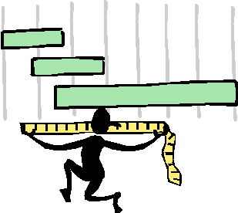
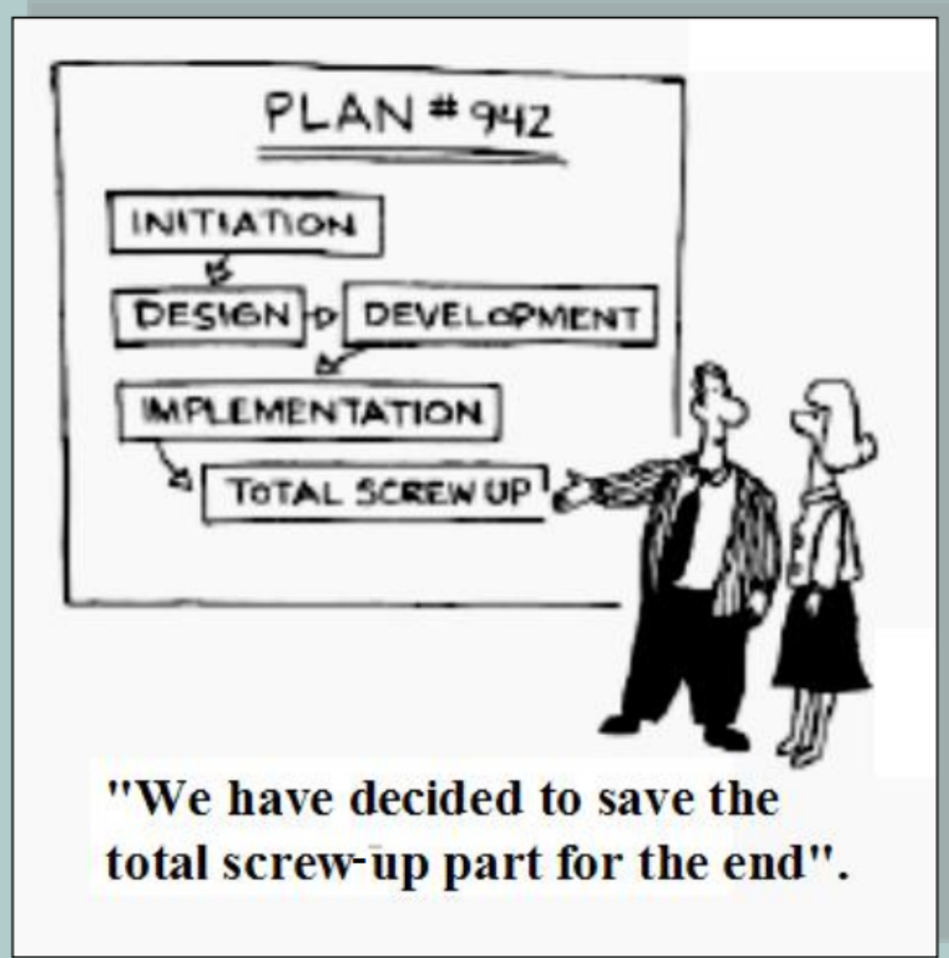
The primary measure of progress
Traditional
Waterfall
Agile
Analysis
Analysis
50%
done
Design
Design
Development
Development
Integration & Testing
Integration & Testing
Implementation
Implementation
50%
done

Slide 7
Agile vs Scrum
"The Agile movement is not anti-methodology, in fact many of us want to restore credibility to the word methodology. We want to restore a balance. We embrace modeling, but not in order to file some diagram in a dusty corporate repository. We embrace documentation, but not hundreds of pages of never-maintained and rarely-used tomes. We plan, but recognize the limits of planning in a turbulent environment."
Jim Highsmith, 1 of the 17 original signatories of the Agile Manifesto
"Scrum is an Agile framework for completing complex projects. Scrum originally was formalized for software development projects, but it works well for any complex, innovative scope of work"
ScrumAlliance, founded by Ken Schwaber, another original signatory of the Agile Manifesto
"Scrum is a management and control process that cuts through complexity to focus on building software that meets business needs… Scrum itself is a simple framework for effective team collaboration on complex software projects."
scrum.org, founded by Ken Schwaber,

Slide 8
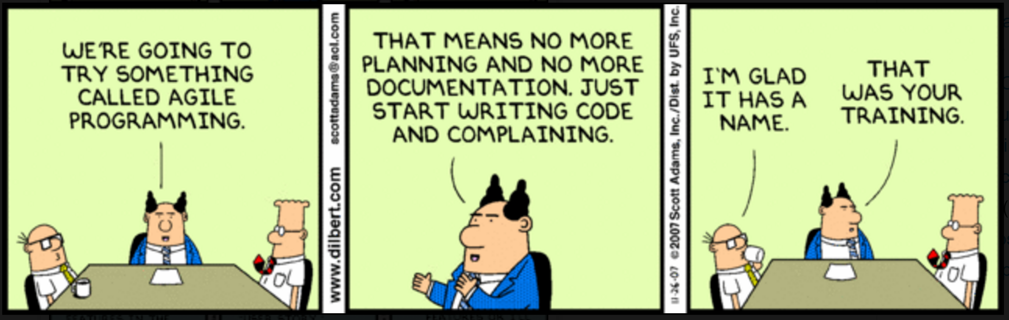
Agile Programming
The aim of agile methods is to reduce overheads in the software process (e.g. by limiting documentation) and to be able to respond quickly to changing requirements without excessive rework.

Slide 9
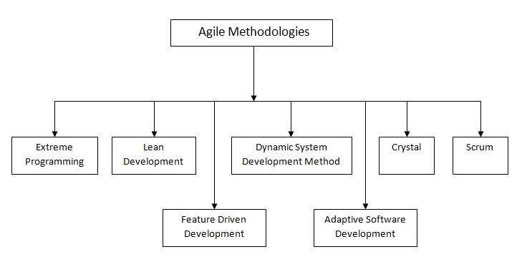
Scrum
The most prevalent of the Agile Methodologies

Slide 10
Definition of scrum
Scrum (n): A framework within which people can address complex adaptive problems, while productively and creatively delivering products of the highest possible value.
Scrum is:
  Lightweight
  Simple to understand
  Difficult to master
Scrum is a process framework that has been used to manage complex product development since the early 1990s.
Scrum is not a process or a technique for building products; rather, it is a framework within which you can employ various processes and techniques.
The Scrum framework consists of Scrum Teams and their associated roles, events, artifacts, and rules. Each component within the framework serves a specific purpose and is essential to Scrum’s success and usage.
The rules of Scrum bind together the events, roles, and artifacts, governing the relationships and interaction between them. The rules of Scrum are described throughout this document.
Specific tactics for using the Scrum framework vary and are described elsewhere.

Slide 11
Scrum Theory:
Process Control Models
PREDICTIVE
EMPIRICAL
Work and outcomes are understood before execution.
Given a well-defined set of inputs, the same outputs are generated every time.
Follow the pre-determined steps to get known results.
Frequent inspection and adaptation occurs as work proceeds.
Processes are accepted as imperfectly designed.
Outputs are often unpredictable and unrepeatable.
Customer knows what he wants.
Engineers know how to build it.
Nothing changes along the way.
Customer discovers what he wants.
Engineers discover how to build it.
Things change along the way.

Slide 12
The Three Legs of Empiricism
Empiricism asserts that knowledge comes from experience and making decisions based on what is known
Transparency
  Significant aspects of the process must be visible to those responsible for the outcome.
  Transparency requires those aspects be defined by a common standard so observers share a common understanding of what is being seen.
  For example:
    A common language referring to the process must be shared by all participants; and,
    Those performing the work and those accepting the work product must share a common definition of “Done”.
  Transparency allows all facets of any Scrum process to be observed by anyone. This promotes an easy and transparent flow of information throughout the organization and creates an open work culture. In Scrum, transparency is depicted through:
    Artifacts
    Project Vision Statement
    Prioritized Product Backlog
    Meetings
    Sprint Review Meetings
    Release Planning Schedule
    Burndown Chart
    Scrumboard
    Inspection

Slide 13
The Three Legs of Empiricism
Empiricism asserts that knowledge comes from experience and making decisions based on what is known
Inspection
  Scrum users must frequently inspect Scrum artifacts and progress toward a Sprint Goal to detect undesirable variances.
  Their inspection should not be so frequent that inspection gets in the way of the work. Inspections are most beneficial when diligently performed by skilled inspectors at the point of work.
  Inspection can be accomplished through:
    Use of a common Scrumboard and other information radiators
    Collection of feedback from the customer and other stakeholders during Sprint reviews, when creating a Prioritized Product Backlog, and during Release Planning processes
    Inspection and approval of the Deliverables by the Product Owner and the customer in the Demonstrate and Validate Sprint process.

Slide 14
The Three Legs of Empiricism
Empiricism asserts that knowledge comes from experience and making decisions based on what is known
Adaptation
  Adaptation happens as the Scrum Team and Stakeholders learn through transparency and inspection and then adapt by making improvements in the work they are doing., especially through Sprint Retrospectives and constant risk identification.
  If an inspector determines that one or more aspects of a process deviate outside acceptable limits, and that the resulting product will be unacceptable, the process or the material being processed must be adjusted. An adjustment must be made as soon as possible to minimize further deviation.
  Scrum prescribes four formal events for inspection and adaptation, as described in the Scrum Events section of this document:
    Sprint Planning
    Daily Scrum
    Sprint Review
    Sprint Retrospective

Slide 15
The Complexity of Software Development
Simple
  Everything is known
Complicated
  More is known than unknown
Complex
  More is unknown than known
  Scrum thrives here
Chaotic
  Very little is known
Far from Agreement
Chaos
REQUIREMENTS
Complex
Complicated
Close to Agreement
Simple
Complicated
Close to Certainty
TECHNOLOGY
Far from Certainty

Slide 16
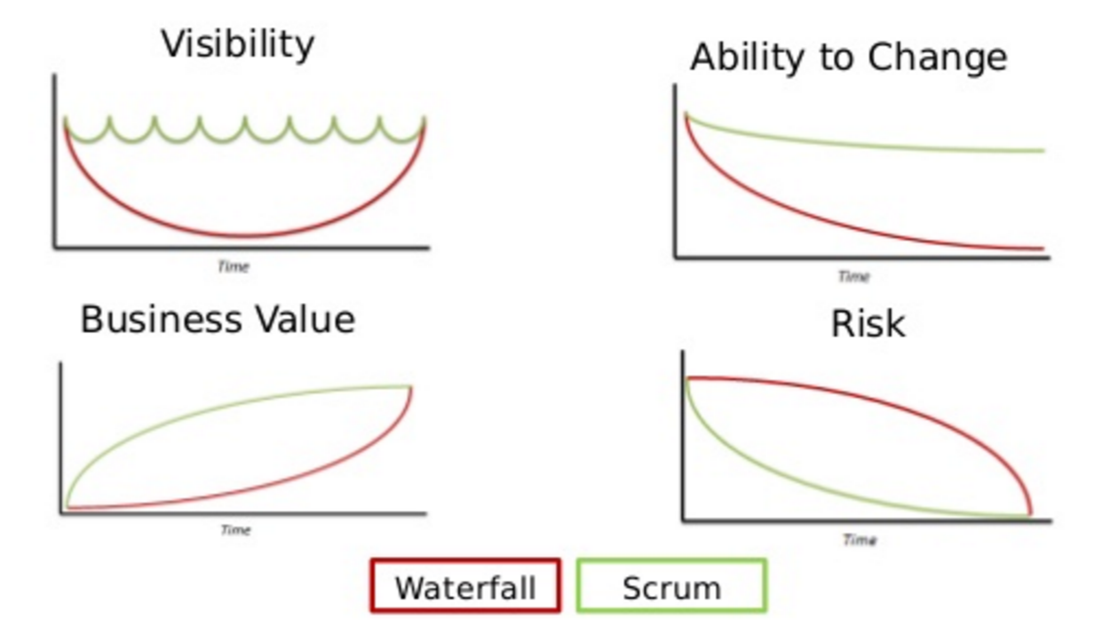
Characteristics of Waterfall vs Scrum

Slide 17
Scrum in a nutshell
A Team commits to delivering working software in 30 days or less.
A time is scheduled to show that software
The Team creates the software
The Team offers their work for inspection and adapts the plan for the next cycle

Slide 18
Scrum Roles,
Artifacts and Events

Slide 19
Prescribed by Scrum
Roles
Product Owner
Development Team
Scrum Master
serves
serves
Artifacts
Product Backlog
Sprint Backlog
Increment
Time Boxed Events
Sprint
Sprint Planning Meeting
Daily Scrum
Sprint Review
Sprint Retrospective

Slide 20
Roles
(high level)
Product Owner
Scrum Team
Manages
the Product Backlog
Optimizes the product value
Scrum
Master
Development
Team
Manages
the Scrum Process
Removes impediments
Manages itself
Creates Done increments

Slide 21



Roles
Product Owner
  Optimizes the value of the Product
  Manages the Product Backlog
  Chooses what and when to release
  Represents stakeholders and customers to the Development Team
  Ideally from the business with profit and loss accountability for Product
Development Team
  Creates the product Increment
  Operates in a series of Sprints
  Organizes itself and its work
  Collaborates with Product Owner to optimize value
  Must have all the skills it needs to deliver a done Increment – breadth and depth;
  ideally more than one team member has the competency
Scrum Master
  Enacts Scrum values, practices, and rules throughout the organization
  Ensures the Scrum Team is functional and productive – "healthy"
  Provides guidance and support for the Scrum Team – has a helpful personality
Does not do all this in a vacuum, works with full Scrum Team
    Scrum does not name sub-roles, e.g. Testers, Coders, Business Analysts…

Slide 22
For our section
The Product Owner will be the direct interface to MSE.
One member of the development team will be in charge of the GitHub repository
The Scrum Master will be the direct interface to me.
Plus every team member will run a Sprint
and produce a formal deliverable.

Slide 23
Artifacts
Product Backlog
  Holds the requirements for the Product
    A minimal but sufficient inventory of work
    An ordered list of desirements
    Potential features of the product
    The single source of truth for what is planned in the product
  Managed by the Product Owner
  Consists of Product Backlog Items (PBIs)
  Public and available
Increment
  Working addition to the product
  Should be releasable
  The sum of all the PBIs completed during the Sprint
  Is usable and it works
  Must be DONE per Scrum Team standards with no work remaining
Sprint Backlog
  Holds all work for the Sprint Goal
  The selected Product Backlog Items ("forecast" for the Sprint
  A plan, often a list of tasks, to deliver the Product Backlog Items against the Sprint Goal
  Created by the Development Team during Sprint Planning
  Often derived by examining and decomposing PBIs
  Might be a simple To Do list
  Work for the Sprint emerges during the Sprint
  Development Team members sign up for work, they aren't assigned
  Development Team members may modify the Sprint Backlog anytime as they see fit
  Progress within the Sprint must be visualized
  Owned and managed by the Development Team

Slide 24
Events (1)
Sprint Planning
  from Product Backlog
  to Forecast, Sprint Goal and Sprint Backlog
  Product Backlog is inspected
  A Sprint Goal is created
  Sprint Backlog is created
    The Development Team selects PBIs for the Sprint in collaboration with the Product Owner
    The selection of Product Backlog items into the Sprint Backlog represents the Development Team's forecast for what can be completed in this Sprint
  The entire Scrum Team attends
Daily Scrum
  from Daily Progress to Updated daily plan
  15 minute daily meeting
  Same time and place
  (this might not be possible in a University setting)
  An opportunity for the Development Team to
    Assess progress toward the Sprint Goal
    Synchronize activities
    Create a plan for the next 24 hours

Slide 25
Events (2)
Sprint Review
  from Sprint, Increment
  to Updated Product Backlog
  The product Increment is inspected with the stakeholders
  Stakeholders are encouraged to provide feedback and to collaborate
  The Product Backlog is updated upon the new insights
Sprint Retrospective
  from Past Spring
  to Improvements for next Sprint
  The Scrum Team discusses
    What went well in the Sprint
    What could be improved
    What we will commit to improve in the next Sprint
Sprint
  container event: 30 days or less in duration
  A container for all activities and the other Scrum events
  Focus is on development activities
  Starts with Sprint Planning
  Ends with Sprint Retrospective
  30 days or less to enable regular feedbace

Slide 26
Roles, Artifacts and Events in Action
have clear
accountability
provide transparent information
serve inspection, adaptation and transparency

Slide 27
Roles Revisitied

Slide 28
Who the Product Owner Is
Defines features and functionality
  The level of detail provided will vary
  Some Product Owners will work closer to implementation details than others
Has the final word on the content and the ordering of the Product Backlog
Not the Development Team's assistant
  If a member of the business, it is preferred that the Product Owner not be tasked with writing a User Story
  Needs to spend as much time with the Development Team as needed

Slide 29
Who the Scrum Master Is
A servant-leader, management position
  Managing the use and adoption of Scrum by the team and within the organization
  Serving and coaching the Scrum Team
  Embodying agility for all to see
Not the Development Team's assistant
  Optional to the Daily Scrum
  Is not there to "drive the team" or "drive results"
  Is not the agile variant of a Project Manager
Guides and cares for the Team
  Adheres to Scrum values, practices and rules
  Understands and uses self-organization
  Is productive
  Increases the quality of Increments
Removes impediments to the Development Team's success that they are unable to remove themselves.

Slide 30
More on the Development Team
The team composition is constant throughout a Sprint
Typically has 3-9 members, with the sweet spot around 6
May have partially allocated members
  Although this is often considered an impediment as they have other priorities
  For instance, Database Administrators, User Interface Design experts, Technical Writers
Non-sequential execution is key
Everyone pitches in regardless of individual skill specialty
The Development Team is held to account as a unit.

Slide 31
Techniques
Complementary
Practices

Slide 32
PBIs
Transparent unit of deliverable work
Contains clear acceptance criteria
  Criteria for successful completion
  Answering "what will be true when this works"
May reference other artifacts like
  Specifications
  Mockups
  Architecture Models
Must be sized appropriately
  Must be completeable (able to be "DONE") within a single Sprint
  Best to have several PBIs in a Sprint
Valid Product Backlog Items
  Feature definitions
  User actions or stories
  Constraints
    e.g., The system responds to all search requests within 10 seconds of receiving the request
  Bugs / Defects
  Behaviors (execution of tasks that can be verified with observation)
  Use Cases
  Desirements (aka functional require(?)ments)
  Non-functional requirements
    e.g., all database records must be replicated in a remote database environment

Slide 33
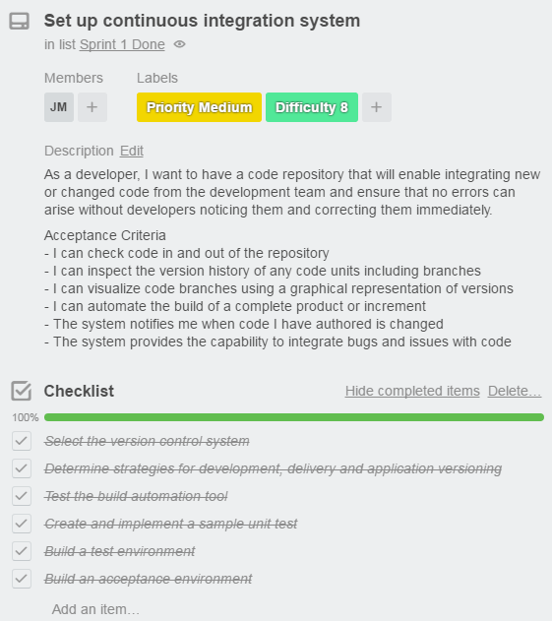
Example PBI
User story
Acceptance criteria
PBI decomposed into tasks

Slide 34
A Scrum Board
Scrum says to visualize progress on the Sprint Backlog.
A Scrum board is an often used means to do so
Note PBIs are decomposed to Tasks by the time
they are represented in the To Do column
Sprint #1
PBI | To Do | In Progress | Done
Each PBI is ideally discrete without dependencies

Slide 35
The Definition of DONE
(DoD)
An increment is deemed complete
after all PBIs for the corresponding Sprint meet their done
criteria and their acceptance criteria.
In pure Scrum, the team defines the definition of done. However, those performing the work and those accepting the work product must share a common definition of “Done”.
The DoD is NOT the same as Acceptance Criteria
  The Definition of Done is a clear and concise list of requirements that the user story must satisfy for the team to call it complete.
  The DoD is a list of technical and non-technical requirements for each user story to meet for the project. It must apply to all items in the backlog.
  DoD is a contract between the Scrum Team & the Product Owner.
  User story Acceptance Criteria can be modified over the course of the Sprint as the user story is further refined.
  The DoD is set during the Release Planning or Sprint 0 – not generally modified once active development print cycles are underway.
  The DoD is often confused with acceptance criteria because, like acceptance criteria, it is used to prove that a story is complete.
  The difference with the DoD is that it is a list of requisites that determine that a story meets company or project requirements, instead of only technical requirements.

Slide 36
Sample Definition of Done
(excerpted)
Preliminary Design.
  is done by showing artifacts that focus on identifying actors, black box software components and their inter-relationships. The architecture is represented by the following artifacts:
    Subsystem context diagrams
    Leaf subsystem level collaborations
    Subsystem collaboration requirements trace diagram
    Software Model Questions are all addressed.
    Level 2 test plan is developed or updated
    …
Detailed Design
  is done by showing artifacts that focus on identifying relationships between a software component’s architecturally significant classes. The Detailed Design is represented by the following artifacts:
      Component level collaboration sequence diagrams
      Component level collaboration class diagrams
      …
Code & Unit Test (CUT)
  Level 1 tests are done using CppUnitLite for C++ and JUnit for Java. Model updated to reflect design impact of code changes. All implementation artifacts from the story are ready for formal review.
    All code written will include Code Headers & Commenting standards
    Each new or modified level 1 test is named to clearly indicate its purpose
    Code and level 1 test drivers are in the code repository on the appropriate branch
    A subject matter expert has peer reviewed level 1 test procedures to verify sufficiency of preconditions tested and expected results verifications
    Level 2 test procedures have been created
Integration
  is done when:
    Verification and regression tests are complete
    All open Level 2 open items have been documented in the test record and in additional software code records and stories.
    Updated Level 2 test plans and procedures
    …

Slide 37
Planning for the
Increment and the Product
The product is the sum of all increments
Release Planning is used to plan out all sprints needed to produce the product.
  Can be done at the PBI level.
  This way the team can know the approximate size of the effort and can make sure they are marching toward completing that amount of work based in their velocity and total work plan.
  Burn up charts and feature burn down charts can be used for this.
Sprint Planning is used to plan the current Sprint, i.e., the current Increment
  Has two main topics: What will we do?
  How will we do it?
  8 hours for a 4 week Sprint
    Usually less for shorter Sprints
  Often the day after the Sprint Retrospective
  The full Scrum Team participates
  What do you think the activities and responsibilities are during Sprint Planning are for:
    Product Owner
    Development Team
    Scrum Master

Slide 38
Sprint Planning
Meeting Flow
Inputs
  Definition of Done
  Development Team Capacity for next Sprint
  Past performance of the Development Team
  The Ready Product Backlog
  The latest Increment
  Retrospective commitments
Outcome
  The Sprint Goal
  Forecast
  Sprint Backlog
    60-70% known and accurate
    Some work is stubbed out for discovery later
    100% time commitment is going to fail
Definition of Done
Development Team (Velocity + Capacity)
Product Backlog
Retrospective Commitments
1
What
Analyze, evaluate and select Product Backlog for Sprint
Sprint Goal gives direction
2
How
Decompose into
actionable plan
Enough Work is decomposed
Sprint Goal + Forecast + Sprint Backlog

Slide 39
Sprint Planning
Roles
Product Owner
  Brings in new PBIs, prioritized
  Clarifies information
Development Team
  Create plan
  Ask questions
Scrum Master
  Identifies impediments
  Conducts risk management
Definition of Done
Development Team (Velocity + Capacity)
Product Backlog
Retrospective Commitments
1
What
Analyze, evaluate and select Product Backlog for Sprint
Sprint Goal gives direction
2
How
Decompose into
actionable plan
Enough Work is decomposed
Sprint Goal + Forecast + Sprint Backlog

Slide 40
Monitoring Sprint Progress
Measurement is for the Development Team and no one else
This is part of self-managing the Sprint's work
Measurements are indications of
  Progress in the Sprint
  If scope should be re-negotiated with the Product Owner
Sprint progress monitoring can be easily misused
  To micromanage the Development Team
  To demonstrate false progress
Progress may change abruptly when
  New work is added or removed during the Sprint
  Scope is renegotiated with the Product Owner
  New things are learned about the work of the Sprint

Slide 41
Sprint Goals
An objective to be met in the Sprint
Through the implementation of the PBIs selected in Sprint Planning
Providing guidance to the Development Team
Allows flexibility in delivering the increment
Allows wiggle room for exact implementation of PBIs
Although the Sprint Goal is fixed
Is sacrosanct throughout the Sprint
As the development team works, it keeps this goal in mind
Each Daily Scrum assesses the Team's progress toward meeting the Sprint
Make the app run on SQL Server in addition to Oracle
Increase find accuracy of search by 20%
Deliver a minimal set of admin features
Decrease upstream payloads by 30%

Slide 42

The Daily Scrum
Daily Scrum
Daily Scrum
  from Daily Progress to Updated daily plan
  15 minute daily meeting
  Same time and place
  (this might not be possible in a University setting)
  An opportunity for the Development Team to
    Assess progress toward the Sprint Goal
    Synchronize activities
    Create a plan for the next 24 hours
Why a Daily Scrum?
  Share commitments
  Identify impediments
  Create focus
  Increase and maintain situational awareness
Good idea to update the Sprint Backlog and Burndown charts at the Daily Scrum
What did I do yesterday that helped the Development Team meet the Sprint Goal?
What will I do today to help the Development Team meet the Sprint Goal?
Do I see any impediment that prevents me or the Development Team from meeting the Sprint Goal?

Slide 43
The Sprint
Sprint
Sprint
  container event: 30 days or less in duration
  A container for all activities and the other Scrum events
  Focus is on development activities
  Starts with Sprint Planning
  Ends with Sprint Retrospective
  30 days or less to enable regular feedbace
All Sprints have consistent duration
Sprints begin as soon as the previous Sprint ends
Scope is negotiated constantly throughout
  Between Development Team and Product Owner
  This recognizes uncertainty even within the Sprint

Slide 44
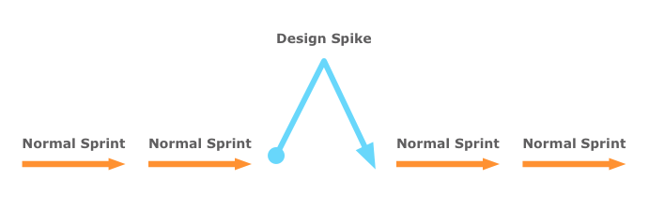
Hitting a Spike
Sometimes the Development Team has difficulty estimating the unknown
  "We don't know enough to size this PBI"
  "The technology is foreign to us"
  "We don’t know enough about the security
  capabilities of this software"
The team may have hit a spike
The spikes teams take on are often proof-of-concept types of activities.
Work is not focused on the finished product. It may even be designed to be thrown away at the end.
Product Owner given the proper expectation that spike solution will most likely not be implemented.
Dealing with Spikes
Have clear objectives and outcomes for the spike.
  Be clear on the knowledge you are trying to gain and the problem(s) you are trying to address. It's easy for a team to stray off into something interesting and related, but not relevant.
Be timeboxed.
  Spikes should be timeboxed so you do just enough work that's just good enough to get the value required.
A user story or task aimed at answering a question or gathering information, rather than at producing shippable product.

Slide 45
Sprint Review Meeting
Sprint Review
Sprint Review
  from Sprint, Increment
  to Updated Product Backlog
  The product Increment is inspected with the stakeholders
  Stakeholders are encouraged to provide feedback and to collaborate
  The Product Backlog is updated upon the new insights
A collaborative working session, not a demo
The Scrum Team shows the increment
Feedback is heard from all present
  Feedback used to guide the next increment
  No slides! Just working software
  4 hours for a 4 week Spring
    Usually less for shorter Sprints
  The full Scrum Team participates
    Complemented by the stakeholders
Product Owner Shares
Development Team Shares
Everyone
  What was done
  What wasn't
  State of the Product Backlog
  Likely Release projections
  The actual Increment of software
  What happened in the Sprint
  How many problems were addressed and the effect on the Increment
  Provides and hears feedback
This is not an excuse for self-congratulations!
This is an inspect and adapt opportunity!

Slide 46



Sprint Review Meeting
Sprint Review
Only completed features may be shown at a Sprint Review.
Product
Backlog
Increment
Current Business Conditions
Review, discover and rearrange info
Sprint
Updated Product
Backlog

Slide 47
Sprint Retrospective:
The Scrum Team's Opportunity to Improve
Sprint Retrospective
Sprint Retrospective
  from Past Spring
  to Improvements for next Sprint
  The Scrum Team discusses
    What went well in the Sprint
    What could be improved
    What we will commit to improve in the next Sprint
A discussion of
  The Scrum process
  Scrum Team members behaviors
  Tools used and needed
  Expanding the Definition of Done (based on Sprint Review)
Goal: to find actionable improvements
  The Scrum Team can enact on the next Sprint
  To adapt common practices and techniques
  To increase the Definition of Done
Typically 3 hours for a 4-week Sprint
  Usually less for shorter Sprints
Occurs after every Sprint Review
Full Scrum Team participation
  Product Owner
  Scrum Master
  Development Team
What worked well?
What will we commit to doing in the next Sprint?
Scrum Team members make actionable commitments
What could be improved?

Slide 48
Event lengths and Sprint length
Event | 20 days | 3 weeks | 2 weeks | 1 week
Sprint Planning | 8 hours | Less than 8 hours (~6 hours) | Less than 8 hours (~4 hours) | Less than 8 hours (~2 hours)
Daily Scrum | 15 minutes
Sprint Review | 4 hours | Less than 4 hours (~3 hours) | Less than 4 hours (~2 hours) | Less than 4 hours (~1 hour)
Sprint Retrospective | 3 hours | Less than 3 hours (~2.25 hours) | Less than 3 hours (~1.5 hours) | Less than 3 hours (~45 minutes)

Slide 49
Planning Horizons
Changing the plan doesn't mean changing timing.
Product
Backlog
Owned by
the Product Owner
Release Plan
Sprint
Backlog
Requires Consultation by the Scrum Team
Daily
Plan
Owned by the Development Team

Slide 50
Backlog Accuracy and Item Detail
Vague
Understood
Estimated PBIs
Tasks
Other Backlog Items
Next
Product Release
Next Next Sprint
Next Sprint
This Sprint
Decreasing clarity
PBIs are estimated and ordered for approximately the next 3 Sprints
The current Sprint is detailed
  Broken into Sprint Backlog Tasks
  Very granular detail
The next 2 Sprints are understood by the entire Scrum Team. They are estimated, valued, ordered, loosely planned.

Slide 51
A ‘prescribing medication’ story

Slide 52
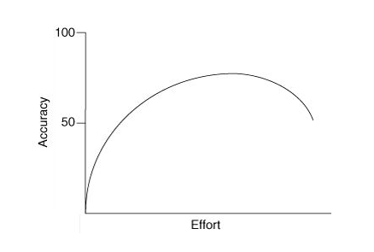
PBI Refinement:
Progression from vague idea to specific tasks
Refining means
  Planning the PBI to an actionable level of detail
  Maintaining a Rolling Backlog Projection
Plan 10% of the Sprint capacity of the Development Team to be spent on refining the Product Backlog
Top ordered Product Backlog items
are well understood and easily
selected in Sprint Planning. These
are READY.
Estimate in groups. Group derived
estimates are demonstrably more
accurate than estimates by
individuals.
Estimate well, but know when to call it quits.
Source: Mike Cohn ("Agile Estimating and Planning")

Slide 53
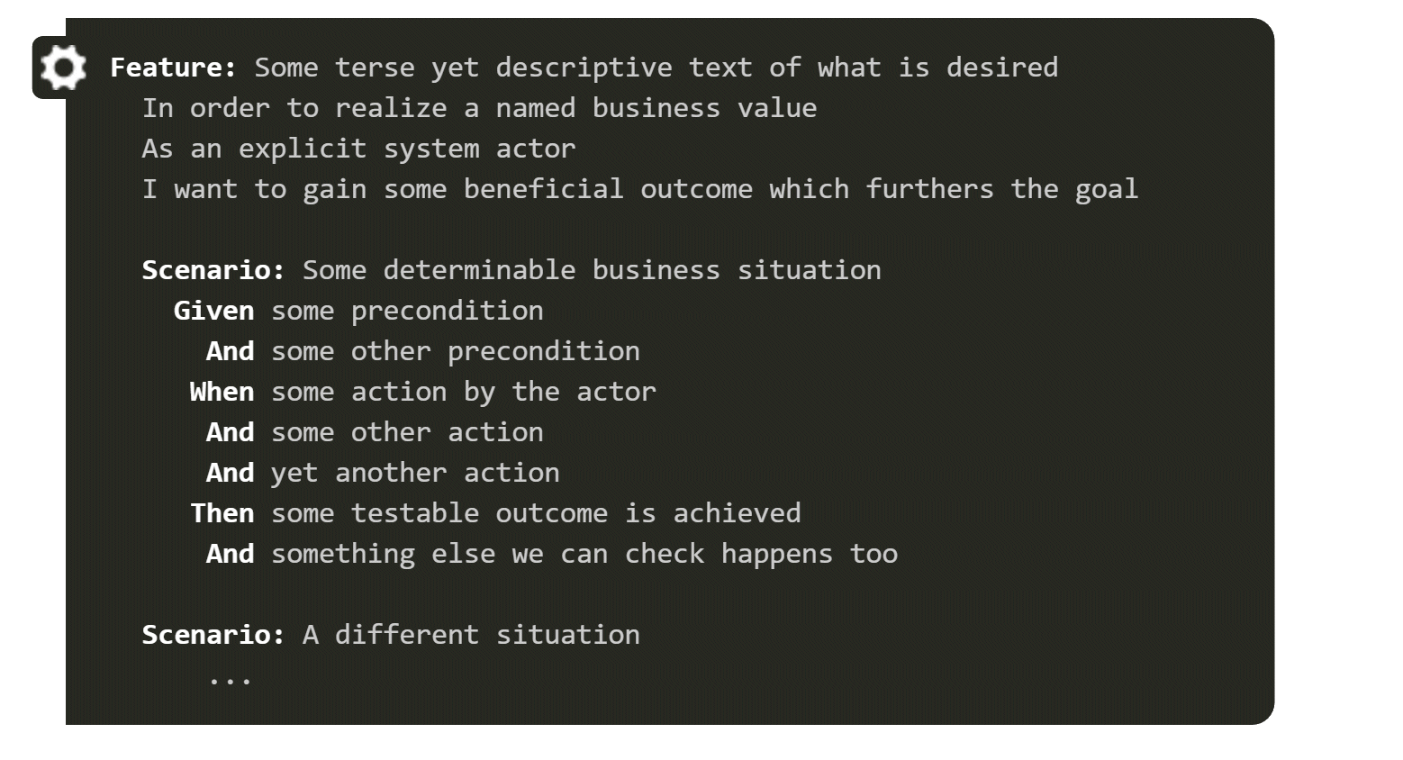
Gherkin Syntax
Gherkin is a line-oriented
language that uses indentation
to define structure.
Line endings terminate
statements (called steps)
and either spaces or tabs
may be used for indentation.
Every scenario consists of a
list of steps, which must
start with one of the keywords
Given, When, Then, But or And
Serves two purposes
  Acts as project documentation
  Useful in automating feature testing
Feature: LogIn Action Test
Description: This feature will test a LogIn and
LogOut functionality
Scenario: Unsuccessful Login with Invalid Credentials
Given user is on Home Page
When user navigates to the LogIn Page
And user enters UserName and Password
But the user credentials are wrong
Then wrong UserName & Password message displayed

Slide 54
Early PBI
Priority or Business Value
User Story
A Refined PBI
Name: clear, short, atomic (single entity)
Value: business value, acts as priority
Description: the user story
"As a ___, I want a ___ that ____"
Acceptance
Criteria: "Given ___ when ___ then ___"
Sizing: how difficult is the development
This PBI is only vaguely understood
A user story is developed and the PBI may or may not be prioritized.
A full refined PBI
READY

Slide 55
Refined PBI
Name
Priority or Business Value
Sizing
Because requirements in Scrum are only loosely defined, they need to revisited and clearly defined before they come into the Sprint.
This is done in during the current Sprint in a ceremony called Product Backlog Refinement.
User Story
Acceptance
Criteria
Acceptance Criteria that follows Gherkin syntax are often more specific and clear because they set up
pre-conditions and post-conditions.
This PBI is Refined and Ready to be moved from the Product Backlog to the Sprint Backlog

Slide 56
Decomposed PBI
  A Refined and Ready PBI may be:
  placed into the Sprint Backlog
  chosen by a member of the Development Team
A Refined and Ready PBI may be pulled into the Sprint backlog.
However, the PBI must be Decomposed into Tasks before it can be worked on.
Caution:
Don't over focus on defining tasks
PBI is decomposed into Tasks

Slide 57
Proper Use of Scrum Boards
(and Trello)
When to move a PBI in a Scrum Board
Product Backlog
Sprint Backlog
Sprint To Do
Sprint In Progress
Sprint
Done
Refined and Ready
Decom-posed*
Claimed
by Dev
Team member
Complete
per
Acceptance
Criteria
* In fully functional scrum boards, the decomposed tasks more to "To Do" but the tasks retain their association with the PBI. In Trello, PBIs move as a whole.

Slide 58
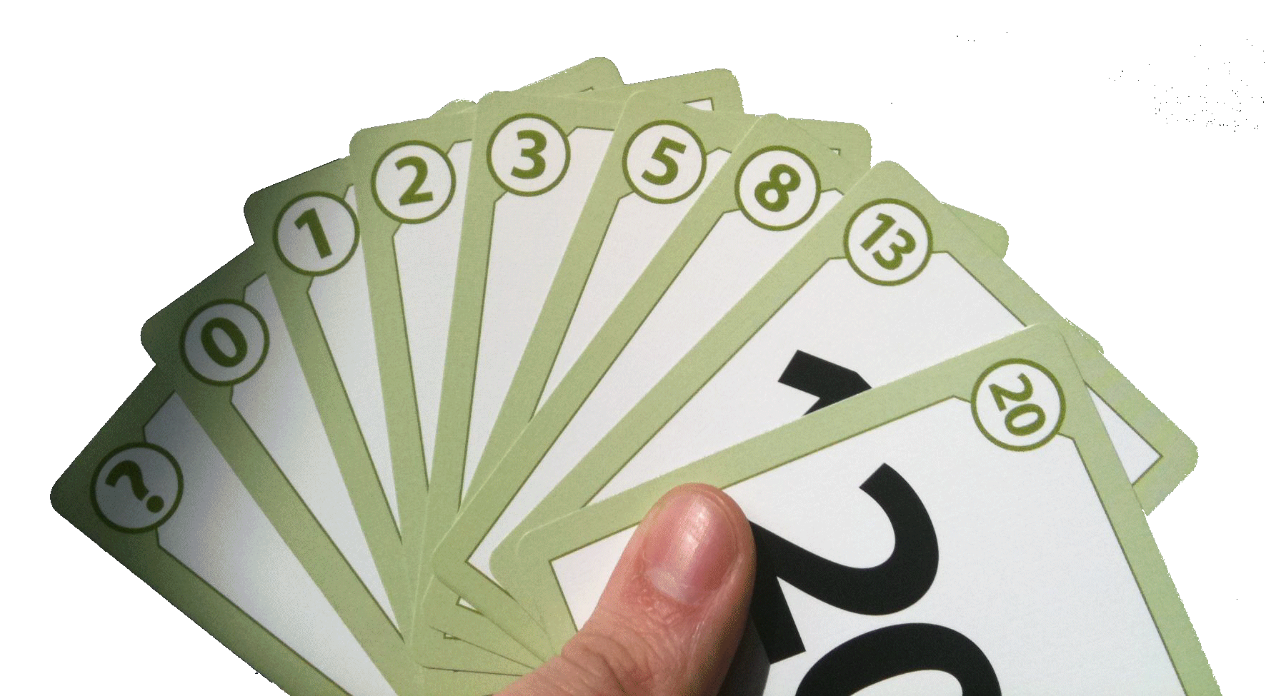
Assigning Points for PBI Sizing
Story points
  A very common way to estimate work based on size, effort and complexity, not duration
  Unit less and numerically relative
  Points are additive, based on historical reality and easy to use and understand
  Common practices: Fibonacci sequence [1, 2, 3, 5, 8, 13, 21, 34 ]
  Sometimes other cards are added: ? (I stil have questions) and ∞ (too big to estimate)
Planning Poker
  Each PBI has a size.
  Each developer has a deck of estimation cards.
  Product Owner reads a user story and it's discussed briefly
  Each developer selects a card that's his or her estimate
  Cards are turned over at the same time so all can see them
  Differences are discussed (especially outliers)
  Re-estimate until estimates converge
  Eventually, as the team gets better at estimating, use older PBIs as a relative measure of new work. "Remember that previous bit of work? This one is like it. And the previous one was a 13."

Slide 59
Business Value
The Product Owner is responsible for this
It isn't always just revenue
It can be estimated or calculated
  Can be High / Medium / Low
  Can use MoSCoW
  Can be numeric value
M ust have
  Critical to the current delivery timebox in order for it to be a success. If even one MUST requirement is not included, the project delivery should be considered a failure
  MUST can be considered an acronym for the Minimum Usable SubseT.
S hould have
  Important but not necessary for delivery in the current delivery timebox.
  While SHOULD requirements can be as important as MUST, they are often not as time-critical or there may be another way to satisfy the requirement, so that it can be held back until a future delivery timebox.
C ould have
  Desirable but not necessary, and could improve user experience or customer satisfaction for little development cost. These will typically be included if time and resources permit.
W on't have
  the least-critical, lowest-payback items, or not appropriate at that time. As a result, WON'T requirements are not planned into the schedule for the delivery timebox. WON'T requirements are either dropped or reconsidered for inclusion in later timeboxes.

Slide 60
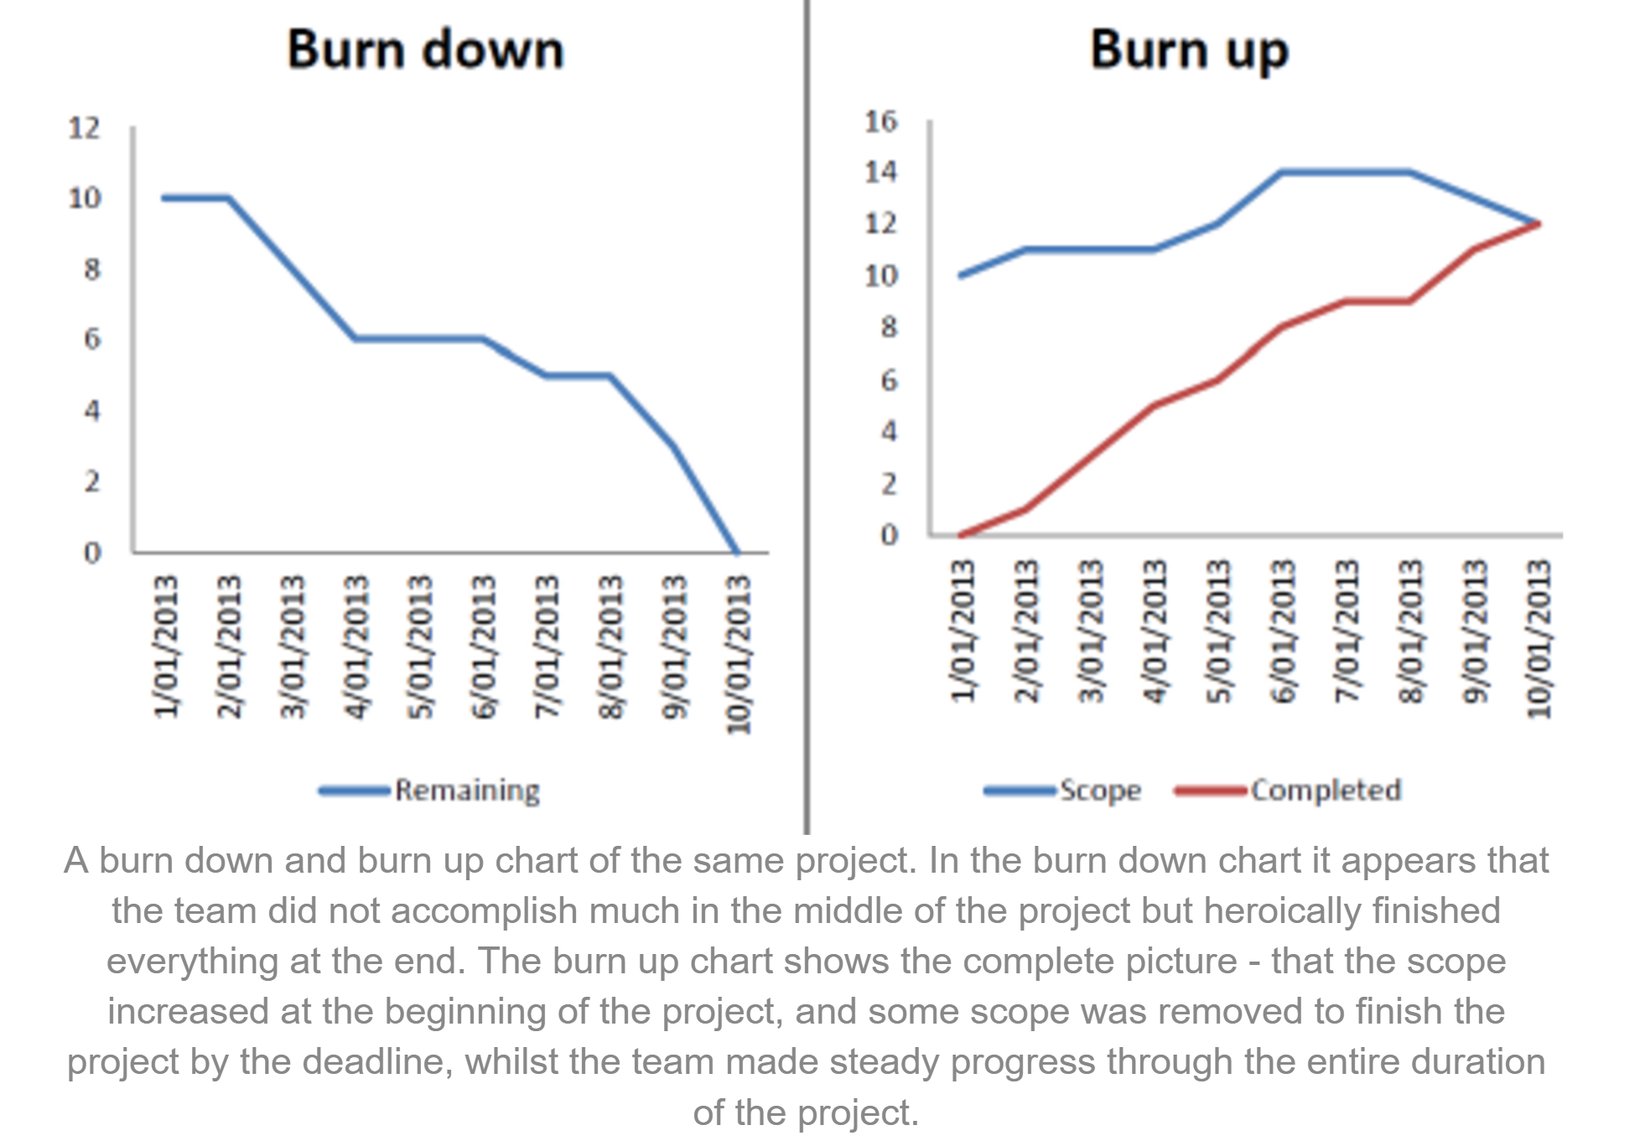
Assigning Points for PBI Value
Business Value can also be assigned points as well
Y axis of burn down and burn up charts can be Sizing or Business Value
Burn up charts may be more accurate – they show scope change
http://www.clariostechnology.com/productivity/blog/burnupvsburndownchart

Slide 61
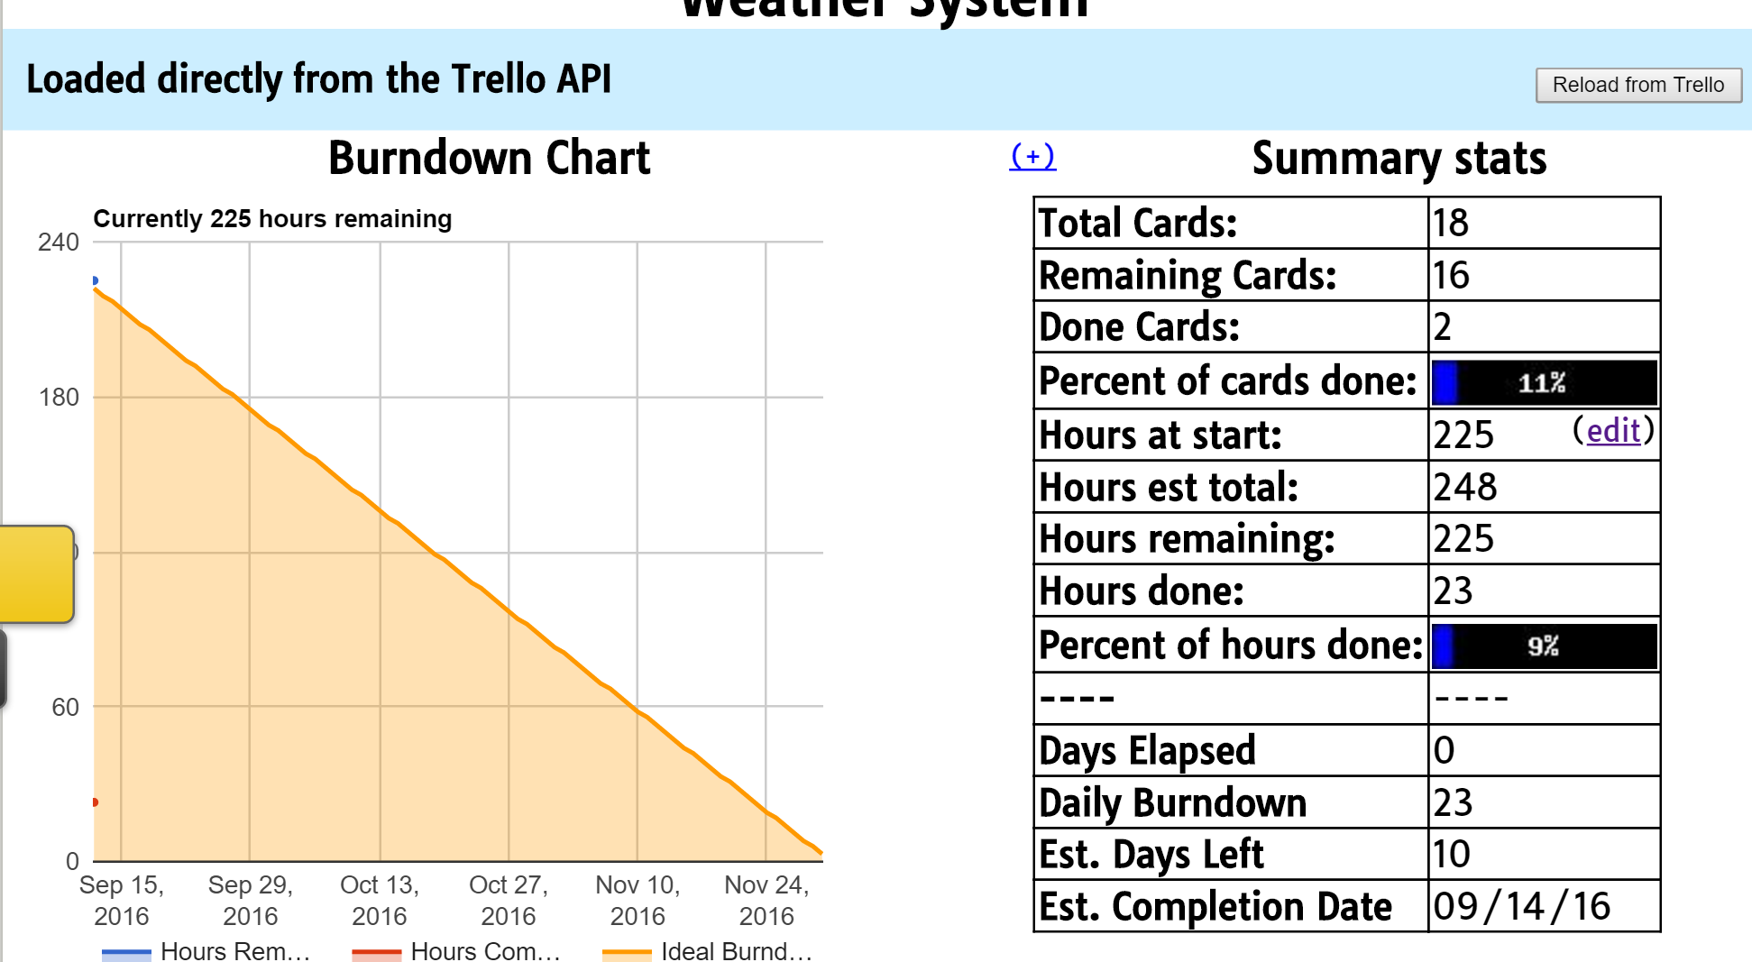
Burndown for Trello
Burndown for Trello bases burndown on number of hours (Y axis)

Slide 62
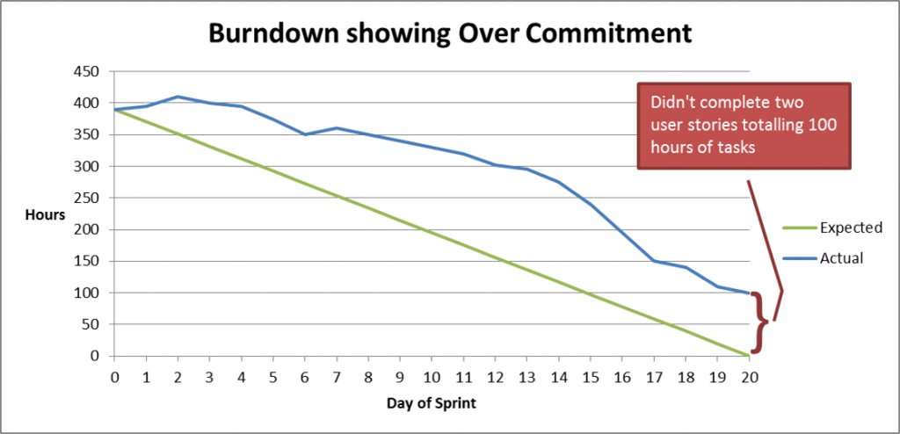
Burndown can show over-commitment problems

Slide 63
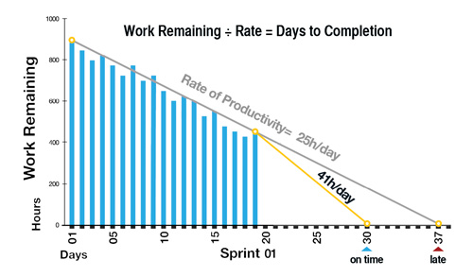
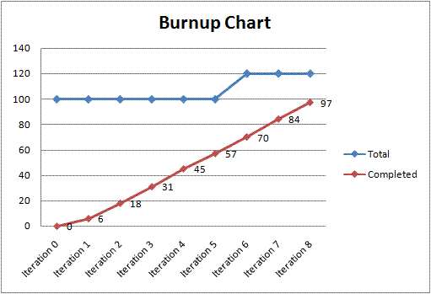
Visualization Suggestions for Project
Sprint Visualization
  Use Trello's Burn Down capability
  (Or Excel with difficulty on Y axis)
  Accept hours as unit for Y axis
  Update at Daily Scrum
Release Visualization (Sprints 1 to 5)
  Use Burn Up charts
  Create two charts
    1 with Business Value on the Y axis
    1 with Effort (PBI Sizing) on the Y axis
  Update prior to each Spring Review

Slide 64
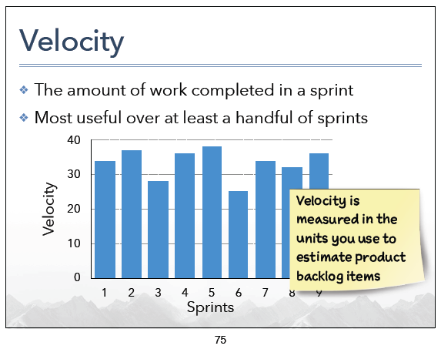
Velocity
A measure of Product Backlog Items delivered per Sprint
Used by the Development Team to gauge how much work to pull in a Sprint Planning meeting
Used by Product Owner to provide forecasts on the Product Backlog completion

Slide 65
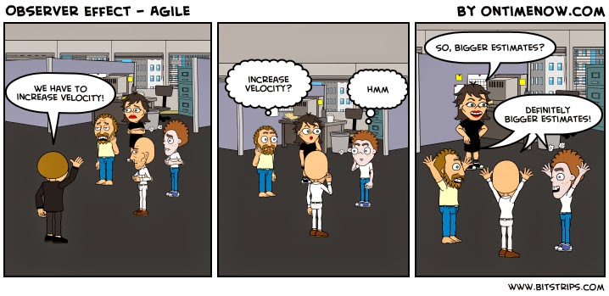
Velocity
Don't Do This
Velocity is supposed to help Development Teams plan better Sprints
It is NOT supposed to be a tool for managers to assess teams!

Slide 66
Ordering the Product Backlog
Risk
  Identify risk for items in the Backlog
  Do the highest risk items first
Return on Investment (ROI)
  Simple business ranking system
  Gives a single number by which to rank work
  You can see value at a glance and this is less subjective
Because the Product Owner says so
Rule #1
An accurate release plan requires an ordered and estimated backlog
Rule #2
An accurate release plan requires known Velocity

Slide 67
Two Basic Types of Release Planning
Date Target Planning
Feature Target Planning
The product will release on a specific date
We Must Answer
How much of the backlog will be complete by a given date?
The product will release when specific features are ready
We Must Answer
When will features A, B, and C be ready?

Slide 68
Cone of Uncertainty
Prioritized Product Backlog
Feature A
Feature B
The red line is the projected progress based on the regression line of Measured Progress observations
Feature C
At Sprint 6, features J through L are in the cone of uncertainty.
Feature J: won't be delivered if progress slows
Feature K: should be delivered given current progress
Feature L: won't be delivered unless progress quickens
Feature D
Feature E
The cone is created by adjusting the slope of projected progress by value +/- y
Feature F
Feature G
Feature H
Feature I
Feature J
Feature K
Feature L

Slide 69
Sprint 0
Per Scrum, there is no Sprint 0
However, many organizations create a Sprint 0, for example:
  The planning team is responsible for producing 3 deliverables by the end of the planning iteration:
    A list of all prioritized features/stories with estimates
    A release plan that assigns each feature/story to an iteration/sprint
    A high-level application architecture, i.e. how the features will likely be implemented
Ken Schawber, co-creator of Scrum agrees: "Sprint 0 has become a phrase misused to describe the planning that occurs prior to the first sprint".

Slide 70
Hybrid models

Slide 71
Agile and plan-driven methods
Most projects include elements of plan-driven and agile processes. Deciding on the balance depends on:
  Is it important to have a very detailed specification and design before moving to implementation? If so, you probably need to use a plan-driven approach.
  Is an incremental delivery strategy, where you deliver the software to customers and get rapid feedback from them, realistic? If so, consider using agile methods.
  How large is the system that is being developed? Agile methods are most effective when the system can be developed with a small co-located team who can communicate informally. This may not be possible for large systems that require larger development teams so a plan-driven approach may have to be used.

Slide 72
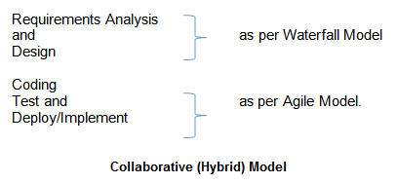
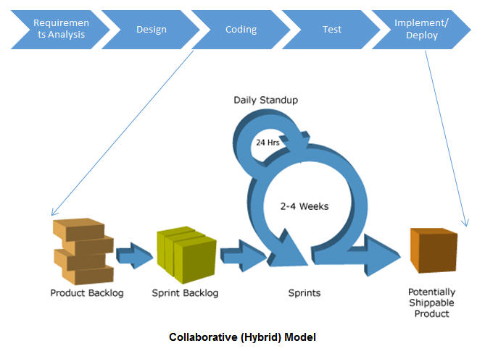
Collaborative Model
Collaborative Model
  See http://jackmyers.info/sweng/hybridCollaborative.html
  " The Collaborative Model aims to combine both the models -- Waterfall and Agile. Leveraging both the Waterfall and Agile approach ensures the success of the project. It removes the disadvantages of both the models; while bringing together the advantages of both."

Slide 73
Variations
The collaborative model divided the phases of the SDLC into
  Waterfall phases
  Agile phases
Other hybrid models blend the approaches
  See http://jackmyers.info/sweng/Agile-Waterfall-Hybrid-Template.pdf
Neither scrun.or nor ScrumAlliance believe in or support hybrid methodologies.
For an interesting take on hybridization, see https://www.scrumalliance.org/community/articles/2015/may/hybrid-agile-versus-agile

Slide 74
Larger Project can use
Multi-team Scrum
Role replication
  Each team has a Product Owner for their work component and ScrumMaster.
Product architects
  Each team chooses a product architect and these architects collaborate to design and evolve the overall system architecture.
Release alignment
  The dates of product releases from each team are aligned so that a demonstrable and complete system is produced.
Scrum of Scrums
  There is a daily Scrum of Scrums where representatives from each team meet to discuss progressand plan work to be done.

Slide 75
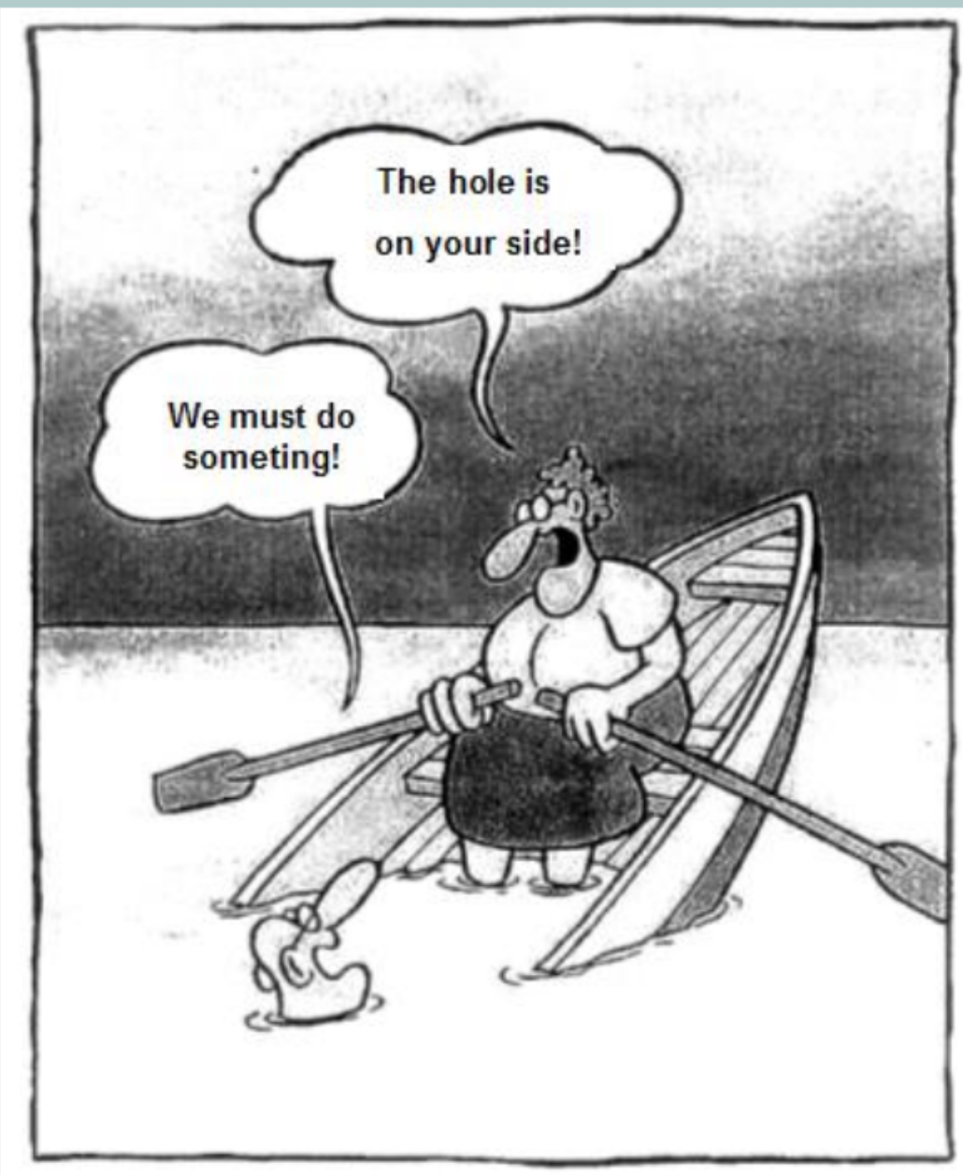
It's all about the team

Slide 76
Teamwork in Scrum
The ‘Scrum master’ is a facilitator who arranges daily meetings, tracks the backlog of work to be done, records decisions, measures progress against the backlog and communicates with customers and management outside of the team.
The whole team attends short daily meetings (Scrums) where all team members share information, describe their progress since the last meeting, problems that have arisen and what is planned for the following day.
  This means that everyone on the team knows what is going on and, if problems arise, can re-plan short-term work to cope with them.

Slide 77
Scrum Values
Commitment
Courage
Focus
Respect
Open-ness

Slide 78
Scrum Values
Value | Misunderstanding | Getting the value right
Commitment | Committing to something that you don’t understand because you are told to by your boss. | Committing yourself to the team and Sprint Goal.
Focus | Focusing on keeping the customer happy | Being focused on the sprint and its goal.
Openness | Telling everyone everything about all your work | Highlighting when you have challenges and problems that are stopping you from success
Respect | Thinking you are helping the team by being a hero | Helping people to learn the things that you are good at and not judging the things that others aren’t good at.
Courage | Even after the decision has been made continuing to push back | Being transparent, but willing to change even if that means accepting that you are wrong, or that your opinion is not the direction that the team is going.

