Slide 1

StarUML Tips

Slide 2
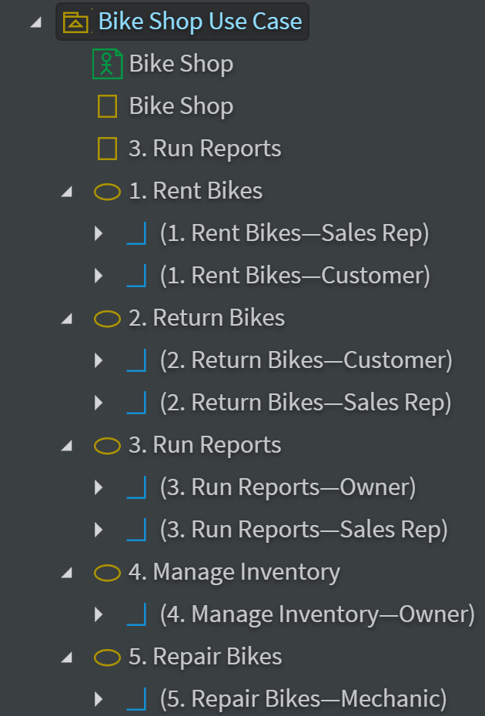
StarUML tips
To move a selected object use Ctrl-<arrow key>
For Use Case Diagrams drag Association from Use Case to Actor
For Analysis Class Diagrams create a Use Case Diagram if you want Actors. Copy Actors to a Class Diagram. Utilize the "Classes (Basic)" and the "Robustness" icon libraries
Activity Diagram Forks and Joins will be vertical or horizontal depending on how you draw them
StarUML model explorer

Slide 3
Use Case Diagrams

Slide 4
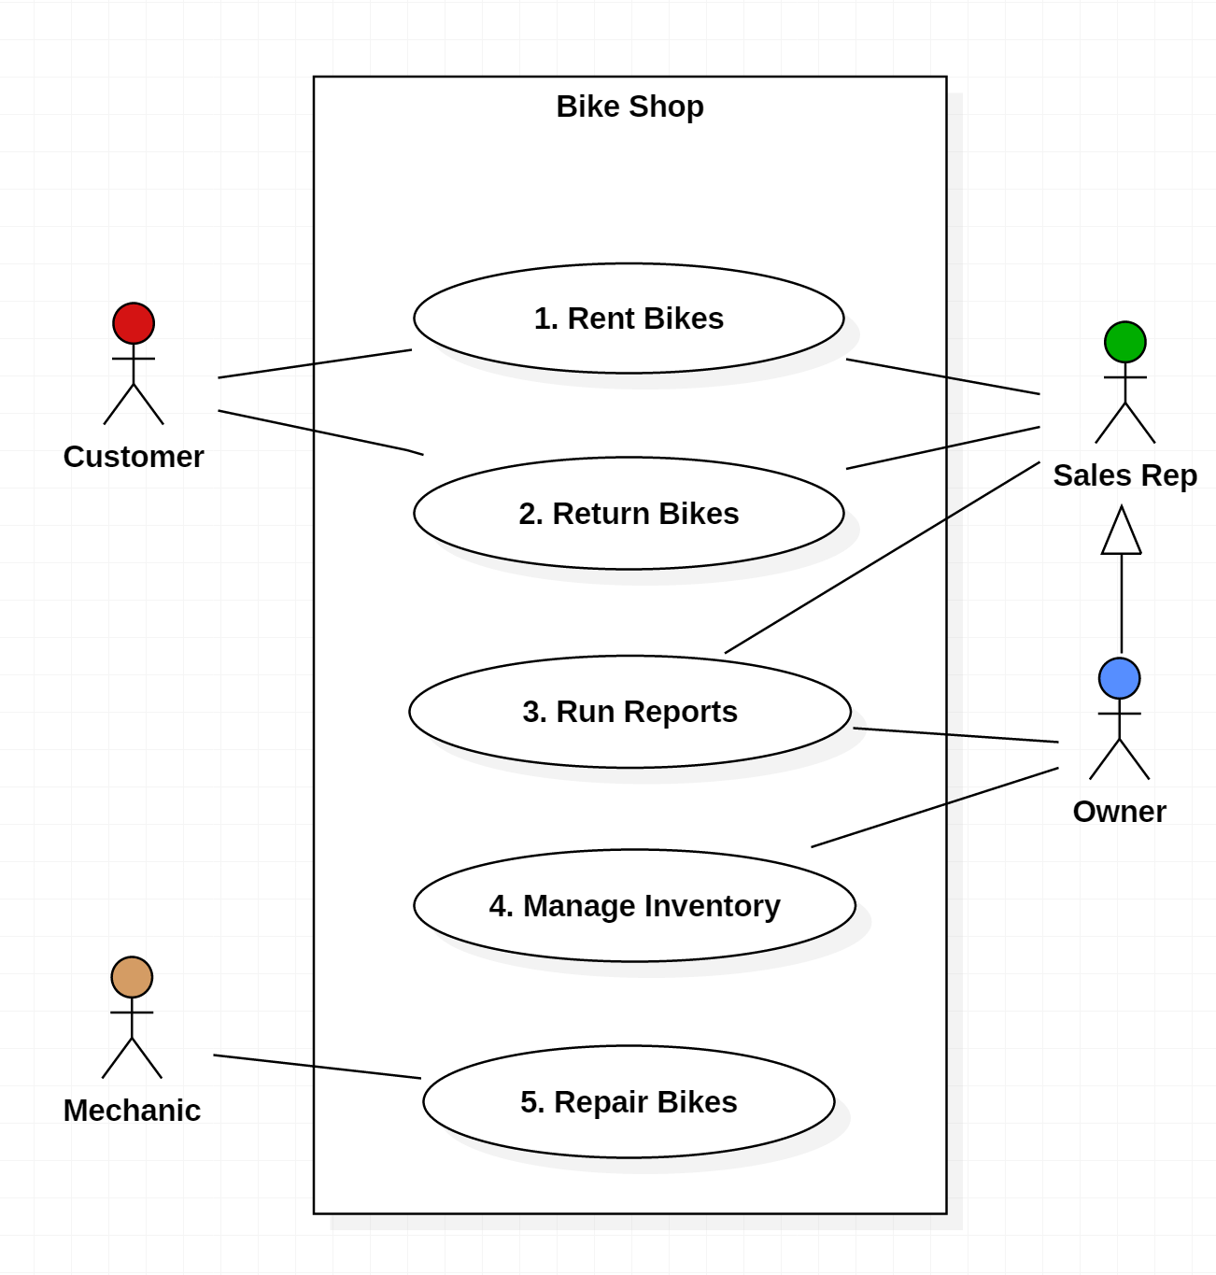
Use Case Diagrams (1)
Purpose
  Visualize the different types of roles in a system
  Show how those roles interact with the system
Usage
  Requirements Document
  (simple Use Case Diagrams)
  Design Document
  (advanced Use Case Diagrams

Slide 5
Use Case Diagrams (2)
  Boundary (aka "Use Case Subject" or "Scope"): defines the considered scope of the diagram.
  Actor: any entity that performs a role in a system. Could be a person, organization or an external system.
  Use Case: a function or an action within the system.
  Association: links an Actor to a Use Case
  Generalization: one Actor can inherit ( or "act as" the role of another Actor

Slide 6
Use Case Diagrams (3)
  Note that the Owner of the Bike Shop can act as a Sales Rep if needed through Generalization
  Both the Sales Rep and the Owner are associated with "Run Reports." Is this redundant?
    No, there are certain reports a Sales Rep runs that an Owner could also run when he is assuming that role.
    But the separate Association between the Owner and Run Reports implies that there are some reports only the Owner can run.

Slide 7
Use Case Diagrams
Use Case diagrams consist of
Actors
  External entities that interact with the system.
  Examples of actors include a user role (e.g., a system administrator, a bank customer, a bank teller) or another system (e.g., a central database, a fabrication line).
  Actors have unique names and descriptions.
Use cases
  Describe the behavior of the system as seen from an actor’s point of view.
  A use case describes a function provided by the system as a set of events that yields a visible result for the actors. Actors initiate a use case to access system functionality. The use case can then initiate other use cases and gather more information from the actors. When actors and use cases exchange information, they are said to communicate

Slide 8
Use Case Description (1)
The Overview
Rent Bike Use Case
Customers have the option to browse or search the database at a customer kiosk to select available bike(s) for rental and specify the rental period for each of the selected bikes. Alternatively, they can have an employee of the bike shop browse or search the database, make customer suggestions with which the customer can agree or disagree, and record the respective rental periods. The selected bikes are then physically examined by an employee to ensure their suitability for rental. If any bikes are unsuitable, they are marked for repair (see Update Bike use case) and alternative bike selections are made by either the customer or employee. Then the system will display to the employee any special discounts that might apply to frequent customers. The employee informs the customer of the final price (including all bike rates, rental durations, rental deposits and discounts) for all bikes rented, accepts the payment for the rental and authorizes the rental. The employee will check out the bikes by either associating the bike(s) with the pre-existing customer record, or by creating a new customer record and then associating that record with the bike(s). A receipt will be printed for the customer which lists the details and cost of each bike rental. A rental request may be cancelled at any time during this process, up until the bikes are associated with the customer. After that, the Return Bike use case will apply.

Slide 9
Use Case Description (2)
The Scenarios
Rent Bike Use Case
Primary Flow “Typical rental”
(consists of subordinate use cases)
Employee Selects Bikes
Employee Selects Customer
Employee Confirms Reservation
Alternate Flow “Customer selects bikes rental”
(consists of subordinate use cases)
Customer Selects Bikes
Employee Selects Rental Log
Employee Selects Customer
Employee Confirms Reservation
Alternate Flow “Cancellation after bike selection” (consists of subordinate use cases)
Employee Selects Bikes
Cancel Reservation
Alternate Flow “Cancellation after bike selection” (consists of subordinate use cases)
Customer Selects Bikes
Cancel Reservation
Alternate Flow “Cancellation after rental log selection” (consists of subordinate use cases)
Customer Selects Bikes
Employee Selects Rental Log
Cancel Reservation
Alternate Flow “Cancellation after customer selection” (consists of subordinate use cases)
Employee Select Bikes
Employee Selects Customer
Cancel Reservation

Slide 10
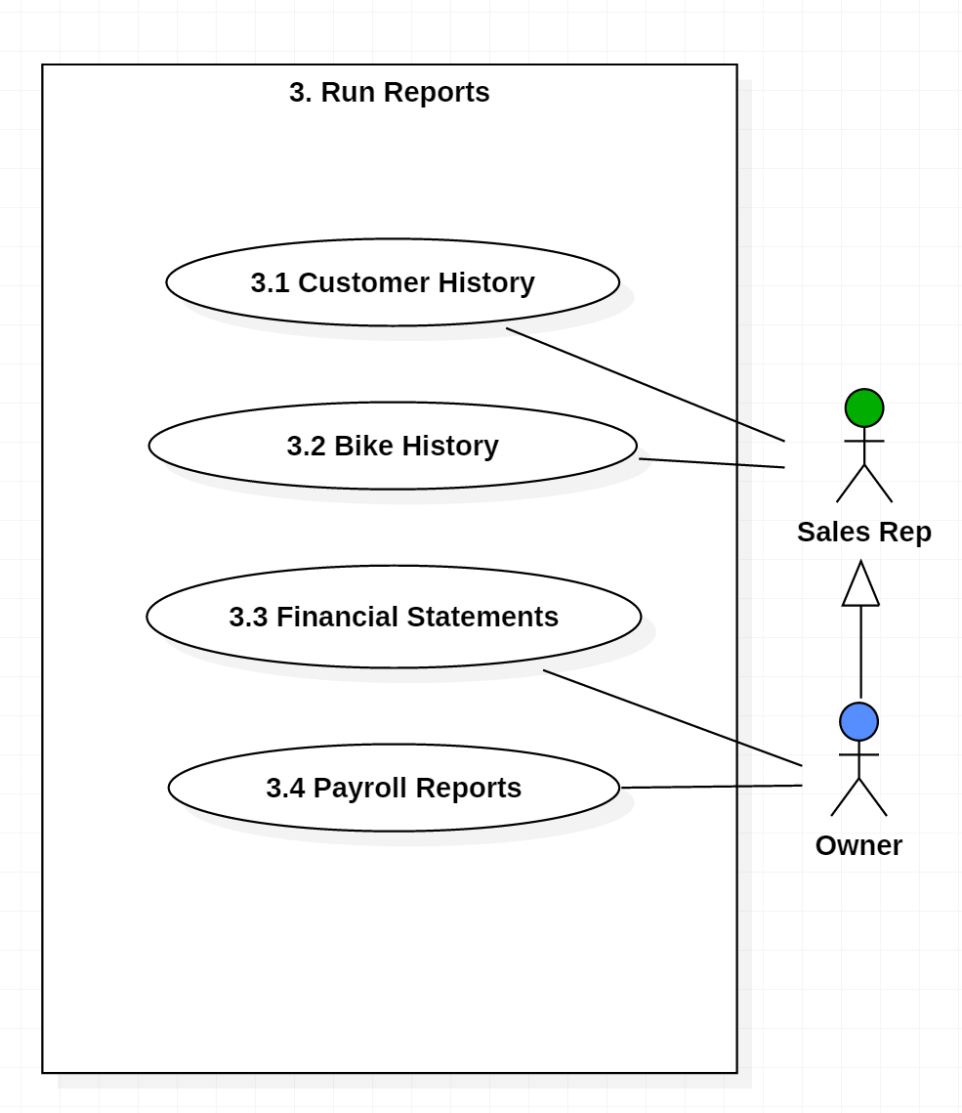
Decomposed Use Case Diagrams
Use case diagrams can be decomposed to lower levels
This is why it is a good idea to number your Use Cases

Slide 11
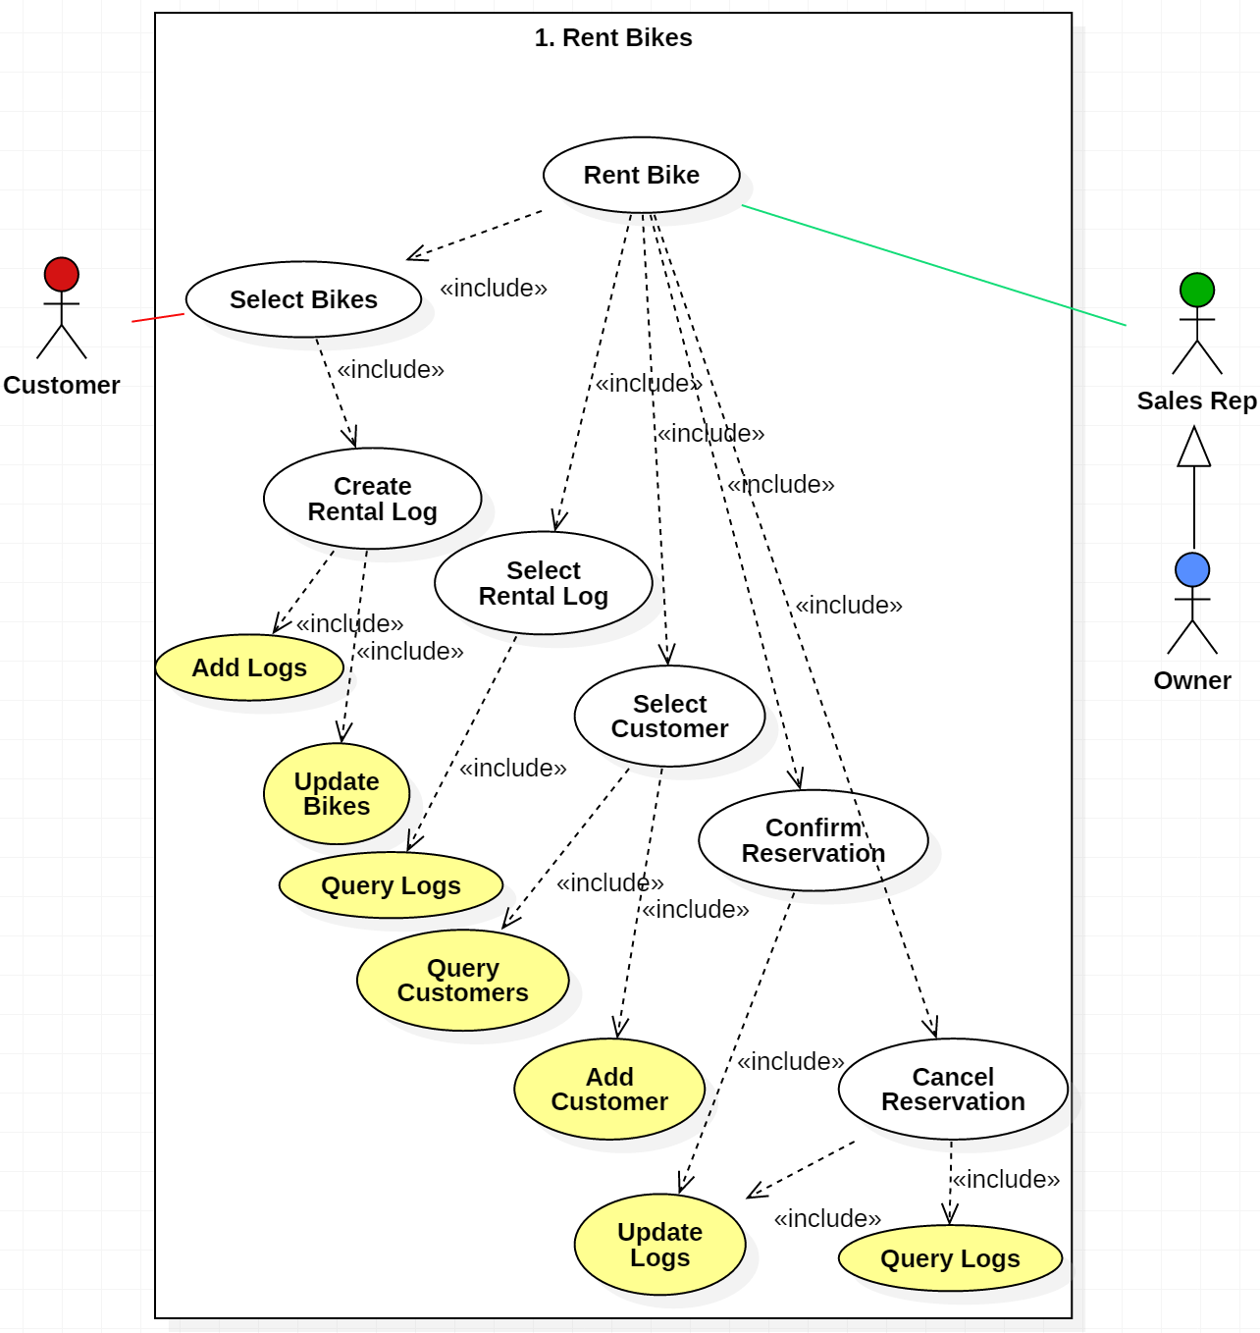
More Advanced Use Case Diagrams
This Use Case
Diagram belongs in
a Design Document
The Use Cases are still functions, but only two are exposed to the Actors
The «^{include}» relationship indicates which functions are included in other functions, i.e., the behavior of the included use case is inserted into the behavior of the including use case
Represents
database functions

Slide 12
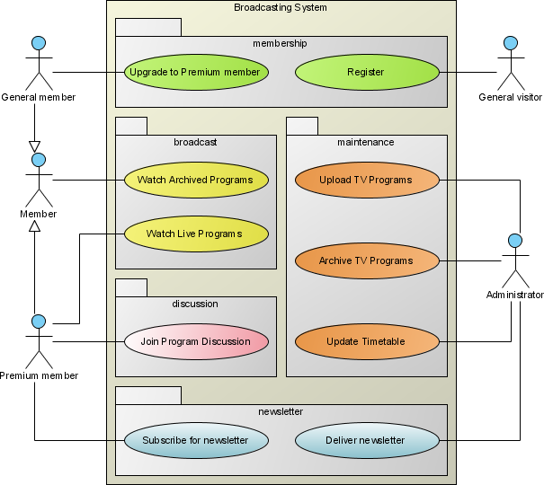
More Use Case Symbols (1)
Package is an optional element that is extremely useful in complex diagrams. Packages are used to group together use cases.

Slide 13
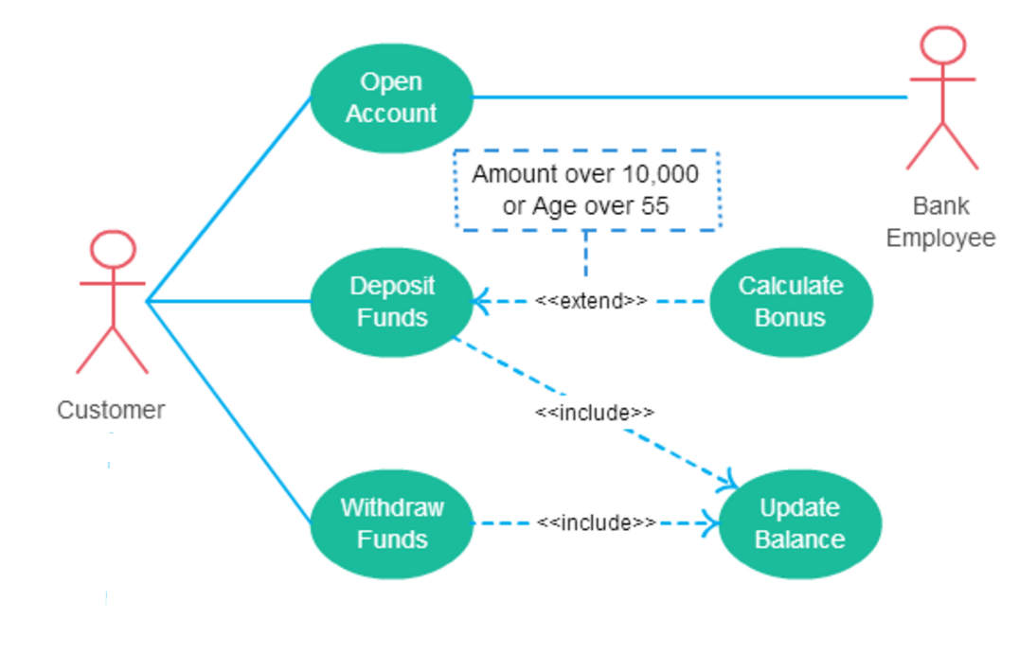
More Use Case Symbols (2)
Extend is used
instead of includes
when one use case
invokes another
use case
conditionally.
(see diagram)

Slide 14
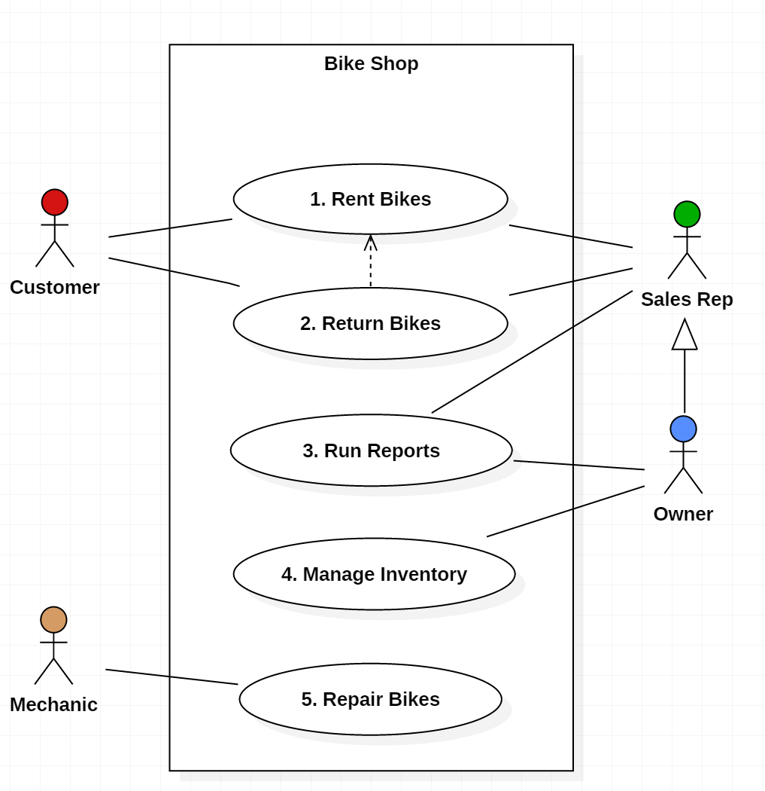
More Use Case Symbols (3)
Dependency:
the extending use case is dependent on the base use case as a one way dependency, i.e. the base use case doesn’t need any reference to the extending use case in the sequence.
You cannot return bikes that have not been first rented, but you can rent bikes without returning them

Slide 15
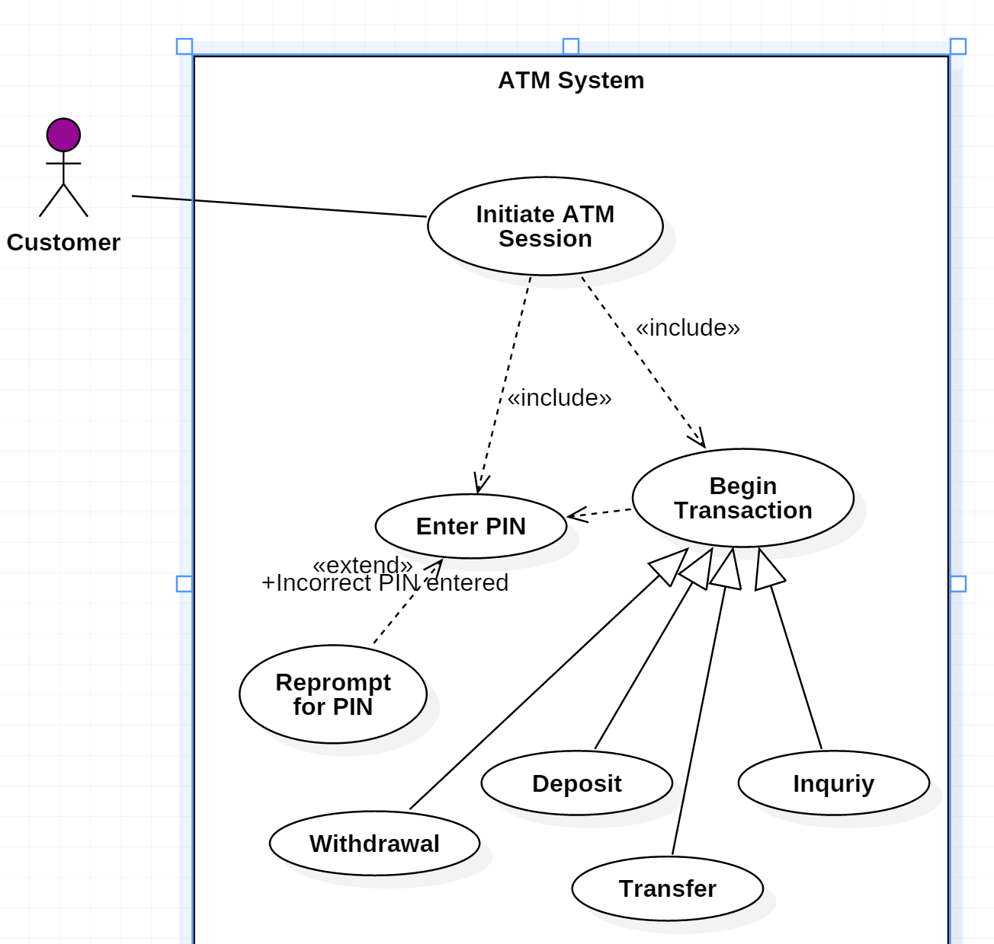
One More Example
A different example of
  Includes
  Extends
  Dependency
  Generalization

