Slide 1
4 + 1 view model of software architecture
A logical view, which shows the key abstractions in the system as objects or object classes.
A process view, which shows how, at run-time, the system is composed of interacting processes.
A development view, which shows how the software is decomposed for development.
A physical view, which shows the system hardware and how software components are distributed across the processors in the system.
Related using use cases or scenarios (+1)

Slide 2
UML Stereotypes
A stereotype is one of three types of extensibility mechanisms in the Unified Modeling Language (UML),
A Stereotype provides the capability to create new kind of modeling elements. Stereotypes must be based on elements that are part of the UML meta-model. Some common stereotypes for a class are entity, boundary, control, utility and exception.
Stereotypes are a way to group classes under a common purpose and are represented by a pair of guillemets (pronounced GEE-may)
« »

Slide 3
Activity Diagrams

Slide 4
Activity Diagrams
There are many kinds of diagrams that depct a process, such as "flow charts" or "workflow diagrams"
The Activity Diagram is one such diagram, except it has been formalized in UML

Slide 5
Activity Diagram
Activity diagrams are used to model system behaviors, and the way in which these behaviors are related in an overall flow
  of the system
  of the data
  of control for performing a task
Describe the step-by-step workflows of activities to be performed in a system for reaching a specific goal.
The logical paths a process follows, based on various conditions, concurrent processing, data access, interruptions and other logical path distinctions, are all used to construct a process, system or procedure.
Diagrams are an oriented graph where nodes represent the activities.

Slide 6
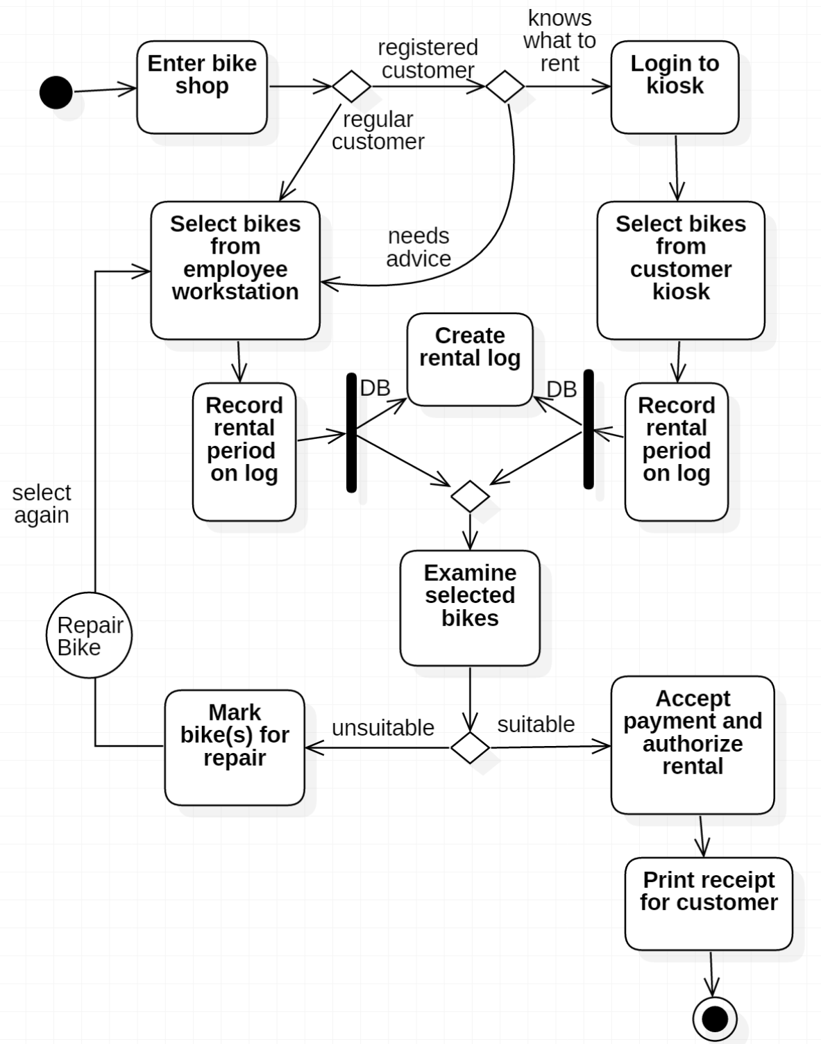
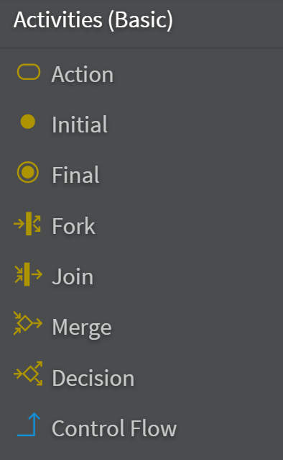
Bike Shop
Join vs Merge
  Merge automatically advances the flow
  Join requires that both Actions complete before flow is advanced,
  (example:
  document
  being
  approved
  by two
  dept heads)
Connector
  Circle
  designates
  another
  Activity
  Diagram
There can be multiple Final nodes.

Slide 7
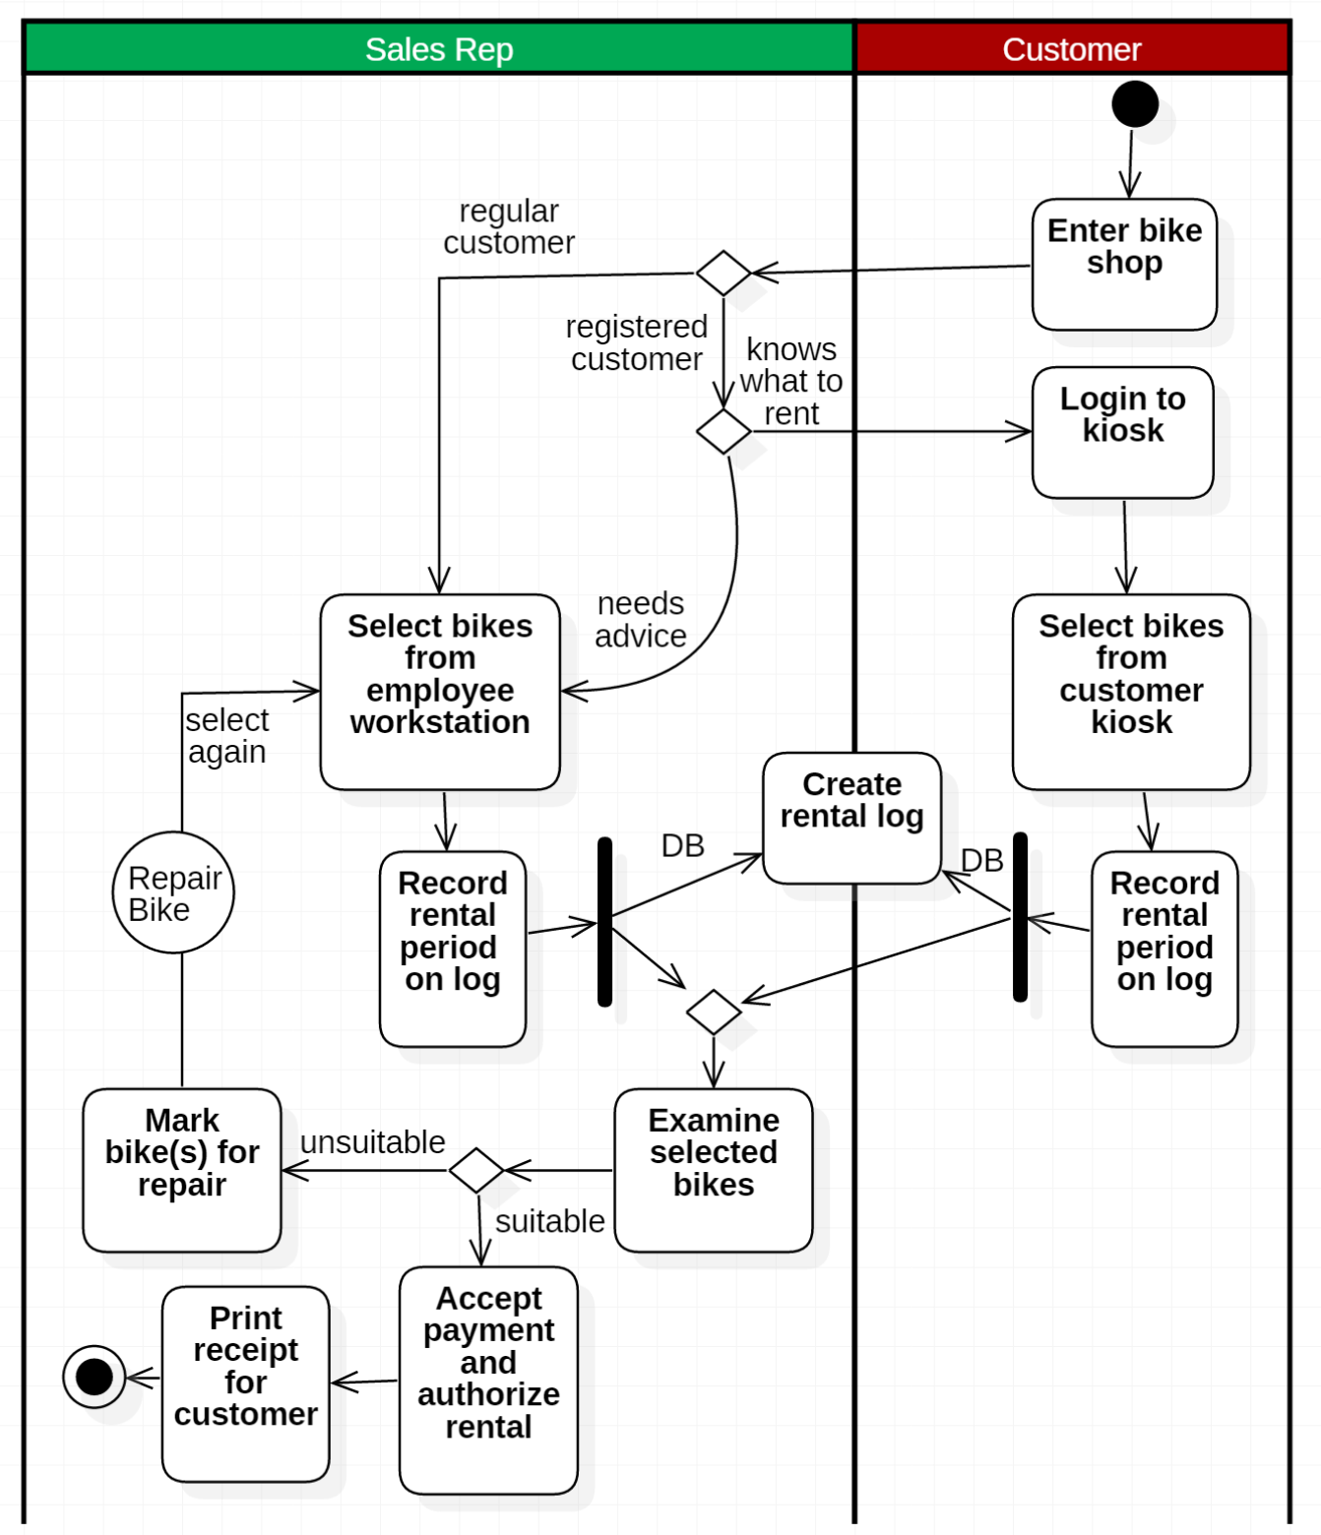
Swimlanes
Swimlanes (horizontal or vertical) can clearly differentiate which Actors are performing which function in an Activity Diagram

Slide 8
Activity Diagrams are essentially flow charts
Diagrams are an oriented graph where nodes represent the activities.
"Check shipping status of a purchased good" example

Slide 9
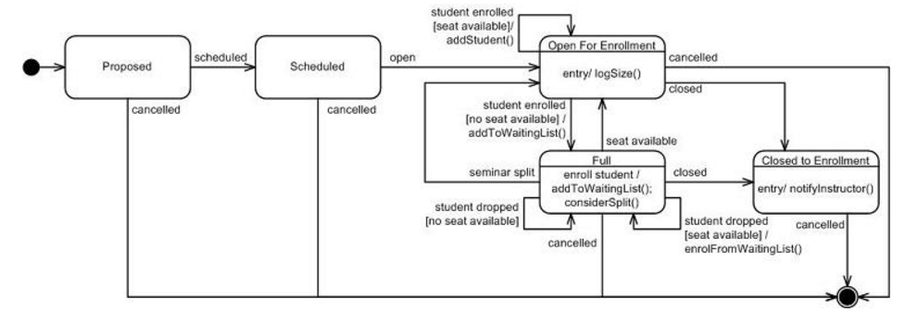
State Diagrams
Sufficiently complex objects warrant State Diagrams
Examples
  Purchased Good states
  Seminar states

Slide 10
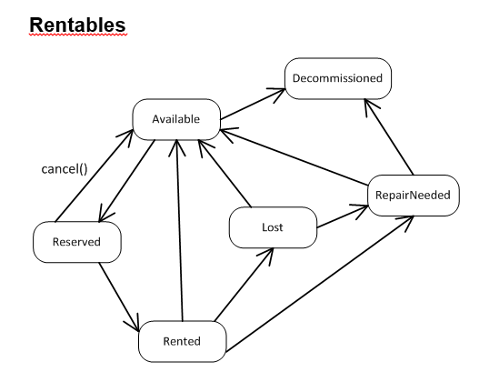
State Diagrams
Bike shop example

Slide 11
Component Diagrams
Shows how the design is organised into logically related groups of objects.
In the UML, these are shown using packages - an encapsulation construct. This is a logical model. The actual organisation of objects in the system may be different.

Slide 12
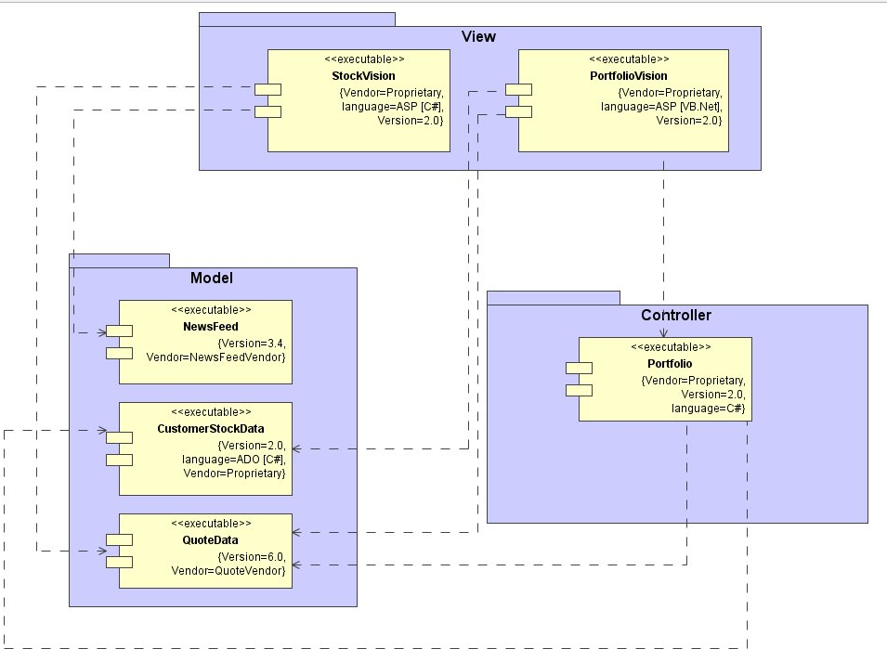
Subsystem Decomposition with Component Diagrams
A subsystem is a replaceable part of the system with well-defined interfaces that encapsulates the state and behavior of its contained classes.
UML component and package conventions

Slide 13
Deployment Diagrams
Deployment diagrams are used to visualize the topology of the physical components of a system where the software components are deployed.
Deployment diagrams are used by the system engineers and describe:
  The physical components (hardware),
  Their distribution
  Their association
The purpose of deployment diagrams:
  Visualize hardware topology of a system.
  Describe the hardware components used to deploy software components.
  Describe runtime processing nodes.

Slide 14
Elements of a Deployment Diagram
UML deployment diagrams are used to depict the relationship among run-time components and nodes
Components
  Components are self-contained entities that provide services to other components or actors.
    A Web server, for example, is a component that provides services to Web browsers.
    A Web browser such as Safari is a component that provides services to a user.
Nodes
  A node is a physical device or an execution environment in which components are executed.
  A system is composed of interacting run-time components that can be distributed among several nodes.
  A node can contain another node, for example, a device can contain an execution environment.
  Represented by boxes containing component icons.

Slide 15
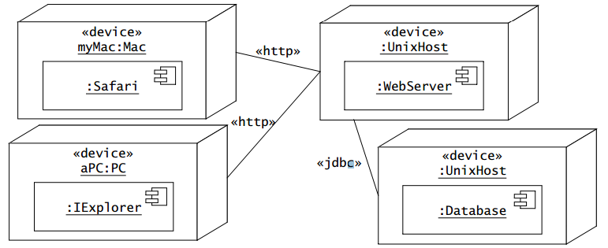
An example
Nodes are represented by boxes containing component icons.
Nodes can be stereotyped to denote physical devices or execution environments.
Communication paths between nodes are represented by solid lines. The protocol used by two nodes to communicate can be indicated with a stereotype on the communication path.

