Slide 1
Getting Started with VS Code

Slide 2
Make an Empty Folder for your Workspace

Slide 3
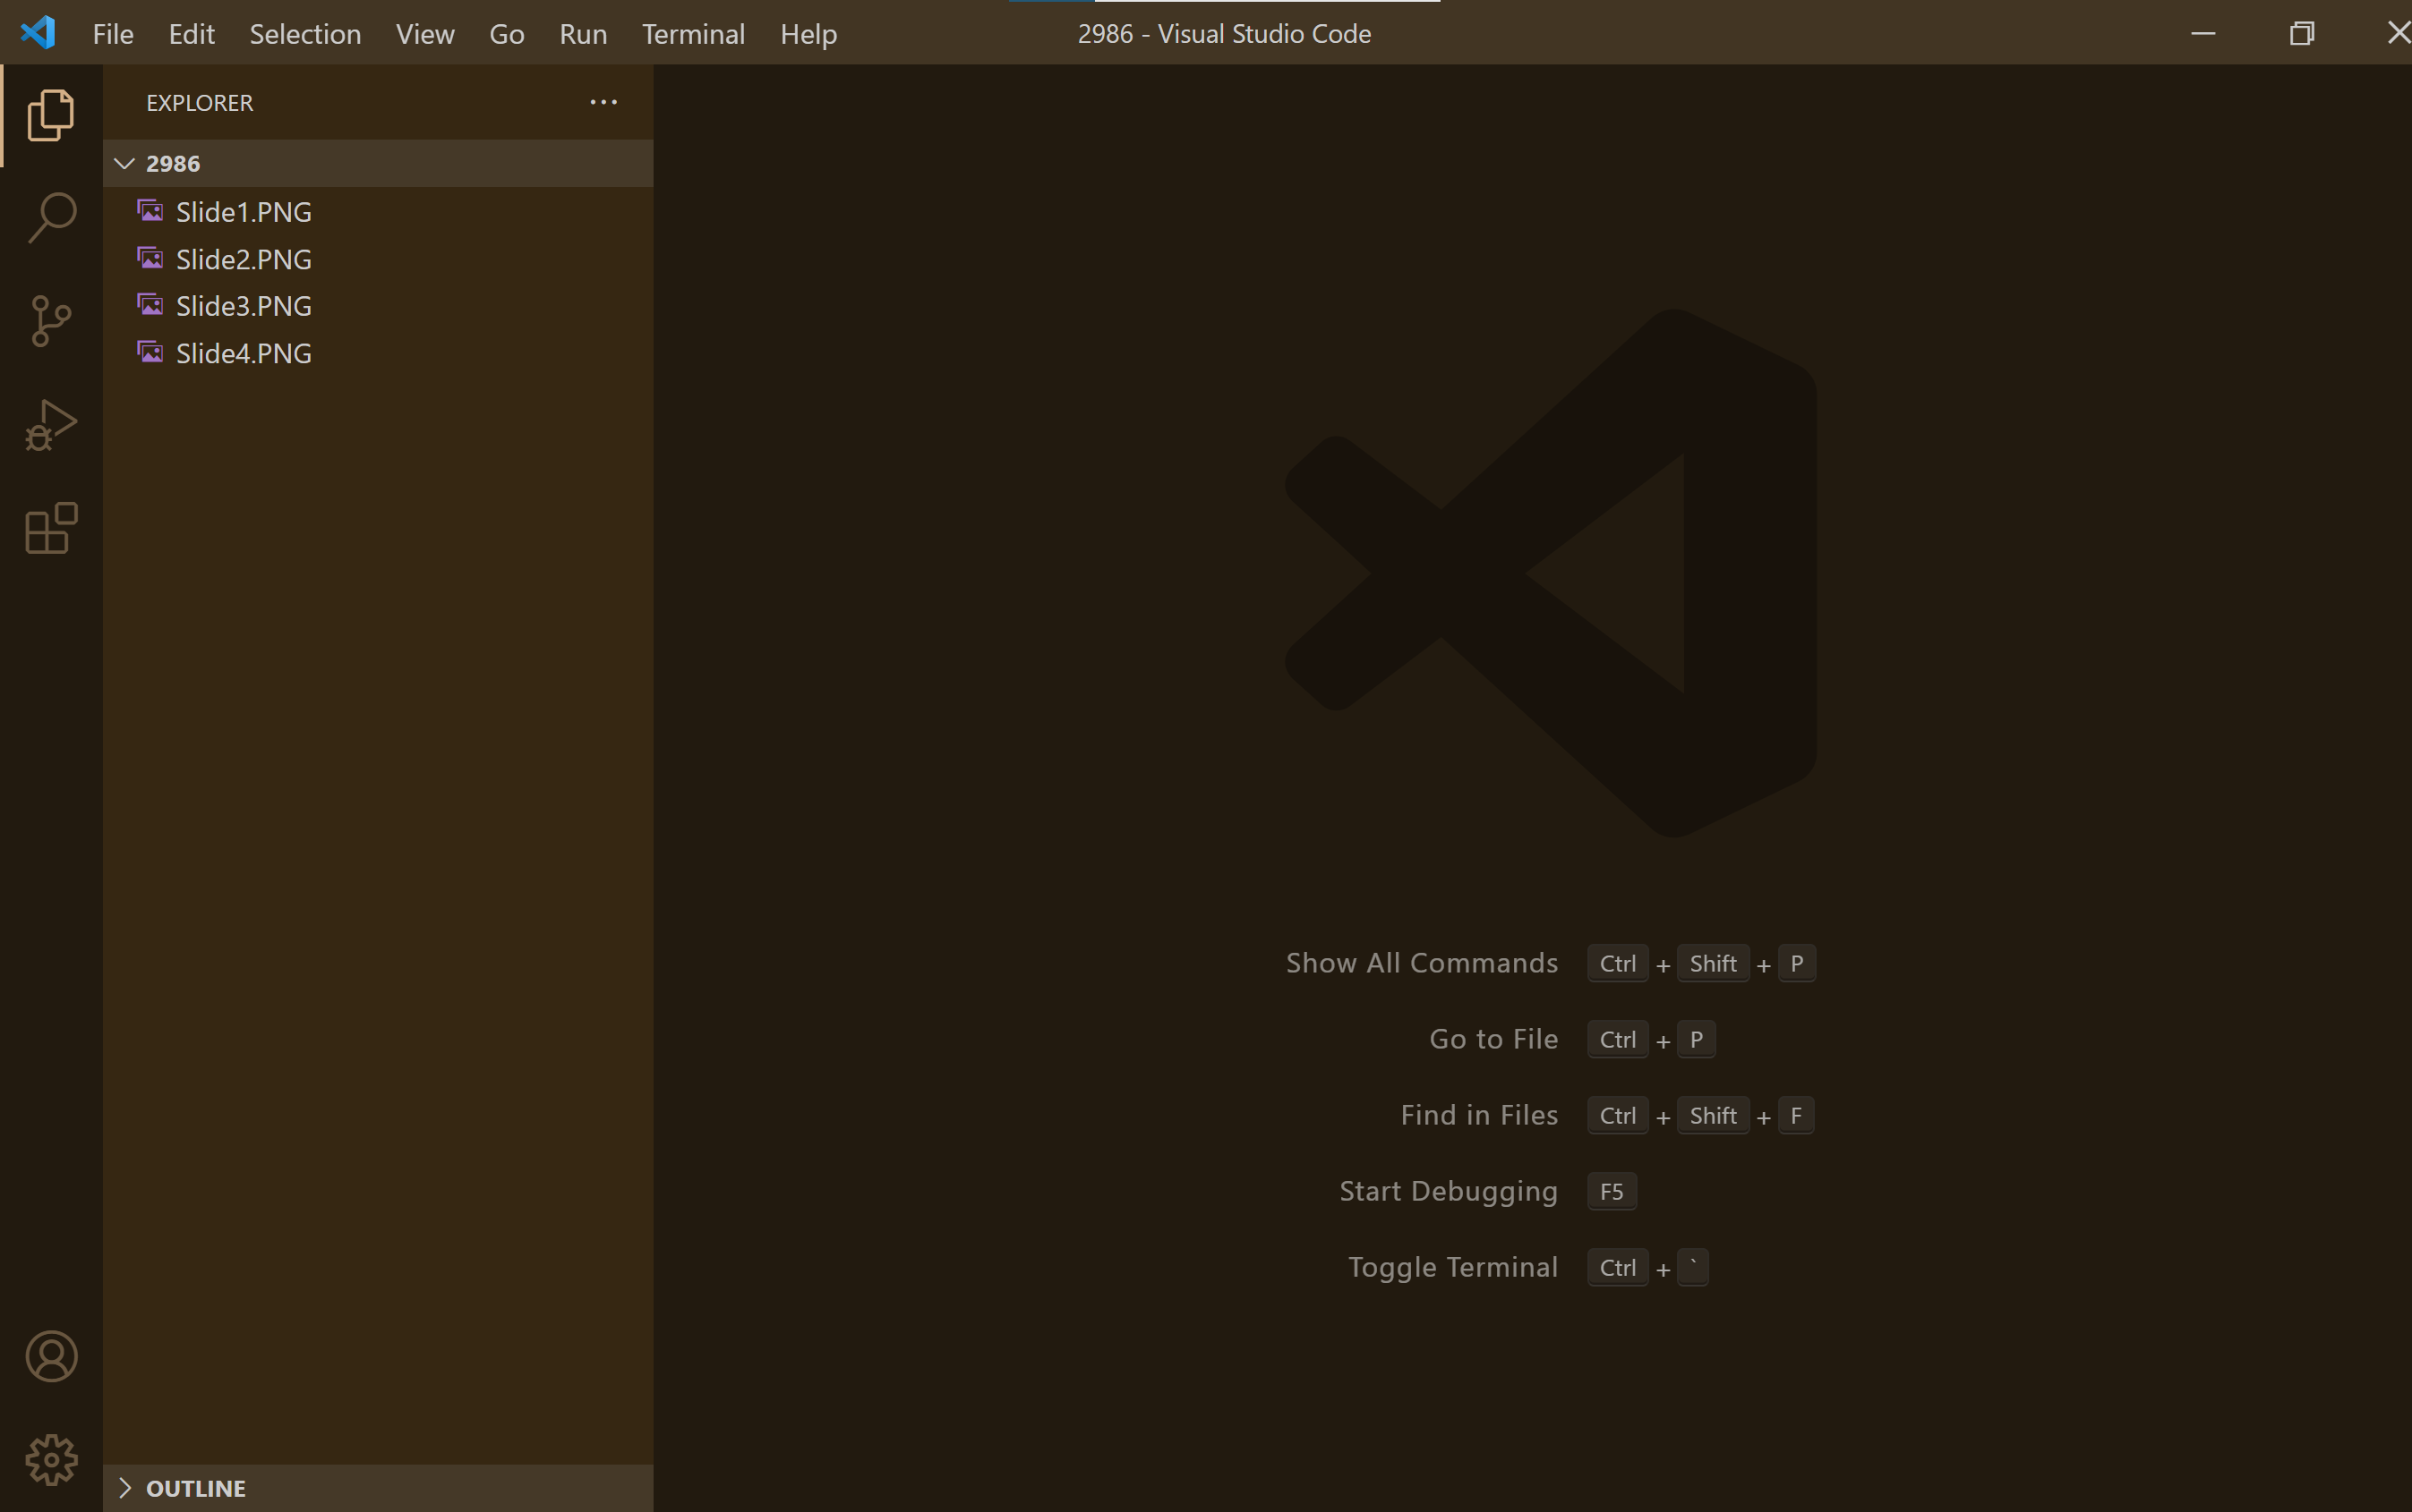
Launch VS Code
Note that VSCode remembers the last folder you opened. In this case, I had opened a "dummy" folder

Slide 4
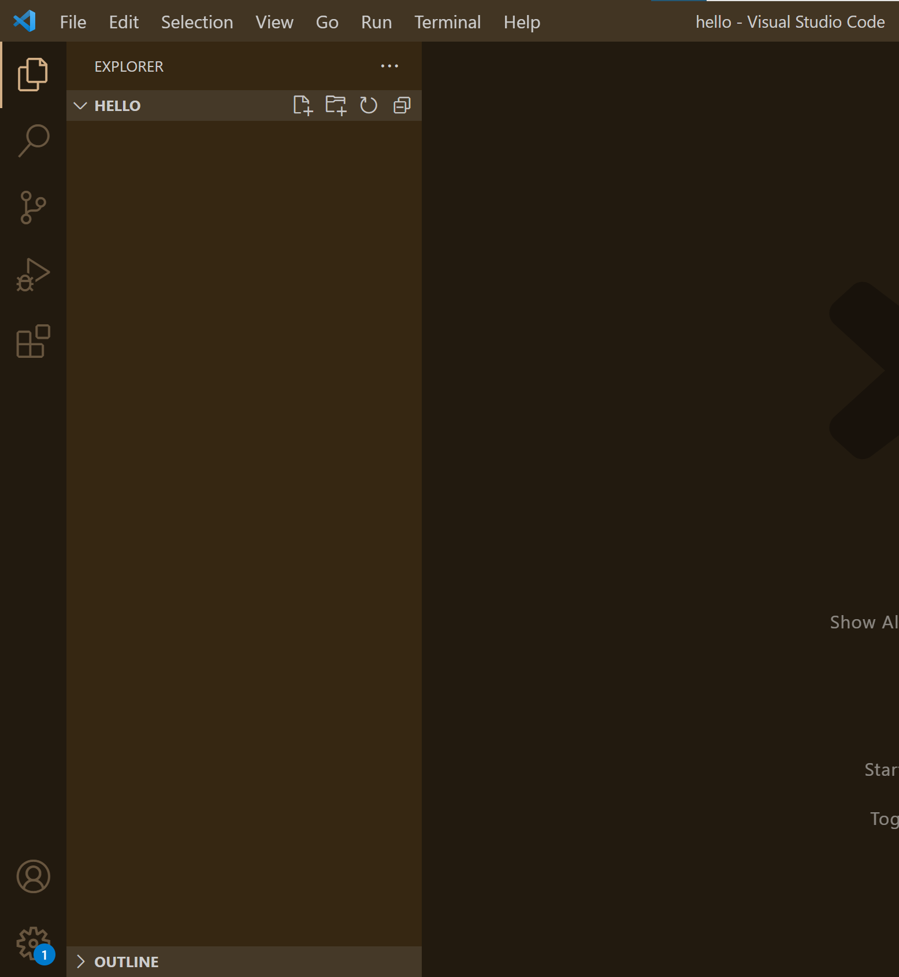
Open the Folder you just created
This is your "workspace" folder

Slide 5
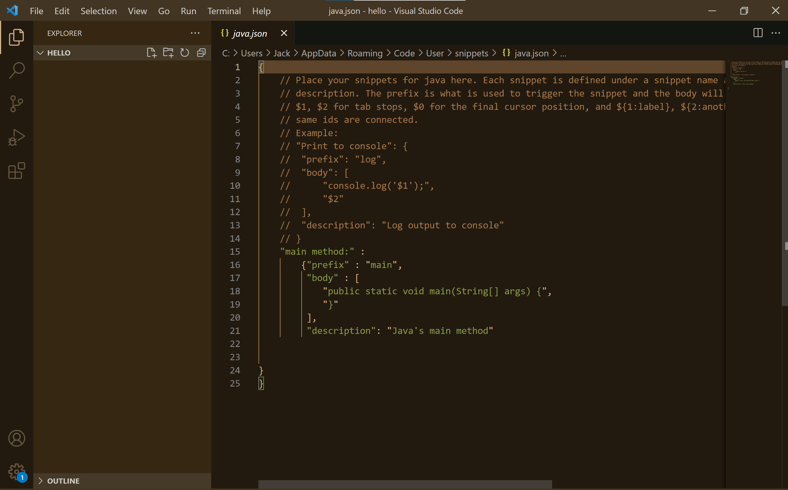
Our snippet for main
To make a new snippet, use the File Menu, then Preferences, then User Snippets. Select java. This will make you a file called java.json
For instance, you could create a snippet for the main method by adding the following json

Slide 6
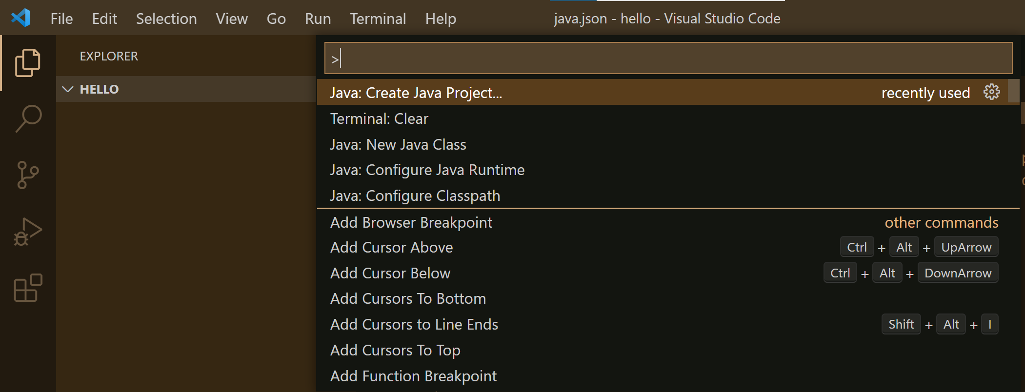
Create a Java Project
Use Ctrl-Shift-P to open the Command Pallete or select from View menu
The project location will be the hello folder we created.
Project created with No build tools

Slide 7
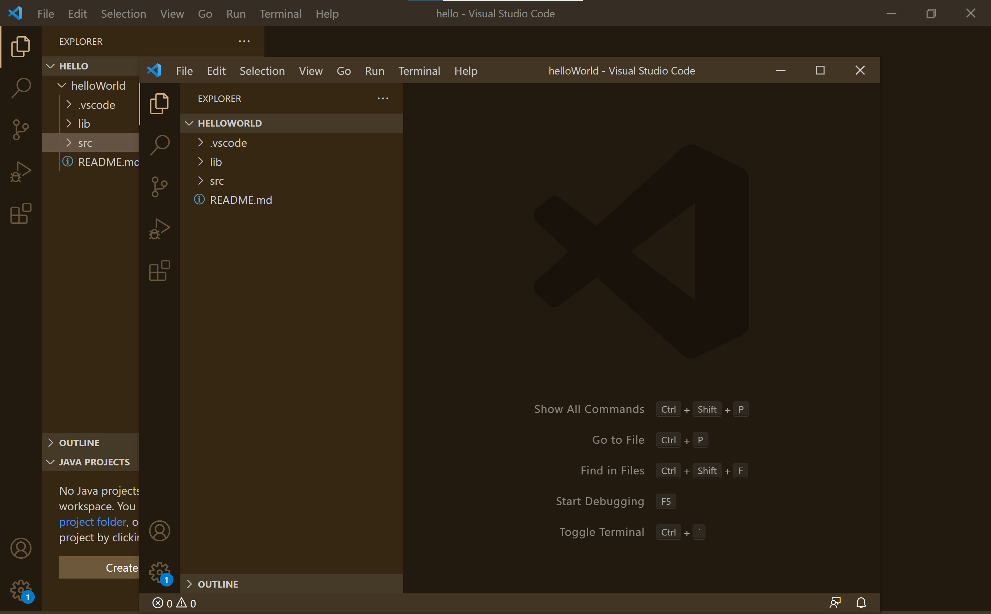
The Results
Notice that this creates two VS Code windows: one for the workspace folder "hello" and one for the project "helloWorld"
I generally choose to work at the workspace level, and so I will close this window.

Slide 8
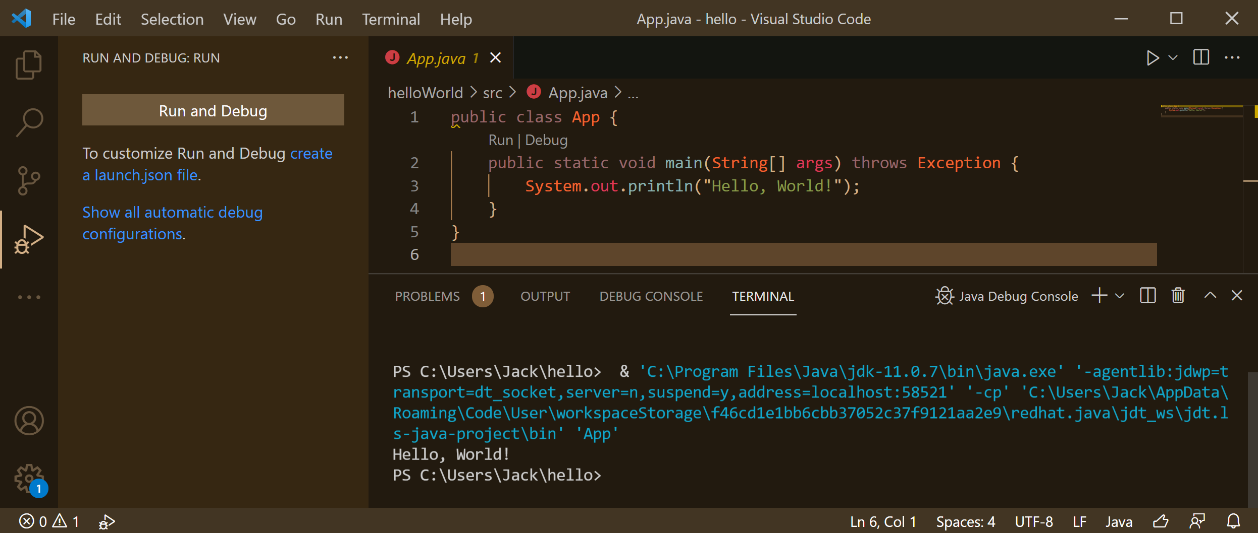
App.java
App.java is created for you, which you can run
The OS level invocation
The console results

Slide 9
A new driver
You can create a new Java class, and call it Driver. You can then use your snippet to add the main method. Save your file as Driver.java

Slide 10
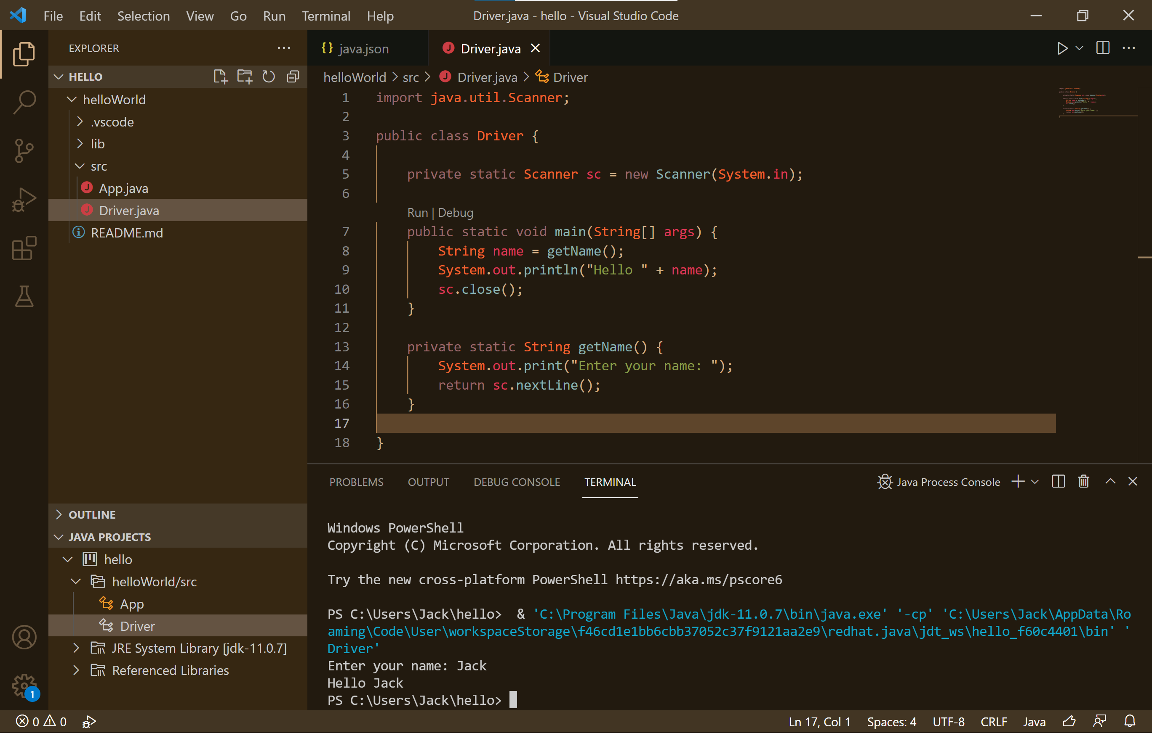
Edit the Driver as shown below and run it
There are many ways to run code, but I like to click the Run button.
A Scanner can read from System.in, i.e., the console or terminal in VS Code
Source code in the notes of this slide.
Notes:
import java.util.Scanner;
public class Driver {
private static Scanner sc = new Scanner(System.in);
public static void main(String[] args) {
String name = getName();
System.out.println("Hello " + name);
sc.close();
}
private static String getName() {
System.out.print("Enter your name: ");
return sc.nextLine();
}
}

Slide 11
Java Code Generators
Java code generators are a nice touch.
You should install this extension

Slide 12
JavaFX

Slide 13
Now install JavaFX Support Extension
Download JavaFX from https://openjfx.io/ I extracted the files to C:\Program Files\JavaFX (a new folder I made)

Slide 14
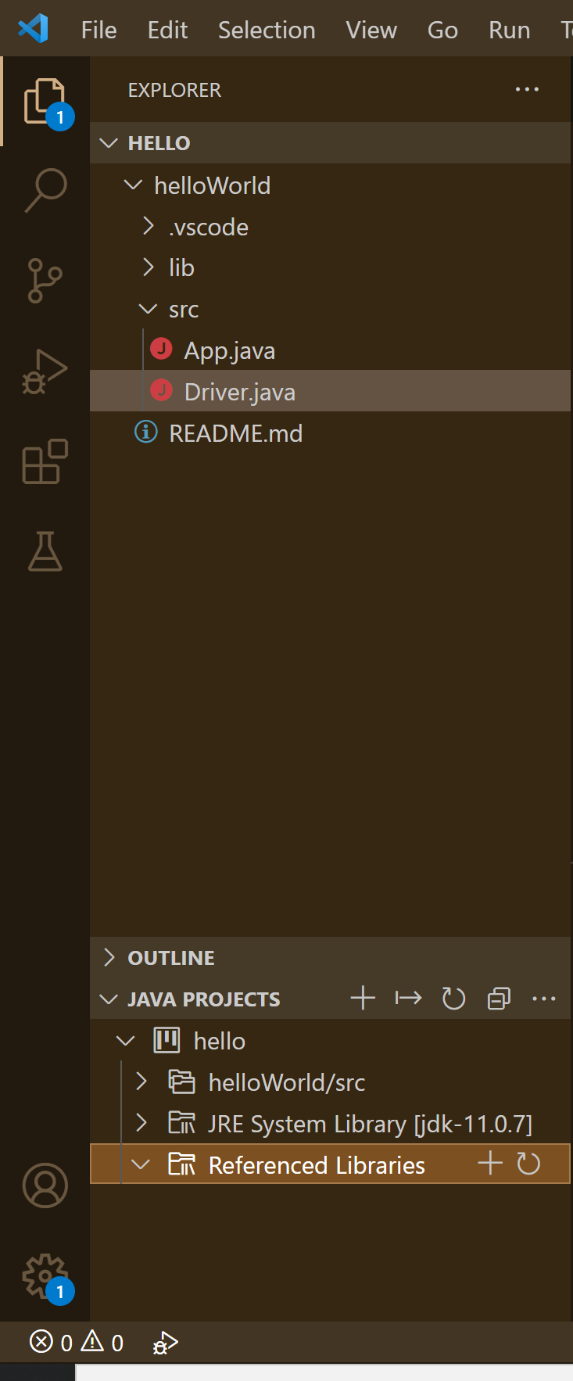
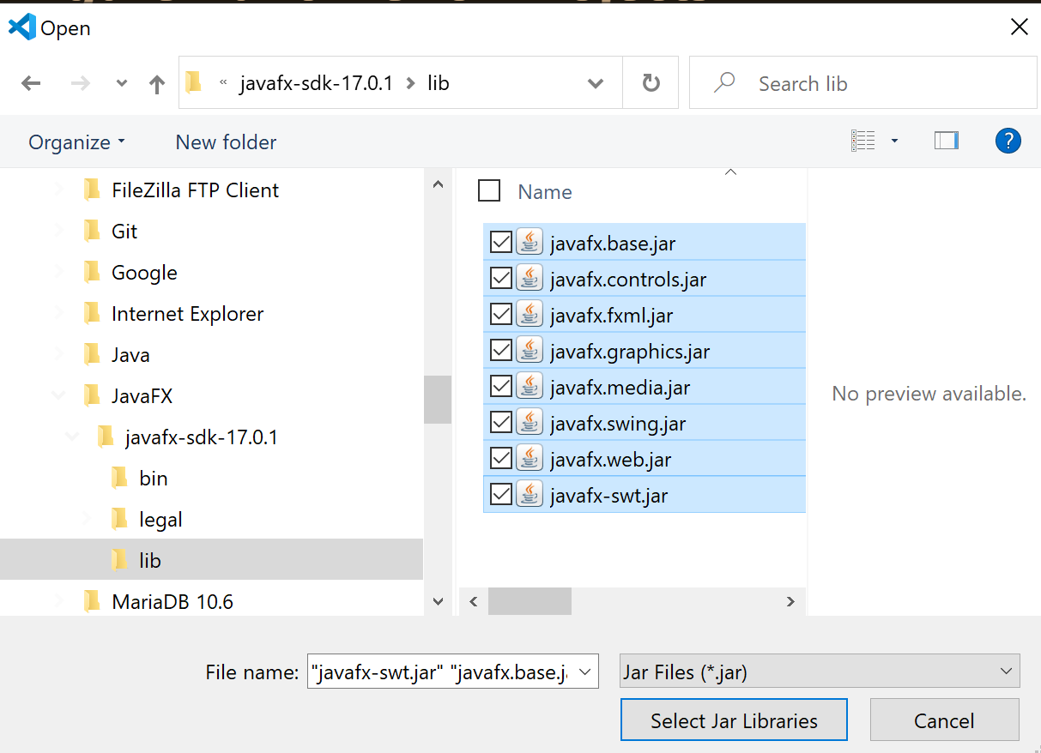
Add the JavaFX libraries into your project
Click on the + sign and an Open window will appear. Navigate to where you installed JavaFX and select all the jar files in the lib folder.
No references!

Slide 15
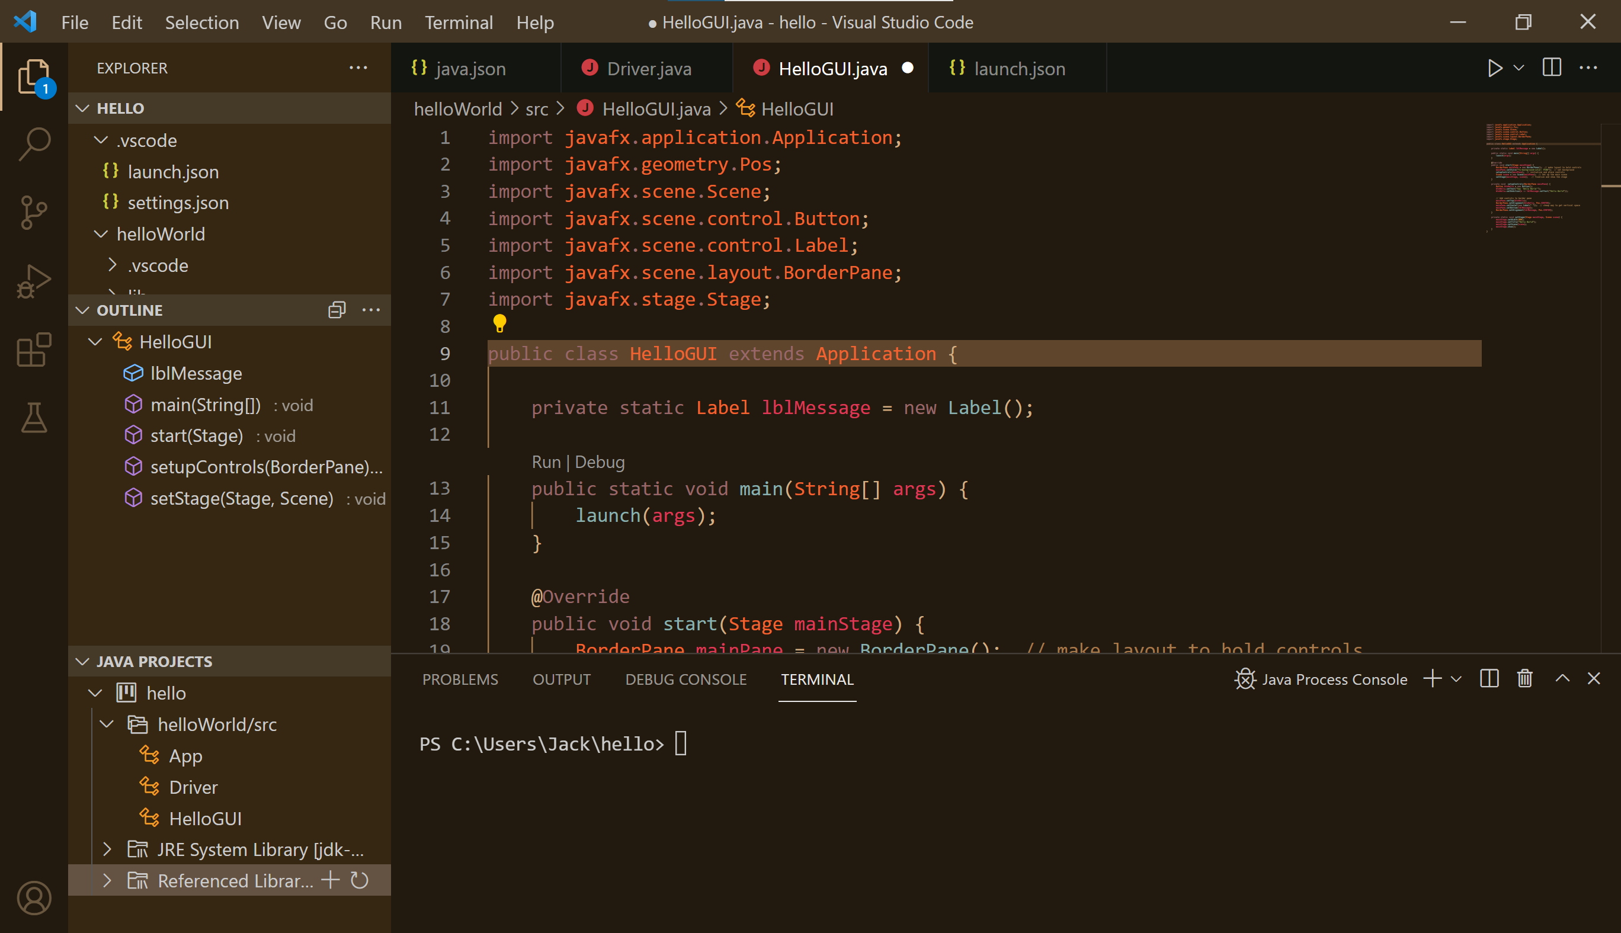
Now make a new Driver/GUI with JavaFX
Source code in the notes of this slide.
Notes:
import javafx.application.Application;
import javafx.geometry.Pos;
import javafx.scene.Scene;
import javafx.scene.control.Button;
import javafx.scene.control.Label;
import javafx.scene.layout.BorderPane;
import javafx.stage.Stage;
public class HelloGUI extends Application {
private static Label lblMessage = new Label();
public static void main(String[] args) {
launch(args);
}
@Override
public void start(Stage mainStage) {
BorderPane mainPane = new BorderPane(); // make layout to hold controls
setupControls(mainPane); // initialize and place controls
Scene scene = new Scene(mainPane); // Set up the main scene
setStage(mainStage, scene); // finalize and show the stage
}
private void setupControls(BorderPane mainPane) {
Button btnHello = new Button();
btnHello.setText("Say 'Hello World'");
btnHello.setOnAction(e -> lblMessage.setText("Hello World")); // Add controls to border pane
mainPane.setTop(btnHello);
BorderPane.setAlignment(btnHello, Pos.CENTER);
mainPane.setCenter(new Label(" ")); // cheap way to get vertical space
mainPane.setBottom(lblMessage);
BorderPane.setAlignment(lblMessage, Pos.CENTER);
}
private static void setStage(Stage mainStage, Scene scene) {
mainStage.setWidth(499);
mainStage.setTitle("Hello World");
mainStage.setScene(scene);
mainStage.show();
}
}

Slide 16
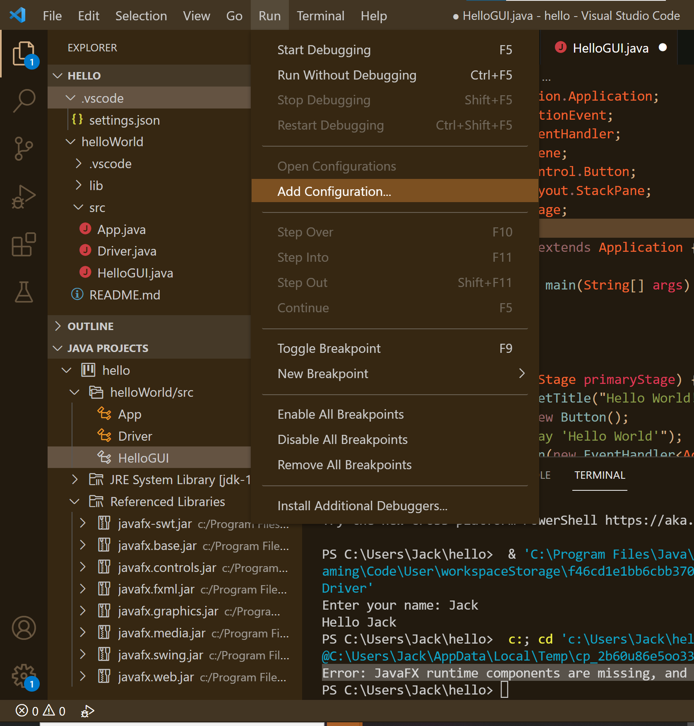
From the Run Menu choose Add Configuration

Slide 17
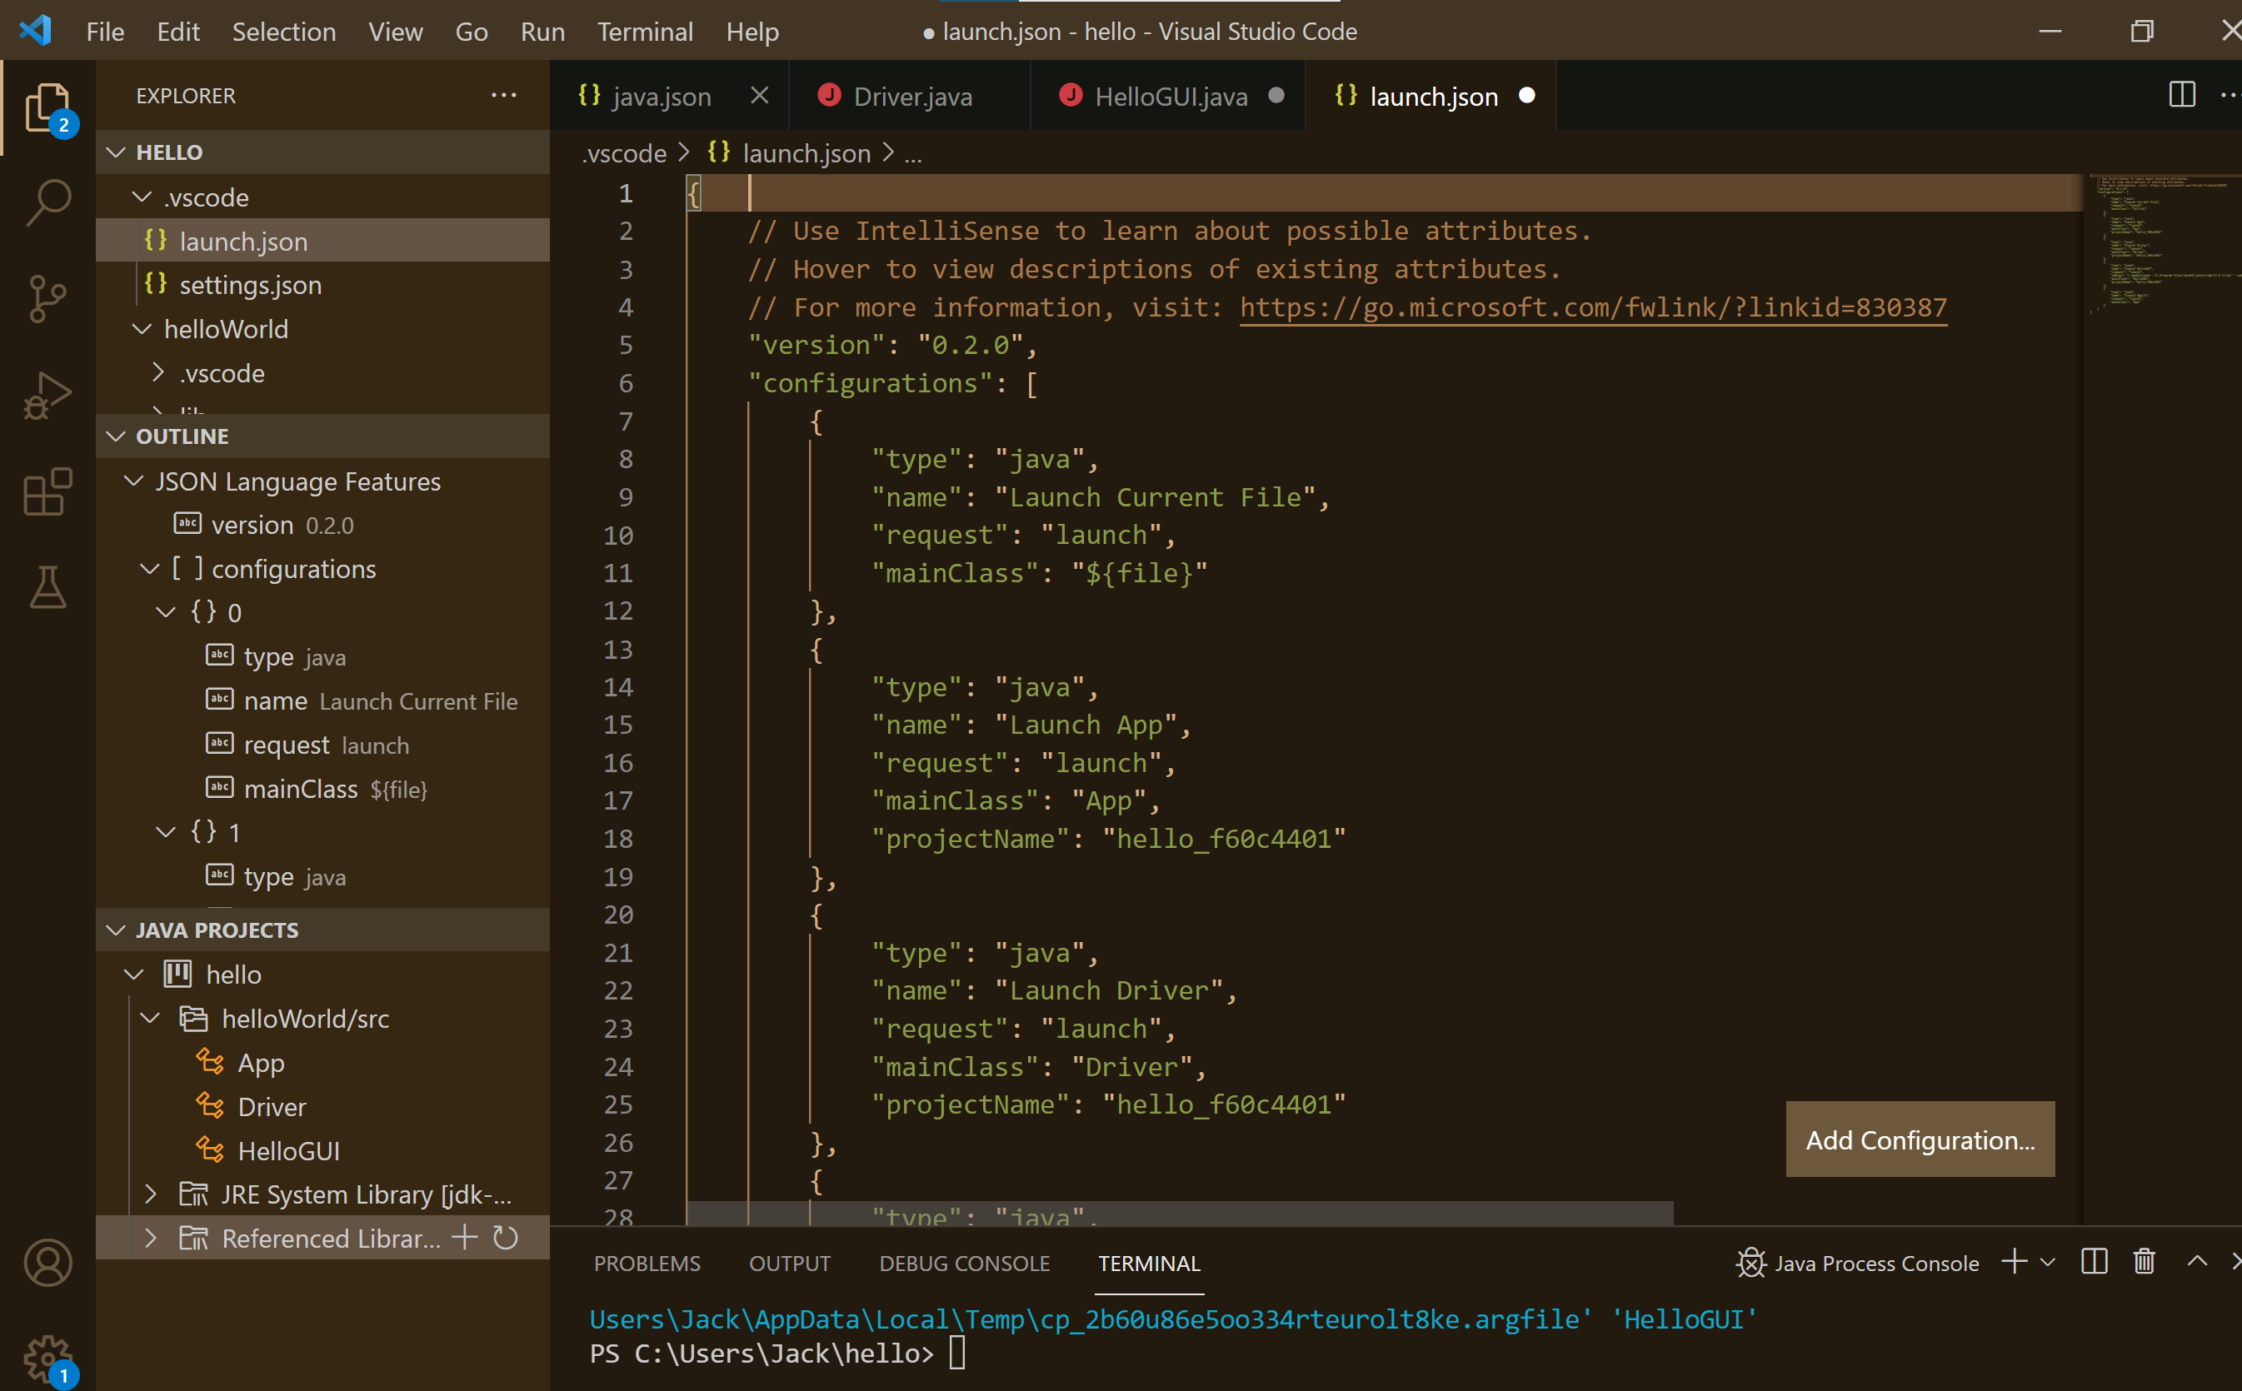
This will create a launch.json file
This is how we will launch that App.java that was made for us
This is how we will launch Driver.java

Slide 18
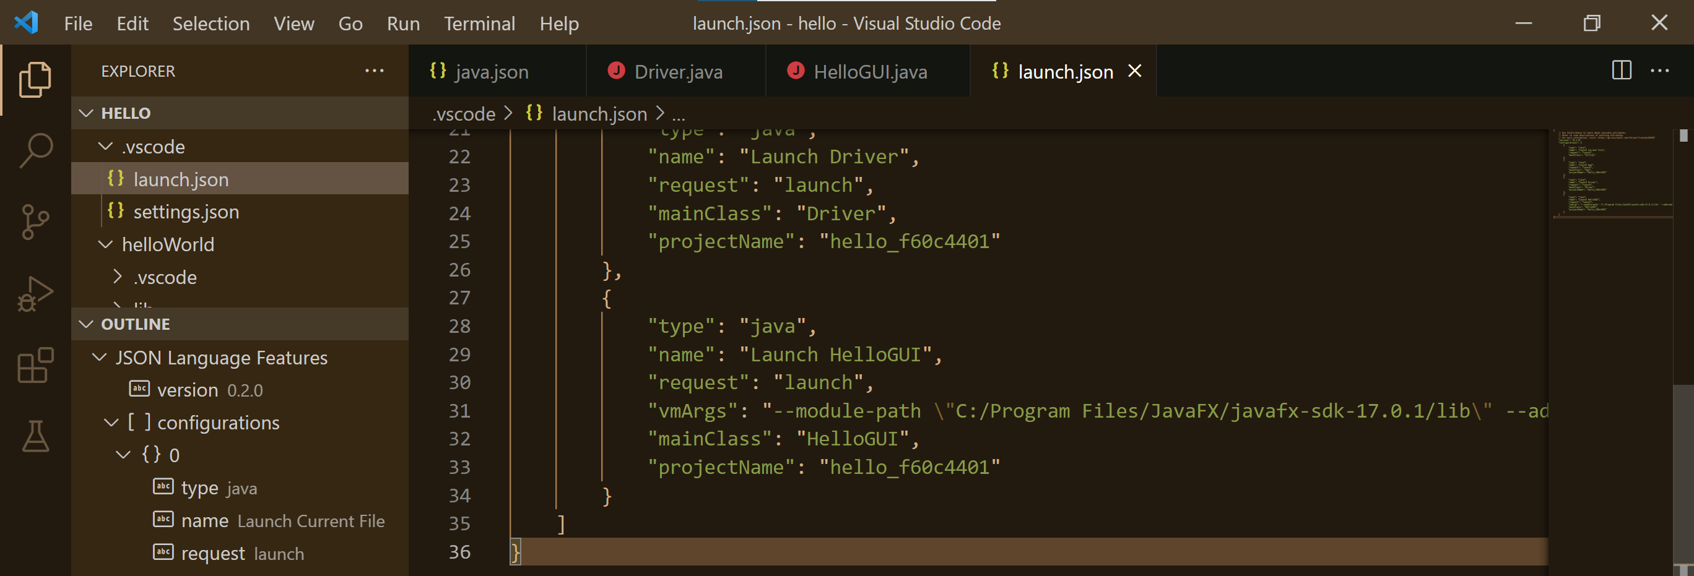
We need to change the launch of JavaFX
This is how we will launch HelloGUI.java, but we need to add in JavaFX
We need to add another key/value pair to launch.json for HelloGUI that tells the compiler where to find JavaFX "vmArgs": "--module-path \"C:/Program Files/JavaFX/javafx-sdk-17.0.1/lib\" --add-modules javafx.controls,javafx.fxml
This can be added after the "request": "launch" line, but must be on one row as shown above. Note the use of the escaped quotes, which is needed in Windows because there is a space in the path name (Program Files).
"

Slide 19
Packages
GitHub integration is easy to install in VS Code and easy to use once configured. But configuring it is tricky, and git itself is complex

Slide 20
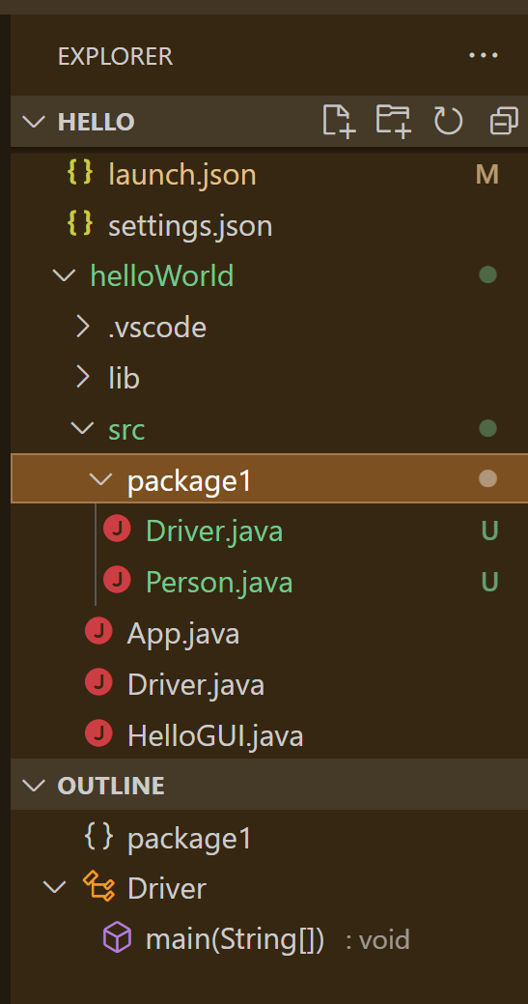
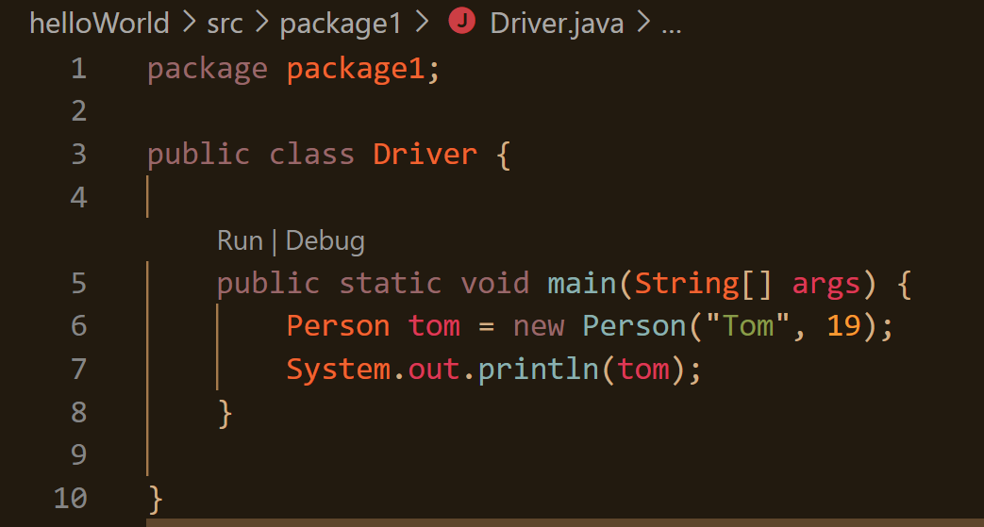
A package is just a folder under src
Then the package statement needs to be the first one in the Java code.
Useful for organizing your code the way the Java API does

Slide 21
GitHub
GitHub integration is easy to install in VS Code and easy to use once configured. But configuring it is tricky, and git itself is complex

Slide 22
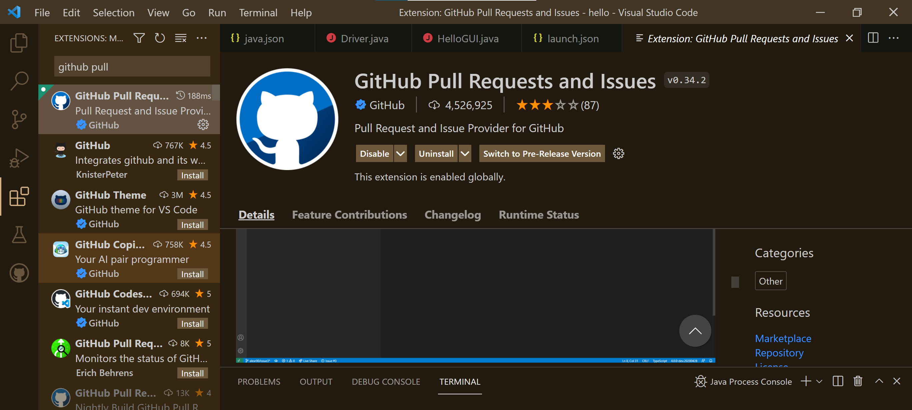
Getting started
Follow the instructions found here: https://code.visualstudio.com/docs/editor/github
Install the GitHub Pull Requests and Issues extension

Slide 23
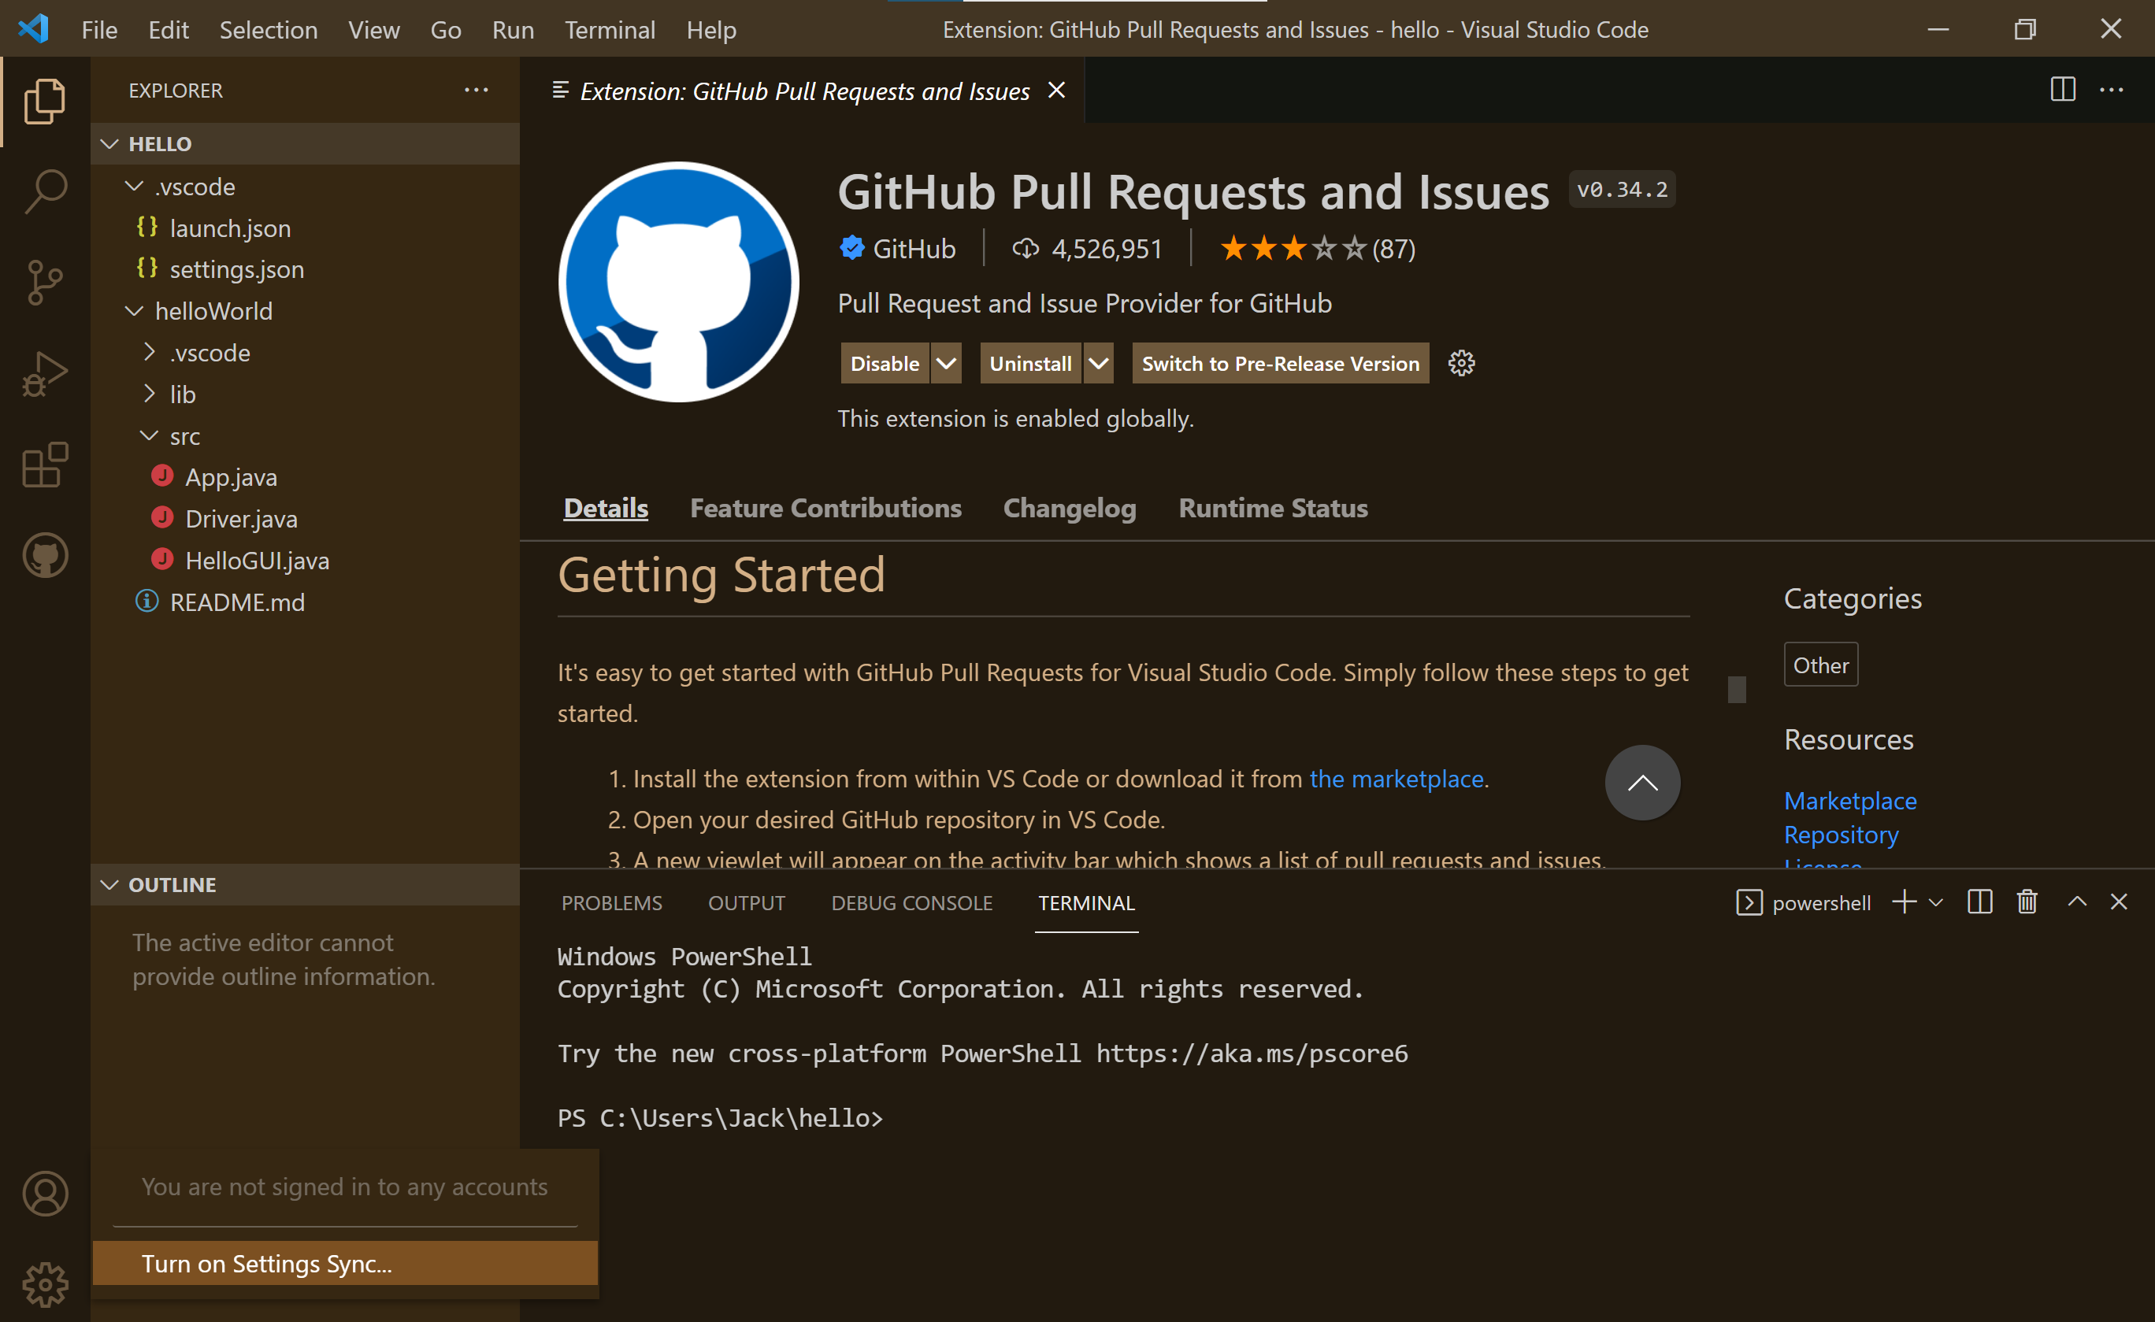
Sign in to Git (1)
Click on the Accounts icon
Turn on Settings synch

Slide 24
Sign in to Git (2)
Sign in and turn on
Sign in with GitHub

Slide 25
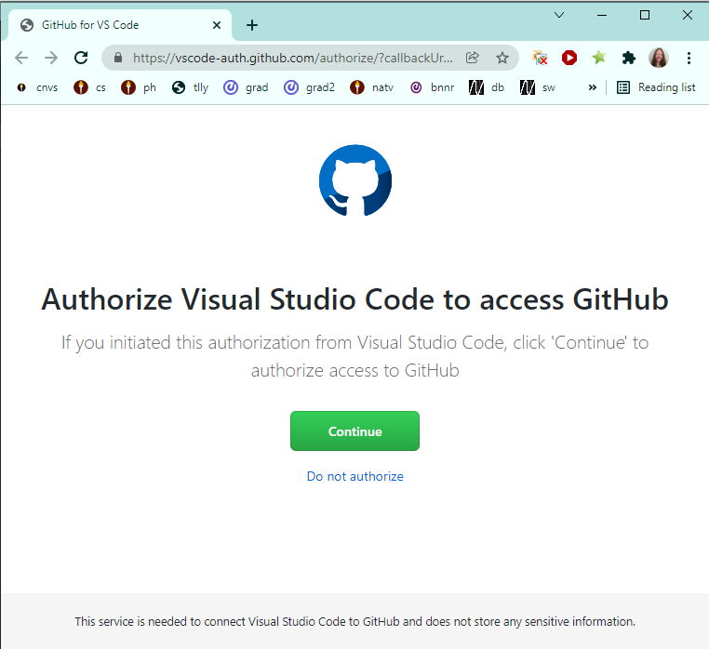
Sign in to Git (3)
This opens a web browser where you can authorize access to GitHub

Slide 26
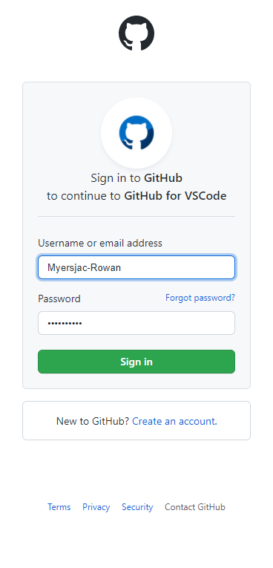
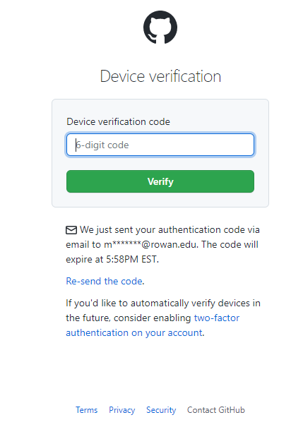
Sign in to Git (4)

Slide 27
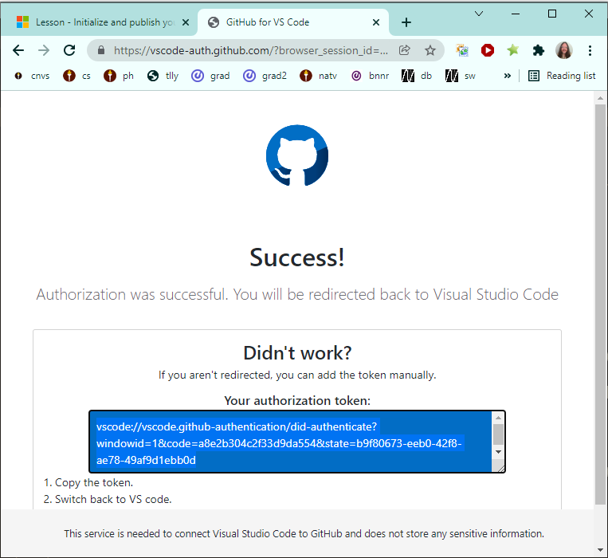
Sign in to Git (5)
You will either be rerouted to VS Code, or you will have to copy this authorization token into VS Code

Slide 28
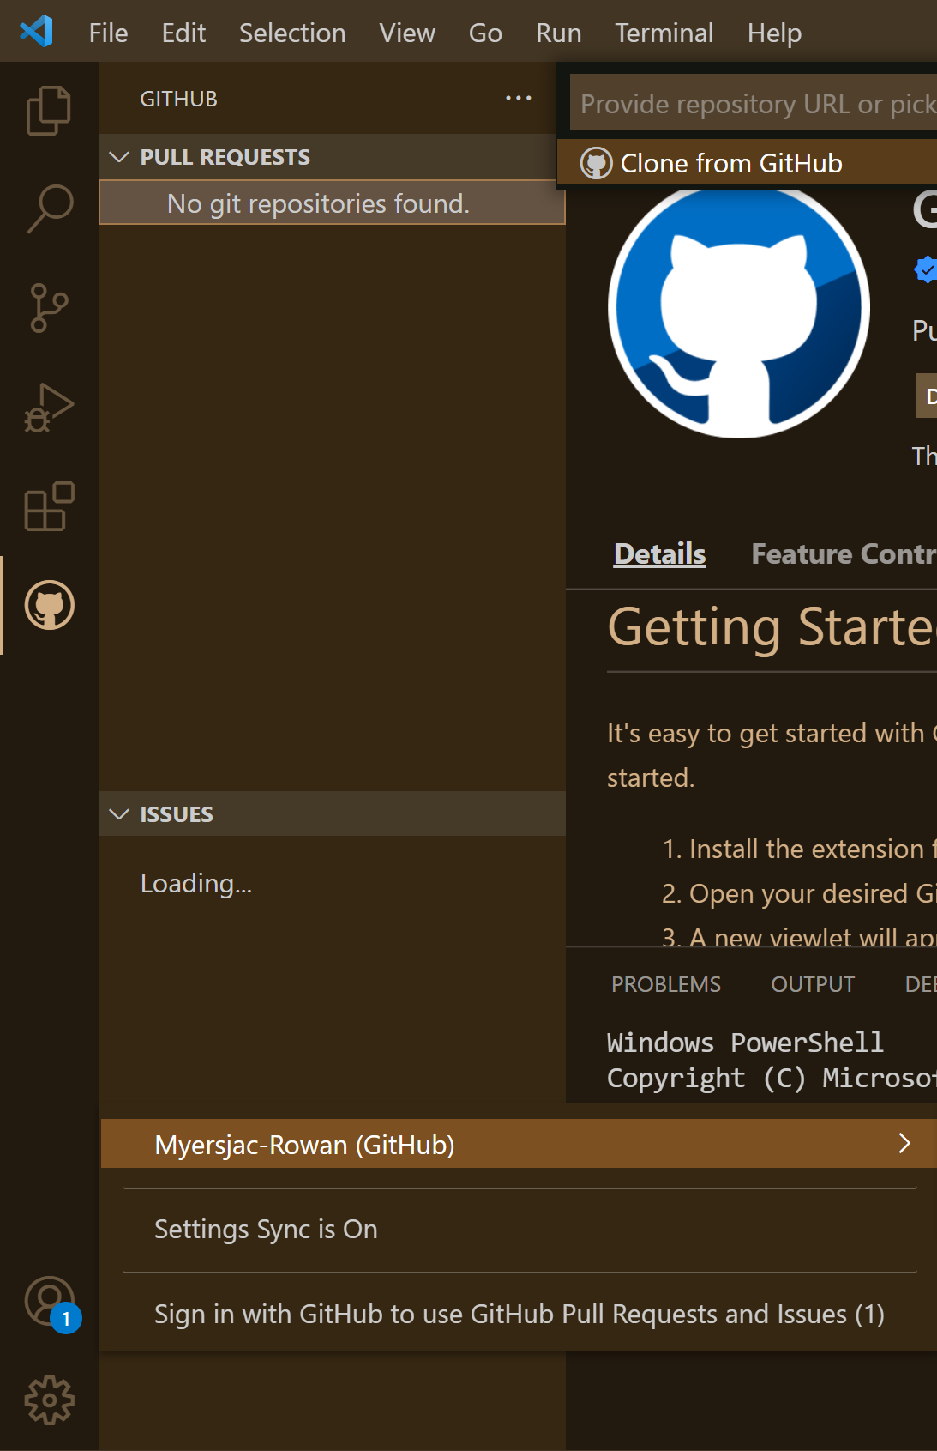
Sign in to Git (6)
Now you will see your GitHub account name when you click on the Accounts icon

Slide 29
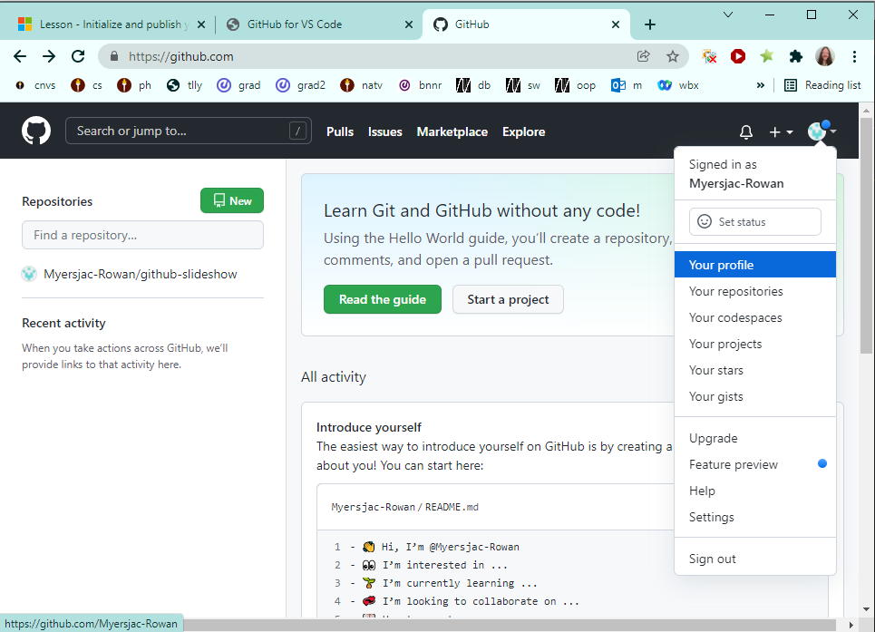
Make a Git Repository (1)
Go to your repositories and make a new one

Slide 30
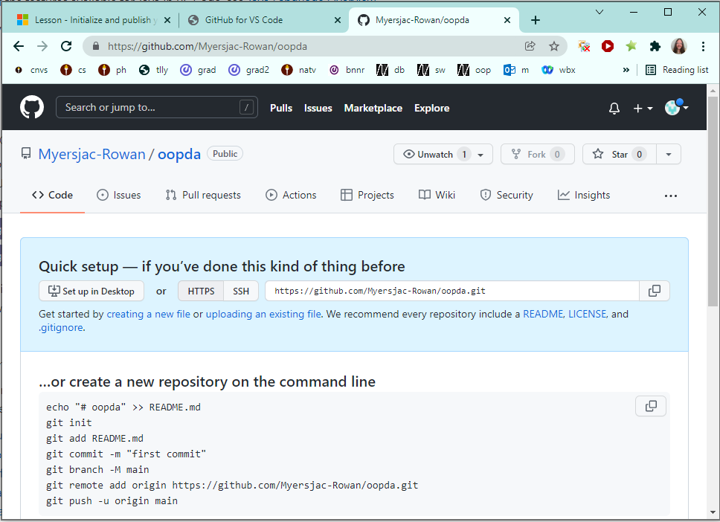
Make a Git Repository (2)
Just made a repository called oopda

Slide 31
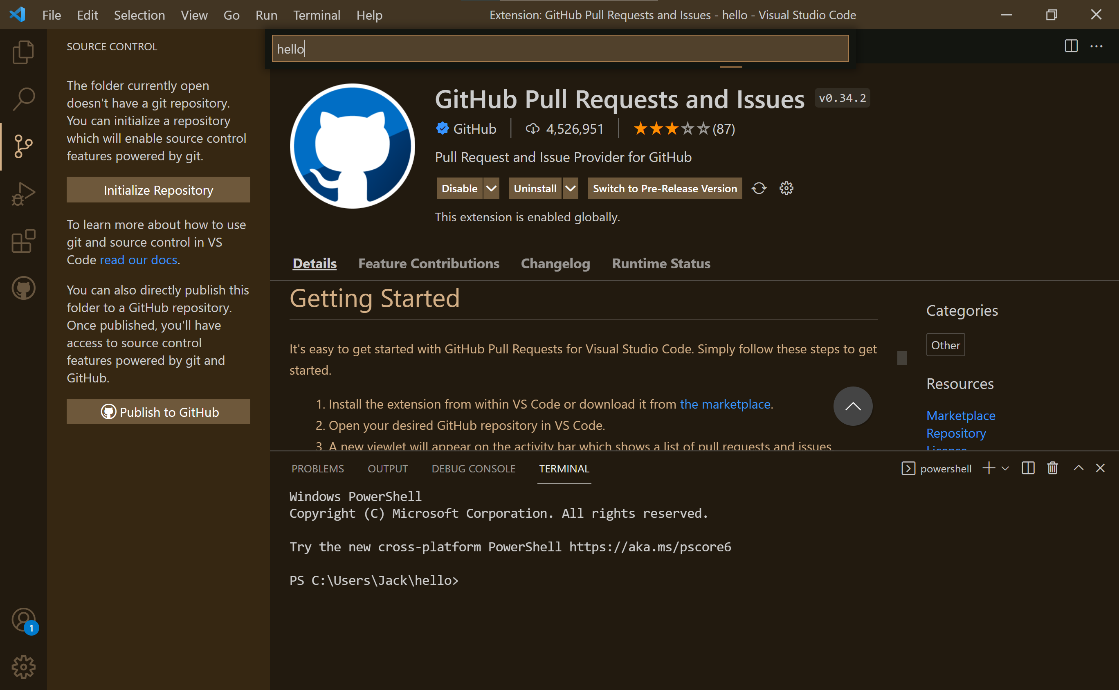
The Source Control Menu

Slide 32
You might need to configure git from command line
C:\Users\Jack>git config --global user.email "myersjac@rowan.edu"
C:\Users\Jack>git config --global user.name "Jack Myers"

Slide 33
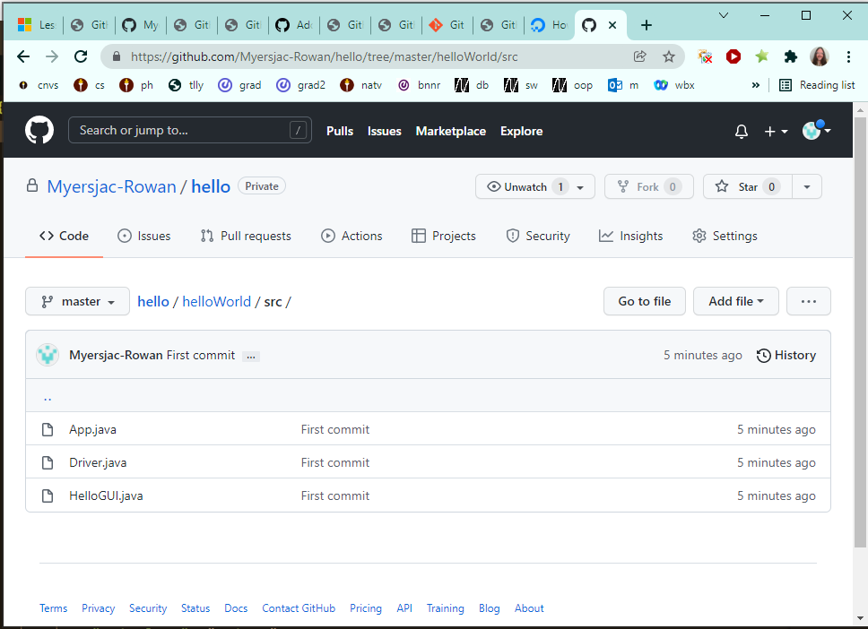
You can publish from VS Code to github

Slide 34
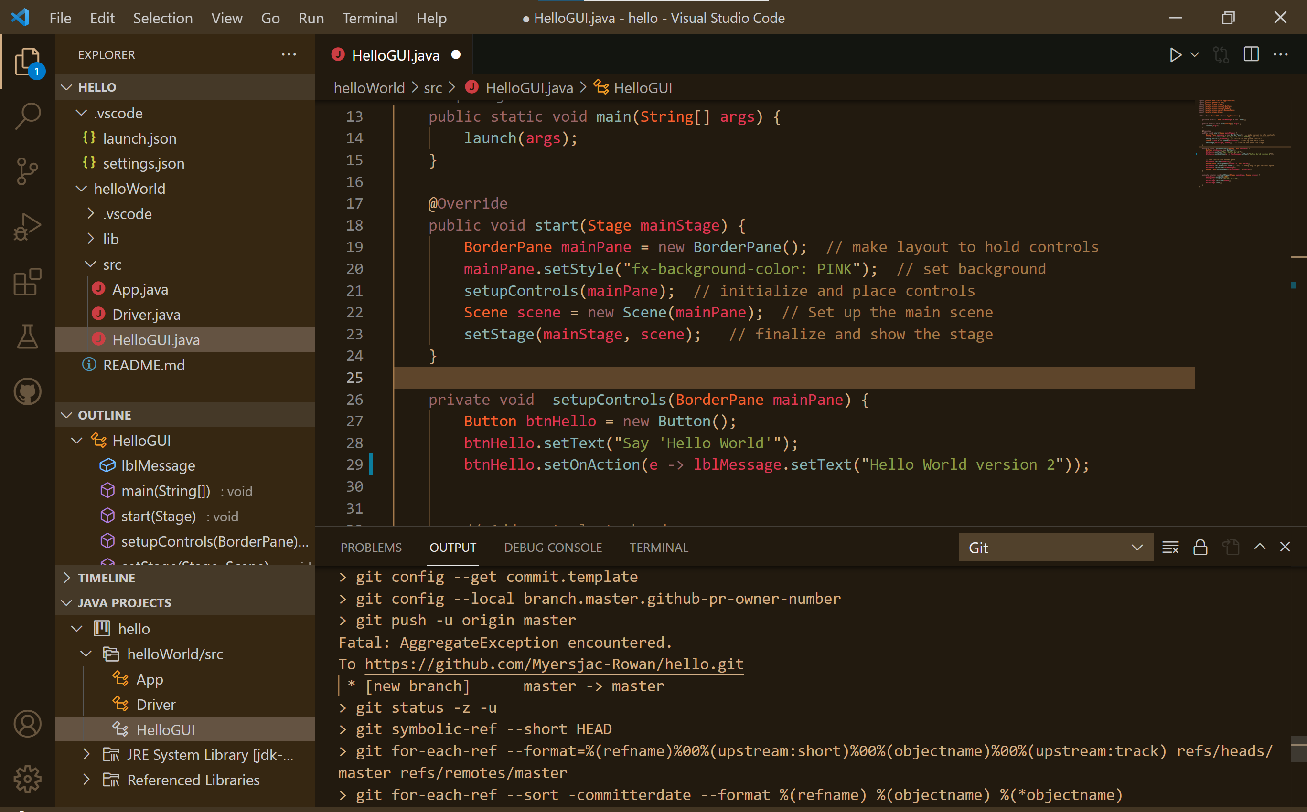
Now we can make a change in the code

Slide 35
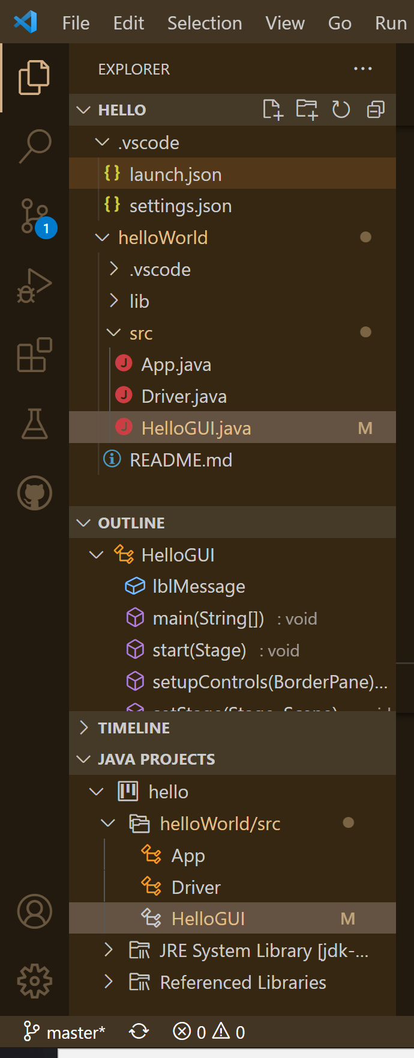
Our local copy is modified
VS Code keeps track of the modification status ("M" means modified)

Slide 36
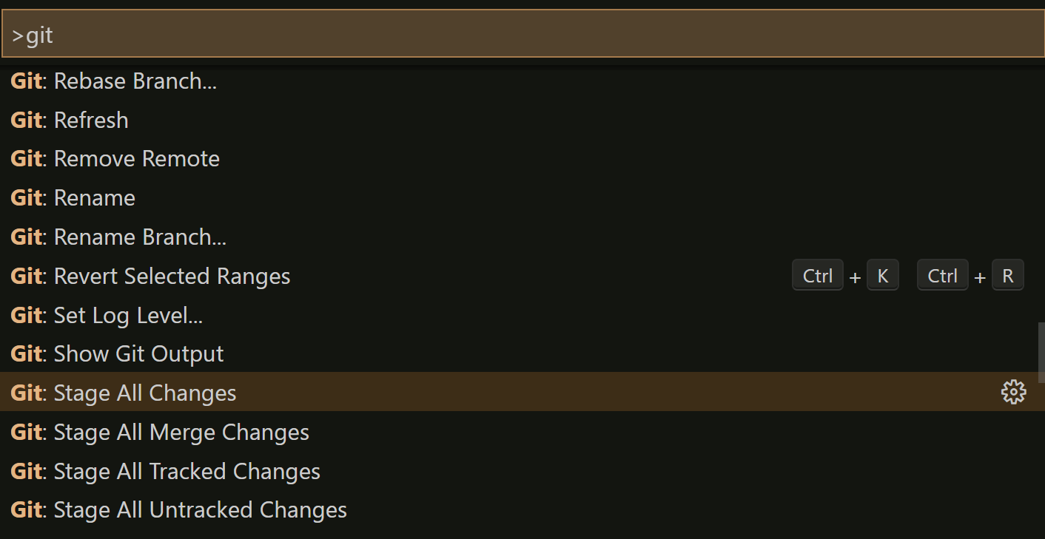

Slide 37
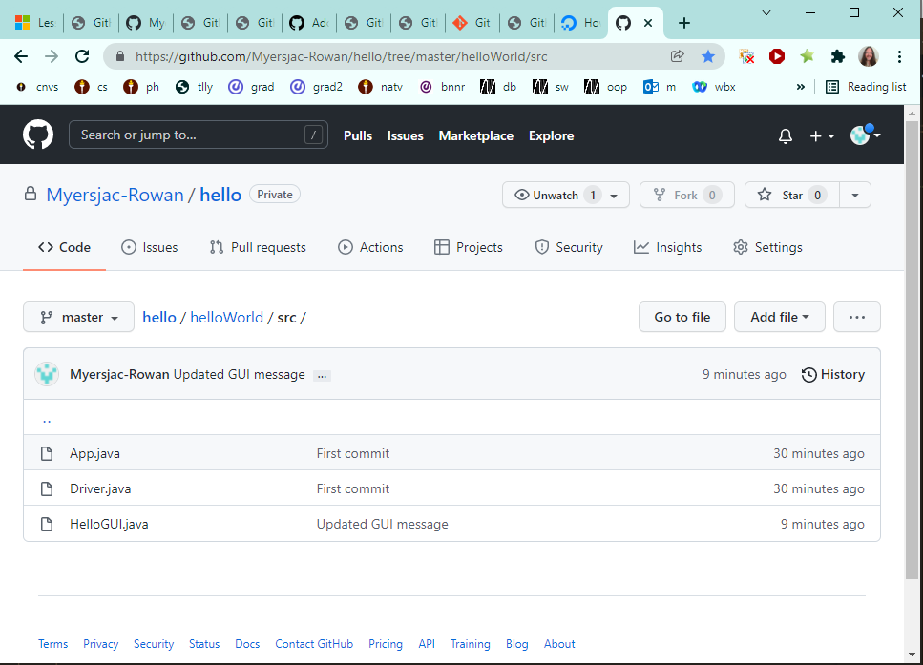
The results in Git (1)

Slide 38
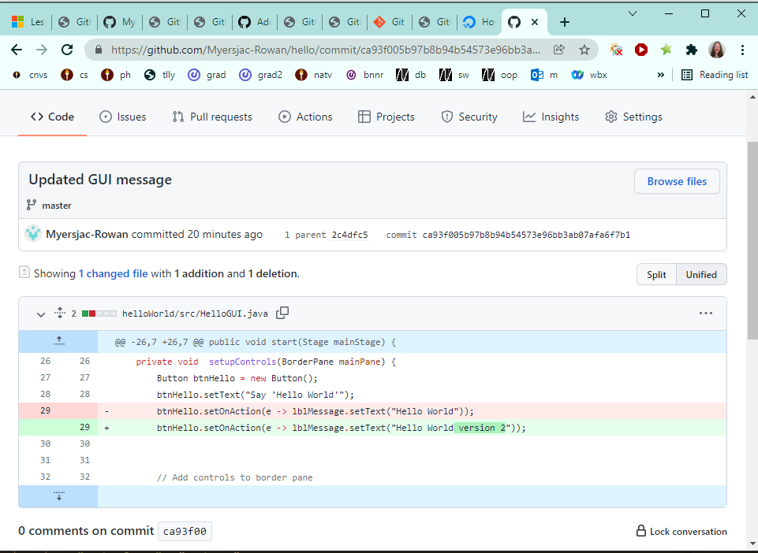
The results in Git (2)

Slide 39
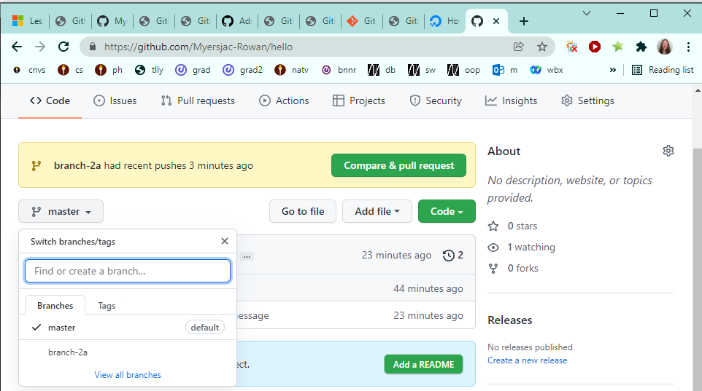
Making a branch
Git create branch (named branch 2a)
Git commit
Git publish branch

Slide 40
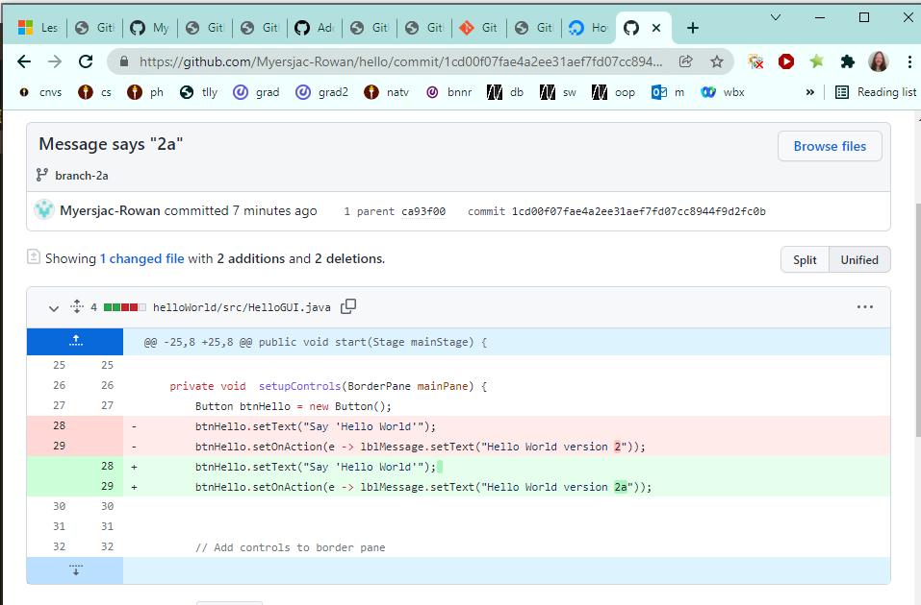
Making a branch

