Slide 1
Introduction to Object-Oriented Programming Lesson 03: Language Fundamentals 1
Basic Syntax
Programming Style
Declaring and Initializing Variables
Constants
Arithmetic Expressions and Operators
Casting
Strings
Console I/O
print() and printf()
Conditional Control Structures
Notes:
Replace this with your course title and your name/contact details.

Slide 2
What happened to the text?
This is a little departure from the text book.
Don't worry, we will return.
Once in a while, I will post a BlueJ icon as a reference, but the book covers language fundamentals in a VERY different order.
28-29

Slide 3
Basic Syntax

Slide 4
import java.util.Scanner;
public class InvoiceApp
{
public static void main(String[] args)
{
// display a welcome message
System.out.println("Welcome to the Invoice Total Calculator");
System.out.println(); // print a blank line
// get the input from the user
Scanner sc = new Scanner(System.in);
System.out.print("Enter subtotal: ");
double subtotal = sc.nextDouble();
// calculate the discount amount and total
double discountPercent = .2;
double discountAmount = subtotal * discountPercent;
double invoiceTotal = subtotal - discountAmount;
// format and display the result
String message = "Discount percent: " +
discountPercent + "\n" +
"Discount amount: " + discountAmount + "\n" +
"Invoice total: " + invoiceTotal + "\n";
System.out.println(message);
}
}
This is the class header for the class InvoiceApp
This is a Java comment.
It is ignored by the compiler.
This area is the body of the class InvoiceApp.
All of the data and methods for this class will be between these curly braces.

Slide 5
This is the method header for the main method.
The main method is where a Java application begins.
import java.util.Scanner;
public class InvoiceApp
{
public static void main(String[] args)
{
// display a welcome message
System.out.println("Welcome to the Invoice Total Calculator");
System.out.println(); // print a blank line
// get the input from the user
Scanner sc = new Scanner(System.in);
System.out.print("Enter subtotal: ");
double subtotal = sc.nextDouble();
// calculate the discount amount and total
double discountPercent = .2;
double discountAmount = subtotal * discountPercent;
double invoiceTotal = subtotal - discountAmount;
// format and display the result
String message = "Discount percent: " +
discountPercent + "\n" +
"Discount amount: " + discountAmount + "\n" +
"Invoice total: " + invoiceTotal + "\n";
System.out.println(message);
}
}
This area is the body of the main method.
All of the actions to be completed during
the main method will be between these curly braces.

Slide 6
Declaring a class and main()

Slide 7
Putting the class declaration together with the main() method

Slide 8
Naming a Class

Slide 9
Parts of a Java Program
Comments
Ignored by the compiler.
// signifies a single-line comment.
/* comment text */ signifies a block comment.
Class Header
The class header tells the compiler things about the class such as what other classes can use it (public) and that it is a Java class (class), and the name of that class (InvoiceApp).
Curly Braces
Define a block of code
When associated with the class header, they define the scope of the class.
When associated with a method, they define the scope of the method.

Slide 10
Parts of a Java Program
The main Method
This line must be exactly as shown in the example (except the args variable name can be programmer defined).
This is the line of code that the java command will run first.
This method starts the Java program.
Every Java application must have a main method.
Java Statements
When the program runs, the statements within the main method will be executed.

Slide 11
Java Statements
// This is a simple Java program.
public class Simple
{
public static void main(String[] args)
{
System.out.println("Programming is great fun!");
}
}
In the example above, we can see that there is only one line that ends with a semi-colon.
System.out.println("Programming is great fun!");
This is because it is the only Java statement in the program.
The rest of the code is either a comment or other Java framework code.

Slide 12
Java Statements
Comments are ignored by the Java compiler so they need no semi-colons.
Other Java code elements that do not need semi colons include:
class headers
Terminated by the code within its curly braces.
method headers
Terminated by the code within its curly braces.
curly braces
Part of framework code that needs no semi-colon termination.

Slide 13
Special Characters
// | double slash | Marks the beginning of a single line comment.
( ) | open and close parenthesis | Used in a method header to mark the parameter list.
{ } | open and close curly braces | Encloses a group of statements, such as the contents of a class or a method.
" " | quotation marks | Encloses a string of characters, such as a message that is to be printed on the screen
; | semi-colon | Marks the end of a complete programming statement

Slide 14
Identifiers (1)
Identifiers are programmer-defined names for:
classes
variables
methods
Identifiers must follow certain rules:
An identifier may only contain:
letters a–z or A–Z,
the digits 0–9,
underscores ( _ ), or
the dollar sign ( $ )
The first character may not be a digit.
Identifiers are case sensitive.
itemsOrdered is not the same as itemsordered.
Identifiers cannot include spaces.

Slide 15
Reserved Words (also known as keywords)

Slide 16
Identifiers (2)

Slide 17
Choosing variable names
There is a lot of freedom over choice of names. Use it wisely!
Choose expressive names to make code easier to understand:
price, amount, name, age, etc.
Avoid single-letter or cryptic names:
w, t5, xyz123

Slide 18
Follow standard Java naming conventions
Package names
Generally all lower_case
package shapes;
package ticket_machine;
Variables and instances
Should be in camelCase
double totalPrice;
bigGreenCircle = new Circle();
Constants
Should be in UPPER_CASE
final int DEFAULT_WIDTH;
Methods
Should be in camelCase
public void calculateTax() …
Classes
Should be in PascalCase
public class Circle { …
public class TicketMachine { …
the fine print: Definitions of camel case and mixed case vary. Also some utilize the awkward "upper camel case" and "lower camel case." I prefer to utilize Microsoft's terminology for case.

Slide 19
Programming Style

Slide 20
Programming Style
Although Java has a strict syntax, whitespace characters are ignored by the compiler.
The Java whitespace characters are:
space
tab
newline
carriage return
form feed
See example: http://jackmyers.info/ioop/src/Lesson-03/programming_style/Compact.java

Slide 21
Indentation
Programs should use proper indentation.
Each block of code should be indented a few spaces from its surrounding block.
Two to four spaces are sufficient.
Tab characters should be avoided.
Tabs can vary in size between applications and devices.
Most programming text editors allow the user to replace the tab with spaces.
See example: http://jackmyers.info/ioop/src/Lesson-03/programming_style/Readable.java

Slide 22
Declaring and Initializing Variables

Slide 23
Local vs. Instance Variables
Instance Variable
A field of a class. Each individual object of a class has its own copy of such a field.
public class Picture {
private Square wall;
private Square window;
private Triangle roof;
private Circle sun;
...
Local Variable
A variable defined inside a method body.
public static void main (String[] args) {
...
double discountPercent = .2;

Slide 24
Scope
29
Scope refers to the part of a program that has access to a variable’s contents.
Variables declared inside a method (like the main method) are called local variables.
The scope of a local variable begins at the declaration of the variable and ends at the end of the method in which it was declared.
This program contains an intentional error.
// This program can't find its variable.
public class Scope
{
public static void main(String[] args)
{
System.out.println(value); // ERROR!
int value = 100;
}
}

Slide 25
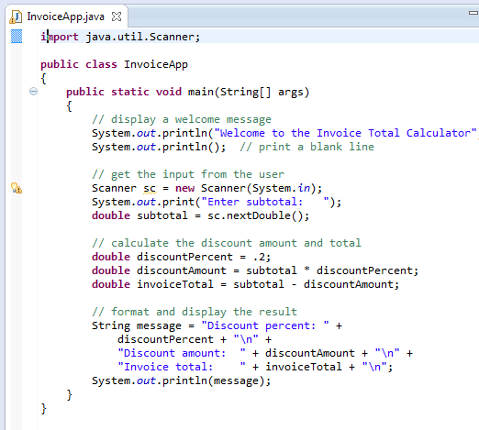
Tracing local variables: A Review
method: main
sc
Scanner
an object reference
a Scanner object
subtotal
500
double
“scrap paper”

Slide 26
Variables and Literals
A variable is a named storage location in the computer’s memory.
A literal is a value that is written into the code of a program.
Programmers determine the number and type of variables a program will need.
// This program has a variable.
public class Variable
{
public static void main(String[] args)
{
int value;
value = 5;
System.out.print("The value is ");
System.out.println(value);
}
}

Slide 27
Variables and Literals
This line is called
a variable declaration.
int value;
The following line is known
as an assignment statement.
value = 5;
0x000
The value 5
is stored in
memory.
0x001
5
0x002
0x003
This is a string literal. It will be printed as is.
System.out.print("The value is ");
System.out.println(value);
The integer 5 will
be printed out here.
Notice no quote marks?

Slide 28
Variable declaration, initialization and assignment

Slide 29
Best Practice: Variable Naming
Start variable names with a lowercase letter and capitalize the first letter in all words after the first word.
Each variable name should be a noun or a noun preceded by one or more adjectives.
Try to use meaningful names that are easy to remember. And make the code more readable and more maintainable.
Which of the following is more descriptive?
double tr = 0.0725;
double salesTaxRate = 0.0725;
Java programs should be self-documenting.
Use camelCase for variable names Use PascalCase for classes

Slide 30
Variable Assignment and Initialization
30-31
In order to store a value in a variable, an assignment statement must be used.
The assignment operator is the equal (=) sign.
The operand on the left side of the assignment operator must be a variable name.
The operand on the right side must be either a literal or expression that evaluates to a type that is compatible with the type of the variable.

Slide 31
Variable Assignment and Initialization
// This program shows variable assignment. public class Initialize { public static void main(String[] args) { int month, days; month = 2; days = 28; System.out.println("Month " + month + " has " + days + " Days."); }
}
These local variables must be declared before they can be used.

Slide 32
Variable Assignment and Initialization
// This program shows variable assignment. public class Initialize { public static void main(String[] args) { int month, days; month = 2; days = 28; System.out.println("Month " + month + " has " + days + " Days."); }
}
Once declared, they can then receive a value (initialization);
however the value must be compatible with the variable’s
declared type.

Slide 33
Variable Assignment and Initialization
// This program shows variable assignment. public class Initialize { public static void main(String[] args) { int month, days; month = 2; days = 28; System.out.println("Month " + month + " has " + days + " Days."); }
}
After receiving a value, the variables can then be used in
output statements or in other calculations.

Slide 34
Variable Assignment and Initialization
// This program shows variable initialization. public class Initialize { public static void main(String[] args) { int month = 2, days = 28;
System.out.println("Month " + month + " has " + days + " Days."); }
}
Local variables can be declared and initialized on
the same line.

Slide 35
Variable Assignment and Initialization
Variables can only hold one value at a time.
Local variables do not receive a default value.
Local variables must have a valid type in order to be used.
public static void main(String [] args) { int month, days; // No value given?
System.out.println("Month " + month + " has " + days + " Days."); } Trying to use uninitialized local variables will generate a Syntax Error when the code is compiled.

Slide 36
Default Values for Instance Variables
Default initial value -- the default value of any instance variable not explicitly initialized when it is declared.
Fields of numeric primitive types have the value zero by default.
Boolean variables have the value false,
Char variables have the value \u0000
Object references have the value null.
Don't make me guess!
Your code should be explicit and easy to read.
Initialize your variables soon after they are declared.

Slide 37
Constants

Slide 38
Creating Constants
Many programs have data that does not need to be changed.
Littering programs with literal values can make the program hard do read and maintain.
Replacing literal values with constants remedies this problem.
Constants allow the programmer to use a name rather than a value throughout the program.
Constants also give a singular point for changing those values when needed.
Constants keep the program organized and easier to maintain.
Constants are identifiers that can hold only a single value.
Constants are declared using the keyword final.
Constants need not be initialized when declared; however, they must be initialized before they are used or a compiler error will be generated.

Slide 39
Creating Constants
Once initialized with a value, constants cannot be changed programmatically.

Slide 40
Arithmetic Expressions and Operators

Slide 41
Arithmetic Expressions and Operators
Arithmetic operator
Operators, such as +, -, *, / and %, that produce a numerical result, as part of an arithmetic expression.
Arithmetic expression
An arithmetic expression is an expression that results in a numeric value.
Examples
5 | -18.02 | price (a variable defined as float)
6 + 3.5 | 18 % 5 | quantity (a variable defined as int)
price * quantity | 0.2 * price | (quantity + 1) * price

Slide 42
Arithmetic Operators

Slide 43
Binary Operators
Binary operators
must have two operands.
Each operator must have a left and right operator.
The arithmetic operators work as one would expect.
It is an error to try to divide any number by zero.
When working with two integer operands, the division operator requires special attention.
http://jackmyers.info/ioop/src/Lesson-03/arithmeticExpressions/Wages.java

Slide 44
Arithmetic Operators and Expressions
Statements that use simple arithmetic expressions

Slide 45
Examples of simple assignment statements

Slide 46
Examples

Slide 47
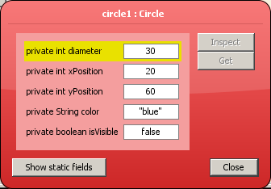
Assignment Statements
Values are stored into fields (and other variables) via assignment statements:
variable = expression;
diameter = 30;
public Circle()
{
diameter = 30;
xPosition = 20;
yPosition = 60;
color = "blue";
isVisible = false;
}

Slide 48
Assignment Statements
Can only store one thing in field at a time
Newer values overwrite older ones
Weird (but legal) code:
public Circle()
{
diameter = 850;
diameter = 30;
xPosition = -140;
yPosition = 60;
color = "blue";
isVisible = false;
xPosition = 20;
}

Slide 49
Integer Division
Division can be tricky.
In a Java program, what is the value of 1/2?
You might think the answer is 0.5…
But, that’s wrong.
The answer is simply 0.
Integer division will truncate any decimal remainder.

Slide 50
Combined Assignment Operators
Java has some combined assignment operators.
These operators allow the programmer to perform an arithmetic operation and assignment with a single operator.
Although not required, these operators are popular since they shorten simple equations.

Slide 51
Combined Assignment Operators
Operator | Example | Equivalent | Value of variable after operation
+= | x += 5; | x = x + 5; | The old value of x plus 5
-= | y -= 2; | y = y – 2; | The old value of y minus 2
*= | z *= 10; | z = z * 10; | The old value of z times 10
/= | a /= b; | a = a / b; | The old value of a divided by b
%= | c %= 3; | c = c % 3; | The remainder of the division of the old value of c divided by 3

Slide 52
Using Operators with Variables

Slide 53
Operator Precedence
Mathematical expressions can be very complex.
There is a set order in which arithmetic operations will be carried out.
Operator | Associativity | Example | Result
- (unary negation) | right to left | x = -4 + 3; | -1
* / % | left to right | x = -4 + 4 % 3 * 13 + 2; | 11
+ - | left to right | x = 6 + 3 – 4 + 6 * 3; | 23
Higher
Priority
Lower
Priority

Slide 54
Grouping with Parenthesis
When parenthesis are used in an expression, the inner most parenthesis are processed first.
If two sets of parenthesis are at the same level, they are processed left to right.
x = ((4*5) / (5-2) ) – 25; // result = -19
3
4
1
2

Slide 55
++ and -- operators
i = 5; System.out.println(++i); //6
This prints out "6" because it takes i adds one to it and returns the value. 5+1=6; This is prefixing, adding to the number before using it in the operation.
i = 6; System.out.println(i++); //6 (i = 7, prints 6)
This prints out "6" because it takes i, stores a copy, adds 1 and returns the copy. So you get the value that i was, but also increment it at the same time.

Slide 56
Casting

Slide 57
Implicit Casting
You can convert one data type to another, by a operation called “casting”.
Two ways to cast: implicitly and explicitly
http://jackmyers.info/ioop/src/Lesson-03/casting/Casting.java

Slide 58
Explicit Casting

Slide 59
Casting between char and int

Slide 60
Strings

Slide 61
The String Class
Java has no primitive data type that holds a series of characters.
The String class from the Java standard library is used for this purpose.
In order to be useful, the a variable must be created to reference a String object.
String number;
Notice the S in String is upper case.
By convention, class names should always begin with an upper case character.
// A simple program demonstrating String // objects.
public class StringDemo
{
public static void main(String[] args)
{
String greeting = "Good morning ";
String name = "Herman";
System.out.println(greeting + name);
}
}

Slide 62
The String Methods
Since String is a class, objects that are instances of it have methods.
One of those methods is the length method.
stringSize = name.length();
This statement calls the length method on the object pointed to by the name variable.
// This program demonstrates the String // class's length method.
public class StringLength
{
public static void main(String[] args)
{
String name = "Herman";
int stringSize;
stringSize = name.length();
System.out.println(name + " has " + stringSize + " characters.");
}
}

Slide 63
String Methods
The String class contains many methods that help with the manipulation of String objects.
String objects are immutable, meaning that they cannot be changed.
Many of the methods of a String object can create new versions of the object.
// This program demonstrates a few of the // String methods.
public class StringMethods
{
public static void main(String[] args)
{
String message = "Java is Great Fun!";
String upper = message.toUpperCase();
String lower = message.toLowerCase();
char letter = message.charAt(2);
int stringSize = message.length();
System.out.println(message);
System.out.println(upper);
System.out.println(lower);
System.out.println(letter);
System.out.println(stringSize);
}
}

Slide 64
Using Strings
Java commands that have string literals must be treated with care.
A string literal value cannot span lines in a Java source code file.
System.out.println("This line is too long and now it has spanned more than one line, which will cause a syntax error to be generated by the compiler. ");

Slide 65
String Concatenation
The String concatenation operator can be used to fix this problem.
System.out.println("These lines are " +
"now ok and will not " +
"cause the error as before.");
String concatenation can join various data types.
System.out.println("We can join a string to " +
"a number like this: " + 5);

Slide 66
The + Operator
The + operator can be used in two ways.
(1) as a concatenation operator
(2) as an addition operator
If either side of the + operator is a string, the result will be a string.
System.out.println("Hello " + "World");
System.out.println("The value is: " + 5);
System.out.println("The value is: " + value);
System.out.println("The value is: " + '/n' + 5);

Slide 67
String Concatenation
The Concatenation operator can be used to format complex String objects.
System.out.println("The following will be printed " +
"in a tabbed format: " +
"\n\tFirst = " + 5 * 6 + ", " +
"\n\tSecond = " + 6 + 4 + "," +
"\n\tThird = " + 16.7 + ".");
Notice that if an addition operation is also needed, it must be put in parenthesis.
"\n\tSecond = " + (6 + 4) + "," +
What number will this line print? →
30
← What number will this line print?
64
http://jackmyers.info/ioop/src/Lesson-03/stringAddition/StringAddition.java

Slide 68
Quiz
System.out.println(5 + 6 + "hello");
System.out.println("hello" + 5 + 6);
11hello
hello56
4 + 5
9
"wind" + "ow"
"window"
"Result: " + 6
"Result: 6"
int price = 500; "# " + price + " cents"
"# 500 cents"
overloading
Notes:
try out in codepad

Slide 69
Using + and += with string variables

Slide 70
Java Escape Sequences
\n | newline | Advances the cursor to the next line for subsequent printing
\t | tab | Causes the cursor to skip over to the next tab stop
\b | backspace | Causes the cursor to back up, or move left, one position
\r | carriage return | Causes the cursor to go to the beginning of the current line, not the next line
\\ | backslash | Causes a backslash to be printed
\' | single quote | Causes a single quotation mark to be printed
\" | double quote | Causes a double quotation mark to be printed

Slide 71
Java Escape Sequences
Even though the escape sequences are comprised of two characters, they are treated by the compiler as a single character.
System.out.print("These are our top sellers:\n");
System.out.print("\tComputer games\n\tCoffee\n ");
System.out.println("\tAspirin");
Would result in the following output:
These are our top seller:
Computer games
Coffee
Asprin
With these escape sequences, complex text output can be achieved.

Slide 72
More Examples of Java Escape Sequences

Slide 73
Using the console for input and output

Slide 74
Console Output
The console window that starts a Java application is typically known as the standard output device.
The standard input device is typically the keyboard.
Java sends information to the standard output device by using a Java class stored in the standard Java library.
Java classes in the standard Java library are accessed using the Java Applications Programming Interface (API).
The standard Java library is commonly referred to as the Java API.

Slide 75
Console Output
36-37
Consider the line:
System.out.println("Programming is great fun!");
This line uses the System class from the standard Java library.
The System class contains methods and objects that perform system level tasks.
The out object, a member of the System class, contains the methods print and println.
The print and println methods actually perform the task of sending characters to the output device.
The value inside the parenthesis will be sent to the output device (in this case, a string).

Slide 76
Console Output: println
36-37
The println method places a newline character at the end of whatever is being printed out.
The following lines:
System.out.println("This is being printed out");
System.out.println("on two separate lines.");
Would be printed out on separate lines since the first statement sends a newline command to the screen.
Use println(); to print a blank line

Slide 77
Console Output: print
The print statement works very similarly to the println statement.
However, the print statement does not put a newline character at the end of the output.
The lines:
System.out.print("These lines will be");
System.out.print("printed on");
System.out.println("the same line.");
Will output: These lines will beprinted onthe same line.
Notice the odd spacing? Why do some words run together?

Slide 78
An Aside on Packages and Import: Java Packages
Java organizes its library of classes into packages
Package = directory. Java classes can be grouped together in packages. A package name is the same as the directory (folder) name which contains the .java files. You declare packages when you define your Java program, and you name the packages you want to use from other libraries in an import statement.

Slide 79
An Aside on Packages and Import: Java Packages
An import statement is a way of making more of the functionality of Java available to your program.

Slide 80
The Scanner Class
To read input from the keyboard we can use the Scanner class.
The Scanner class is defined in java.util, so we will use the following statement at the top of our programs: import java.util.Scanner;
Scanner objects work with System.in
To create a Scanner object: Scanner keyboard = new Scanner (System.in);

Slide 81
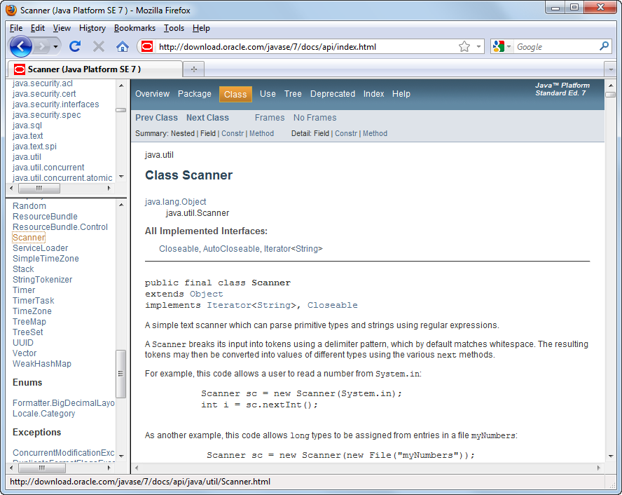
Console Input
The Scanner class
java.util.Scanner
How to use the Scanner class to create an object
With an import statement
Scanner sc = new Scanner(System.in);
Without an import statement
java.util.Scanner sc = new java.util.Scanner(System.in);
The documentation for the Scanner class

Slide 82
Using the Scanner Object

Slide 83
print() and printf()

Slide 84
The printf Method
You can perform formatted console output with the System.out.printf method.
The method’s general format is:
System.out.printf(FormatString, ArgumentList)
FormatString is a string that contains text and/or special formatting specifiers
ArgumentList is a list of zero or more additional arguments, formatted according to the format specifiers listed in the FormatString.

Slide 85
Simple Output
The simplest way you can use the printf method is with only a format string and no additional arguments.
System.out.printf("I love Java programming.\n");
This method call simply prints the string "I love Java programming.\n".
Using the method without any format specifiers is like using the System.out.print method.
\n is the newline character.

Slide 86
Single Format Specifier and Argument
Let’s look at an example that uses a format specifier and an additional argument:
int hours = 40;
System.out.printf("I worked %d hours this week.\n",hours);
When this string is printed, the value of the hours argument will be printed in place of the %d format specifier.
I worked 40 hours this week.
The %d format specifier was used because the hours variable is an int.
An error will occur if you use %d with a non-integer value.

Slide 87
Multiple Format Specifiers and Arguments
Here’s another example:
int dogs = 2;
int cats = 4;
System.out.printf( "We have %d dogs and %d cats.\n",dogs, cats);
First, notice that this example uses two %d format specifiers in the format string.
Also notice that two arguments appear after the format string.
The value of the first integer argument, dogs, is printed in place of the first %d.
The value of the second integer argument, cats, is printed in place of the second %d.
We have 2 dogs and 4 cats.

Slide 88
Multiple Format Specifiers and Arguments
The following code shows another example:
int value1 = 3;
int value2 = 6;
int value3 = 9;
System.out.printf("%d %d %d\n", value1, value2, value3);
In the printf method call, there are three format specifiers and three additional arguments after the format string.
This code will produce the following output:
3 6 9
These examples show the one-to-one correspondence between the format specifiers and the arguments that appear after the format string.

Slide 89
Setting the Field Width
A format specifier may also include a field width. Here is an example:
int number = 9;
System.out.printf("The value is %6d\n", number);
The format specifier %6d indicates that the argument number should be printed in a field that is 6 places wide. If the value in number is shorter than 6 places, it will be right justified. Here is the output of the code.
The value is 9
the value of the argument is wider than the specified field width, the field width will be expanded to accommodate the value.
1
2
3
4
5
6

Slide 90
Using Field Widths to Print Columns
Field widths can help when you need to print values aligned in columns. For example, look at the following code:
int num1 = 97654, num2 = 598; int num3 = 86, num4 = 56012; int num5 = 246, num6 = 2; System.out.printf("%7d %7d\n", num1, num2); System.out.printf("%7d %7d\n", num3, num4); System.out.printf("%7d %7d\n", num5, num6);
This code displays the values of the variables in a table with three rows and two columns. Each column has a width of seven spaces. Here is the output for the code:
97654 598 86 56012 246 2
1
2
3
4
5
6
7
1
2
3
4
5
6
7

Slide 91
Printing Formatted Floating-Point Values
If you wish to print a floating-point value, use the %f format specifier. Here is an example:
double number = 1278.92; System.out.printf("The number is %f\n", number);
This code produces the following output:
The number is 1278.920000
You can also use a field width when printing floating-point values. For example the following code prints the value of number in a field that is 18 spaces wide:
System.out.printf("The number is %18f\n", number);

Slide 92
Printing Formatted Floating-Point Values
In addition to the field width, you can also specify the number of digits that appear after the decimal point. Here is an example:
double grossPay = 874.12; System.out.printf("Your pay is %.2f\n", grossPay);
In this code, the %.2f specifier indicates that the value should appear with two digits after the decimal point. The output of the code is:
Your pay is 874.12
1
2

Slide 93
Printing Formatted Floating-Point Values
When you specify the number of digits to appear after the decimal point, the number will be rounded. For example, look at the following code:
double number = 1278.92714; System.out.printf("The number is %.2f\n", number);
This code will produce the following output:
The number is 1278.93
1
2

Slide 94
Printing Formatted Floating-Point Values
You can specify both the field width and the number of decimal places together, as shown here:
double grossPay = 874.12; System.out.printf("Your pay is %8.2f\n", grossPay);
The output of the code is:
Your pay is 874.12
1
2
3
4
5
6
7
8
1
2

Slide 95
Printing Formatted Floating-Point Values
You can also use commas to group digits in a number. To do this, place a comma after the % symbol in the format specifier. Here is an example:
double grossPay = 1253874.12; System.out.printf("Your pay is %,.2f\n", grossPay);
This code will produce the following output:
Your pay is 1,253,874.12

Slide 96
Printing Formatted String Values
If you wish to print a string argument, use the %s format specifier. Here is an example:
String name = "Ringo";
System.out.printf("Your name is %s\n", name);
This code produces the following output:
Your name is Ringo

Slide 97
Printing Formatted String Values
You can also use a field width when printing strings. For example, look at the following code:
String name1 = "George", name2 = "Franklin"; String name3 = "Jay", name4 = "Ozzy"; String name5 = "Carmine", name6 = "Dee"; System.out.printf("%10s %10s\n", name1, name2); System.out.printf("%10s %10s\n", name3, name4); System.out.printf("%10s %10s\n", name5, name6);
This code displays the values of the variables in a table with three rows and two columns. Each column has a width of ten spaces. Here is the output of the code:
George Franklin Jay Ozzy Carmine Dee

Slide 98
More Format Specifiers
Java provides much more powerful format specifiers for more complex formatting needs.
The API documentation gives an overview of them all.
http://download.oracle.com/javase/7/docs/api/

Slide 99
Conditional Control Structures

Slide 100
The if Statement
The if statement decides whether a section of code executes or not.
The if statement uses a boolean to decide whether the next statement or block of statements executes.
if (boolean expression is true)
execute next statement.

Slide 101
Flowcharts
If statements can be modeled as a flow chart.
if (coldOutside)
wearCoat();
Is it cold
outside?
Yes
Wear a coat.

Slide 102
Flowcharts
A block if statement may be modeled as:
if (coldOutside) {
wearCoat();
wearHat();
wearGloves();
}
Is it cold
outside?
Yes
Wear a coat.
Wear a hat.
Wear gloves.
Note the use of curly
braces to block several
statements together.

Slide 103
Relational Operators
In most cases, the boolean expression, used by the if statement, uses relational operators.
Relational Operator | Meaning
> | is greater than
< | is less than
>= | is greater than or equal to
<= | is less than or equal to
== | is equal to
!= | is not equal to

Slide 104
Boolean Expressions
A boolean expression is any variable or calculation that results in a true or false condition.
Expression | Meaning
x > y | Is x greater than y?
x < y | Is x less than y?
x >= y | Is x greater than or equal to y?
x <= y | Is x less than or equal to y.
x == y | Is x equal to y?
x != y | Is x not equal to y?

Slide 105
Boolean Expressions

Slide 106
if Statements and Boolean Expressions
if (x > y)
System.out.println("X is greater than Y");
if (x == y)
System.out.println("X is equal to Y");
if (x != y)
{
System.out.println("X is not equal to Y");
x = y;
System.out.println("However, now it is.");
}
Example: http://jackmyers.info/ioop/src/Lesson-03/booleanExpressions_conditionalStatements/AverageScore.java

Slide 107
Programming Style and if Statements
An if statement can span more than one line; however, it is still one statement.
if (average > 95)
grade = ′A′;
is functionally equivalent to
if(average > 95) grade = ′A′;

Slide 108
Programming Style and if Statements
Rules of thumb:
The conditionally executed statement should be on the line after the if condition.
The conditionally executed statement should be indented one level from the if condition.
If an if statement does not have the block curly braces, it is ended by the first semicolon encountered after the if condition.
if (expression)
statement;
No semicolon here.
Semicolon ends statement here.

Slide 109
Block if Statements
Conditionally executed statements can be grouped into a block by using curly braces {} to enclose them.
If curly braces are used to group conditionally executed statements, the if statement is ended by the closing curly brace.
if (expression)
{
statement1;
statement2;
}
Curly brace ends the statement.

Slide 110
Block if Statements
Remember that when the curly braces are not used, then only the next statement after the if condition will be executed conditionally.
if (expression)
statement1;
statement2;
statement3;
Only this statement is conditionally executed.

Slide 111
Flags
A flag is a boolean variable that monitors some condition in a program.
When a condition is true, the flag is set to true.
The flag can be tested to see if the condition has changed.
if (average > 95)
highScore = true;
Later, this condition can be tested:
if (highScore)
System.out.println("That′s a high score!");

Slide 112
Comparing Characters
Characters can be tested using the relational operators.
Characters are stored in the computer using the Unicode character format.
Unicode is stored as a sixteen (16) bit number.
Characters are ordinal, meaning they have an order in the Unicode character set.
Since characters are ordinal, they can be compared to each other.
char c = ′A′;
if(c < ′Z′)
System.out.println("A is less than Z");

Slide 113
if-else Statements
The if-else statement adds the ability to conditionally execute code when the if condition is false.
if (expression)
statementOrBlockIfTrue;
else
statementOrBlockIfFalse;
See example: http://jackmyers.info/ioop/src/Lesson-03/booleanExpressions_conditionalStatements/Division.java

Slide 114
The Payroll Class
// Determine whether the employee worked over 40 hours
if (hoursWorked > 40)
{
// Calculate regular pay for the first 40 hours.
grossPay = 40 * payRate;
// Calculate overtime pay at 1.5 times the regular
// hourly pay rate.
overtimePay = (hoursWorked - 40) * (payRate * 1.5);
// Add the overtime pay to regular pay.
grossPay += overtimePay;
}
else
{
// No overtime worked.
grossPay = payRate * hoursWorked;
}
Example File:
http://jackmyers.info/java/src/Lesson-01/1-4/Payroll.java
Payroll
hoursWorked : double
payRate : double
+ setHoursWorked(hours : double) : void
+ setPayRate(rate : double): void
+ getHoursWorked() : double
+ getPayRate() : double
+ getGrossPay() : double

Slide 115
if-else Statement Flowcharts
No
Yes
Is it cold
outside?
Wear shorts.
Wear a coat.

Slide 116
if-else-if Statements
if-else-if statements can become very complex.
Imagine the following decision set.
if it is very cold, wear a heavy coat,
else, if it is chilly, wear a light jacket,
else, if it is windy wear a windbreaker,
else, if it is hot, wear no jacket.

Slide 117
if-else-if Statements
if (expression)
statement or block
else if (expression)
statement or block
// Put as many else ifs as needed here
else
statement or block
Care must be used since else statements match up with the immediately preceding unmatched if statement.

Slide 118
Example
if (score < 60)
grade = 'F';
else if (score < 70)
grade = 'D';
else if (score < 80)
grade = 'C';
else if (score < 90)
grade = 'B';
else if (score <= 100)
grade = 'A';
else // Invalid score
grade = '?';
See http://jackmyers.info/ioop/src/Lesson-03/booleanExpressions_conditionalStatements/TestGrade.java

Slide 119
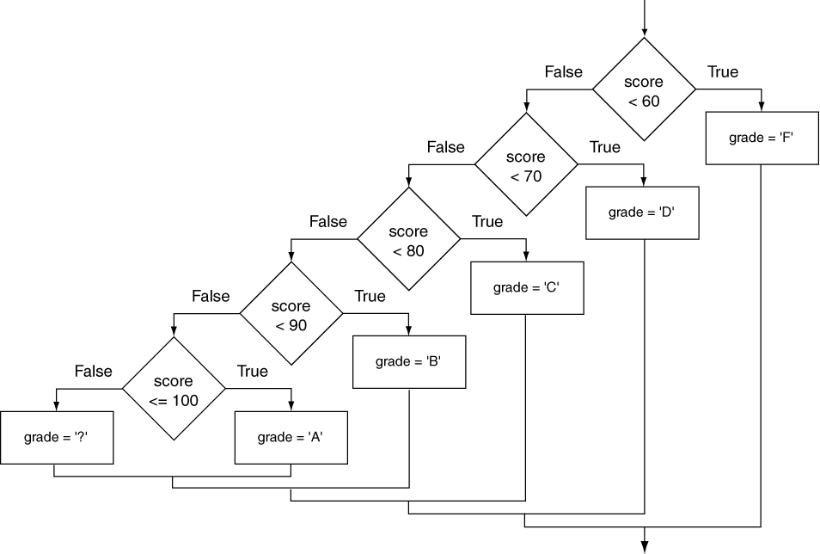
if-else-if Flowchart

Slide 120
Nested if Statements
// Determine whether the user qualifies.
if (employed == 'y')
{
if (recentGrad == 'y')
{
System.out.println("You qualify for " + "the special interest rate.");
}
else
{
System.out.println("You must be a " +
"recent college graduate to qualify.");
}
}
else
{
System.out.println("You must be employed" + to qualify.");
}
}
If an if statement appears inside another if statement (single or block) it is called a nested if statement.
The nested if is executed only if the outer if statement results in a true condition.
See example: http://jackmyers.info/ioop/src/Lesson-03/booleanExpressions_conditionalStatements/LoanQualifier.java

Slide 121
Nested if Statement Flowcharts
No
Yes
Is it cold
outside?
Wear shorts.
No
Is it
snowing?
Yes
Wear a jacket.
Wear a parka.

Slide 122
if-else Matching
Curly brace use is not required if there is only one statement to be conditionally executed.
However, sometimes curly braces can help make the program more readable.
Additionally, proper indentation makes it much easier to match up else statements with their corresponding if statement.

Slide 123
if-else Matching
This else
matches
with this
if.
if (employed == ′y′)
{
if (recentGrad == ′y′)
{
System.out.println("You qualify for the " +
"special interest rate.");
}
else
{
System.out.println("You must be a recent " +
"college graduate to qualify.");
}
}
else
{
System.out.println("You must be employed to qualify.");
}
This else
matches
with this
if.

Slide 124
Boolean (or Logical) Operators
Java provides two binary logical operators (&& and ||) that are used to combine boolean expressions.
Java also provides one unary (!) logical operator to reverse the truth of a boolean expression.
Operator | Meaning | Effect
&& | AND | Connects two boolean expressions into one. Both expressions must be true for the overall expression to be true.
|| | OR | Connects two boolean expressions into one. One or both expressions must be true for the overall expression to be true. It is only necessary for one to be true, and it does not matter which one.
! | NOT | The ! operator reverses the truth of a boolean expression. If it is applied to an expression that is true, the operator returns false. If it is applied to an expression that is false, the operator returns true.

Slide 125
The && Operator
The logical AND operator (&&) takes two operands that must both be boolean expressions.
The resulting combined expression is true if (and only if) both operands are true.
See example: jackmyers.info/ioop/src/Lesson-03/booleanExpressions_conditionalStatements/LogicalAnd.java
Expression 1 | Expression 2 | Expression1 && Expression2
true | false | false
false | true | false
false | false | false
true | true | true

Slide 126
Example of &&
public class PresidentialQualifier {
public static void main(String []args) {
int age = 37;
int yearsLivedInUS = 12;
boolean isCitizen = true;
if (age >= 35 && yearsLivedInUS >= 14 && isCitizen) {
System.out.println("Eligible to be U.S. President");
}
else {
System.out.println("Not eligible to be U.S. President");
}
}
}
Eligible or not?

Slide 127
The || Operator
The logical OR operator (||) takes two operands that must both be boolean expressions.
The resulting combined expression is false if (and only if) both operands are false.
See example: jackmyers.info/ioop/src/Lesson-03/booleanExpressions_conditionalStatements/LogicalOr.java
Expression 1 | Expression 2 | Expression1 || Expression2
true | false | true
false | true | true
false | false | false
true | true | true

Slide 128
The ! Operator
The ! operator performs a logical NOT operation.
If an expression is true, !expression will be false.
if (!(temperature > 100))
System.out.println("Below the maximum temperature.");
If temperature > 100 evaluates to false, then the output statement will be run.
See example: jackmyers.info/ioop/src/Lesson-03/booleanExpressions_conditionalStatements/LogicalNot.java
Expression 1 | !Expression1
true | false
false | true

Slide 129
Short Circuiting
Logical AND and logical OR operations perform short-circuit evaluation of expressions.
Logical AND will evaluate to false as soon as it sees that one of its operands is a false expression.
Logical OR will evaluate to true as soon as it sees that one of its operands is a true expression.
However, there are two other operators which will not short-circuit:
&
|

Slide 130
Logical Operators
Counter will always increment, even if isValid is false.
No short-circuiting
Counter will always increment, even if isValid is true.
No short-circuiting

Slide 131
The Exclusive Or ^
public class DualLightSwitch {
public static void main(String []args) {
String upstairsLightSwitch = "up";
String downstairsLightSwitch = "up";
if (upstairsLightSwitch.equals("up") ^
downstairsLightSwitch.equals("up")) {
System.out.println("Light is on");
}
else {
System.out.println("Light is off");
}
}
}
Light on or off?

Slide 132
Order of Precedence
The ! operator has a higher order of precedence than the && and || operators.
The && and || operators have a lower precedence than relational operators like < and >.
Parenthesis can be used to force the precedence to be changed.

Slide 133
Order of Precedence
Order | Operators | Description
1 | (unary negation) ! | Unary negation, logical NOT
2 | * / % | Multiplication, Division, Modulus
3 | + - | Addition, Subtraction
4 | < > <= >= | Less-than, Greater-than, Less-than or equal to, Greater-than or equal to
5 | == != | Is equal to, Is not equal to
6 | & | Boolean Logical AND
7 | ^ | Boolean Logical Exclusive OR
8 | | | Boolean Logical OR
9 | && | Logical AND
10 | || | Logical OR
11 | ? : | Conditional or Ternary operator
12 | = += -= *= /= %= | Assignment and combined assignment operators.

Slide 134
Comparing String Objects
In most cases, you cannot use the relational operators to compare two String objects.
Reference variables contain the address of the object they represent.
Unless the references point to the same object, the relational operators will not return true.
See examples
See example: http://jackmyers.info/ioop/src/Lesson-03/booleanExpressions_conditionalStatements/GoodStringCompare.java
http://jackmyers.info/ioop/src/Lesson-03/booleanExpressions_conditionalStatements/StringCompareTo.java

Slide 135
Ignoring Case in String Comparisons
In the String class the equals and compareTo methods are case sensitive.
In order to compare two String objects that might have different case, use:
equalsIgnoreCase, or
compareToIgnoreCase
See example: http://jackmyers.info/ioop/src/Lesson-03/booleanExpressions_conditionalStatements/SecretWord.java

Slide 136
Examples

Slide 137
Unusual way Java uses == with Strings

Slide 138
Reminder On Variable Scope
29
In Java, a local variable does not have to be declared at the beginning of the method.
The scope of a local variable begins at the point it is declared and terminates at the end of the method.
When a program enters a section of code where a variable has scope, that variable has come into scope, which means the variable is visible to the program.
Let's explore:
http://jackmyers.info/ioop/src/Lesson-02/VariableScope.java

Slide 139
The Conditional Operator
The conditional operator is a ternary (three operand) operator.
You can use the conditional operator to write a simple statement that works like an if-else statement.
The format of the operators is:
expression1 ? expression2 : expression3
The conditional operator can also return a value.

Slide 140
The Conditional Operator
The conditional operator can be used as a shortened if-else statement:
x > y ? z = 10 : z = 5;
This line is functionally equivalent to:
if(x > y)
z = 10;
else
z = 5;

Slide 141
The Conditional Operator
Many times the conditional operator is used to supply a value.
number = x > y ? 10 : 5;
This is functionally equivalent to:
if(x > y)
number = 10;
else
number = 5;
See example:
http://jackmyers.info/ioop/src/Lesson-03/booleanExpressions_conditionalStatements/ConsultantCharges.java

Slide 142
The switch Statement
The if-else statement allows you to make true / false branches.
The switch statement allows you to use an ordinal value to determine how a program will branch.
The switch statement can evaluate an integer type or character type variable (or String) and make decisions based on the value.

Slide 143
The switch Statement
The switch statement takes the form:
switch (SwitchExpression)
{
case CaseExpression:
// place one or more statements here
break;
case CaseExpression:
// place one or more statements here
break;
// case statements may be repeated
//as many times as necessary
default:
// place one or more statements here
}

Slide 144
The switch Statement
The switch statement takes an ordinal value (byte, short, int, long, char, or String*) as the SwitchExpression.
switch (SwitchExpression)
{
…
}
The switch statement will evaluate the expression.
If there is an associated case statement that matches that value, program execution will be transferred to that case statement.
* Java version 7 and later.

Slide 145
The switch Statement
Each case statement will have a corresponding CaseExpression that must be unique.
case CaseExpression:
// place one or more statements here
break;
If the SwitchExpression matches the CaseExpression, the Java statements between the colon and the break statement will be executed.

Slide 146
The case Statement
The break statement ends the case statement.
The break statement is optional.
If a case does not contain a break, then program execution continues into the next case.
Examples
http://jackmyers.info/ioop/src/Lesson-03/booleanExpressions_conditionalStatements/NoBreaks.java
http://jackmyers.info/ioop/src/Lesson-03/booleanExpressions_conditionalStatements/PetFood.java
The default section is optional and will be executed if no CaseExpression matches the SwitchExpression.
See example: http://jackmyers.info/ioop/src/Lesson-03/booleanExpressions_conditionalStatements/SwitchDemo.java

Slide 147
Switch statement examples
A switch statement that uses an integer
A switch statement that uses a string

Slide 148
Fall through cases

Slide 149
IOOP Glossary Terms to Know
Terms to know for tests/quizzes (see class web site)
arithmetic expression | arithmetic operator | assignment operator | assignment statement | binary operator
block | boolean expression | cast | condition | conditional operator
constant | control structure | decrement operator | default initial value | default label
exclusive or operator | expression | final field variable | identifier | If, if-else
implicit type conversion | Increment operator | local variable | logical operator | object reference
operand | operator | operator precedence | post-decrement, post-increment | pre-decrement, pre-increment
quotient | relational operator | reserved word | short-circuit operator | string
switch statement | ternary operator | unary operator | uninitialized variable | variable declaration
wrapper classes |  | Non-glossary terms to know
 |  | conditional statement |  | literal

