Slide 1
Fun
ACT! Advanced
Computing
Technologies
Information Management Concepts

Slide 2
Introduction
The importance of data and information
Many organizations recognize their data is a vital enterprise asset.
Data and information gives insight about customers, products, and services. It can help companies innovate and reach strategic goals.
Despite that recognition, few organizations actively manage data as an asset from which they can derive ongoing value.
Deriving value from data doesn't happen in a vacuum or by accident; it requires:
intention, planning, coordination, commitment, management, leadership.
Data Management: the development, execution, and supervision of plans, policies, programs, and practices that deliver, control, protect, and enhance the value of data and information assets throughout their lifecycles.
Data Management Professional: any person who works in any facet of data management (from technical management of data throughout its lifecycle to ensuring that data is properly utilized and leveraged) to meet strategic organizational goals. Data management professionals fill many roles:
database administrators, network administrators, programmers, data stewards, data strategists, Chief Data Officers.

Slide 3
The DIKW Pyramid
Wisdom
Knowledge
Data
Information
+ insight
The ability to make well-informed decisions and take effective action based on understanding of the underlying knowledge
The result of analyzing and interpreting information to uncover patters trends and relationships. Provides an understanding of "how" and "why" certain phenomena occur.
+ meaning
+ context
Organized structured and contextualized data. Information is useful for answering basic questions like "who", "what", "where" and "when"
Raw, unprocessed facts and figures without context. Foundation for all subsequent layers, but holds limited value in isolation.

Slide 4
Fundamental IM Concepts
identification of information needs
Organization of information
acquisition and creation of information
Database creation and population
organization and storage of information
Quantum storage
Database modeling (ER diagrams) – high level
Database table structures
information access and dissemination
Database systems
Structured Query Language (SQL) – basic retrieval
analysis and interpretation of information
Structured Query Language (SQL) – aggregate functions

Slide 5
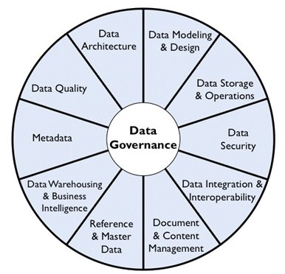
DMBOK
Data and information are also vital to the day-to-day operations of most organizations. They have been called the ‘currency’, the ‘life blood’, and even the ‘new oil’ of the information economy.
To support the data management professionals who carry out the work, DAMA International (The Data Management Association) has produced the second edition of The DAMA Guide to the Data Management Body of Knowledge (DMBOK2).
DAMA. Earley, S., & Henderson, D., Sebastian-Coleman, L (Eds.). The DAMA Guide to the Data Management Body of Knowledge (DAMA-DM BOK). Bradley Beach, NJ: Technics Publications, LLC. 2017.

Slide 6
DMBOK in Other Courses
CS 02435 - Database Systems: Theory and Programming ❶
CS 02440 - Data Warehousing ❷
CS 02480 - Introduction to Data Mining ❸
CS 02485 - Web and Text Mining ❹
This course 
The DAMA Wheel defines the Data Management Knowledge Areas. It places data governance at the center of data management activities, since governance is required for consistency within and balance between the functions. The other Knowledge Areas (Data Architecture, Data Modeling, etc.) are balanced around the Wheel.
✪
✪
②
②
①
②
④
②
①
②
①
②
③
②
③
①
②
④
✪
DAMA. Earley, S., & Henderson, D., Sebastian-Coleman, L (Eds.). The DAMA Guide to the Data Management Body of Knowledge (DAMA-DM BOK). Bradley Beach, NJ: Technics Publications, LLC. 2017.

Slide 7
DMBOK Areas Not Covered In-depth
Data Governance
Data Architecture
Data Security
Document and Content Management
Reference and Master Data
Data Warehousing & Business Intelligence
Metadata
Data Quality

Slide 8
Data Governance
Strategy: defining, communicating, and driving execution of Data Strategy and Data Governance Strategy
Policy: setting and enforcing policies related to data and Metadata management, access, usage, security, and quality
Standards and quality: setting and enforcing Data Quality and Data Architecture standards
Oversight: providing hands-on observation, audit, and correction in key areas of quality, policy, and data management (often referred to as stewardship)
Compliance: ensuring the organization can meet data-related regulatory compliance requirements
Issue management: identifying, defining, escalating, and resolving issues related to data security, data access, data quality, regulatory compliance, data ownership, policy, standards, terminology, or data governance procedures
Data management projects: sponsoring efforts to improve data management practices
Data asset valuation: setting standards and processes to consistently define the business value of data assets

Slide 9
Governance Exercise
37 Interactive Entertainment (37IE) is one of the Top 25 Game Companies among the globe and one of the Top 20 Internet Companies within China. | Cinemark provides premium out-of-home entertainment experiences as one of the largest and most influential theatrical exhibition companies in the world | Grace Realty is in the industry of Offices of Real Estate Agents and Brokers. has been providing Ocean City New Jersey real estate services since 1947.
Rowan University is a public research university in Glassboro, New Jersey, with a medical campus in Stratford and medical and academic campuses in Camden. | Data Governance Questions to Ask What data is currently being collected? How is the data currently being used? What insights do we want to achieve? What data do we need to obtain? Why do you need certain data? How can you manage data? Who has access to the data? How is the data stored? How often is the data updated? How the data analyzed? What is the quality of the data? | Starbucks Corporation is an American multinational chain of coffeehouses and roastery reserves headquartered in Seattle, Washington. It was founded in 1971 and is currently the world's largest coffeehouse chain.

Slide 10
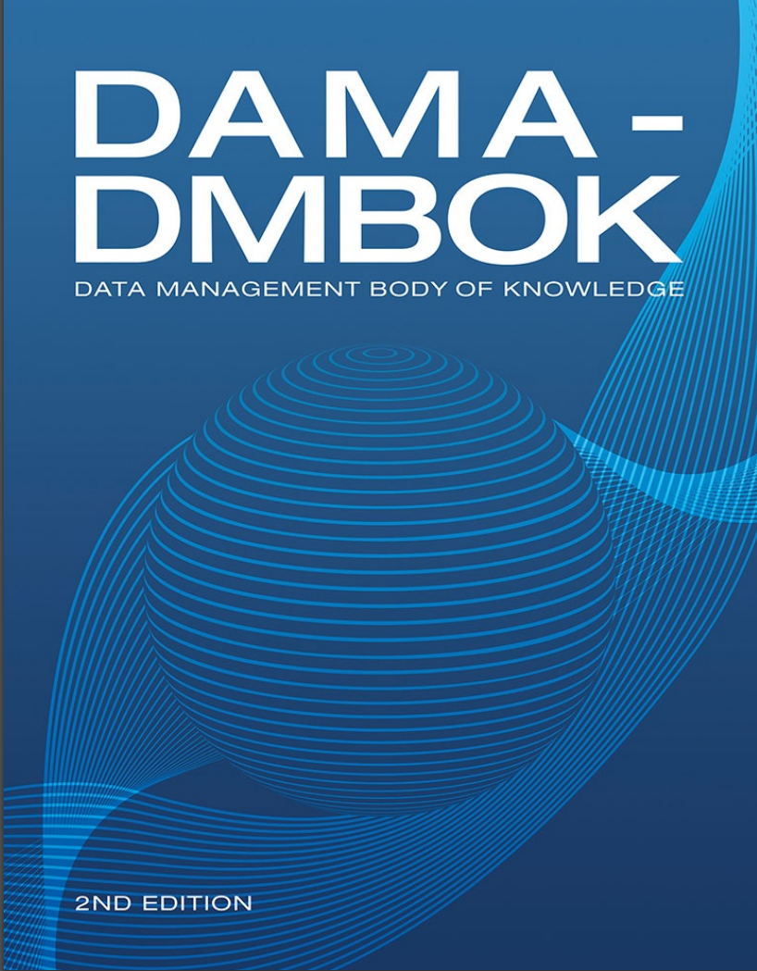
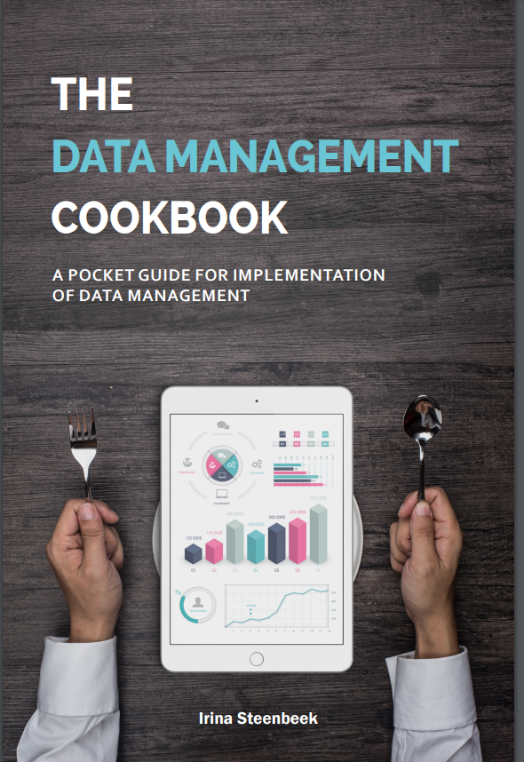
References for this Slide Deck

