Slide 1
Text By the Bay 2015: Marek Kolodziej Unsupervised NLP Tutorial using Apache Spark https://www.youtube.com/ watch?v=pIMs946Eu2U
The math gets deep around the 16th minute, but the concepts and principles are easily grasped.

Slide 2
Emphasis
Deep Learning and Word Vectors aren't that new — natural evolution of Natural Language Processing and Machine Learning
Deep learning, as the technique is known, involves applying layers of calculations to data, such as sound or images, to recognize key features and similarities.
It offers a powerful way for machines to recognize similarities that would normally be abstruse to a computer: the same face seen from different angles, for instance, or a word spoken in different accents. Will Knight, Sr. Editor, AI for the MIT Technology Review on May 31, 2015
Word Vectors, Distributed representations of words in a vector space help learning algorithms to achieve better performance in natural language processing tasks by grouping similar words. Tomas Mikolov, Google Engineer, Distributed Representations of Words and Phrases and their Compositionality

Slide 3
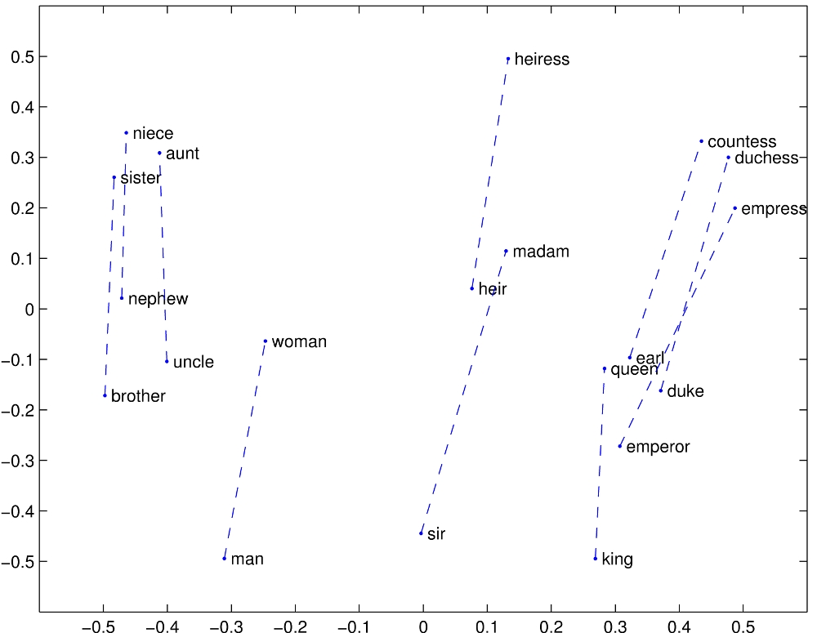
More on Word Vectors http://nlp.stanford.edu/projects/glove/
The Euclidean distance (or cosine similarity) between two word vectors provides an effective method for measuring the linguistic or semantic similarity of the corresponding words. Sometimes, the nearest neighbors according to this metric reveal rare but relevant words that lie outside an average human's vocabulary.

Slide 4
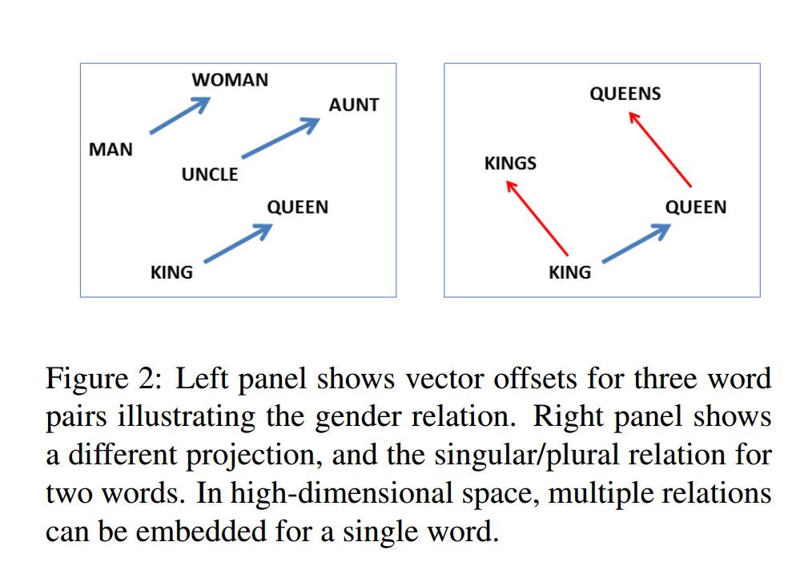
Word Vectors Mikolov's Research
"We have found that a simple vector offset method based on cosine distance is remarkably effective in solving these questions. In this method, we assume relationships are present as vector offsets, so that in the embedding space, all pairs of words sharing a particular relation are related by the same constant offset." – Tomas Mikolov, Microsoft Research, Linguistic Regularities in Continuous Space Word Representations, 2013
"Because of the much lower computational complexity, it is possible to compute very accurate high dimensional word vectors from a much larger data set." -- Tomas Mikolov, Google, Efficient Estimation of Word Representations in Vector Space, 2013
"To maximize the accuracy on the phrase analogy task, we increased the amount of the training data by using a dataset with about 33 billion words… This resulted in a model that reached an accuracy of 72%. We achieved lower accuracy 66% when we reduced the size of the training dataset to 6B words, which suggests that the large amount of the training data is crucial." -- Tomas Mikolov, Google, Distributed Representations of Words and Phrases and their Compositionality, 2013
From Linguistic Regularities in Continuous Space Word Representations

Slide 5
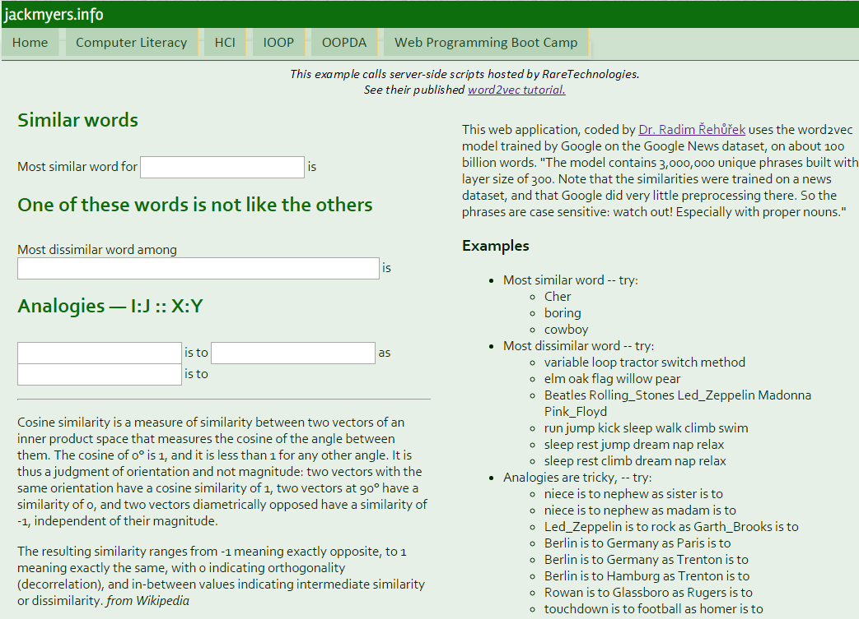
Demo: Google's word2vec
http://jackmyers.info/hci/lessons/08/w2vDemo.html

Slide 6
Emphasis
Deep Learning and Word Vectors aren't that new — natural evolution of Natural Language Processing and Machine Learning
What is new:
Fast Training: better algorithms, Graphics Processing Units (GPUs)
Uses in Real NLP Systems
Analogies like man : woman :: king : queen only a very primitive beginning

Slide 7
Traditional NLP Challenges
Complex preprocessing pipelines
Boilerplate detection (HTML tags, etc.)
Language detection
Sentence segmentation
Word segmentation / tokenization
In English, you can use white space between words.
But how about Mandarin?
Spell checking
Dealing with non-words – "graffe" ➔ "giraffe"
Dealing with real words and context – "I had chocolate mouse for desert."
Stemming and Lemmatization (see subsequent slides)
Stop Word Removal (see subsequent slides)
Case Folding – conversion to lower case
Often good, but is "Bath" = "bath"? Is "Jack" = "jack"? Is "Turkey" = "turkey"?
Americanization … or is that Americanisation? ☺
"rumour" or "rumor"? "catalog" or "catalouge"? "estrogen " or "oestrogen "?

Slide 8
Stemming and Lemmatization
Reduce inflectional forms and sometimes derivationally related forms of a word to a common base form
am, are, is ➔be
car, cars, car's, cars' ➔car
the boy's cars are different colors ➔ the boy car be differ color
Stemming – crude chopping or word suffixes (e.g., university → univers) vs. Lemmatization – uses a vocabulary and morphological analysis
Stop Word Removal
TF-IDF: (Term Frequency – Inverse Document Frequency)
Term Frequency is the relative* number of times a word appears in a document (*to avoid bias towards longer documents)
Inverse Document Frequency is a measure of how important the word is – namely, is it rare or common across all documents.
The least useful word in English might be "the"

Slide 9
Stop Words: How Are They Determined?
Stop Word Removal
TF-IDF: (Term Frequency – Inverse Document Frequency)
Term Frequency is the relative* number of times a word appears in a document (*to avoid bias towards longer documents)
Inverse Document Frequency is a measure of how important the word is – namely, is it rare or common across all documents.
The least useful word in English might be "the"
Term Frequency
Inverse Document Frequency
t = term; d = document;
N = number of documents in set
D = set of documents
Number of documents in which term t appears.

Slide 10
Four Sample Documents
For avocado purists - eating a half of a plain avocado sprinkled with lemon juice or your favorite seasoning is all you need. Try a little paprika or balsamic vinegar for an added twist.
Yosemite Sam is an American animated cartoon produced by Warner Bros. Animation. Along with Elmer Fudd, he is the de facto archenemy of Bugs Bunny.
A gin and tonic is a highball cocktail made with gin and tonic water poured over ice. It is usually garnished with a slice or wedge of lime. The amount of gin varies according to taste.
A glacier is a persistent body of dense ice that is constantly moving under its own weight; it forms where the accumulation of snow exceeds its ablation (melting and sublimation) over many years, often centuries.

Slide 11
doc1 doc2 doc3 doc4
tf("ice", doc3) = 0.5 + (0.5 x 1) / 3) = 0.667
tf("ice", doc4) = 0.5 + (0.5 x 1) / 2) = 0.75
idf("ice", doc1 thru doc4) = log (4 / (1 + 2) ) = 0.125
tf("of", doc3) = 0.5 + (0.5 x 2) / 3) = 0.833
tf("of", doc4) = 0.5 + (0.5 x 2) / 2) = 1.0
idf("of", doc1 thru doc4) = log (4 / (1 + 4) ) = -0.097
a | 3
avocado | 2
for | 2
or | 2
added | 1
all | 1
an | 1
balsamic | 1
eating | 1
favorite | 1
half | 1
is | 1
juice | 1
lemon | 1
little | 1
need | 1
of | 1
paprika | 1
plain | 1
purists | 1
seasoning | 1
sprinkled | 1
try | 1
twist | 1
vinegar | 1
with | 1
you | 1
your | 1
is | 2
along | 1
american | 1
an | 1
animated | 1
animation | 1
archenemy | 1
bros | 1
bugs | 1
bunny | 1
by | 1
cartoon | 1
de facto | 1
elmer | 1
fudd | 1
he | 1
of | 1
produced | 1
sam | 1
the | 1
warner | 1
with | 1
yosemite | 1
gin | 3
and | 2
is | 2
of | 2
tonic | 2
with | 2
according | 1
amount | 1
cocktail | 1
garnished | 1
highball | 1
ice | 1
it | 1
lime | 1
made | 1
or | 1
over | 1
poured | 1
slice | 1
taste | 1
the | 1
to | 1
usually | 1
varies | 1
water | 1
wedge | 1
a | 2
is | 2
its | 2
of | 2
ablation | 1
accumulation | 1
and | 1
body | 1
centuries | 1
constantly | 1
dense | 1
exceeds | 1
forms | 1
glacier | 1
ice | 1
it | 1
many | 1
melting | 1
moving | 1
often | 1
over | 1
own | 1
persistent | 1
snow | 1
sublimation | 1
that | 1
the | 1
under | 1
weight | 1
where | 1
years | 1

Slide 12
Higher tf values indicate higher term frequency per document.
Higher idf values indicate how "important" (unique) the word is. → "ice" more important than "of"
The term frequency – inverse document frequency measure (formula above) gives higher values to documents where the search term is more frequent and more uncommon.
tf("ice", doc3) = 0.5 + (0.5 x 1) / 3) = 0.667
tf("ice", doc4) = 0.5 + (0.5 x 1) / 2) = 0.75
idf("ice", doc1 thru doc4) = log (4 / 2 ) = 0.301
tf("of", doc3) = 0.5 + (0.5 x 2) / 3) = 0.833
tf("of", doc4) = 0.5 + (0.5 x 2) / 2) = 1.0
idf("of", doc1 thru doc4) = log (4 / 4 ) = 0
tf("snow", doc4) = 0.5 + (0.5 x 1) / 2) = 0.75
idf("snow", doc1 thru doc4) = log (4 / 1 ) = 0.602

Slide 13
Four Sample Documents
d | tfidf ("of", d, D) | tfidf("ice", d, D) | tfidf("snow", d, D)
doc1 | 0 | 0 | 0
doc2 | 0 | 0 | 0
doc3 | 0 | 0.201 (0.667 x 0.301) | 0
doc4 | 0 | 0.226 (0.75 x 0.301) | 0.451 (0.75 x 0.602)
 | "of" is a useless word (stop word) | doc4 better hit for "ice" than doc3. In this case, doc3's repetition of the word "gin" lowered the value of the word "ice" | "snow" is unique to doc4
For avocado purists - eating a half of a plain avocado sprinkled with lemon juice or your favorite seasoning is all you need. Try a little paprika or balsamic vinegar for an added twist. (doc1)
Yosemite Sam is an American animated cartoon produced by Warner Bros. Animation. Along with Elmer Fudd, he is the de facto archenemy of Bugs Bunny. (doc2)
A gin and tonic is a highball cocktail made with gin and tonic water poured over ice. It is usually garnished with a slice or wedge of lime. The amount of gin varies according to taste. (doc3)
A glacier is a persistent body of dense ice that is constantly moving under its own weight; it forms where the accumulation of snow exceeds its ablation (melting and sublimation) over many years, often centuries. (doc4)

Slide 14
The term frequency – inverse document frequency measure (formula above) gives higher values to documents where the search term is more frequent and more uncommon.
tf("with", doc1) = 0.5 + (0.5 x 1) / 3) = 0.667
tf(with", doc2) = 0.5 + (0.5 x 1) / 2) = 0.75
tf("with", doc3) = 0.5 + (0.5 x 2) / 3) = 0.833
tf("with", doc4) = 0.5 + (0.5 x 0) / 2) = 0.5
idf("with", doc1 thru doc4) = log (4 / 3 ) = 0.125
d | tfidf ("with", d, D)
doc1 | 0.083
doc2 | 0.094
doc3 | 0.104
doc4 | 0.063
The tfidf values for "with" are not high. (It is in three out of four documents.) Perhaps "with" should be a stop word too.

Slide 15
Morphological Challenges
Morphology: the identification, analysis, and description of the structure of a given language's morphemes and other linguistic units, such as root words, affixes, parts of speech, intonations and stresses, or implied context.
Challenges
English irregularities (swim, swam, swum)
More irregular langauges (e.g., Turkish)
uygarlaştiramadiklarimizdanmişsinizcasina – behaving as if you were among those we could not civilize
uygar civilized
laş +BEC (become)
tir +CAUS (cause to)
ama +NABL (not able)
dik +PART (past participle)
lar +PL (plural)
imiz +P1PL (1st person plural possessive)
dan +ABL (from / among)
miş +PAST (past tense)
siniz +2PL (2nd person plural)
casina +AsIf (adverb)
Morphological Form Classes | Regularly Inflected Verbs
Stem | walk | play
-s form | walks | plays
-ing participle | walking | playing
Past form or –ed participle | walked | played
Applied English morphologies
Suffix | Base Verb/Adjective | Derived Noun
-ation | computerize (V) | computerization
-ee | appoint (V) | appointee
-er | kill (V) | killer
-ness | fuzzy (A) | fuzziness

Slide 16
Syntax Challenges
Part of Speech tagging
"I have a pain in my back. " (noun)
"I want to go back to Hawaii. " (adverb)
"I back Donald Trump for president. " (verb)
"The ball is in the back yard. " (adjective)
Resolving references
Anaphoras -- use of a word referring to or replacing a word used earlier in a sentence, to avoid repetition
"I like it and so do they." → "I like it, and they like it."
Cataphoras -- the use of a word or phrase that refers to or stands for a later word or phrase
"He may be only 10, but Carson acts like an adult" → "He" = "Carson"
"The students were not allowed to do that."
Inflections
Paul seems unhappy. (Matter of fact statement
Paul seems unhappy. (But maybe he really isn't…)

Slide 17
N-grams Speech and Language Processing: An introduction to speech recognition, computational linguistics and natural language processing. Daniel Jurafsky & James H. Martin. 2007
N-grams are also about syntactic and semantic content
N-gram models predict the next word from the previous n-1 words
"Please turn your homework ___ " ← what is the next word?
Computing the probability of the next word will turn out to be closely related to computing the probability of a sequence of words.
Can help with perfectly grammatically correct sentences like "They are leaving in about fifteen minuets to go to her house."
N-grams useful to ascertain most correct translation
he briefed to reporters on the chief contents of the statement
he briefed reporters on the chief contents of the statement
he briefed to reporters on the main contents of the statement
he briefed reporters on the main contents of the statement
"briefed reporters" more likely than "briefed to reporters"
"main contents" more likely than "chief contents"
Chinese statement

Slide 18
N-grams and Multidimensional Scaling
N-grams can begin to develop phrases
After "eat" comes a noun phrase
"Italian food" is more common than "British food"
This can also communicate information about culture.
Multidimensional scaling for three noun classes
Body parts (black)
Animals (red)
Places (cities: blue; countries/continents: green)
RUSSIA
FRANCE
CHINA
WRIST
ASIA
EUROPE
ANKLE
AFRICA
SHOULDER
ARM
FINGER
AMERICA
BRAZIL
EYE
HAND
MOSCOW
TOE
LEG
EAR
FACE
FOOT
NOSE
HAWAII
HEAD
TOKYO
TOOTH
MONTREAL
MOUSE
ATLANTA
DOG
CHICAGO
CAT
TURTLE
PUPPY
COW
LION
NASHVILLE
KITTEN
OYSTER
BULL

Slide 19
CBOW
CBOW (Continuous bag of words)
5-10 words to the left and right of the center word and try to predict center word
"If you look at the record of global _______ data, you will find that the late 20th "
temperature
Predict the word given the context
Example: Google search
CBOW can be trained over billions of words in one day. – Lin Qiu, Microsoft Research, 2014

Slide 20
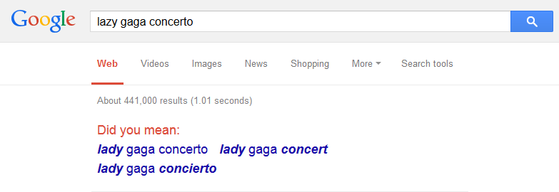
Skip-gram
Skip-gram
Predict surrounding words based on center word
Predict the context given the word
Slower, but better accuracy for infrequent words

Slide 21
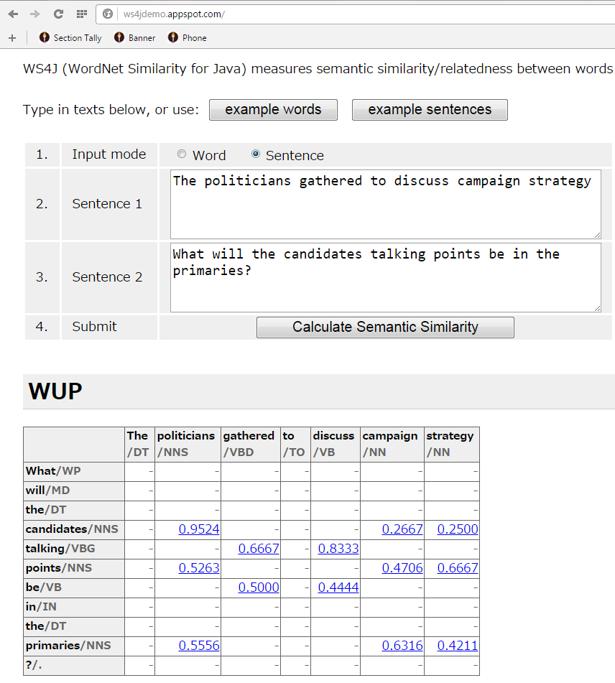
Another Implementation http://ws4jdemo.appspot.com
The two sentences were not a previously used example
Notice how nouns (both plural and singular) are compared to other nouns, etc.
Do you agree with the semantic similarities?

