Slide 1
Markup Languages Lesson Three CSS Basics
CSS Introduction
CSS in Eclipse
Applying Styles
Cascading and Inheritance
ids and classes Colors, Sizes and Fonts
Selectors and Pseudoclasses
Aligning Text
"When authors came to the web, they wanted to create beautiful pages; …they wanted to say something about fonts, and colors, and typography. Then they came to HTML and found they couldn't do that."
Håkon Wium Lee
CSS co-creator; CTO of Opera

Slide 2
Design and Analysis Principles

Slide 3
Analyze site’s purpose, audience
What do we (or what does the client) want to achieve with the site?
How will the site achieve the established goals?
Whom are we trying to reach, and what are the audience demographics—education level, age range, gender, or special interests?
What does the intended audience already know about the information that will be presented on the site?
What values or experiences might members of this audience have in common?
continued

Slide 4
Analyze site’s purpose, continued
What are the client’s goals?
How will the audience be transformed or edified by the information presented on the Web site?
How will we keep visitors interested and engaged over the long term?
What are the specific needs of the site’s users, and how will we tailor the design and content to those needs?
Which browsers are predominantly used by the target audience?
What Internet access speed is typical, on average, for the target audience?

Slide 5
Design considerations
Navigation — Make sure it reflects the site’s structure and is consistent on every page
Fonts — Choose fonts that provide optimal readability and suit the target audience
Page length — Break information into manageable chunks, so users don’t need to scroll excessively
continued

Slide 6
Design considerations, continued
Color and contrast — Choose your color scheme carefully
Color establishes the look and feel of your site, and draws the user’s eye to specific content
Text must be easy to read, with sufficient contrast, against its background color
Load time — Use media files and other “heavy” components conservatively, and don’t place too many on a page
Typography — Adjust line height, letter spacing, etc., to improve readability
Do not over-style body text

Slide 8
Introduction to CSS

Slide 9
HTML and CSS
HTML
CSS
For content
For style and formatting

Slide 10
CSS History
CSS3 not yet a standard
BUT, all modern browsers support most of the best features of CSS3.

Slide 11
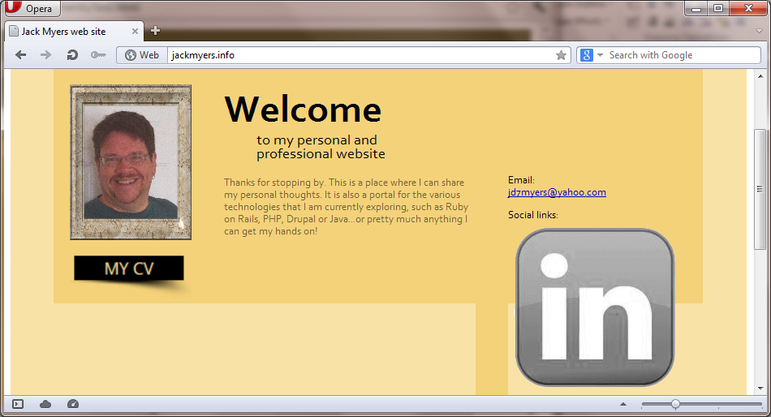
Sample of CSS
#feature-links img
{
padding: 5px;
width: 25 px;
}
Safari 5.1.7
Opera 12.02
Internet Explorer 9.0
Mozilla Firefox 15.0
Huh?

Slide 12
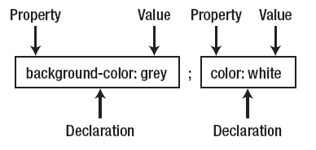
What is CSS?
Cascading Style Sheets are how you specify the appearance and formatting of web pages.
CSS Style
Rule Sets: Made up of one or more declarations separated by a semi-colon
Styles must be defined, but also applied to tags

Slide 13
Three Methods of Applying Style
Inline style
Styles are applied within an HTML tag using the global attribute 'style'
Embedded style
Use the style element <style> and a CSS selector
Using an External Stylesheet
CSS file does not need <style> element, but syntax same as embedded style.
HTML file requires a <link> in the <head> section

Slide 14
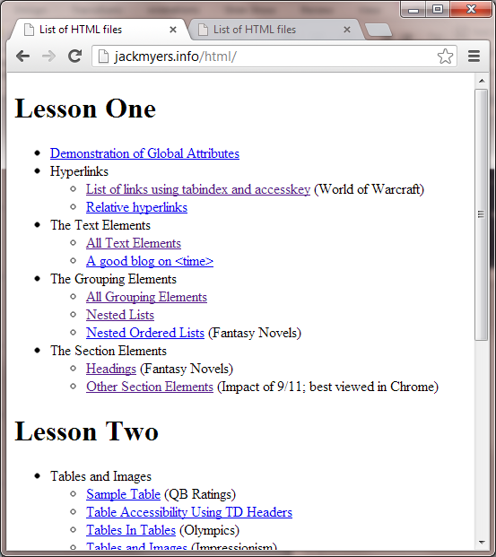
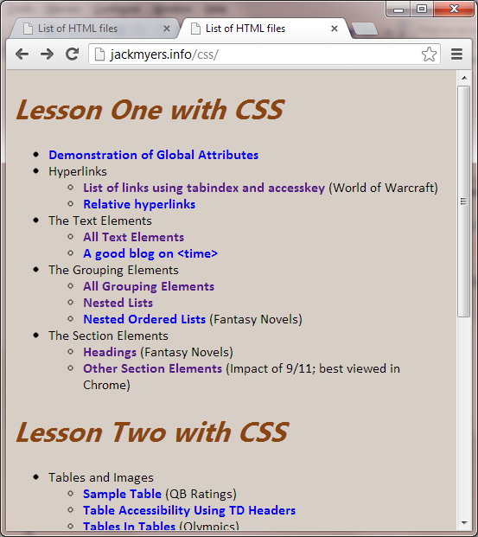
Applying Simple Styles

Slide 15
First two methods
Inline Style
Embedded Style
<body style="background-color:#d7cec6; font-family:calibri, serif;">
<head>
<title>List of HTML files</title>
<style type="text/css">
h1 { font-family: "Lao UI Bold", Helvetica, serif;
font-style: italic;
font-size: 2em;
color: SaddleBrown;
}
a { font-weight: bold;
text-decoration: none;
}
a:link { color: DarkBlue; }
a:visited { color: Indigo; }
</style>
</head>

Slide 16
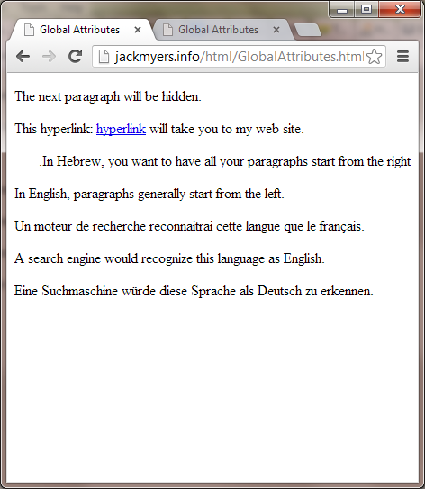
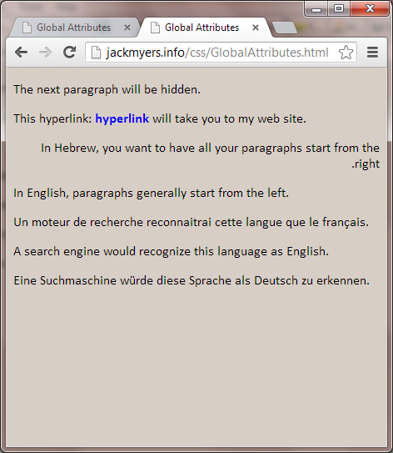
The same styles in an external style sheet

Slide 17
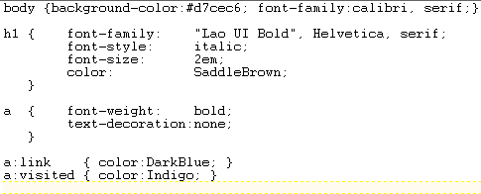
The HTML code
GlobalAttributes.html
simplebrown.css

Slide 18
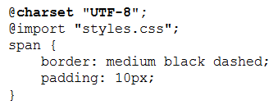
@import for Modular Stylesheets
You can use @import to bring in multiple stylesheets
Optionally use @charset to specify character set used
@import statements must appear first.
Only @charset directives can precede them.
But, this can be slower than multiple <link> statements

Slide 19
Another Stylesheet Example

Slide 20
Viewing CSS

Slide 21
Commenting CSS files is a good idea

Slide 22
Using Eclipse to code CSS

Slide 23
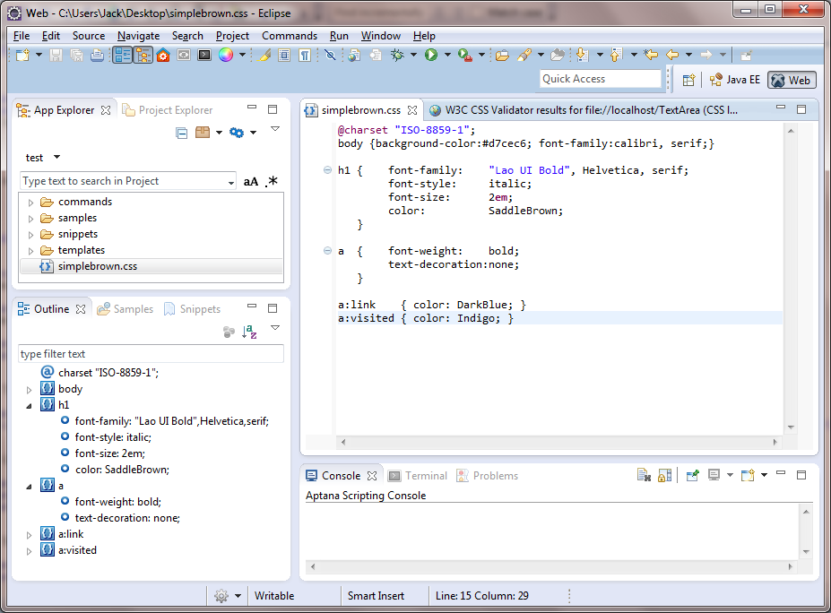
CSS in Eclipse

Slide 24
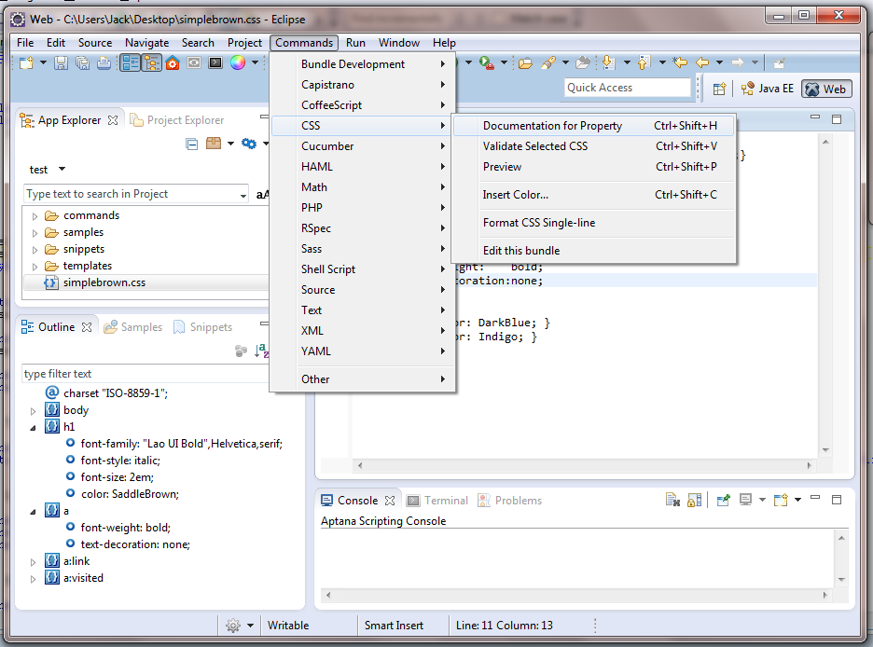
Help in Eclipse (1)
You can also validate your CSS from the Command menu.

Slide 25
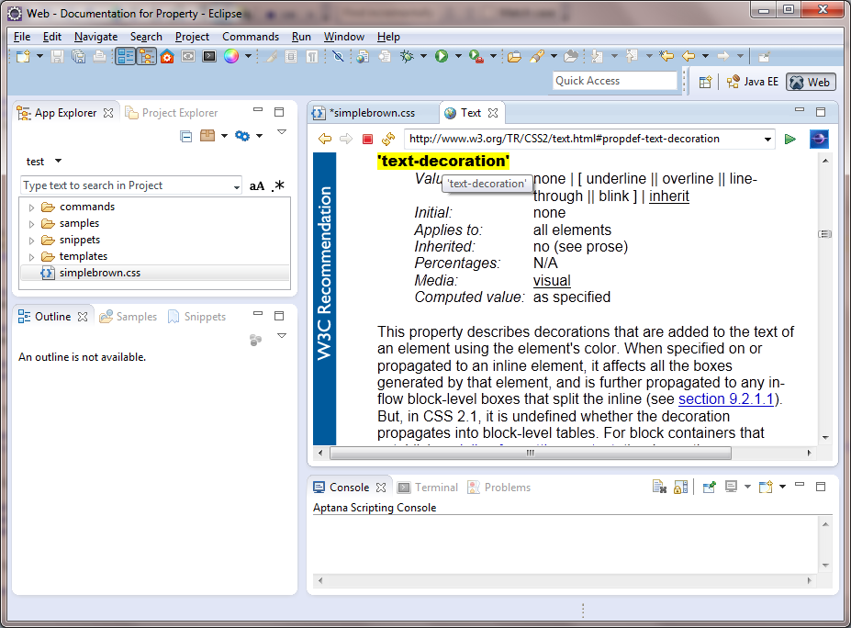
Help in Eclipse (2)
Help for the text-decoration property

Slide 26
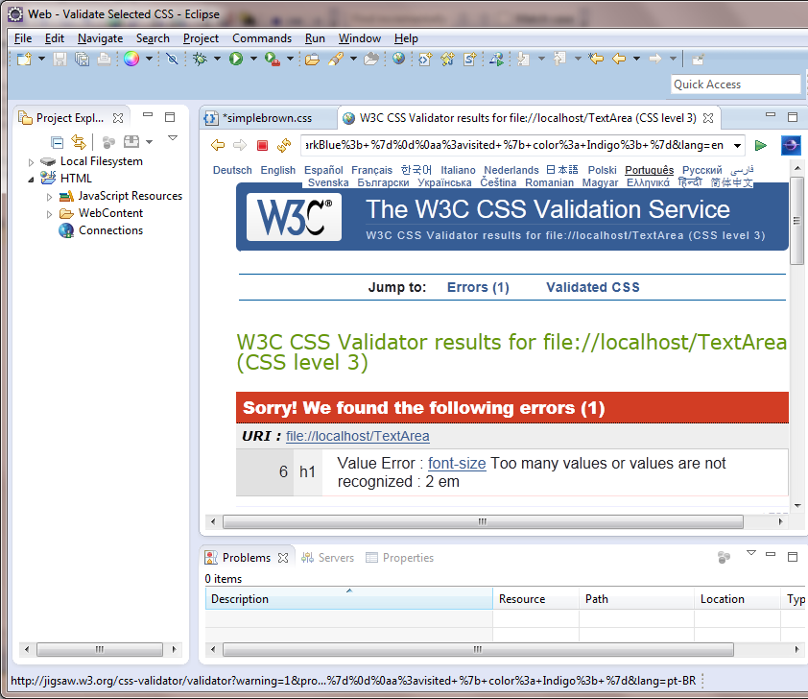
Validating CSS in Eclipse
h1 {
font-family: "Lao UI Bold", Helvetica, serif;
font-style: italic;
font-size: 2 em;
color: SaddleBrown;
}

Slide 27
Validating CSS Outside of Eclipse

Slide 29
Objectives (1)
Given an HTML page, create a CSS style sheet for formatting the web page using any of the types of selectors or rules presented in chapter 4.
Given a selector in the CSS for an HTML document, describe what the selector applies to.
Describe three ways to include CSS in a web page.
Explain why it’s usually best to use an external style sheet for formatting a page.
Describe the changes you need to make to the HTML and CSS files if you want to use CSS to format the HTML5 semantic elements in older browsers.
Distinguish between absolute and relative units of measurement.
Know how to use color in CSS

Slide 30
Objectives (2)
Describe these types of selectors: universal, type, id, class, descendant, child, sibling, pseudo-class, and pseudo-element.
Describe one accessibility guideline for using pseudo-class selectors.
Explain how user style sheets, !important rules, and specificity are used in the cascade order for applying rule sets.
Describe these properties for styling fonts: font-family, font-style, font-weight, font-size, and line-height.
Describe these properties for formatting text: text-indent, text-align, text-decoration, and text-shadow.

Slide 31
Applying Styles: Mechanisms, Cascading and Inheritance

Slide 32
Validating CSS Outside of Eclipse

Slide 33
Applying Styles to HTLM5 Tags in Older Browsers
See detailed description
in Murach text, p. 122

Slide 34
Three ways to provide styles

Slide 35
Cascading and Inheriting Styles
Inheritance
How the elements in the HTML markup inherit properties from their parent (containing) elements and pass them on to their children.
Cascading
When CSS declarations are being applied to a document, how are conflicting rules resolved?

Slide 36
Cascading
There are many ways for a style to be applied, as we have seen:
Inline
Embedded
Stylesheet
Styles are also applied via two other mechanisms
Browser styles (also known as user agent styles)
Default styles a browser applies in the absence of a specified style
User styles
While most users do not use this feature, one can create their own stylesheet to apply to all pages visited.
Google Chrome, for example, creates a file in the user's profile directory called Default\User StyleSheets\Custom.css.

Slide 37
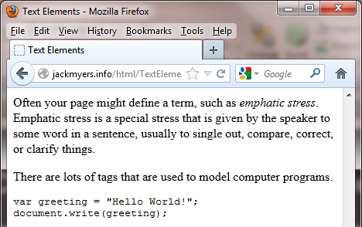
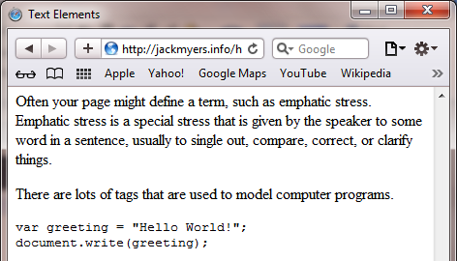
Examples of Variations in Browser Styles: Firefox vs Safari
Mozilla Firefox decided to add an italics style to the <dfn> element.
Safari did not.

Slide 38
So what happens when styles collide?
<h1 style="color:red>Hello</h1>
<h1 style="color:red>Hello</h1>
There is a particular order:
Inline styles
Embedded styles
External styles
User styles
Browser styles
What color should the <h1> be?
The browser defaults to black
The user has set their preference to blue
In the document, the style tag says brown
But one h1 chose red to be the color using the style attribute.
However, the linked stylesheet said h1's should be purple.

Slide 39
Important Rules

Slide 40
Marking a style important (1)
<h1 style="color:red>Hello</h1>
<h1 style="color:red>Hello</h1>
There is a particular order:
Inline styles
Embedded styles
External styles
User styles
Browser styles
What color should the <h1> be?
The browser defaults to black
The user has set their preference to blue
In the document, the style tag says brown
But one h1 chose red to be the color using the style attribute.
However, the linked stylesheet said h1's should be purple.
h1 { color: purple !important; }

Slide 41
Marking a style important (2)
<h1 style="color:red>Hello</h1>
<h1 style="color:red>Hello</h1>
There is a particular order:
Inline styles
Embedded styles
External styles
User styles
Browser styles
What color should the <h1> be?
The browser defaults to black
The user has set their preference to blue. They said it was !important
In the document, the style tag says brown
But one h1 chose red to be the color using the style attribute.
However, the linked stylesheet said h1's should be purple.
User importance trumps all !
h1 { color: purple !important; }

Slide 42
ids and classes

Slide 43
Selecting by id or class
So far, we have only seen selecting by type.
The selector a will alter formatting for the entire type (hyperlink)
a { link: DarkBlue;
visited: Indigo;
}

Slide 44
Coding CSS

Slide 45
CSS rule sets that select by type, id, and class
all elements
type
id
class

Slide 46
More on id and class
ID
id is defined as "a unique identifier to an element"
Can be used once per page.
Good for repeating constructs that occur once, but you use a lot
Menu
Class
A class can be used multiple times per page
You can also assign multiple classes to the same element

Slide 47
An Example
Header region
Navigation region
Main
region
Feature region
Column regions
Content
region

Slide 48
Using id and class (1)
Each page will only have one header region.
Good candidate for using "id"
<div id="header-content">
<span id="site-title">Jack Myers</span>
<span id="site-subtitle">instructor and educator</span>
</div>

Slide 49
Using id and class (2)
Column regions
There are three columns here
Could you use id?
Yes
But notice that firstcol and middlecol are identical
#content-firstcol {float: left;
width: 235px;
height: 100px;
padding: 0 15px;
background: #F9E2A6;
border-right: 1px solid #A68F55;}
#content-middlecol {float: left;
width: 235px;
height: 100px;
padding: 0 15px;
background: #F9E2A6;
border-right: 1px solid #A68F55;}
#content-lastcol {float: left;
width: 235px;
height: 100px;
padding: 0 15px;
background: #F9E2A6;}

Slide 50
Using ids to differentiate unique sections
<div id="content-container">
<div id="content-firstcol">
<h2>Observation</h2>
There are only 10 kinds of computer scientists: those who appreciate binary and those that do not.
</div>
<div id="content-middlecol">
<h2>Favorite Quote</h2>
"To succeed, jump as quickly at opportunities as you do at conclusions."<br /><br /> <span style="margin-left: 90px;"> <em>-- Benjamin Franklin</em></span>
</div>
<div id="content-lastcol">
<h2>Current Courses</h2>
<ul>
<li>Computer Networks</li>
<li>Programming Languages:<br />Theory and Implementation</li>
</ul>
</div>
</div>

Slide 51
Using id and class (3)
You can use a class instead of an id.
Columns will have a border on their right, except for the last col.
But there is still a lot of repetition between "col" and "lastcol".
.content-col {float: left;
width: 235px;
height: 100px;
padding: 0 15px;
background: #F9E2A6;
border-right: 1px solid #A68F55;}
#content-lastcol {float: left;
width: 235px;
height: 100px;
padding: 0 15px;
background: #F9E2A6;}
Column regions

Slide 52
Using id and class (4)
Now columns have their own class, and there is a separate class for a right border
Not only is the repetition reduced, but the right border class can be used for other elements besides columns.
.content-col {float: left;
width: 235px;
height: 100px;
padding: 0 15px;
background: #F9E2A6;}
.rightborder {border-right: 1px solid #A68F55;}
The last column needs to pick up two styles.
Column regions

Slide 53
Using classes with ids
ids no longer needed for style, but only to uniquely identify different sections.
<div id="content-container">
<div id="content-firstcol" class="content-col">
<h2>Observation</h2>
There are only 10 kinds of computer scientists: those who appreciate binary and those that do not.
</div>
<div id="content-middlecol" class="content-col">
<h2>Favorite Quote</h2>
"To succeed, jump as quickly at opportunities as you do at conclusions."<br /><br />
<span style="margin-left: 90px;"><i>-- Benjamin Franklin</i></span>
</div>
<div id="content-lastcol" class="content-col rightborder">
<h2>Current Courses</h2>
<ul>
<li>Computer Networks</li>
<li>Programming Languages:<br />Theory and Implementation</li>
</ul>
</div>
</div>
Two different classes used.

Slide 54
Cascading and Inheritance Revisited

Slide 55
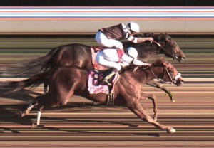
Cascading: When styles clash, we know the priority…
There is a particular order:
Important user styles
Important inline styles
Important embedded styles
Important external styles
Inline styles
Embedded styles
External styles
User styles
Browser styles
But what about "ties" ? (conflicting instructions at the same level)
The browser always chooses the most specific style.

Slide 56
Breaking Ties (1)
The first style makes all hyperlinks black by defining a style for the selector "a"
But the second style is more specific than the first.
It applies to only the hyperlinks with a class="myclass"
The w3c.org hyperlink will be white text, not black.
<html>
<head>
<style type="text/css">
a {
color: black;
}
a.myclass {
color:white;
background:grey;
}
</style>
</head>
<body>
<a href="http://apress.com"> Visit the Apress website</a>
<a class="myclass" href="http://w3c.org"> Visit the W3C website</a>
</body>
</html>

Slide 57
Breaking Ties (2)
This time, the hyperlink also picked up competing colors.
But the second style is just as specific as the first.
It will use the LAST style defined for the color (myclass2)
The w3c.org hyperlink will be white text.
<html>
<head>
<title>Example</title>
<style type="text/css">
a.myclass1 {
color: black;
}
a.myclass2 {
color:white;
background:grey;
}
</style>
</head>
<body>
<a href="http://apress.com"> Visit the Apress website</a>
<a class="myclass1 myclass2" href="http://w3c.org"> Visit the W3C website</a>
</body>
First style defined
Second style defined

Slide 58
Breaking Ties (3)
What color will the text of the hyperlink be now?
Black
What color will the background be?
Grey (note that the background was never in conflict)
<html>
<head>
<title>Example</title>
<style type="text/css">
a.myclass2 {
color:white;
background:grey;
}
a.myclass1 {
color: black;
}
</style>
</head>
<body>
<a href="http://apress.com"> Visit the Apress website</a>
<a class="myclass1 myclass2" href="http://w3c.org"> Visit the W3C website</a>
</body>
First style defined
Second style defined

Slide 59
You can have multiple external stylesheets

Slide 60
Cascading and Inheriting Styles
Cascading
When CSS declarations are being applied to a document, how are conflicting rules resolved?
Inheritance
How the elements in the HTML markup inherit properties from their parent (containing) elements and pass them on to their children.
If a property is not defined, it will search its parent for their property.
Generally, appearance properties are inherited
Generally, layout properties are not inherited

Slide 61
An Example
External stylesheet
/* Make strong text a bold brown */ strong {font-weight: bold; color: #905656; font-style:normal; }
http://jackmyers.info/css/CascadeInherit.html
Embedded style in CacscadeInherit.html
<style> figcaption { font-style:italic; } </style>
HTML Code in CacscadeInherit.html
Why is the "Zombie device" paragraph in italics?
Why isn't "spoofed IP address" red?
Why isn't "red" in italics?
Why isn't "red" brown?

Slide 62
A similar example without inline styles
External stylesheet
/* Make strong text a bold brown */ strong {font-weight: bold; color: #905656; font-style:normal; }
http://jackmyers.info/css/CascadeInherit2.html
HTML Code in CacscadeInherit2.html
<head>
<link rel="stylesheet" type="text/css" href="/main.css">
<style>
figcaption { font-style:italic; }
figcaption p strong { color:red }
</style>
</head>
<body>
<figcaption>How a server reacts to a DDoS attack with a
<strong style="font-style:italic">spoofed IP address</strong>.
<p>Zombie device is depicted with a <strong>red</strong> screen.</p>
</figcaption>
Notice how the very specific style functions.

Slide 63
Forced Inheritance
You can force inheritance by using the special value inherit in a style, which explicitly instructs the browser to use the parent element's value for the property.
http://jackmyers.info/css/ForceInheritance.html

Slide 64
Again, Specificity!

Slide 65
Colors, Sizes and Fonts

Slide 66
Colors and Sizes
Colors
By hex code (#rrggbb)
#FF00000 is red
#00FF00 is green (actually "lime")
#0000FF is blue
#FFFF00 is yellow
#FFFFFF is white
#000000 is black
#2A2A2A (or any hex where r=g=b) is gray
By name
http://www.w3schools.com/tags/ ref_colornames.asp
By function
rgb(r, g, b) and rgba(r, g, b, a)
hsl(h, s, l) and hsla(h, s, l, a) [hue, saturation, lightness]
Alpha value for transparency
Sizes
Height and width
Absolute units
in: Inches
cm: centimeters
mm: millimieters
pt: points (1 point is 1/72 inches)
pc: picas (1 pica is 12 pts)
Relative units
em: relative to font size of unit
ex: relative to "x" height of unit
rem: relative to font size of root elment
px: number of pixels
%: a percentage

Slide 67
Example of Colors
A three digit hex code means the r, g, b values are the same digit twice. For example, #FC0 means #FFCC00. Not commonly used.

Slide 68
More Examples of Colors
See http://jackmyers.info/css.Colors.html and http://jackmyers.info/css.Colors2.html

Slide 69
Most Common Units

Slide 70
Example CSS using Sizes
See http://jackmyers.info/css.Sizes.html

Slide 71
Fonts all belong to a Font Family
The five generic font families
serif
sans-serif
monospace
cursive
fantasy

Slide 72
Accommodating Uncommon Fonts
Techniques
Try to use standard fonts whenever possible
Remember Apple devices use different font sets
Provide alternative fonts if you are using newer or rarer fonts (e.g. Calibri)
Always include the generic font-family last

Slide 73
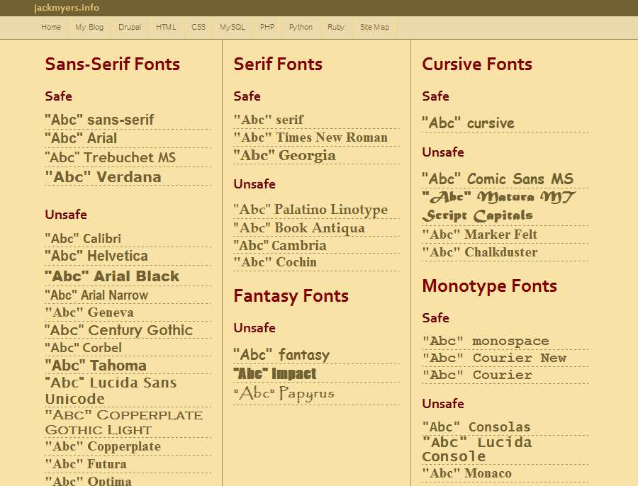
Fonts.html on Windows 7 (Safari)
✓
✓
✓
✓
Look varies
✓
✓
✓
✓
✓
✓
✓
✓
✓
✓
✓
✓
✓
✓
✓
✓
✓
✓
✓
✓
✓
✓
✓
✓

Slide 74
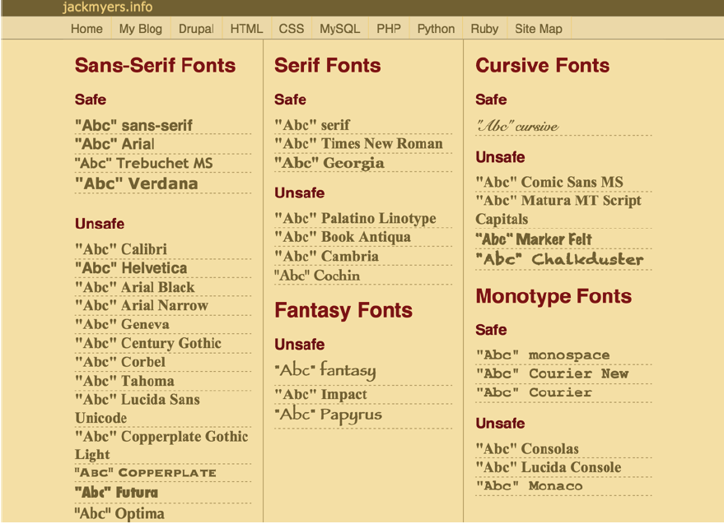
Fonts.html on iPad (Safari)
✓
✓
Look varies
✓
✓
✓
✓
✓
✓
✓
✓
✓
✓
✓
✓
✓
✓
✓
✓
✓
✓
✓
✓
✓
✓

Slide 75
Some recommended font-families
Serif Fonts
Georgia, serif
"Palatino Linotype", "Book Antiqua", Palatino, serif
"Times New Roman", Times, serif
Monospace Fonts
"Courier New", Courier, monospace
"Lucida Console", Monaco, monospace
Sans-Serif Fonts
Arial, Helvetica, sans-serif
"Arial Black", Gadget, sans-serif
"Comic Sans MS", cursive, sans-serif
"Lucida Sans Unicode", "Lucida Grande", sans-serif
Tahoma, Geneva, sans-serif
"Trebuchet MS", Helvetica, sans-serif
Verdana, Geneva, sans-serif

Slide 76
Generally good idea to set font at high level, then override if needed

Slide 77
Linking to the Web Fonts API
To link to Google’s Web Fonts API and use the font named “Acme,” you would write:
<link rel="stylesheet" type="text/css" href="http://fonts.googleapis.com/css?family=Acme" />
This code must be placed inside the <head> section of each document that should have access to the font
After establishing the link to the Web Fonts API, use the font-family property to apply the font as you normally would:
body {
font-family: Acme, Verdana, sans-serif; }

Slide 78
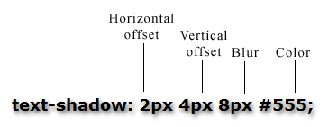
The text-shadow property
Shadow effects are a popular design technique that can add appeal and draw the user’s eye to particular items

Slide 79
Font styles, weights, variants

Slide 80
Combine several font statement into one

Slide 81
text-transform and text-decorate

Slide 82
text-shadow

Slide 83
Selectors and Pseudoclasses

Slide 84
Using Selectors in CSS
Objective | Solution
Select all elements | Use the universal selector "*"
Select elements by type | Use the type selector
Select elements by class | Use the class selector
Select elements by id | Use the id selector
Select elements based on attributes | Use the attributes selector
Create a union of selectors | Separate selectors with a comma
Select descendants of elements | Separate selectors with a space
Select children of an element | Use the > selector
Select sibling elements | Use the + or ~ selectors
Select first line of a block of text | Use the ::first-line selector
Select first letter of a block of text | Use the ::first-letter selector
Insert content into an element | Use :before and :after selectors
Insert numeric content into an element | Use the counter function
✓
✓
✓
✓

Slide 85
Reminder: universal, type, id, and class selectors
all elements
type
id
class

Slide 86
Attribute Selectors

Slide 87
More Complex Attribute Selectors
<style type="text/css">
* { font-size: x-small;
font-family: Verdana; }
[href] { border-top: 3px solid yellow; }
[data-redline] { border-bottom: 3px solid red; }
[data-purpleline] { border-bottom: 3px solid purple; }
[lang="de"] { color: SaddleBrown; }
[class~="apple"] { color: Crimson; }
[class^="fancy"] { font-style: italic; }
[class$="border"] { border: thin black solid;
padding: 4px; }
[style*="italic"] { font-weight: bold;
color: Navy; }
[lang|="en"] { font-family: Georgia; }
</style>
Examine the file http://jackmyers.info/css/AttributeSelectors.html
What do each of the style definitions above do?

Slide 88
Meaning of the Special Characters In Selections
Selector | Description
[attr^="val"] | Value begins with "val"
[attr$="val"] | Value end with "val"
[attr*="val"] | Value contains "val"
[attr~="val"] | Value contains multiple values, one of which is "val"
[attr|="val" | Value is a hyphen separated list of values, the first of which is "val"

Slide 89
Combining Selectors
a union of selectors
equivalent

Slide 90
Using Relationships
Space
Plus
Greater than
Tilda
Descendant is any descendant, whereas child is the direct descendant

Slide 91
More on Relationships
More complex relationships possible
Style from http://jackmyers.info/css/ProgLang.html
Interpret CSS What does each style definition mean? What is each definition doing and why?
<style>
body { font-family=font-size: 10pt; }
h1+p, h2+p { font-size: 8pt; }
h1+p strong:first-child, h2+p strong:first-child { color: blue; }
</style>

Slide 92
Pseudo class selectors
Used to format elements based on their location in the document structure
Enable you to format content without having to introduce any new elements or attributes into your HTML document structure

Slide 93
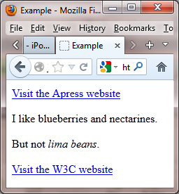
:first-child and :last-child pseudo class
Select only elements that are the first element defined by the element that contains them (the parent element, as it is known).
To make only the first item in your lists bold, you could write:
li:first-child { font-weight:bold; }
:last-child selector selects elements that are the last elements defined by their containing element
<html>
<head>
<title>Example</title>
<style type="text/css">
:last-child {
border: thin black solid;
padding: 4px; }
</style>
</head>
<body>
<a href="http://apress.com">Visit
the Apress website</a>
<p>I like <span>blueberries</span> and <span>nectarines</span>.
<p>But not <em>lima beans</em>.</p>
<a href="http://w3c.org">Visit the W3C website</a>
</body>
</html>

Slide 94
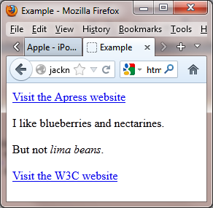
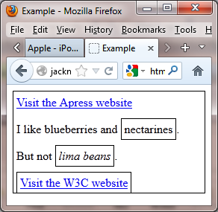
:first-child and :last-child pseudo class
:last-child selector selects elements that are the last elements defined by their containing element
How many elements will be boxed? Which ones?
<html>
<head>
<title>Example</title>
<style type="text/css">
:last-child {
border: thin black solid;
padding: 4px; }
</style>
</head>
<body>
<a href="http://apress.com">Visit
the Apress website</a>
<p>I like <span>blueberries</span> and <span>nectarines</span>.
<p>But not <em>lima beans</em>.</p>
<a href="http://w3c.org">Visit the W3C website</a>
</body>
</html>
4

Slide 95
The :nth-child pseudo class
Select the nth child element of its parent element
For example: li:nth-child(3) { background-color: silver; }
This rule says, “Select any list item that is the third child element of its parent element, and give it a silver background.”
The argument (n) determines which element or elements will be selected for formatting
The easiest arguments to use are:
A keyword, even or odd, to select even-numbered child elements or odd-numbered child elements
A positive integer (1, 2, 3, etc.) to select a specific child element in a sequence of elements, from top to bottom

Slide 96
The :nth-of-type pseudo class
Also selects based on an element’s position in its parent element structure, but selects only the element type specified
For example:
p:nth-of-type(2) {
background-color: silver; }
Selects any paragraph that’s the second paragraph of its parent
Would not be affected if other element types were introduced to the parent element structure

Slide 97
More Pseudo-classes and Pseudo-elements
See: http://jackmyers.info/css/WolfAndFox.html

Slide 98
The :focus pseudo class
Similar to the :hover and :visited pseudo classes, which you use to style link states
Use :focus to style an element when it comes into focus because a user has clicked it or pressed the Tab key to navigate to it

Slide 99
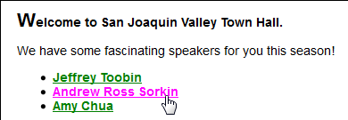
An Example

Slide 100
:before and :after pseudo elements
Set the location for generated content
If you want to add an asterisk before the content in <aside> elements, write:
aside:before { content: "*"; }
Pseudo elements must be written at the end of a selector
A style rule can have only one pseudo element

Slide 101
The content property
Declares the content that should appear before or after an actual element’s content
String content (text) must be placed in quotation marks
You can apply styles to generated content, just as you can with actual content

Slide 102
Using the CSS Counter Feature
Setting up the counter
The first step is to reset the counter to its base value and give it a name. Achieved with the counter-reset property, like the following example:
body { counter-reset: myCounter; 0}
Incrementing the counter
The next step is to specify when the counter increments and by what value. This can be specified with the counter-increment property. If no value is specified then a default increment of one is used:
h2 { counter-increment: myCounter 1; }
Displaying the counter
Generate content using the counter function, and :before pseudo class:
h2:before { counter(myCounter) " "; }
Starting value; default is 0
Name of counter
Use -1 to count backwards by one!
or :after

Slide 103
Multiple Counters
You can use multiple counters to keep track of nested numbering schemes.
body { counter-reset: outer 0; }
h2 { counter-reset: inner 0;
counter-increment: outer 1; }
p { counter-increment: inner 1;
margin-left: 20px; }
h2:before { content: counter(outer) ". "; }
p:before { content: counter(inner, lower-alpha) ") "; }
You can also give the counter function a second parameter to change the style. (list-style-type)
decimal, decimal-leading-zero
lower-roman, upper-roman, lower-greek, lower-alpha, upper-alpha,
armenian, hebrew, hiragana (japanese), etc.
http://jackmyers.info/css/NestedParagraphs.html

Slide 104
More Complex Use of Counters
There is also the counters() function for specifying nested counters.
Takes the form: counters(identifier, separator) and is recursive.
This works fine for elements such as lists, where lists can be nested inside each other.
ol { counter-reset: section; list-style-type: none; } ol li { counter-increment: section; } ol li:before { content: counters(section, ".") ": "; }
See http://jackmyers.info/css/NestedLists.html
after counter prints
Separator
Name of counter

Slide 105
Using Counters Exercise
Make a reference article where the abstract is smaller font than the subsequent paragraphs
Use counters to keep track of footnotes for any <cite> tags
Make sure your footnotes look real, i.e., small and superscript.

Slide 106
Images as style content
To generate image content from a style sheet, use the content property with the following syntax:
selector:pseudo-element { content: url(path-to-image); }
The content property is followed by url, followed by parentheses that contain the URL for the image file
The URL path cannot be in quotes

Slide 107
Aligning Text

Slide 108
Aligning and Indenting

Slide 109
Example

Slide 110
Floating an Image
Go to http://jackmyers.info/css/FloatImage.html and resize the window and observe.

Slide 111
Stopping the float
You can also clear from the right or from both.
In http://jackmyers.info/css/Float.html, the footer would try to fit around the floating paragraphs before it.
<style>
.left { float:left; width:60%; }
.right { float:right; width:40%; }
.floatOff { clear:both; }
</style>
<footer id="footer" class="floatOff">
<!--#include virtual="/includes/dateModifiedFooter.shtml" -->
</footer>

Slide 112
Objectives (1)
Given an HTML page, create a CSS style sheet for formatting the web page using any of the types of selectors or rules presented in chapter 4.
Given a selector in the CSS for an HTML document, describe what the selector applies to.
Describe three ways to include CSS in a web page.
Explain why it’s usually best to use an external style sheet for formatting a page.
Describe the changes you need to make to the HTML and CSS files if you want to use CSS to format the HTML5 semantic elements in older browsers.
Distinguish between absolute and relative units of measurement.
Know how to use color in CSS

Slide 113
Objectives (2)
Describe these types of selectors: universal, type, id, class, descendant, child, sibling, pseudo-class, and pseudo-element.
Describe one accessibility guideline for using pseudo-class selectors.
Explain how user style sheets, !important rules, and specificity are used in the cascade order for applying rule sets.
Describe these properties for styling fonts: font-family, font-style, font-weight, font-size, and line-height.
Describe these properties for formatting text: text-indent, text-align, text-decoration, and text-shadow.

Slide 114
For Your Enjoyment: A Sample Stylesheet from Text (1)

Slide 115
For Your Enjoyment: A Sample Stylesheet from Text (2)

Slide 116
Exercises
Exercise 3-1 on page 116 and Exercise 4-1 on page 160
Hallowe'en Store Exercises 3 and 4
Find a highly formatted, professional-looking web page you like.
You won't know all the CSS to duplicate it (yet), but get started by identifying styles and planning your CSS strategy

Slide 117
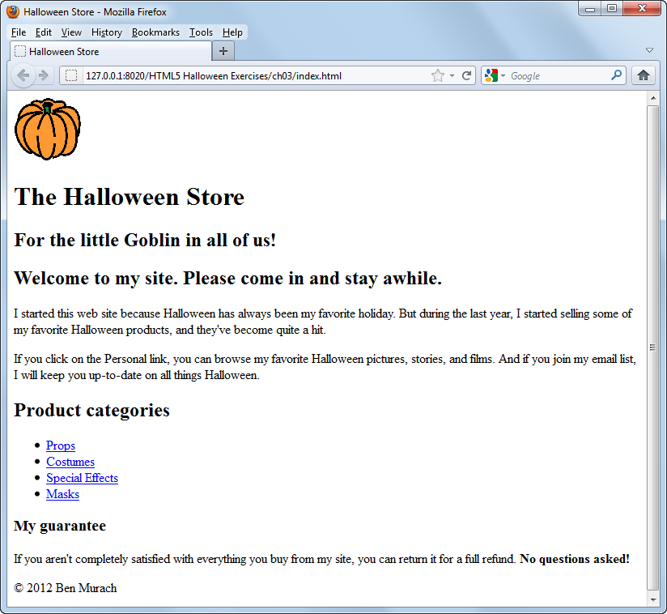
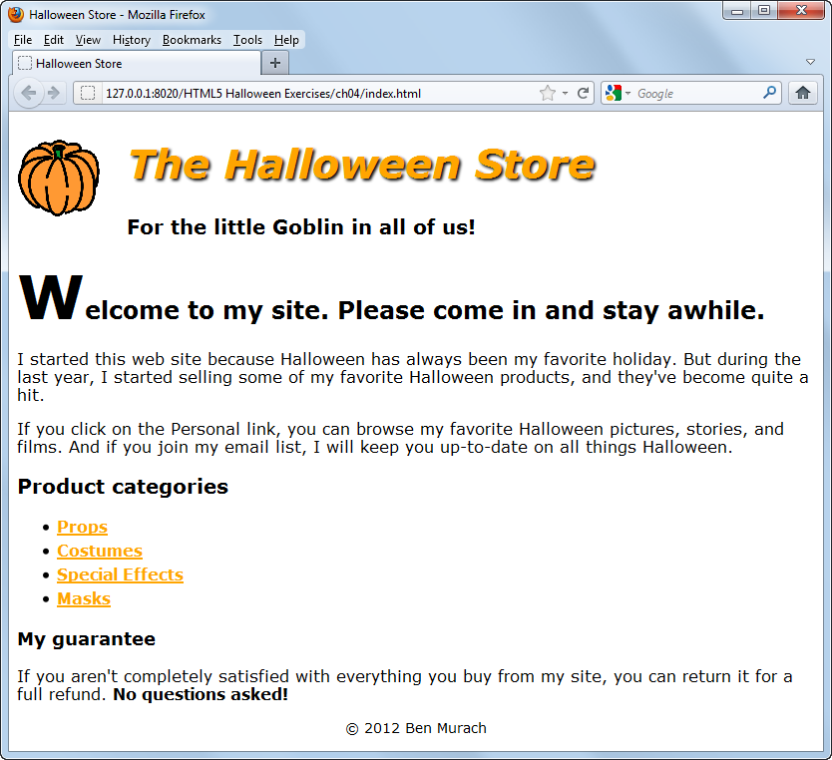
Exercises (2)

Slide 118
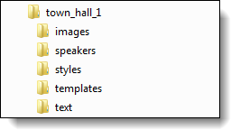
Where to find files

Slide 119
