Slide 1
Bad HTML can make a Good Prototype

Slide 2
Good HTML
Let's be clear…good HTML development requires a separation of style and content
HTML should have little to no styling
HTML should avoid outdated conventions like <b> for bold and <i> for italics
CSS should generally be an external style sheet
However, sometimes bad HTML can be produced more quickly for easy rapid prototyping
Be aware though, that the bad HTML will be thrown away for production coding.

Slide 3
A Quick and Dirty Mockup
The more CSS you know, the better your bad HTML will be.
But the objective at this point is speed.

Slide 4
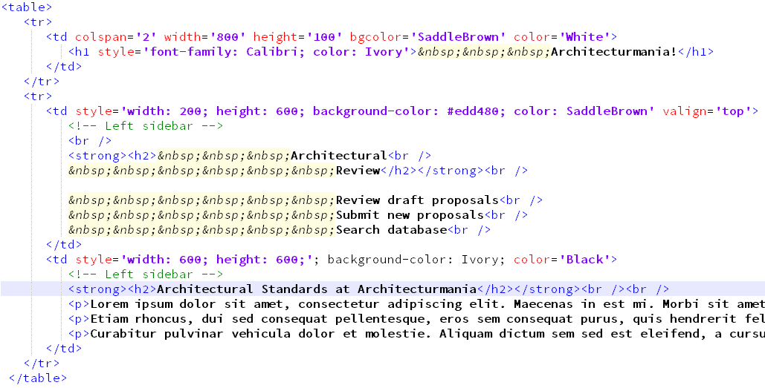
Tables are NOT Supposed to be Used for Layouts, but…

