Slide 1
CS 00500 – Graduate Seminar
Lesson 8.2
The Value of LeetCode for CS Graduate Students
A Tool for Interview Prep and Algorithmic Thinking

Slide 2

What is LeetCode?
LeetCode is an online platform offering coding challenges to improve algorithmic and problem-solving skills.
Features:
  3,800+ problems in multiple languages
  Company-specific questions
  Mock interviews
  Discussion forums and solutions

Slide 3
Why LeetCode Matters
Interview-Centric Practice: Focused on data structures and algorithms.
Company Tags: Target preparation with real interview questions.
Time Complexity Focus: Learn to optimize solutions for performance.

Slide 4
LeetCode Problem Types
Challenging questions are available across a variety of topics
  Data Structures
  Algorithmic Techniques
  Advanced Algorithms
  Mathematical and Theoretical Concepts
  Graph Theory
  Specialized Areas

Slide 5
Data Structures Topics
Array
String
Hash Table
Linked List
Matrix
Stack
Queue
Binary Tree
Trie
Segment Tree
Binary Search Tree
Graph
Heap (Priority Queue)
Ordered Set
Doubly-Linked List

Slide 6
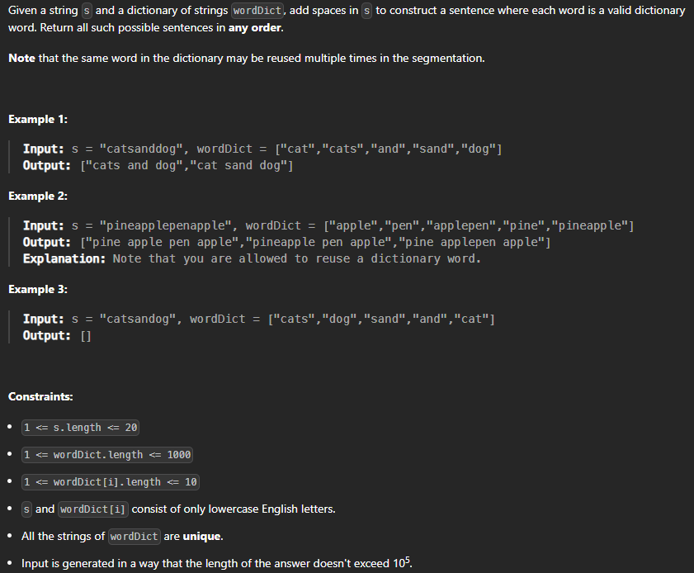
Data Structures Topics

Slide 7
Algorithmic Techniques
Topics
Dynamic Programming
Greedy
Backtracking
Divide and Conquer
Breadth-First Search
Depth-First Search
Binary Search
Sliding Window
Prefix Sum
Bit Manipulation
Memoization
Recursion
Two Pointers
Bitmask

Slide 8
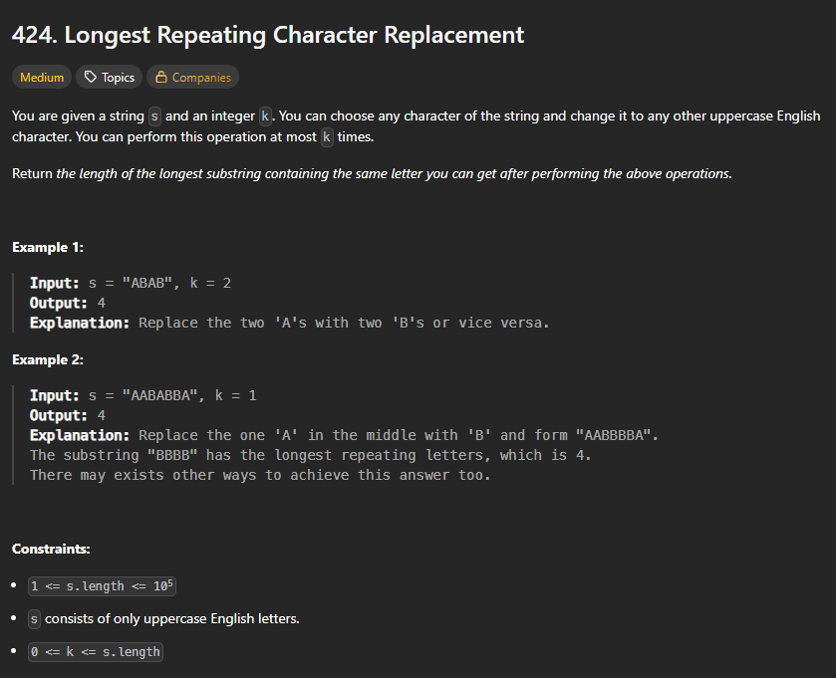
Data Structures Topics

Slide 9
Advanced Algorithms
Union Find
Topological Sort
Shortest Path
Binary Indexed Tree
String Matching
Rolling Hash
Game Theory
Brainteaser
Counting Sort
Quickselect
Merge Sort
Radix Sort
Shell
Bucket Sort
Minimum Spanning Tree
Eulerian Circuit
Suffix Array
Line Sweep

Slide 10
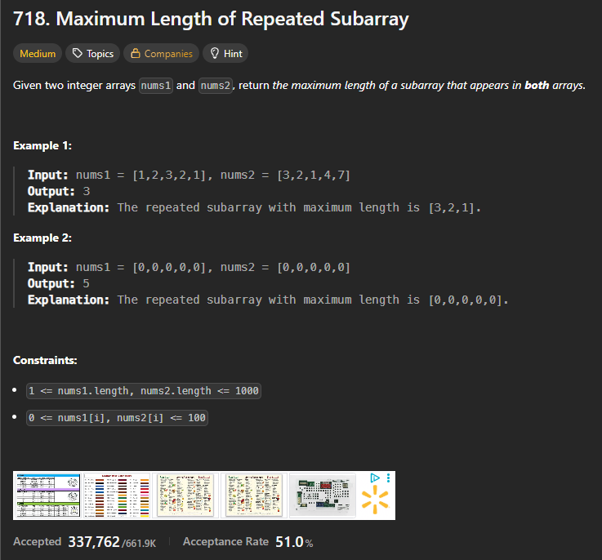
Data Structures Topics

Slide 11
Mathematical and Theoretical Topics
Math
Number Theory
Probability and Statistics
Geometry
Combinatorics
Counting
Hash Function

Slide 12
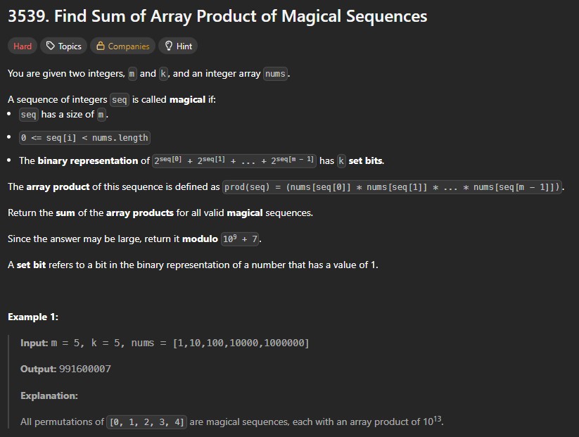

Slide 13
Graph Theory Topics
Strongly Connected Component
Biconnected Component
Topological Sort
Shortest Path
Minimum Spanning Tree

Slide 14
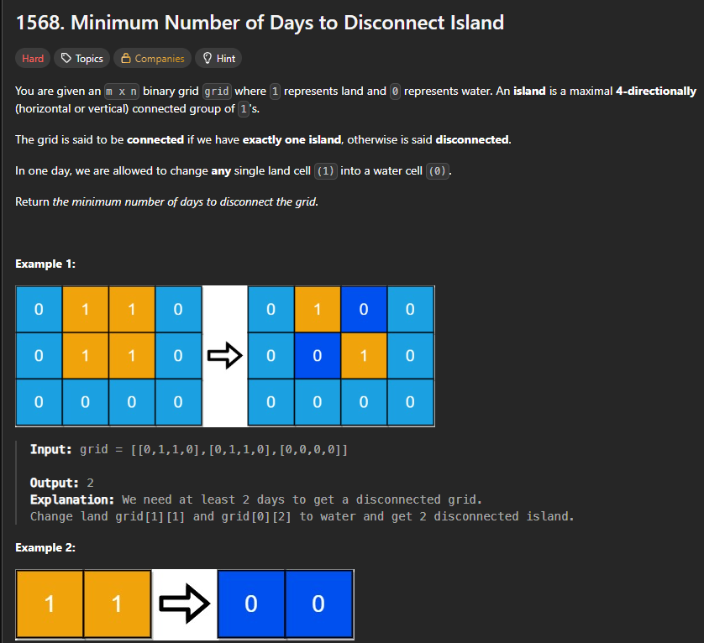
Data Structures Topics

Slide 15
Specialized Areas
Database
Simulation
Design
Enumeration
Data Stream
Iterator
Concurrency
Interactive

Slide 16
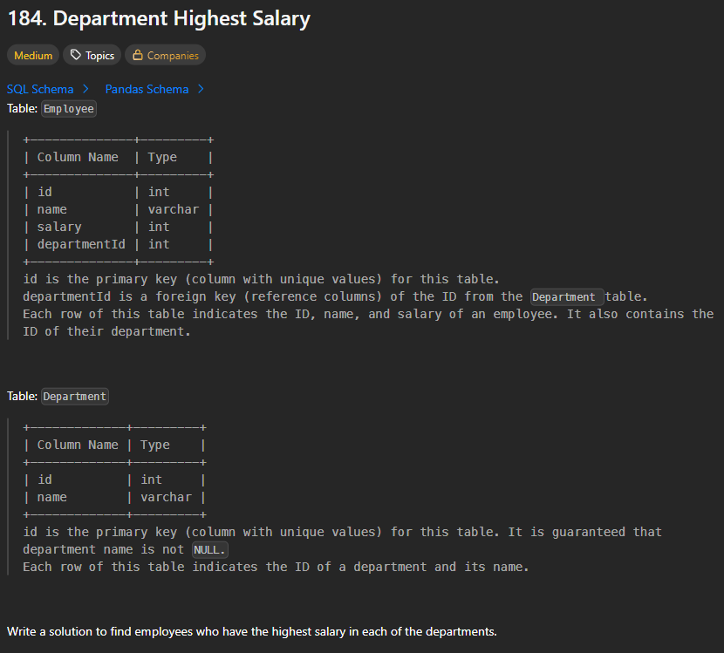
Data Structures Topics

Slide 17
Benefits for Graduate Students
Career Preparation: Prepares for academia, industry, and research interviews.
Improves Algorithmic Thinking: Useful for research areas like ML and HPC.
Reinforces Core CS Concepts: Deepens understanding of foundational skills.

Slide 18
How to Get Started
Sign up at leetcode.com
Start with 'Easy' level problems
Use 'Explore' cards or company-specific lists
Track your progress
Learn from the community; review solutions from others

Slide 19
Strategy for Grad Students
Set a schedule: 2–3 problems per week
Form a study group for discussion
Focus on problem patterns, not memorization
Use GitHub to build a portfolio

Slide 20
Our Masters Programs
MS Cybersecurity
  Focus on data structures and basic programming problems
MS Data Science
  Focus on algorithmic thinking and databases
MS Computer Science
  All pretty much relevant

Slide 21

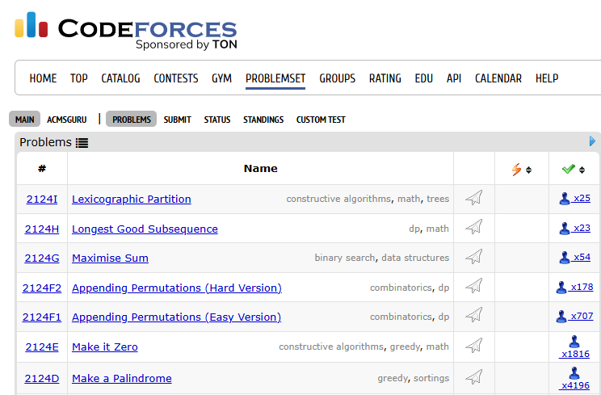
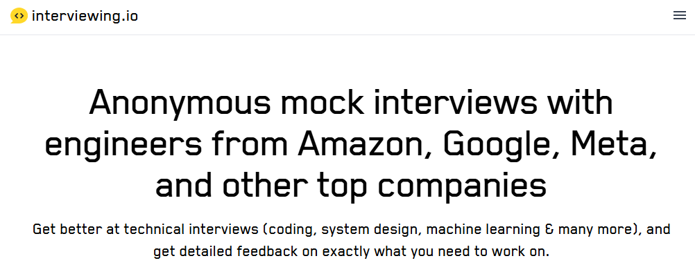
Alternatives and Complements
Other Platforms:
  HackerRank https://www.hackerrank.com/
  Codeforces
  https://codeforces.com/problemset
  Interviewing.io
  https://interviewing.io/
Books:
  Cracking the Coding Interview
  by Gayle Laakmann McDowell
  Elements of Programming
  Interviews (series)

