Slide 1
CS 00500 – Graduate Seminar Lesson 5.1 Ethics in Computer Science
Utilitarianism
Deontology
Virtue Ethics
Notes:
Replace this with your course title and your name/contact details.

Slide 2
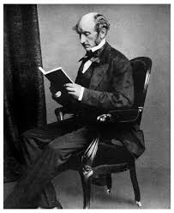
What is Utilitarianism?
Ethical framework based on outcomes: "The greatest good for the greatest number."
Founded on consequentialism: actions are judged by their consequences.
Focus on maximizing overall happiness or utility.
Jeremy Bentham Bentham
John Stuart Mill

Slide 3
Evolution of Utilitarianism
Originated in the 18th-19th century as a response to rigid moral rules.
Mill expanded the theory to consider quality as well as quantity of happiness.
Modern variations: Rule vs. Act utilitarianism.
Applied in policy-making and cost-benefit analysis.

Slide 4
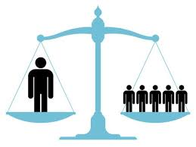
Why Utilitarianism is Unique
Focuses on outcomes rather than intentions or character.
Flexible and adaptable to diverse scenarios.
Quantitative approach to ethical decisions.
Challenges: Measuring 'happiness' and potential disregard for minority rights.

Slide 5
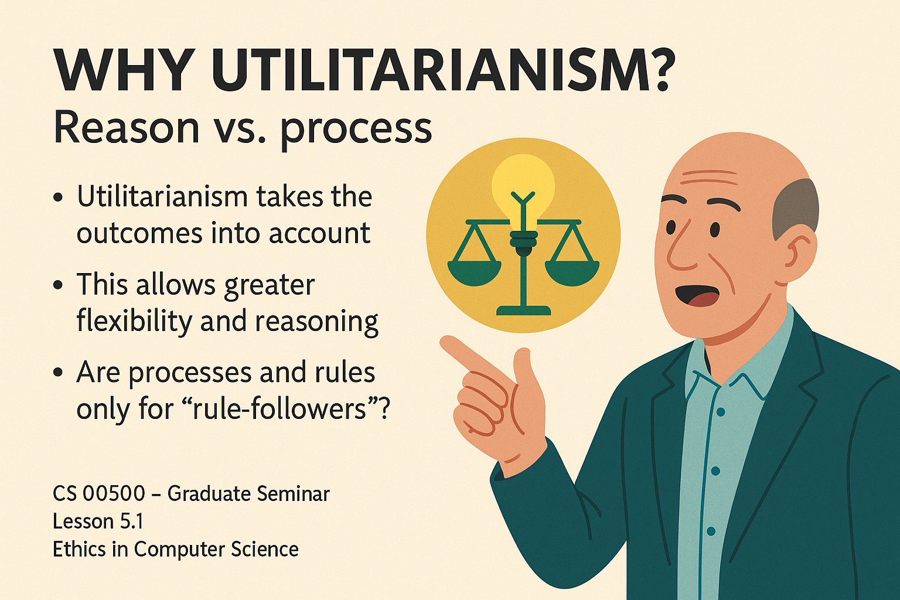
Examples in Computer Science
Data privacy vs. societal benefit: Sharing user data for public health.
AI algorithms: Optimizing traffic flow to benefit the majority.
Net neutrality: Maximizing benefit to most users.
Software updates: Prioritizing features for majority benefit.

Slide 6
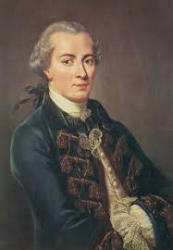
What is Deontology?
Ethics based on duties, rules, and obligations.
Morality of an action is determined by universal moral laws.
'Do the right thing,' regardless of consequences.
Immanuel Kant

Slide 7
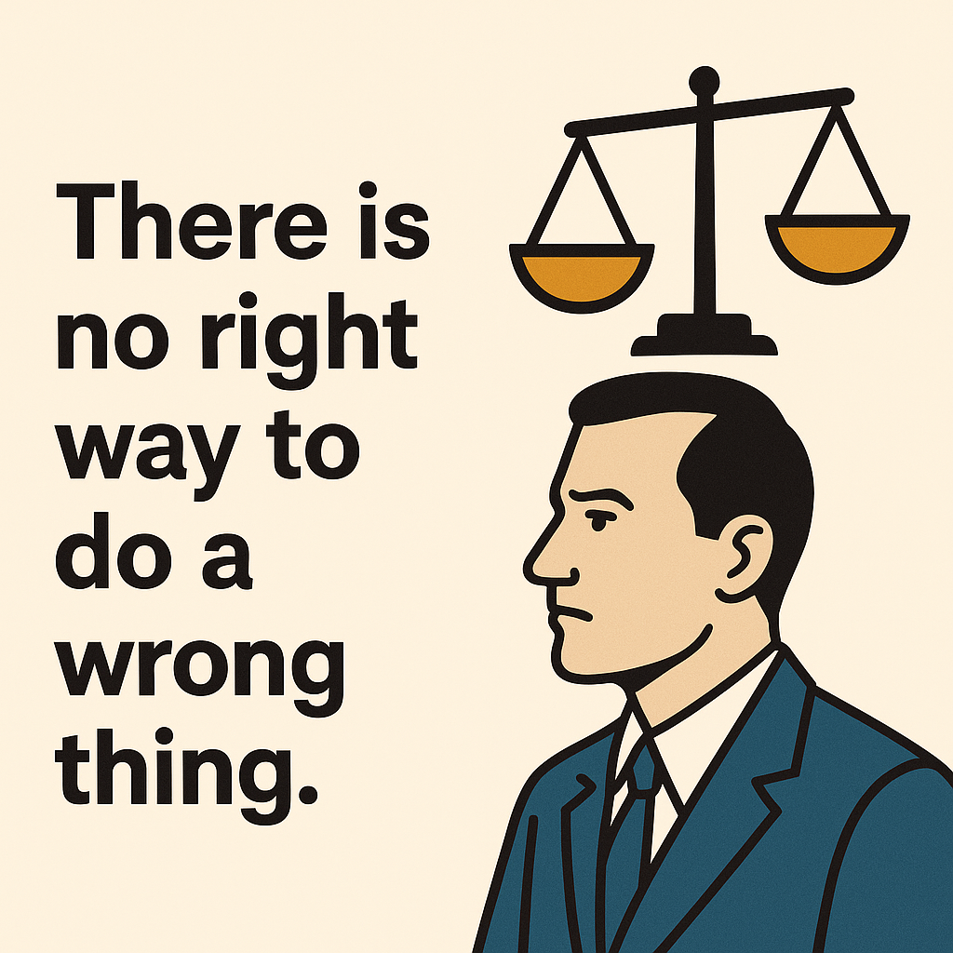
Evolution of Deontology
Emerged as a counter to consequentialist theories.
Kant's categorical imperative: Act only on maxims that can be universal.
Modern interpretations focus on rights, justice, and fairness.

Slide 8
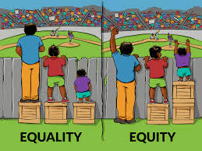
Why Deontology is Unique
Emphasizes intention and adherence to moral duty.
Provides clear moral rules and principles.
Protects individual rights even against majority benefit.
Challenges: Can lead to rigid decisions that ignore outcomes.

Slide 9

Examples in Computer Science
Refusing to build surveillance software due to privacy rights.
Following strict data protection laws regardless of utility.
AI decision-making constrained by ethical rules (e.g., not lying).
Developers' duty to fix security vulnerabilities.

Slide 10
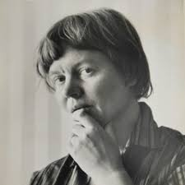
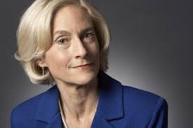
What is Virtue Ethics?
Focuses on character and moral virtues rather than rules or outcomes.
'What would a virtuous person do?'
Emphasizes developing moral character and habits.
Philippa Foot
Rosalind Hursthouse

Slide 11
Evolution of Virtue Ethics
Originated in ancient Greek philosophy.
Revived in the 20th century as an alternative to rule-based ethics.
Focuses on moral education, role models, and community values.
Virtue Ethics
Concerned with the moral character or goodness of the individual carrying out the action
Focuses on the person carrying out the action
Deontology
Concerned with following moral duties, rules, or principles
Focuses on the action itself, not the person or outcome
A right act or a good act is an act carried out by a virtuous person
A right act is one that follows moral rules or duties, regardless of the consequences

Slide 12
Why Virtue Ethics is Unique
Focuses on moral character rather than isolated decisions.
Encourages continuous moral growth and practical wisdom.
Flexible: context and character are central.
Challenges: Hard to apply to specific rules or policies.
Virtue Ethics
Concerned with the moral character or goodness of the individual carrying out the action
Focuses on the person carrying out the action
Utilitarianism
An action is right if it isuseful or beneficial to the majority
Focuses on the consequences of the action
A right act or a good act is an act carried out by a virtuous person
A right act is an act that brings the greatest good for the greatest number of people

Slide 13
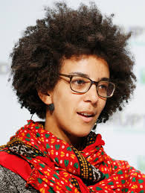
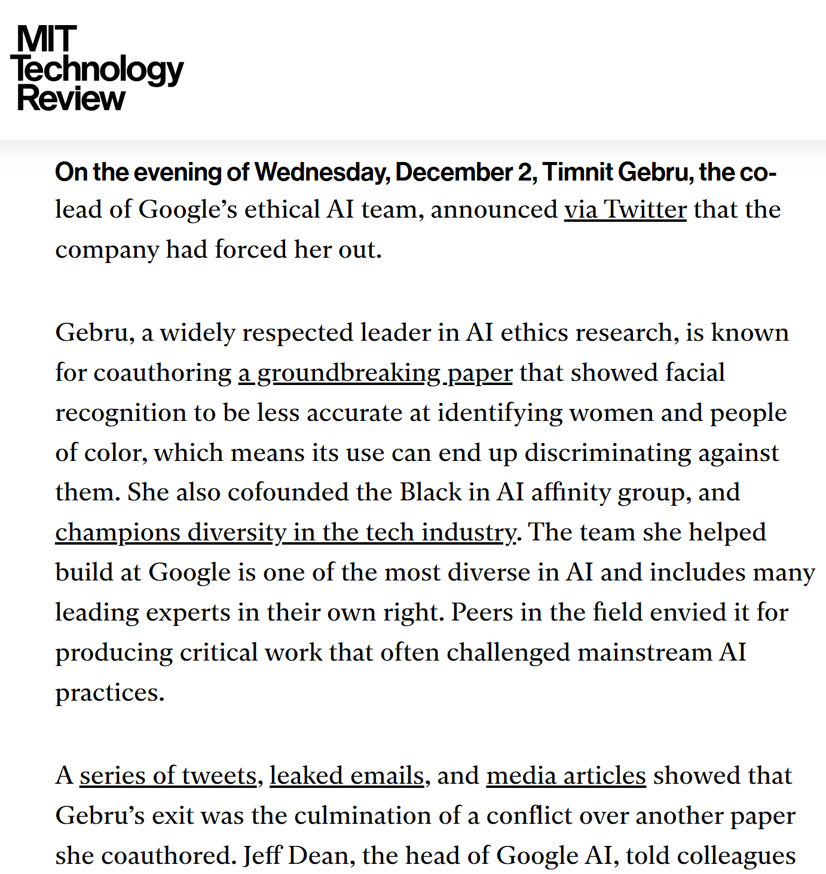
Examples in Computer Science
Encouraging ethical culture in tech companies (e.g., honesty).
Developers refusing to work on harmful tech.
Building inclusive platforms reflecting good character.
Mentoring and encouraging responsibility among tech teams.
https://www.technologyreview.com/2020/12/04/1013294/google-ai-ethics-research-paper-forced-out-timnit-gebru/

Slide 14
Comparison of the Three Models
Utilitarianism: Outcome-based, maximizes overall good.
Deontology: Rule-based, focuses on duty and moral obligations.
Virtue Ethics: Character-based, focuses on moral virtues.
Key differences: consequences vs. duties vs. virtues.

Slide 15
Ethics Case Study: Facial Recognition Technology (FRT)
On one hand, facial recognition technology can make life easier and processes smoother. Many smartphones now offer facial recognition as a quick and secure login option, such as Apple's FaceID on the iPhone. In public spaces and transportation hubs, FRT can speed up security checks, reduce wait times, and improve the overall user experience. Its ability to quickly and accurately verify identities has made it a valuable tool in enhancing safety and efficiency.
However, the widespread use of facial recognition technology has also drawn criticism from various campaign groups and privacy advocates…
Utilitarianism: Approve if benefits outweigh privacy concerns.
Deontology: Reject due to violation of individual rights.
Virtue Ethics: Evaluate based on virtues like fairness and integrity.
Same issue, different ethical outcomes.
Deontology
Even though facial recognition technology can be used for good purposes such as criminal investigations, the dangers it poses to privacy rights could outweigh its benefits, said Hill. Both the right to privacy and users’ right to control their personal information shared on social media platforms should be protected, she added.
New laws to protect those rights should be modeled after regulations that made wiretapping, or the recording of communications between parties without their consent, illegal.
Virtue Ethics
Let’s look at another metric called the false positive rate, which assesses how often a FRT search will return results when there is no matching image in the database. Breaking results down by race, the same algorithm that produces the 98 percent true positive rate overall can also produce a false positive rate for black men several times the false positive rate for white men — and an even higher false positive rate for Black women. This example is not merely a hypothetical: in NIST testing, many algorithms have exhibited this pattern.
https://www.itpro.com/
Utilitariansim
https://news.harvard.edu/gazette/
https://www.aclu.org/

