Slide 1
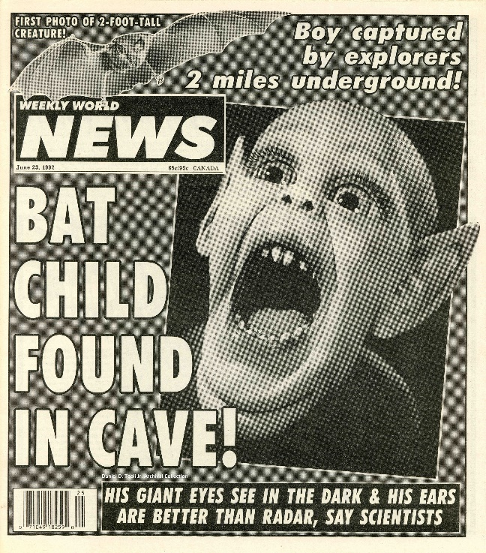
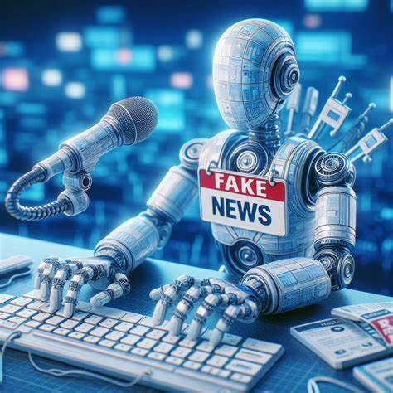
CS 00500 – Graduate Seminar Lesson 4.4 Disinformation Security
Notes:
Replace this with your course title and your name/contact details.

Slide 2

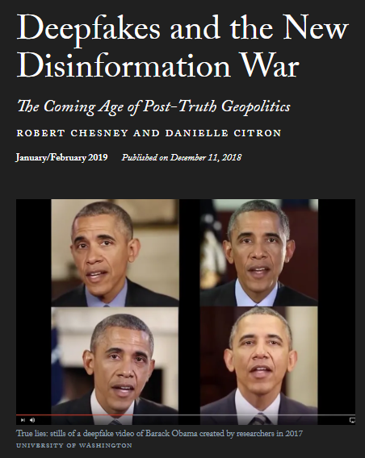
What is Disinformation Security
Disinformation security is the field that focuses on defending against and mitigating the harmful effects of disinformation and misinformation.
This area of cybersecurity addresses the manipulation, spread, and amplification of false or misleading information, particularly in digital spaces like social media, news platforms, and online communities.
Disinformation security combines elements of traditional cybersecurity (e.g., technical defenses) with social science and policy to safeguard the integrity of information.
Notes:
Slide 2
Deepfakes have a number of worthy applications. Modified audio or video of a historical figure, for example, could be created for the purpose of educating children. One company even claims that it can use the technology to restore speech to individuals who have lost their voice to disease. But deepfakes can and will be used for darker purposes, as well. Users have already employed deepfake technology to insert people's faces into pornography without their consent or knowledge, and the growing ease of making fake audio and video content will create ample opportunities for blackmail, intimidation, and sabotage. The most frightening applications of deepfake technology, however, may well be in the realms of politics and international affairs. There, deepfakes may be used to create unusually effective lies capable of inciting violence, discrediting leaders and institutions, or even tipping elections.
Content is everywhere, produced by everyone
Deepfakes have the potential to be especially destructive because they are arriving at a time when it already is becoming harder to separate fact from fiction. For much of the twentieth century, magazines, newspapers, and television broadcasters managed the flow of information to the public. Journalists established rigorous professional standards to control the quality of news, and the relatively small number of mass media outlets meant that only a limited number of individuals and organizations could distribute information widely. Over the last decade, however, more and more people have begun to get their information from social media platforms, such as Facebook and Twitter, which depend on a vast array of users to generate relatively unfiltered content. Users tend to curate their experiences so that they mostly encounter perspectives they already agree with (a tendency heightened by the platforms' algorithms), turning their social media feeds into echo chambers. These platforms are also susceptible to so-called information cascades, whereby people pass along information shared by others without bothering to check if it is true, making it appear more credible in the process. The end result is that falsehoods can spread faster than ever before.
These dynamics will make social media fertile ground for circulating deepfakes, with potentially explosive implications for politics. Russia's attempt to influence the 2016 U.S. presidential election- spreading divisive and politically inflammatory messages on Facebook and Twitter-already demonstrated how easily disinformation can be injected into the social media bloodstream. The deepfakes of tomorrow will be more vivid and realistic and thus more shareable than the fake news of 2016. And because people are especially prone to sharing negative and novel information, the more salacious the deepfakes, the better.

Slide 3
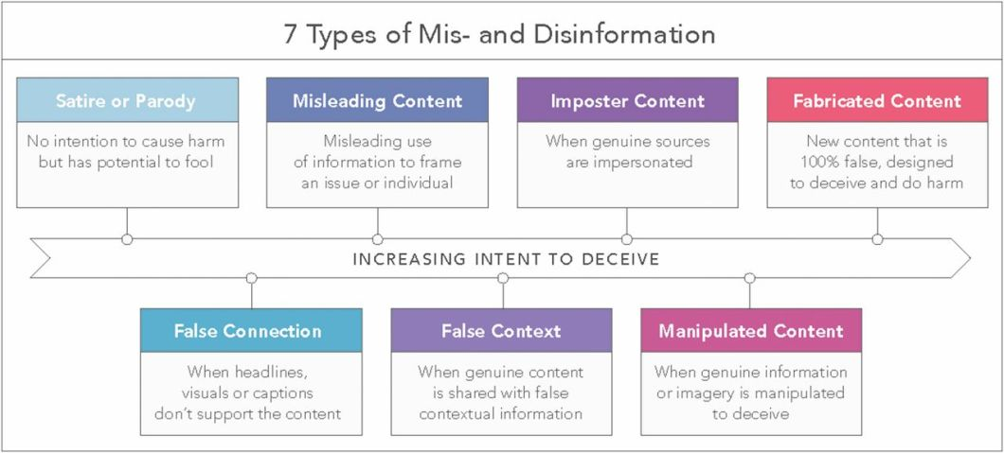
Types of Content
Satire or Parody
Misleading Content
Imposter Content
Fabricated Content
No intention to cause harm but has potential to fool
Misleading use of information to frame an issue or individual
When genuine sources are impersonated
New content that is 100% fake designed to deceive and do harm
False Connection
False Content
Manipulated Content
When headlines, visuals or captions don't support the content
When genuine content is shared with false contextual Information
When genuine information or imagery is manipulated to deceive
Waldrop, M. (2017) News Feature: The genuine problem of fake news. Proceedings of the National Academy of Sciences, 114 (48), 12631-12634.

Slide 4
Generative Adversarial Network (GAN): Model that generates new data that looks like real data
A GAN has two neural networks that compete with each other:
Generator (G)
Job: Create fake data (images, audio, video) that look real.
Discriminator (D)
Job: Look at data and decide if it’s real or fake.
They train together in a game:
The Generator gets better at making fakes.
The Discriminator gets better at catching fakes.
Training continues until the generator’s output is so realistic that the discriminator can’t reliably tell it’s fake.
Fake data
1
Generator
Real data
Discriminator
Correctly detected fake data
2
3
Better fake data
Continuous training cycle

Slide 5

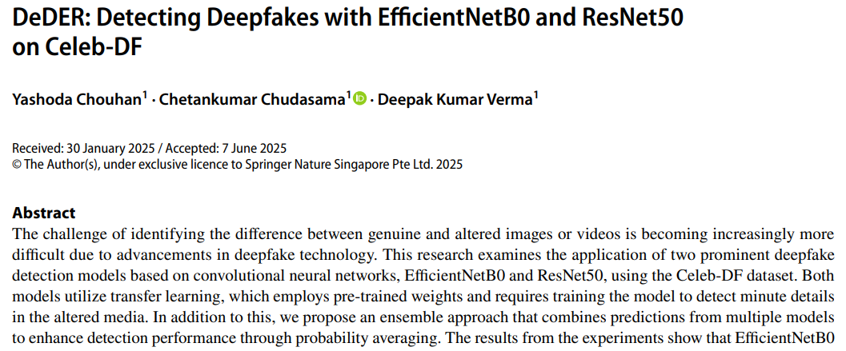
Playing Defense Detection – spot fake media after it appears
Visual Inconsistencies (within a single frame)
Check individual frames for things that seem “off” to a machine
Lighting and Shadows – A fake face might not reflect light the same way as the body or background.
Facial Features – Teeth, eyes, or skin texture may look too smooth or blurry in certain spots.
Eye Details – Pupils might not reflect the room correctly, or blinking frequency can be unnatural.
Temporal Inconsistencies (across multiple frames)
Deepfakes currently can’t perfectly mimic natural motion over time
Lip-Sync Issues – The mouth may not perfectly match the audio when speaking.
Micro-Expressions – Real humans have tiny, brief expressions (eyebrow twitches, cheek muscle flickers) that are hard to fake.
Head and Eye Movement – Fake faces may “slide” or jitter slightly, and gaze direction may jump unnaturally.
Frequency and Audio-Visual Inconsistencies
analyze hidden patterns in sound and image frequencies:
Video Flicker or Noise Patterns – GAN-generated frames can leave unnatural frequency artifacts.
Audio Mismatch –voice tone and ambient noise don’t match the scene
This study examines past work on deepfake identification. It focuses on improvements in model designs, the Celeb-DF dataset, methods for finetuning, and the issues researchers face. Deepfake discovery typically relies on identifying marks and errors that are added during the editing process. Such artifacts are not necessarily perceptible to the human eye but may be determined by machine learning methods. The initial works concentrated mainly on Convolutional Neural Networks (CNNs) for anomaly detection in facial expressions, blink patterns, and other minute cues…

Slide 6
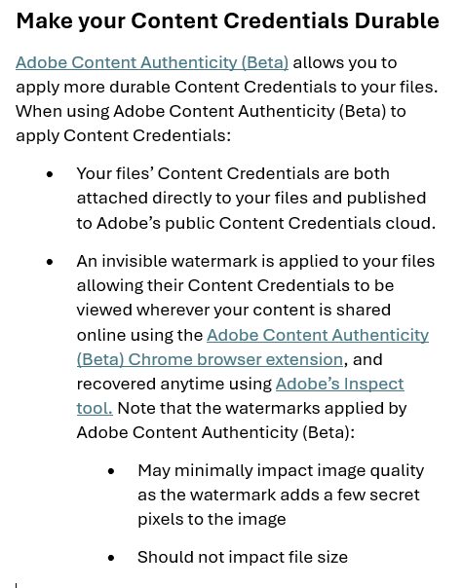
Playing Defense Watermarking – Authenticate original content proactively
What is a watermark?
A digital watermark is a hidden signature added to images, videos, or audio when they are first created.
It can be visible (like a TV station logo) or invisible (embedded in the pixels or audio frequencies).
Invisible watermarks are hard to remove and don’t affect how the content looks or sounds.
How Watermarks Stop Deepfake Confusion
A digital watermark is a hidden signature added to images, videos, or audio when they are first created.
It can be visible (like a TV station logo) or invisible (embedded in the pixels or audio frequencies).
Invisible watermarks are hard to remove and don’t affect how the content looks or sounds. If the watermark is missing or altered, the video is likely a fake.

Slide 7
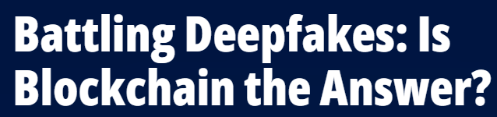
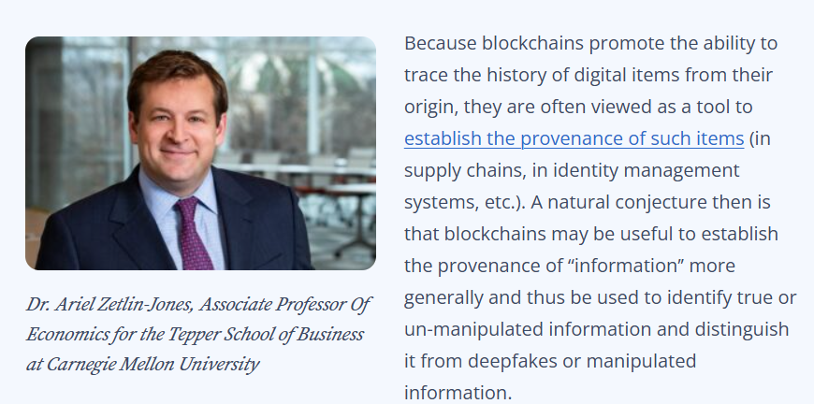
Playing Defense Blockchain Provenance
Original Content is Registered
When a photo, video, or audio file is created, the system makes a unique digital fingerprint (called a hash) of the file.
That hash and metadata (like who made it, when, and where) are stored on a blockchain.
Blockchain is tamper-proof, so this record cannot be changed later.
Content is Shared
When the content is published online, its hash can be checked against the blockchain.
If it matches the registered hash, it’s authentic.
If it doesn’t match or isn’t on the blockchain, it’s unverified and might be a fake or altered copy.
Detecting Deepfakes
A deepfake will not have a matching blockchain record, because it wasn’t created and registered by the original source
Platforms or viewers can instantly check the blockchain to verify authenticity.

Slide 8
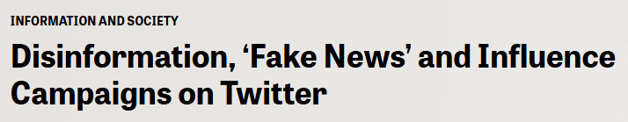
Botnets and Automated Influence Campaigns
Detection and analysis of bot-driven disinformation on social media platforms.
Detection Techniques
Machine Learning Models: Utilize features like user metadata, tweet content, and network behavior to classify accounts as bots or humans.
Crowdsourcing: Engage human annotators to identify bots, though this method faces challenges such as fatigue and scalability.
Hybrid Approaches: Combine machine learning with human input to improve detection accuracy.
Real-World Examples
Twitter Botnets: Automated accounts spread political misinformation during 2016 U.S. elections.
TikTok Engagement Manipulation: Bots generating fake likes and comments to amplify content visibility.
Doppelganger Campaign: A Russian disinformation operation creating fake news websites mimicking legitimate outlets to spread pro-Kremlin narratives.
Facebook's Fake Profiles: Facebook plans to integrate millions of fake personnas who will pose as actual users on Facebook and Instagram.
So-called bots—automated accounts—are believed to play a key role in the spread of fake news and disinformation. These worries have been especially prominent in investigations into Russian attempts to influence the 2016 election. Bots are distinct from professional trolls, which are human-run accounts that usually seek to provoke or to spread disinformation. “Cyborg” accounts combine human-generated content with automated posting.⁴⁶
An explosion of academic research has documented large networks of false accounts that seek to spread disinformation on social media.⁴⁷ Social media companies, too, have confirmed that fake accounts and networks of bots played a central role in promoting fake news. Facebook implicitly confirmed the main conclusions of the U.S. intelligence community about both automated accounts and coordinated fake news campaigns by state actors in a public April 2017 report, but cut information on Russia’s role from the report after an internal debate.⁴⁸ In October 2017, Facebook disclosed that content from accounts linked to Russia had reached more than 126 million users.⁴⁹
Twitter reported that it had identified 36,746 accounts—a figure later upped to more than 50,000—that “generated automated, election related content and had at least one of the characteristics we used to associate an account with Russia.”⁵⁰ In addition to automated accounts, Twitter ultimately identified 3,817 accounts linked to the Internet Research Agency, the so-called troll farm with links to the Kremlin.

Slide 9
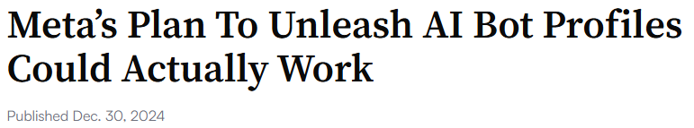
Botnets and Automated Influence Campaigns
Detection and analysis of bot-driven disinformation on social media platforms.
Detection Techniques
Machine Learning Models: Utilize features like user metadata, tweet content, and network behavior to classify accounts as bots or humans.
Crowdsourcing: Engage human annotators to identify bots, though this method faces challenges such as fatigue and scalability.
Hybrid Approaches: Combine machine learning with human input to improve detection accuracy.
Real-World Examples
Twitter Botnets: Automated accounts spread political misinformation during 2016 U.S. elections.
TikTok Engagement Manipulation: Bots generating fake likes and comments to amplify content visibility.
Doppelganger Campaign: A Russian disinformation operation creating fake news websites mimicking legitimate outlets to spread pro-Kremlin narratives.
Facebook's Fake Profiles: Facebook plans to integrate millions of fake personnas who will pose as actual users on Facebook and Instagram.
If you thought that 2024 was a big year for social platforms pushing AI elements into their apps, you ain’t seen nothing yet, with Meta looking to bring even more AI to your feeds over the next year.
How is it going to do that?
Well, aside from injecting AI chatbots into every aspect that it can, Meta’s next plan is to deploy millions of generative AI characters and have them pose as actual users on Facebook and Instagram.
According to Connor Hayes, Meta’s VP of product for gen AI, soon, there’ll be a whole range of new AI profiles activated within its apps.
As per Hayes (via The Financial Times):
“We expect these AIs to actually, over time, exist on our platforms, kind of in the same way that accounts do. They’ll have bios and profile pictures and be able to generate and share content powered by AI on the platform.”
Which is not overly surprising.
In an interview back in August, Meta CEO Mark Zuckerberg explained that:
“Every part of what we do is going to get changed in some way [by AI]. [For example] feeds are going to go from - you know, it was already friend content, and now it’s largely creators. In the future, a lot of it is going to be AI generated.”

Slide 10
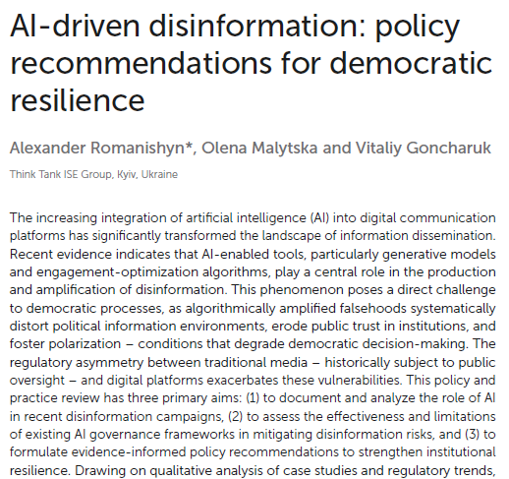
LLMs and Disinformation
LLMs like GPT-4 can mass-generate fake news/propaganda.
During political events, LLMs such as ChatGPT and GPT-3 have been used to create persuasive, yet entirely fake, political narratives that can sway public opinion.
AI-generated posts claiming false cures for COVID-19 or exaggerated side effects of vaccines spread widely across health-related websites and social media.
This content often mixed scientific terminology with misleading claims, making it appear credible.

Slide 11
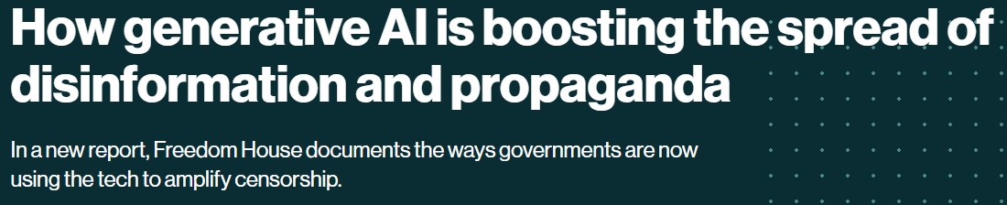
LLMs and Disinformation
LLMs like GPT-4 can mass-generate fake news/propaganda.
During political events, LLMs such as ChatGPT and GPT-3 have been used to create persuasive, yet entirely fake, political narratives that can sway public opinion.
AI-generated posts claiming false cures for COVID-19 or exaggerated side effects of vaccines spread widely across health-related websites and social media.
This content often mixed scientific terminology with misleading claims, making it appear credible.
Disinformation and deepfakes
As generative AI tools grow more sophisticated, political actors are continuing to deploy the technology to amplify disinformation.
Venezuelan state media outlets, for example, spread pro-government messages through AI-generated videos of news anchors from a nonexistent international English-language channel; they were produced by Synthesia, a company that produces custom deepfakes. And in the United States, AI-manipulated videos and images of political leaders have made the rounds on social media. Examples include a video that depicted President Biden making transphobic comments and an image of Donald Trump hugging Anthony Fauci.
And though these developments are not necessarily surprising, Funk says one of the most interesting findings is that the widespread accessibility of generative AI can undermine trust in verifiable facts. As AI-generated content on the internet becomes normalized, “it’s going to allow for political actors to cast doubt about reliable information,” says Funk. It’s a phenomenon known as “liar’s dividend,” in which wariness of fabrication makes people more skeptical of true information, particularly in times of crisis or political conflict when false information can run rampant.

Slide 12
Cognitive Hacking and Psychological Exploits
The psychology of misinformation: Why we’re vulnerable
Tommy Shane, June 30, 2020
The psychology of misinformation — the mental shortcuts, confusions, and illusions that encourage us to believe things that aren’t true — can tell us a lot about how to prevent its harmful effects.
Cognitive Miserness: The tendency for individuals to use mental shortcuts and minimize cognitive effort in processing information -- leads to acceptance of misinformation when deeper, more analytical thought is necessary.
Dual Process Theory: Human cognition operates thru two systems: System 1 (fast, automatic, and effortless thinking) and System 2 (slow, deliberate, and effortful thinking). People often rely on System 1 – efficient, but prone to errors. Making it easier for misinformation to slip through unnoticed.
Heuristics: Rules of thumb used to simplify decision-making and judgment processes. Can lead to biased or incorrect conclusions, especially when relying on superficial cues or incomplete info.
Cognitive Dissonance: Psychological discomfort experienced when encountering information that conflicts with one’s existing beliefs or knowledge. To reduce discomfort, individuals may reject or dismiss contradictory information, often perpetuating false beliefs and misinformation.
Confirmation Bias: Tendency to favor information that supports one's pre-existing beliefs while disregarding or undervaluing information that contradicts them. This bias strengthens existing misconceptions and allows misinformation to persist, as individuals seek out validating information.
Motivated Reasoning: Individuals use their reasoning abilities to justify beliefs they want to hold, rather than objectively seeking the truth. This can lead to the acceptance of misinformation.
Pluralistic Ignorance: Individuals mistakenly believe that others in society hold a certain belief or opinion when, in fact, only a few people actually do. This misperception can lead to the spread of misinformation, especially when social norms or misunderstandings amplify incorrect views.
Third-Person Effect: The belief that other people are more susceptible to misinformation than oneself. This effect causes individuals to underestimate their own vulnerability to false information and may result in a lack of action in critically evaluating the information they encounter.
Fluency: The ease with which information is processed and understood. Information that is easy to process, such as familiar or well-presented content, is often perceived as more truthful, regardless of its actual accuracy. Repetition of such information can further enhance its believability.
Bullshit Receptivity: The tendency to accept statements or information that are vague, meaningless, or nonsensical, often referred to as "bullshit" without critically assessing the information.

Slide 13
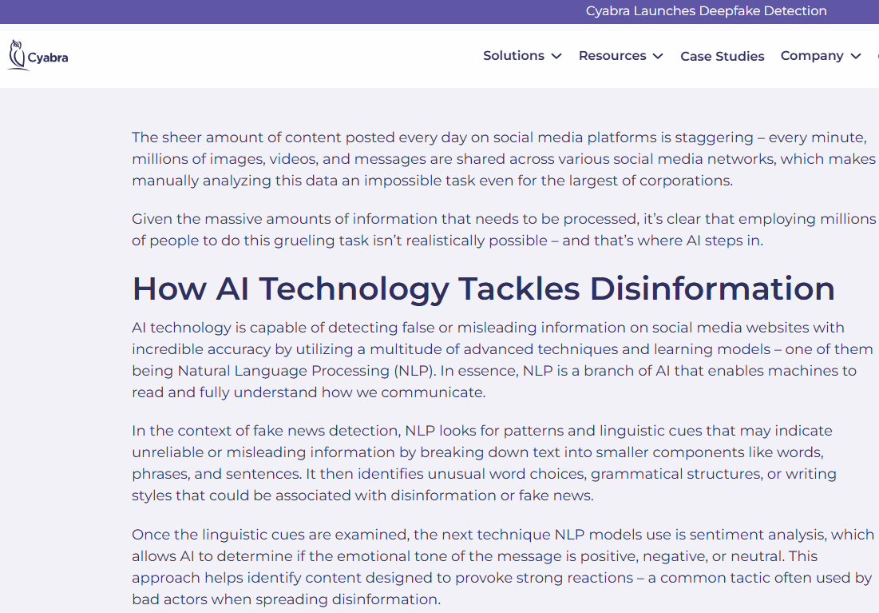
Real-Time Disinformation Monitoring
AI systems can track disinformation to identify and respond to disinformation as it spreads across digital platforms.
Crisis Response: Monitor and mitigate the impact of false information during critical events such as elections and pandemics.
Platform Transparency: Analyze transparency reports from major social media platforms to assess their efforts in combating disinformation.
Platforms like Cyabra and Graphika analyze social media activity, detect coordinated disinformation campaigns, & provide real-time alerts to mitigate the spread of false info.
Machine Learning Models: identify patterns indicative of disinformation, such as unusual posting frequencies or coordinated messaging.
Crowdsourced Fact-Checking: users can collaboratively assess and annotate potentially misleading content.
Behavioral Analysis: monitoring user behavior to detect anomalies that may signify the presence of bots or inauthentic accounts.

Slide 14
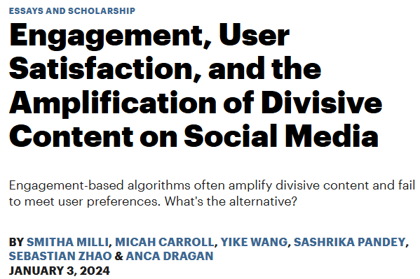
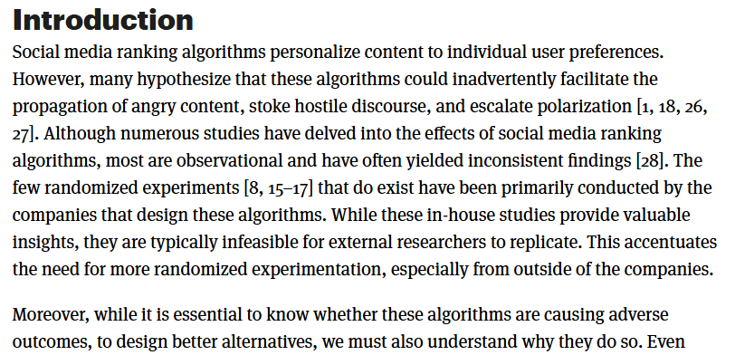
Social Media Manipulation and Algorithmic Amplification
Social media platforms utilize recommendation algorithms that prioritize and amplify content based on engagement metrics (likes, shares, comments).
Leads to the amplification of disinformation, as sensational or misleading content often generates more engagement than accurate content.
Encourages viral spread of disinformation, often creating echo chambers where misinformation is reinforced.
Algorithmic Amplification: The algorithm doesn't necessarily evaluate truthfulness but boosts content with higher engagement, which is more likely to include misinformation.
Engagement Metrics: Social media algorithms prioritize content that garners high user engagement, often amplifying sensational or polarizing content, including disinformation.
Echo Chambers & Filter Bubbles: These algorithms create echo chambers where users are exposed primarily to content reinforcing their existing beliefs, significantly amplifying misinformation, especially divisive or emotionally charged info.
Auditing Recommendation Systems can understanding & audit how social media algorithms select and recommend content is essential in addressing the spread of disinformation. Recommendations need to be transparent and accountable.
Explainable AI can explain why certain content is being recommended to users which can help to reduce unintentional bias and manipulation by providing insight into the algorithm’s decision-making process.

Slide 15
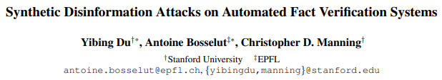
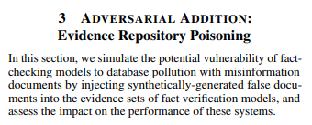
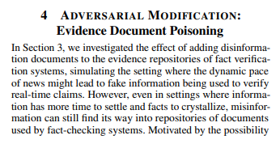

Adversarial Attacks on Fact-Checking Systems
In the battle against misinformation, fact-checking algorithms are used to detect and flag misleading or false information.
However, attackers have developed techniques to bypass or confuse these algorithms.
Text Perturbations: Attackers modify the text of misinformation in subtle ways, such as changing words, rephrasing sentences, or inserting slight grammatical errors to confuse the algorithm. Goal? Make the content undetectable by fact-checking systems without altering its meaning.
Discrediting Fact-Checkers: Attackers may attempt to delegitimize fact-checking organizations themselves by spreading misinformation about their methods, biases, or affiliations. Goal? Diminish trust in fact-checking, making it easier for false information to spread.

Slide 16
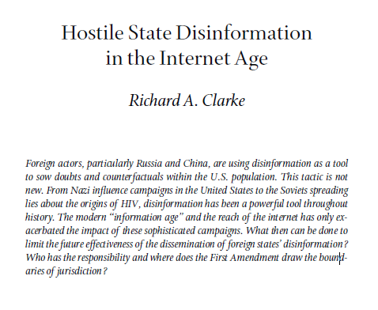
Influence Operations and Nation-State Actors
Nation-states use disinformation as hybrid warfare.
Focus: OSINT, forensic analysis, counter-troll measures.
Examples: Russian 2016 election interference, Ukraine campaigns.
References: U.S. Senate Reports; EU vs. Disinfo.

Slide 17
References
What is Disinformation Security? https://www.foreignaffairs.com/articles/world/2018-12-11/deepfakes-and-new-disinformation-war
Types of Content Waldrop, M. (2017) News Feature: The genuine problem of fake news. Proceedings of the National Academy of Sciences, 114 (48), 12631-12634.
Deepfake Detection https://libkey.io/libraries/600/articles/667254181/content-location?utm_source=api_132&allow_speedbump=trueLLMs and Disinformation
Watermarks for Content Authentication https://helpx.adobe.com/creative-cloud/help/cai/use-content-credentials.html
Blockchain Provenance https://tepperspectives.cmu.edu/all-articles/battling-deepfakes-is-blockchain-the-answer/
Botnets and Automated Influence Campaigns https://knightfoundation.org/reports/disinformation-fake-news-and-influence-campaigns-on-twitter/
Botnets and Automated Influence Campaigns https://www.socialmediatoday.com/news/Meta-ai-bot-plan-boost-engagement-facebook-instagram/736242/
LLMs and Disinformation https://www.frontiersin.org/journals/artificial-intelligence/articles/10.3389/frai.2025.1569115/pdf
LLMs and Disinformation https://www.technologyreview.com/2023/10/04/1080801/generative-ai-boosting-disinformation-and-propaganda-freedom-house/
Cognitive Hacking and Psychological Exploits https://firstdraftnews.org/articles/the-psychology-of-misinformation-why-were-vulnerable/
Real-Time Disinformation Monitoring https://cyabra.com/blog/role-of-ai-in-combating-social-media-threats/
Social Media Manipulation / Algorithmic Amplification https://knightcolumbia.org/content/engagement-user-satisfaction-and-the-amplification-of-divisive-content-on-social-media
Adversarial Attacks on Fact-Checking Systems https://arxiv.org/pdf/2202.09381
Influence Operations and Nation-State Actors http://ezproxy.rowan.edu/login?&url=https://www.proquest.com/docview/2161593888?pq-origsite=primo&accountid=13605&searchKeywords=Deepfakes%20and%20the%20New%20Disinformation%20War%20The%20Coming%20Age%20of%20Post-Truth%20Geopolitics

