Slide 1
CS 00500 – Graduate Seminar
Lesson 4.5
Quantum Computing
Quantum computers, with their super-powers, can solve complex problems that would take classical computers millennia to crack.
Notes:
Replace this with your course title and your name/contact details.

Slide 2
Why is Quantum Computing So Special?
Quantum computing is different from the fixed 0s and 1s, bits and bytes, used in today’s devices.
  Based on quantum mechanics, a branch of physics that can be hard to comprehend.
  The way in which quantum computing deals effectively with large degrees of uncertainty feels like the way we make many of the decisions we encounter in daily life.
Quantum computing is complementary to classical computing, the kind of computing we use today, not a replacement for it.
By working with uncertainty, we can take on some of the biggest, most complex problems that humanity faces, in a new and powerful way. Quantum computing will solve problems for which today’s computing falls short — problems in areas such as:
  modeling the climate,
  drug discovery,
  financial optimization

Slide 3
Quantum Problems
Encryption.
  Combinatorics is a branch of mathematics that deals with the different ways in which items can be arranged by permutation.
  The number of permutations grows exponentially as the number of items increases, so that beyond a certain threshold, today’s computers are ineffective.
  Encryption is still built on combinatorics, on the assumption that the related calculations are unmanageable. With quantum computing, however, it becomes much simpler to crack encryption.
Chemical Engineering
  Chemical engineering and biological engineering are concerned with the process of assembling molecules and finding new ones.
  Because molecules can be highly complex, the number of possible patterns they form can increase exponentially.
  Quantum simulations will help engineers predict the structure and properties of novel molecules that would otherwise be impossible to model.
  Key to developing new drugs and materials.

Slide 4
Quantum Problems
Biological Engineering.
  Photosynthesis sustains life on Earth by storing solar energy in chemical form and producing organic matter (i.e., food), starting from CO2 and water.
  The energy produced by photosynthesis in plants millions of years ago is responsible for the fossil fuels (coal, oil and gas) we use today.
  With quantum computing, we will possess the right computing power to run molecular-level simulations and understand the most important process in sustaining life.
    Can allow us to capture huge quantities of solar radiation energy in photovoltaic cells
    Improve the yield of food plants through tailored biotechnology solutions, a sustainable way of eradicating famine.
Financial
  Computing speed is a source of competitive advantage in financial markets, and quantum algorithms can increase speed for an important set of financial calculations,
  The New York Stock Exchange, for example, generates about 1 terabyte (1012 bytes) of new trading data every day.

Slide 5
Quantum Problems
More rapid machine learning
Climate Science and Weather forecasting
  Quantum computing can improve tracking and predictions of meteorological conditions because it can handle, efficiently and rapidly, vast amounts of data containing many variables. This is possible by drawing upon the immense computing power of qubits and by using quantum-like optimization
Complex scheduling
Logistics operations
  Optimizing the routes of thousands of fuel tankers traversing the globe
  Helping decide which ICU patients require the most urgent care
Supercharged artificial intelligence, with the power to better train algorithms that can finally turn driverless cars and drone taxis into a reality.

Slide 6
The Classical Computer
The classical computer is a physical device for carrying out a set of computational instructions encoded into an algorithm.
An algorithm is defined to be a well-defined, finite step of instructions that are carried out systematically in a given number of steps for solving a well defined problem.
What is the binary representation of the number 203?
  128 + 64 + 8 + 2 + 1
  2⁷ + 2⁶ + 2³ + 2¹ + 2⁰
Let's examine how to add 7 to 1 using binary addition ⊕
  111 ⊕ 01 = 1000 Each bit is in the set { 0, 1 }
  Essentially you carry over the 1
A computer is a physical device that transforms an input string of
length m to an output string of length n using an algorithm.
Classical computers rely on these strings being determinate. That is, the input string is fixed to a single value and the output string is fixed to a single value.
1
1
0
0
1
0
1
1

Slide 7
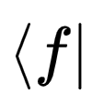
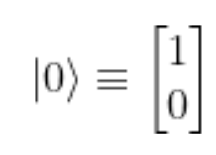
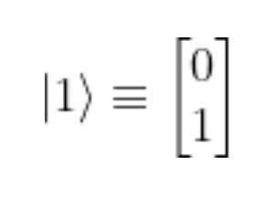
Cbit
In quantum mechanics, bra–ket notation is used ubiquitously to denote quantum states. The notation uses angle brackets, to construct "bras" and "kets". A bra is of the form and is identified as a row vector.
A ket is of the form |v⟩ denoting a vector v in a vector space and represents the state of a quantum system.
A ket can be identified with a column vector
The two possible states {0, 1} of the classical bit (now referred to as Cbit) are as follows:
This treates the state of a bit as a vector, and uses the Dirac bra-ket notation. So we would read the first representation as ket-0.
Note that the value in the bottom row represents the value of the bit in its designated state.

Slide 8
Basis Vectors
A classical bit has two possible states,
as we have seen. These states are
represented by the basis vectors.
Vectors have an origin (the tail of the vector) and a final end (the head of the vector). This is why the state of 0 is a vector that looks like this:
Basis vectors are a set of vectors that span the entire vector space, in this case these column vectors:
0
1

Slide 9
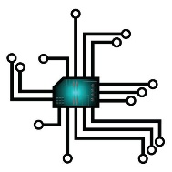
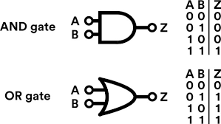
More on Classical Computers
The components of a computer are involved with
data, the means of processing it and control
mechanisms
Computer chips contain modules that contain logic
gates which contain transistors. The transistor is a
semiconductor that regulates current or voltage flow and can be in one of two distinct states – on or off. The information is made up of bits which can be set to either 0 or 1.
Transistors are combined to create logic gates
which perform a Boolean function performed
on one or more binary inputs and produce a
single binary output.
A transistor is just an electric switch.
Electricity is electrons moving from one place to another
A switch is a passage that can block electrons from moving in one direction
Memory
Arithmetic-
Logic Unit
Control Unit

Slide 10
Quantum
Tunnelling

Slide 11
The Critical Angle
A typical scale for a transistor is 14 nm, which is about the same size as a cold virus and over 500x less than a red blood cell's diameter.
At such small sizes, electrons can "leap" over a closed switch by a process called quantum tunnelling. Electrons are quantum particles, but so are particles of light.
Consider light waves. When light crosses the boundary of two media (e.g., water and air) that have a different refractive index, the beam of light will bend (refraction).
There will be a critical angle (θ_{c})
of incidence
  At angles < critical angle ➔
  some refraction
  some reflection.
  At angles >= critical angle ➔
  all reflection.

Slide 12
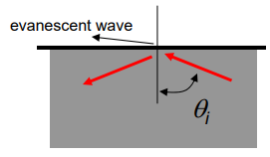
Evanescent Waves
But there is an evanescent wave -- a wave that does not change in time or space, which is a standing wave that happens right where the reflection occurs
  Evanescent waves are always present in the case of total internal reflection
  The evanescent wave decays
  exponentially away from the
  water / air interface.

Slide 13
Probabilistic Quantum Mechanics
Electrons are quantum particles. And quantum particles can be described by a wave function. (Just like light can be defined as a wave function.)
Sometimes the electron should not be allowed through a switch.
(In much the same way as light whose angle is beyond the critical angle should not be allowed to escape the medium in which it is in.)
Quantum physics, unlike classic physics, is probabilistic. We cannot pinpoint exactly where an electron is (the Heisenberg Uncertainty Principle)
  the more precisely the momentum of a particle is known,
  the less precisely we can know its position.
Even though you cannot precisely know the position of an electron, but we can know with a high probability where the electron is. The probability can be expressed by a wave function.

Slide 14
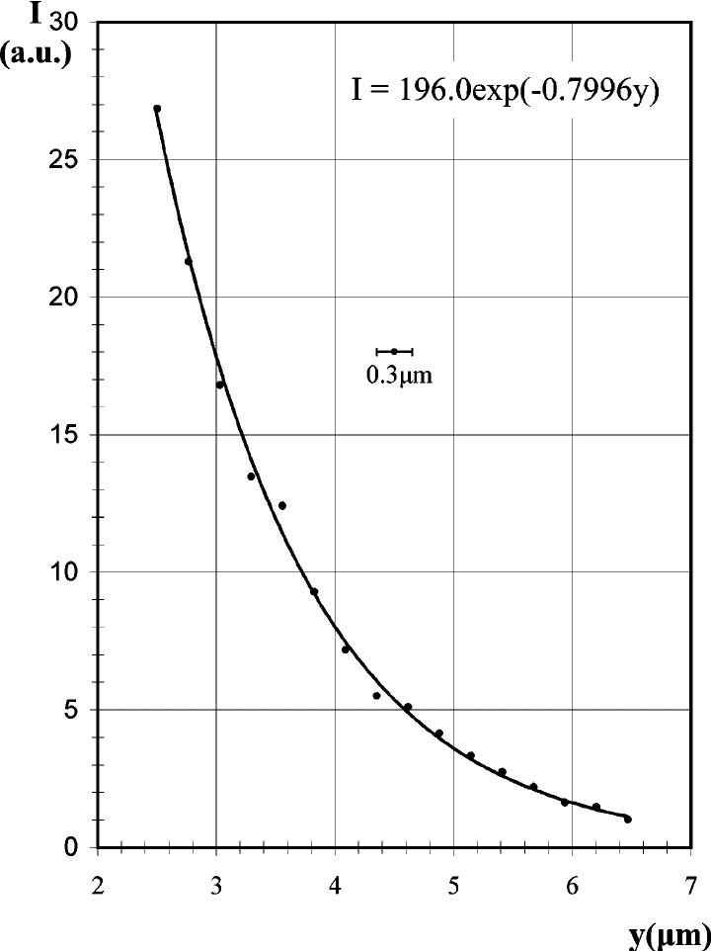
Quantum Tunnelling
Remember when total reflection occurs, 100% of the
particles of light are not reflected. Some particles will be in
the evanescent wave which very quickly (exponentially) decays.
Evanescent waves cannot usually be seen or
detected, BUT if we place another material
sufficiently close to the boundary where the
evanescent way originated, the wave might not
completely decay to zero before hitting the next material.
If the wave hits the next material, it can continue
to travel onwards

Slide 15
Qubits

Slide 16
The Quantum Computer
RECALL: "Classical computers rely on these strings being determinate. That is, the input string is fixed to a single value and the output string is fixed to a single value."
For a quantum computer, both input and output strings are also determinant, BUT the output string is determined probabilistically
The Cbit becomes a qubit, denoted by |q⟩
Instead of having a value of either 0 or 1, the qubit, as discussed previously, has a probability of both 0 or 1. The qubit can be in any proportion of both states at once. This is called superposition.
But as soon as you test it to determine its value, the qubit has to "decide" whether to a 0 or a 1. (The output string is fixed to a single value.)
As long as the qubit is unobserved, it is in a superposition of 0 or 1, and you cannot predict which it will be.

Slide 17
Qubits
Qubits are subject to errors introduced by noise in the environment around them. A result of 0 can be accidentally flipped to a result of 1, or vice versa, and there’s no easy way to know that an error has occurred.
Qubits can be used for quantum computing only when they’re kept in a state of coherence, i.e., free of interaction with their environment.
Qubits are hard to create and hard to maintain in a state of coherence; they also tend to interfere with nearby qubits in an uncontrolled fashion.
Taming qubits is one of the biggest challenges to overcome in creating useful quantum computers. A popular approach to building quantum computers involves the use of superconducting qubits, which must be kept at a temperature very close to absolute zero to minimize interference due to heat

Slide 18
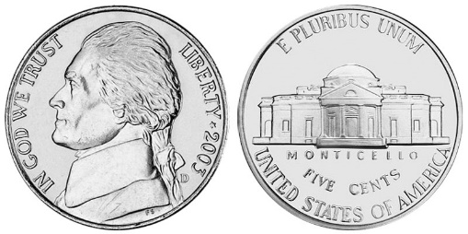
Superpositioned Qubits
Qubits can achieve a mixed state called a superposition, where they are both 1 and 0 at the same time.
A regular computer tries to solve a problem in the same way you might try to escape from a maze – by trying every possible corridor, turning back at dead ends, until you eventually find the way out.
But superposition allows the quantum
computer to try all the paths at once.
In a classic computer, two qubits can represent four possible states (00, 01, 10, 11) but only one of them at any possible time.
In the quantum computer, two qubits can also represent the exact same four states at the same time.
Quantum computers can simultaneously represent 2^{n} states, where n = number of qubits. To represent a million possible states would require 1,000 bits but only 20 qubits.
Four classic bits can either be 0 or 1
Qubits are in a superposition state of both 0 and 1 until collapse

Slide 19
Classical bits vs Qubits
Possible values of 4 classical bits
Sixteen (2⁴) possibilities of which you can use just one.
Four qubits can represent all of these combinations at once when they are in a probable state.
Each qubit's probabilistic state |q⟩ can be represented by:
  |q⟩ = α • |0⟩ + β • |1⟩
  α and β are complex numbers which are
  multiplied by the state vector.
  α and β are probability amplitudes
  | α | ² and | β | ² give the probability of measuring |0⟩ and |1⟩ respectively
  Probabilities must sum to 1, thus
  | α | ² ⁺ | β | ² = 1
0
0
0
0
1
0
0
0
0
0
0
1
1
0
0
1
0 or 1
0 or 1
0 or 1
0 or 1
0
0
1
0
1
0
1
0
0
0
1
1
1
0
1
1
0
1
0
0
1
1
0
0
0
1
0
1
1
1
0
1
0
1
1
0
1
1
1
0
0
1
1
1
1
1
1
1

Slide 20
Classical bits vs Qubits:
Probability Amplitudes
The probability amplitude is a quantity that carries all of the information necessary to specify the probability of locating a particle at any position and at any time.
Math…
Probability Amplitudes
  Traditional probability is represented in percentages, e.g., 50% a coin is heads; 50% tails
  Vector-based. Each event has an associated
  vector (or complex number) and the sum of the
  squared magnitude of these vectors is 1.
  The wavefunction of a particle (Ψ) is just the distribution of these complex numbers over space.
Four qubits can represent all of these combinations at once when they are in a probable state.
Each qubit's probabilistic state |q⟩ can be represented by:
  |q⟩ = α • |0⟩ + β • |1⟩
  α and β are complex numbers which are
  multiplied by the state vector.
  α and β are probability amplitudes
  | α | ² and | β | ² give the probability of measuring |0⟩ and |1⟩ respectively
  Probabilities must sum to 1, thus
  | α | ² ⁺ | β | ² = 1
0 or 1
0 or 1
0 or 1
0 or 1
A representation of probability amplitude α
Ψ
(the wave
function)
The imaginary part of Ψ
a mathematical description of a quantum state of a particle as a function of momentum, time, position, and spin
The real part of Ψ
x (position)
probability amplitude β could look quite different

Slide 21
Myths and Misconceptions
A qubit is represented not by “0 and 1 at the same time” but by two complex numbers.
These numbers take on a continuum of values, so they are indeed much more versatile than the binary option afforded to a single bit.

Slide 22
Another way to look at this (1)
Let's look at the two possible basis states as vectors of length 1.
A classical bit could only be at the top of the right angle, or the right-hand side. For either the 1 or the 0 value.
Think of the y axis as the |1⟩ dimension and the x axis as the |0⟩ dimension.
But imagine a vector of length 1 in between states |0⟩ and |1⟩
The vector is still of size 1, but the horizontal component is 60% of the way to |0⟩ and the veritcal component is 80% of the way to |1⟩
0.6 and 0.8 are the amplitudes of each basis state.
1.0 |1⟩
0.8 |1⟩
0.0 |1⟩
0.0 |0⟩
0.6 |0⟩
1.0 |0⟩
https://pavanjayasinha.medium.com/but-what-is-a-quantum-phase-factor-d05c15c321fe

Slide 23

Another way to look at this (2)
0.6 and 0.8 are the amplitudes of each basis state.
The square of each will give us the probability of the superposition collapsing into a certain basis state.
Probability = |α|² or |ß|²
1.0 |1⟩
0.8 |1⟩
0.0 |1⟩
0.0 |0⟩
0.6 |0⟩
1.0 |0⟩
In this example, the probability of the state collapsing into |0> and |1> is 36% and 64%, respectively.
With the Pythagorean theorem, we know that the sum of
the squares of each side equals the radius. Since the radius
equals 1 (because the sum of probabilities can't exceed 1)
we can sum up our findings and state this truth for any two
amplitudes, denoted by Greek letters alpha and beta.

Slide 24
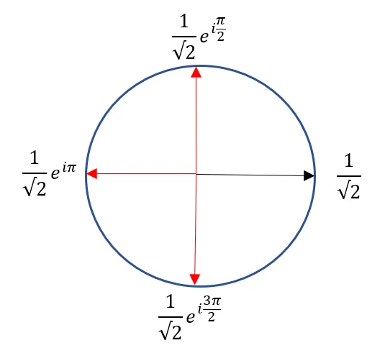
Another way to look at this (3)
Probability = |α|² or |ß|²
Given Born's Rule, if there is a 0.5 probability of a 1, and
a 0.5 probability of a 0, (each expressed as ½) then the
probability amplitude α is the square roon of ½ or 1 /√2
If you want to express the probability of (1/2) then your real amplitude for the given basis state would be (1/√2). That’s it. All possibilities for amplitudes lie on the number line, and there’s only one real amplitude for any magnitude.
Introducing complex numbers to the mix allows us an
extra degree of freedom. Through the rotation of the
complex vector, you can encode the same magnitude
(1/√2 – the black vector) with an infinite number of
configurations around a circle.
The direction of these vectors is what we refer to as
a phase factor. Given that each axis is complex, that
would imply that our coefficients alpha and beta are
also complex amplitudes.
Complex numbers enable all the qubit possibilities

Slide 25
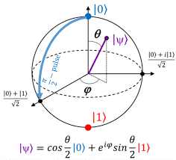
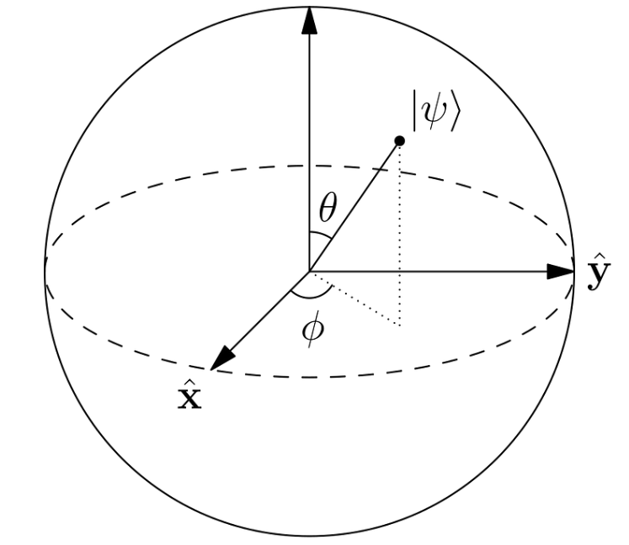

Another way to look at this (4)
Complex numbers enable all
the qubit possibilities
The direction of these vectors is what we refer to as a phase
factor. Coefficients alpha and beta are also complex amplitudes.
The only reason phase is important is because it brings about
interference effects. And interference effects are only dependent
on the difference in phase between the two waves
Thus a 2 dimension, circular representation is insufficient.
We need a sphere to represent four dimensions.
(Mathematical simplification makes it possible to
only represent three of these dimensions.*)
A representation of probability amplitude α
Ψ
(the wave
function)
The imaginary part of Ψ
sin(θ/2) is the amplitude for the |0> state
cos(θ/2) is the amplitude for the |1> state
The real part of Ψ
x (position)
Φ is the phase factor
*one degree of freedom is removed by the normalization constraint |α|² + |β|² = 1

Slide 26
Interference Effects Can Help Us Develop Quantum Algorithms
Recall how interference works.
In quantum computing, we can take advantage of interference effects to devise quantum algorithms to speed computing.
Again, we are able to do calculations on all states at the same time but we are only able to get one state output in the end.
Example: searching a large database for one record.
  Design a quantum algorithm in a way that all the records we do not want somehow destructively interfere. And we get some constructive interference for the record that we do want.
  The wrong answers effectively cancel each other out, and the right answer is the one that remains.

Slide 27
Visualizing a qubit's superposition
Recall: "Instead of having a value of either 0 or 1, the qubit, as discussed previously, has a probability of both 0 or 1. The qubit can be in any proportion of both states at once. This is called superposition."
Also recall: the probability of a qubit's state relies on complex numbers with a real and an imaginary part.
  This makes it difficult to visualize the superposition of a qubit.
  However, using mathemathical calculations, we can represent
  the probalistic state of a qubit by its location on a Bloch Sphere.
  The sphere has a radius of 1. Note the point on the surface
  of the sphere at the end of the purple line. This is the state
  of the wavefunction Ψ.
  The base state of 0 is at the north pole, and the base state of
  1 is at the south pole. Notice that the state of the qubit |q⟩ (represented here as | Ψ ⟩)
  is more probably going to be |0⟩ than |1⟩, as it is closer to the north pole.
  If you want to understand the math behind this, check out this video: The Bloch Sphere (simply explained) https://www.youtube.com/watch?v=a-dIl1Y1aTs

Slide 28
Basis States
Eigenstate is a definite state of a quantum system where the observer can predict the result of a particular measurement with certainty. It is characterized by a wave function defining the probabilities of obtaining possible outcomes from the quantum system measurements.
  Computational basis (Z) Eigenstates of this basis: |0⟩ and |1⟩ from a Z measurement
  Plus/minus basis (X) Eigenstates of this basis: |+⟩ and |-⟩ from an X measurement
  Left/right basis* (Y) Eigenstates of this basis: |L⟩ and |R⟩ from a Y measurement
*also known as the +i/- i basis
|-⟩
⟩
|+⟩

Slide 29

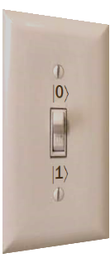




Envisioning Phase
Z
In quantum computing not only are qubits in a superposition between |0⟩ and |1⟩, but we are in three dimensional (Bloch sphere) space.
Measurements in the Z basis (the computational basis) still collapse to |0⟩ or |1⟩.
But we can rotate the switch around the Z axis. The phase can be considered to be the direction the switch is pointing, which is represented by the wave function vector ψ
We can also measure in the X or Y basis as well as the Z basis. But you can only measure in a single basis.
|-⟩
Z
Imagine
a light
switch in
two
dimensions.
This represents
a classical bit:
either 0 or 1
|$ψ$⟩
θ
Y
|L⟩
φ
|R⟩
|+⟩
X
Phase comes into play when looking at the interference of different amplitudes. (Recall that there are two waves for the complex numbers in the X and Y basis.)
We don't see the phase directly when measuring states in the Z basis.
The minus signs cause different terms to cancel out. So when changing basis or combining different states, the phase controls which amplitudes constructively and destructively interfere.

Slide 30
I get measuring in the Z basis (to get a |0⟩ or |1⟩) but why measure in X or Y?
  Computational basis (Z) Eigenstates of this basis: |0⟩ and |1⟩ from a Z measurement
  Plus/minus basis (X) Eigenstates of this basis: |+⟩ and |-⟩ from an X measurement
  Left/right basis* (Y) Eigenstates of this basis: |L⟩ and |R⟩ from a Y measurement
X-basis measurements are used when you need to extract information from superpositions or interference patterns, detect certain errors, or perform operations related to entanglement and quantum communication.
Example: quantum communication protocols like quantum teleportation that rely on entanglement.
Transfer of quantum information across long distances without physically sending qubits
Secure communication protocols, such as Quantum Key Distribution (QKD), where the security of transmitted keys relies on the principles of quantum mechanics
Distributed quantum computing, where qubits are teleported between different quantum processors or nodes to perform computations in parallel
Y-basis measurements are necessary when detecting phase relationships that involve imaginary numbers or combined errors, and are useful in tasks like quantum error correction.
Example: Shor code to correct errors due to noise and qubit interference.
The two most common qubit errors are the bit-flip ∣0⟩ to ∣1⟩ or vice versa, and the phase-flip ∣+⟩ to ∣-⟩ or vice versa.
Each qubit is encoded into three qubits to protect against bit-flips. Each of those qubits is further encoded into three qubits to protect against phase-flips.
If these "three-somes" agree, no error. Otherwise the two that agree will correct the outlier qubit.

Slide 31
The lifecycle of a qubit
The qubits come into play in the following manner:
  Once the initial state is provided and until the output is ready, the transformations being performed inside a quantum computer are all performed on the qubits.
  The process of quantum computing cannot be observed, as it will destroy the process (as the qubits will collapse into a base state and no longer be probabilistic.)
  Imagine an algorithm that requires several qubits:
    The quantum computer will simultaneously update all the qubits – sometimes this is called quantum parallelism.
    During the entire computational process, all the qubits are in an indeterminate state.
    Once the computation has been completed, the output string is also in an indeterminate state.
    BUT, the process of measurement (getting the output of the algorithm) collapses the indeterminate state (with a certain probability) to specify the determinate output string which has a likelihood of occurrence.

Slide 32
Why are quantum computers powerful
A 30-qubit-quantum computer would equal the processing power of a conventional computer that could run teraflops (trillions of floating-point operations per second).
Todays typical desktop computers run at speeds measured in gigaflops (billions of floating-point operations).

Slide 33
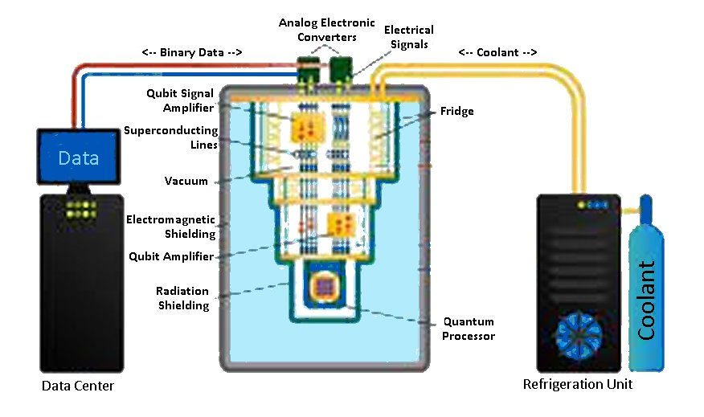
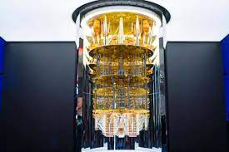
So what does all this mean?
For a few algorithms, a quantum computer is much faster than a classical computer – in some cases exponentially faster – since all the possible states of many qubits are being updated simultaneously in the process of quantum computation.
This provides a completely new and different paradigm for computer science.

Slide 34
The Challenges: Hardware
In hardware, several related challenges need to be addressed:
  Better qubits: Qubits with lower error rates will produce far better results. Qubits and their control machinery need to generate less noise so as not to cause cross-talk (interference among nearby qubits and the environment) and be better isolated from other noise, such as heat and vibration.
  More qubits: Once each qubit behaves better, we can pack them together more densely and in greater numbers. As in classical computing, this development will greatly increase computing power while reducing costs.
  Cooling and supercooling: Superconducting qubits require extremely low temperatures, but lower temperatures are better for error reduction for all kinds of qubits. Therefore, better, cheaper, easier-to-manufacture cooling and supercooling will help the other hardware challenges.
  Error correction: Error correction will require multiple solutions, one of which is to combine several physical qubits into a single, self-correcting logical qubit. Colder temperatures and better control machinery will reduce the error count and ease the burden on error correction.

Slide 35
The Challenges: Software and People
In software, major challenges include the following:
  Quantum algorithms: Many decades of work have gone into optimizing algorithms for mainstream computers, but quantum algorithms are in their early days. Both theoretical advances and optimization in practice are needed.
  Error mitigation: Software can help predict and reduce errors, making today’s quantum computers more useful and reducing the burden on hardware error correction.
People power is lacking as well:
  Scientists and researchers: Theoretical work and advanced development are needed to move the field forward, but there are too few qualified people.
  Software developers: Only a small number of software developers know how to use quantum computing systems and contribute to their further development, though this share is slowly increasing.

