Slide 1
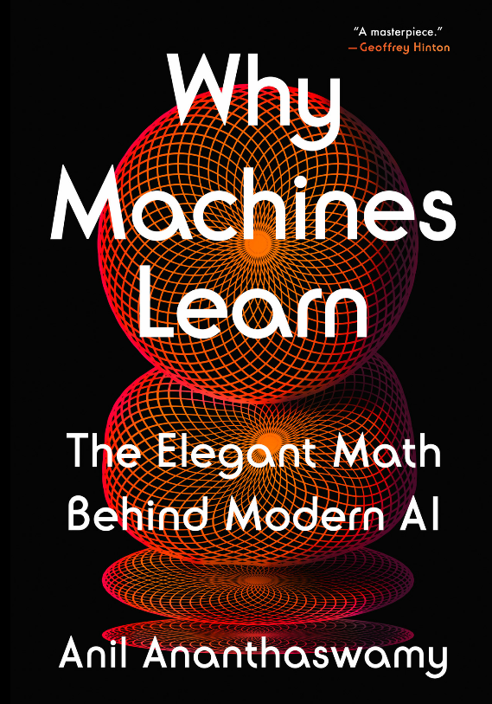
CS 00500 – Graduate Seminar Lesson 4.3 Machine Learning
Notes:
Replace this with your course title and your name/contact details.

Slide 2



AI and Machine Learning
Artificial Intelligence
Artificial intelligence uses computer science and data to enable problem solving in machines.
Machine learning refers to the study of computer systems that learn and adapt automatically from experience, without being explicitly programmed.
Deep learning is a machine learning technique that layer algorithms and computing units – or neurons – into artificial neural networks that mimic the human brain.
Machine Learning
Deep Learning
https://www.coursera.org/articles/ai-vs-deep-learning-vs-machine-learning-beginners-guide

Slide 3
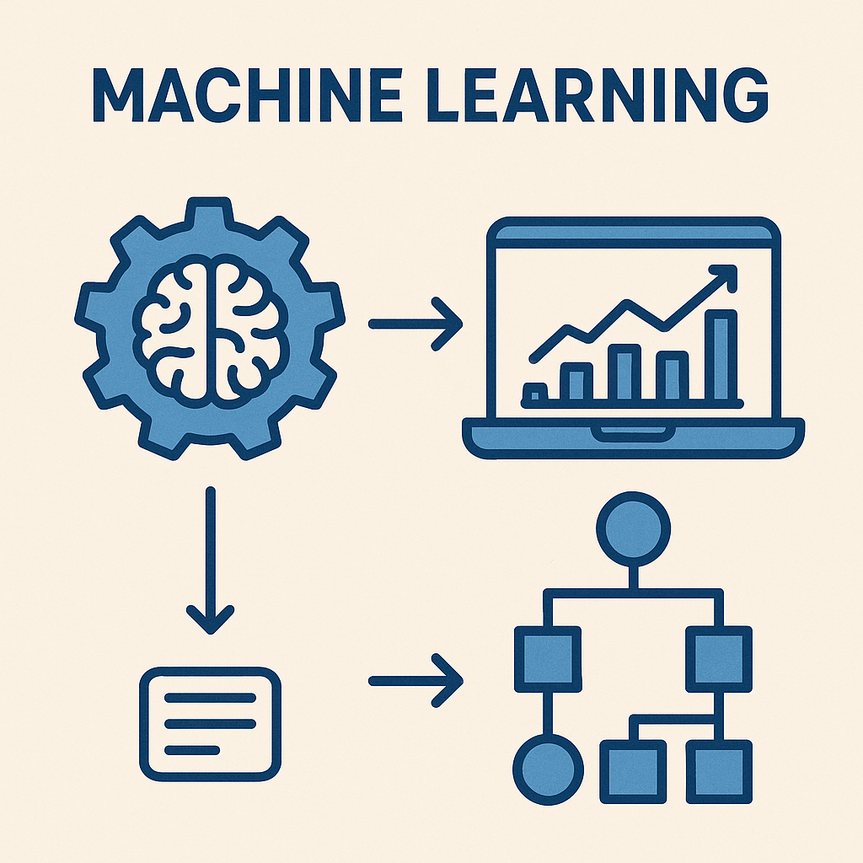
What Exactly, is Machine Learning?
Machine learning: a type of AI that involves building machines that can learn to discern patterns in data without being explicitly programmed to do so.
Trained machines can then detect similar patterns in new, previously unseen data, making possible applications that range from recognizing pictures of cats and dogs to creating autonomous cars.
Inputs |  | Output
a | b | c
4 | 2 | 8
1 | 2 | 5
0 | 5 | 10
2 | 1 | 4
5 | 2 | ???
You be the machine!
Study this data and look for a pattern
What should "???" be?

Slide 4
What Exactly, is Machine Learning?
Machine learning: a type of AI that involves building machines that can learn to discern patterns in data without being explicitly programmed to do so.
Trained machines can then detect similar patterns in new, previously unseen data, making possible applications that range from recognizing pictures of cats and dogs to creating autonomous cars.
Inputs |  | Output
a | b | c
4 | 2 | 8
1 | 2 | 5
0 | 5 | 10
2 | 1 | 4
5 | 2 | ???
The model used is a regression model - a statistical tool used to analyze the relationship between a dependent variable (c) and one or more independent variables (a, b)
Did you guess 9?
a + 2b = c

Slide 5
Example: Housing in Glassboro
Address | Bedrooms | Square Footage | Price (USD) | Sale Date
1202 Woodruff Rd | 3 | 1,719 | 240,000 | 16-Jun-25
317 New St | 3 | 1,632 | 259,900 | 26-Jun-25
1807 S Academy St | 3 | 960 | 270,000 | 18-Jun-25
320 Franklin Rd | 4 | 1,684 | 299,000 | 6-Jun-25
109 Mazzeo Dr | 3 | 1,484 | 347,500 | 27-Jun-25
213 Wilmer St | 4 | 1,700 | 385,500 | 3-Jun-25
555 Fairview Rd | 3 | 1,740 | 435,400 | 13-Jun-25
24 Meghan Ct | 3 | 2,323 | 450,000 | 9-Jun-25
118 Field Loop | 2 | 1,698 | 470,000 | 13-Jun-25
401 Sturgess Ct | 3 | 1,936 | 505,000 | 25-Jun-25
529 Fern Road | 3 | 1,216 | ???
Training Data
Based on the trained model, a 3-bedroom, 1,216 sq ft home in Glassboro is expected to sell for around $295,000
But the house is listed at $225,000
Training data way too sparse
Input parameters way too small

Slide 6
Python Code
import numpy as np
from sklearn.linear_model import LinearRegression
# Training data
X = np.array([
[3, 1632],
[3, 960],
[3, 1719],
[3, 1740],
[3, 2323],
[4, 1700],
[4, 1684],
[3, 1484],
[3, 1936],
[2, 1698]
])
y = np.array([
259900,
270000,
240000,
435400,
450000,
385500,
299000,
347500,
505000,
470000
])
Address | Bedrooms | Square Footage | Price (USD) | Sale Date
1202 Woodruff Rd | 3 | 1,719 | 240,000 | 16-Jun-25
…
118 Field Loop | 2 | 1,698 | 470,000 | 13-Jun-25
401 Sturgess Ct | 3 | 1,936 | 505,000 | 25-Jun-25
529 Fern Road | 3 | 1,216 | 295,258
# Train the model
model = LinearRegression()
model.fit(X, y)
# Predict your house
your_house = np.array([[3, 1216]])
predicted_price = model.predict(your_house)[0]
print(f"Predicted sale price: ${predicted_price:,.2f}")

Slide 7
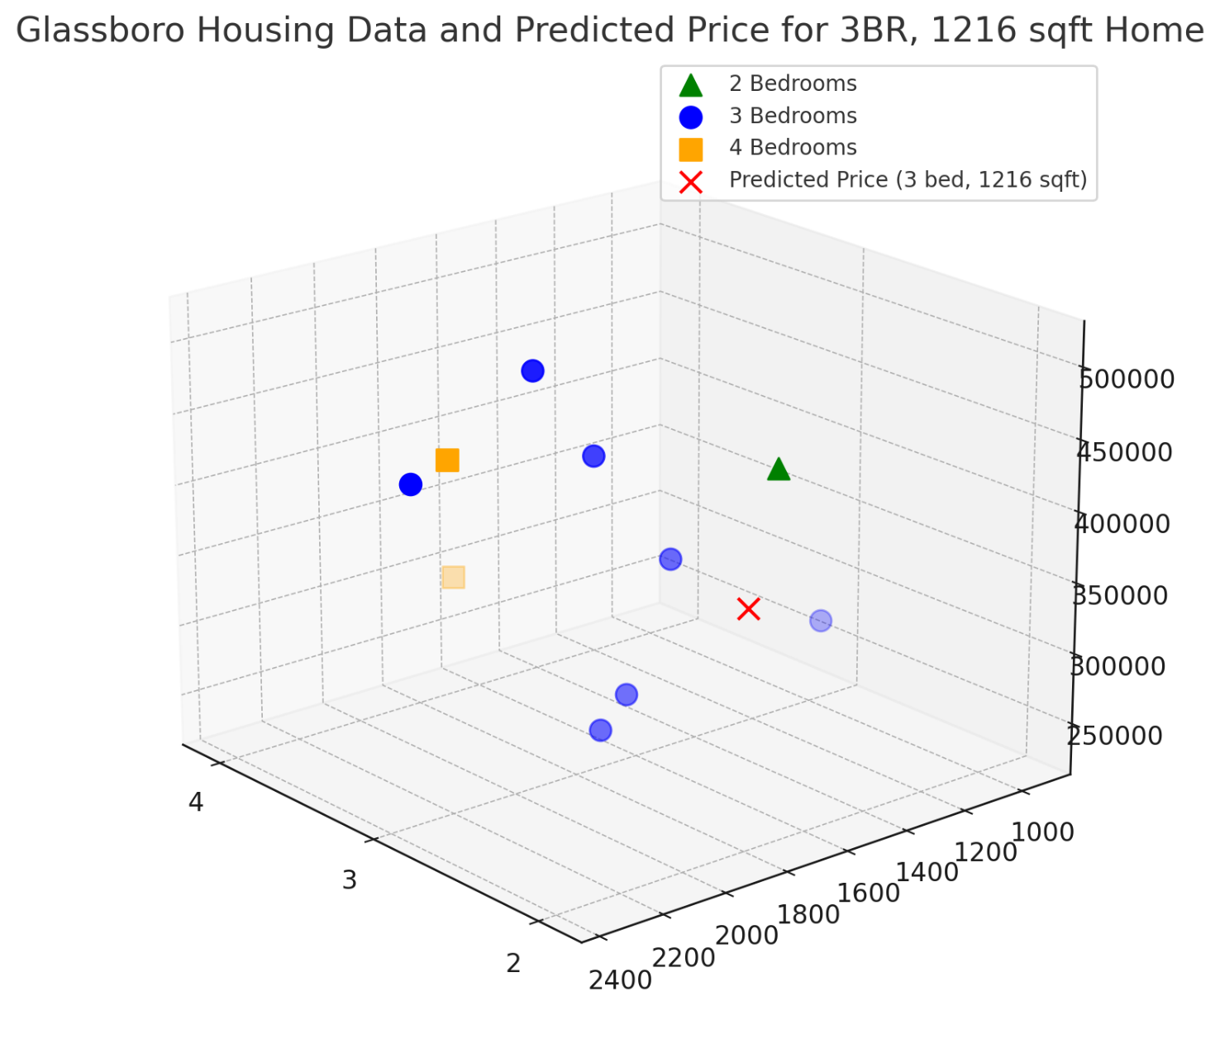
3D Model Visualization
Price
Number of bedrooms
Square footage

Slide 8
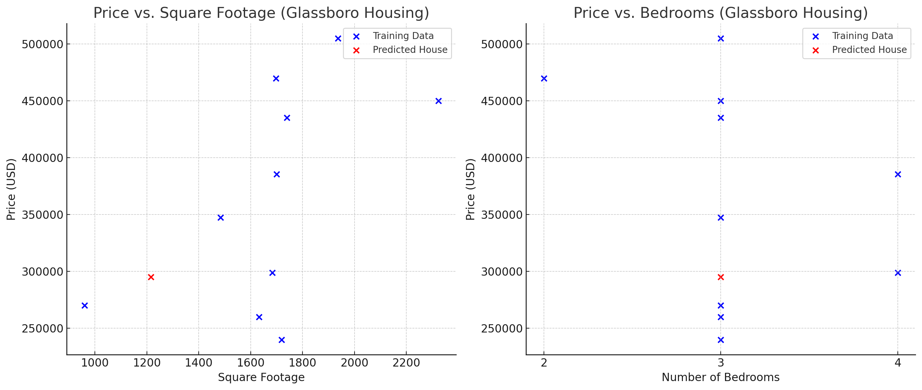
2D Model Visualization

Slide 9
The Mathematics of Machine Learning

Slide 10
The Math of Machine Learning
Vectors
Vectors represent data points, features, and weights in ML models.
A house described by [3 bedrooms, 1216 sqft] is a 2D feature vector. In training, we update weight vectors to minimize error.
Matrices
Matrices handle multiple data points and allow for efficient batch computation.
A dataset of 100 houses, each with 2 features, is stored in a 100×2 matrix. ML libraries use matrix operations to train models efficiently (e.g., in linear regression or neural networks).
Linear Algebra
The language of data and models in ML. Concepts like dot products, projections, and eigenvectors underpin algorithms.
Example: Principal Component Analysis (PCA)** uses eigenvectors to reduce dimensionality and find structure in data.
Probability and Statistics
They allow ML to reason under uncertainty and build models of the world from incomplete data.
Example: Naive Bayes** is based on Bayes’ Theorem, and many ML models (e.g., logistic regression, Bayesian networks) rely on probabilistic reasoning.
Optimization Theory
Every ML algorithm aims to optimize something -- typically a loss function that quantifies prediction error.
Example: Training a neural network is a large-scale non-convex optimization problem where we try to find weights that minimize prediction error.
Calculus
Calculus enables optimization by computing how small changes in inputs affect outputs – critical for gradient-based learning.
Example: Gradient descent** uses derivatives to minimize a loss function by updating model parameters in the direction of steepest descent.
(** explained in further slide)

Slide 11
Linear Algebra: Eigenvectors
An eigenvector is a special kind of vector that doesn't change direction when a transformation (like stretching, rotating, or shrinking) is applied to it — it only gets scaled.
A transformation of a vector is a rule or operation that moves or changes vectors.
A linear transformation (like the ones we care about in Principle Component Analysis, ML, and graphics) can make the following changes to a vector:
Stretch
Shrink
Shear (slanting)
length and direction of v1 changed
v1
These vectors show a change in x and a change in y. e.g., v1 (0 change in x, 10 change in y)
v1
v1'
Flip
Rotate
v2
v2 (eigenvector)
Done by applying a matrix to a vector (matrix-vector product)
k is the strength of the shear
v1
v1'
1
0
k
1
x
0
10
=
1×0 + k×10
0×0 + 1×10
=
5
10
Horizontal shear matrix
v2
v2'
1
0
k
1
x
10
0
=
1×10 + k×0
0×10 + 1×0
=
10
0

Slide 12
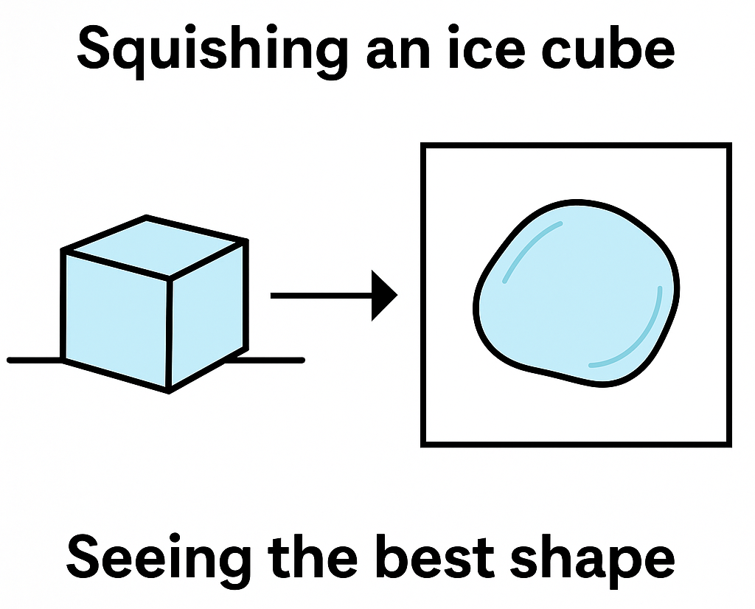

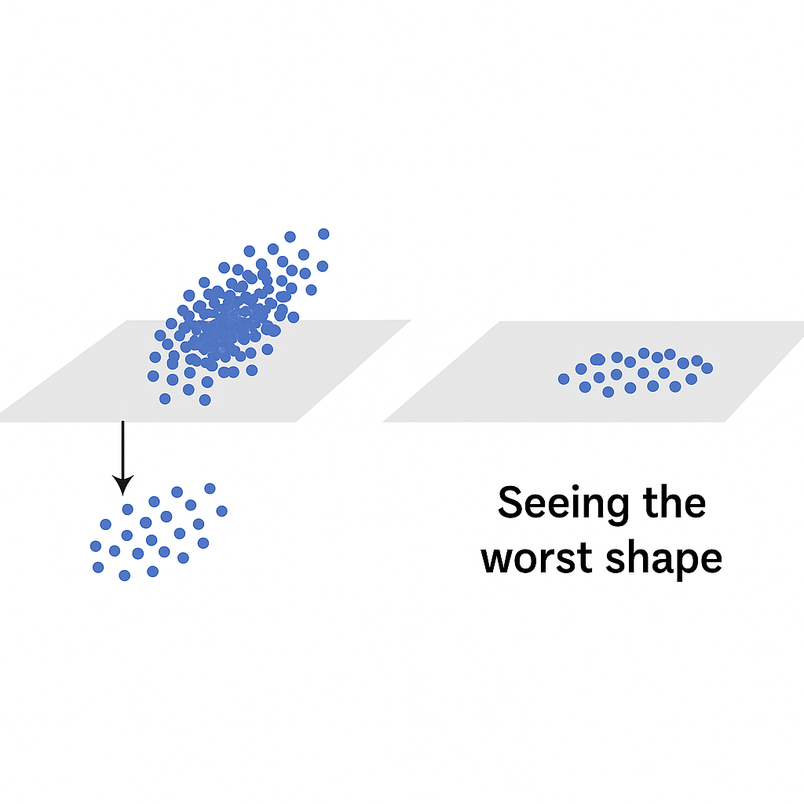
Linear Algebra Example: Principle Component Analysis (PCA)
PCA: way to simplify a dataset that has many features (dimensions), by finding the most important patterns in the data.
Imagine your data is a cloud of points in a high-dimensional space (like a scatterplot, but in many dimensions).
PCA finds new directions (called principal components) that:
Point in the directions where the data varies the most.
Are straight lines through the data cloud that best describe the shape of the data.
These directions are the eigenvectors — think of them as "new axes" that better capture the data’s layout.
PCA lets us drop the less important directions, keeping only the top few that capture most of the structure to reduce dimensionality.
Imagine squishing a 3D ice cube onto a table. PCA finds the flattest angle to view the cube where you can still see its shape — but now in 2D instead of 3D.
Now let's flatten a point cloud
worst shape
worst shape
best shape
best shape

Slide 13
PCA Reduces Dimensionality
How PCA Reduces Dimensionality
Transforms the original features into a new set of orthogonal (uncorrelated) features called principal components.
These principal components are ordered by how much variance they capture from the original data:
The first principal component (PC1) captures the most variance.
The second principal component (PC2) captures the next most variance, and is orthogonal to PC1
The third principal component (PC3) captures the next most variance and is orthogonal to both PC1 and PC2
By keeping only the top k principal components PCA reduces the dataset to k dimensions while retaining most of its variability
Why Reduce Dimensionality?
Remove noise or redundant features.
Speed up machine learning algorithms (less data to process).
Improve visualization (e.g., projecting data onto 2D or 3D space).
As the number of dimensions ↑, the volume of the space grows so fast that data points become too sparse to effectively analyze.

Slide 14

Probability & Statistics Example: Naïve Bayes
Bayes' Theorem
P(A|B) = _P(B|A) · P(A)_
The probability of A given B = the probability of B given A times the probability of A divided by the probability of B.
for Machine Learning
A: the class label
B: the input features
"naïve" assumes that all input features are independent for the probability of the class
P(B)
Email Spam Classifier
Can machine learning predict if an incoming email is spam or not predicated on the email's subject's words?
Classes (A) are "Spam" and "NotSpam"
Features (B) are the words in the email
P(Spam|words) = P(claim|Spam) · P(offer|Spam) · P(meeting|Spam) · P(Spam)_
P(NotSpam|words) = P(claim|NotSpam) · P(offer|NotSpam) · P(meeting|NotSpam) · P(NotSpam)_
P(words)
P(words)
word | P(word|Spam) | P(word|NotSpam)
claim | 0.75 | 0.05
offer | 0.65 | 0.20
meeting | 0.10 | 0.70
To: you@rowan.edu
Subject: Claim your offer after the meeting!
P(Spam) = 0.4
P(NotSpam) = 0.6

Slide 15

Probability & Statistics Example: Naïve Bayes
word | P(word|Spam) | P(word|NotSpam)
claim | 0.75 | 0.05
offer | 0.65 | 0.20
meeting | 0.10 | 0.70
To: you@rowan.edu
Subject: Claim your offer after the meeting!
P(Spam) = 0.4
P(NotSpam) = 0.6
We don't need the denominators; we can compare relative Spam / NotSpam values.
P(Spam|words) = P(claim|Spam) · P(offer|Spam) · P(meeting|Spam) · P(Spam)_
P(NotSpam|words) = P(claim|NotSpam) · P(offer|NotSpam) · P(meeting|NotSpam) · P(NotSpam)_
P(Spam|words) ∝ P(claim|Spam) · P(offer|Spam) · P(meeting|Spam) · P(Spam)
∝ 0.75 · 0.65 · 0.10 · 0.4 = 0.0195
P(NotSpam|words) ∝ P(claim|NotSpam) · P(offer|NotSpam) · P(meeting|NotSpam) · P(NotSpam)
∝ 0.05 · 0.20 · 0.70 · 0.6 = 0.0042
∝ means "is proportional to"
P(words)
P(words)

Slide 16
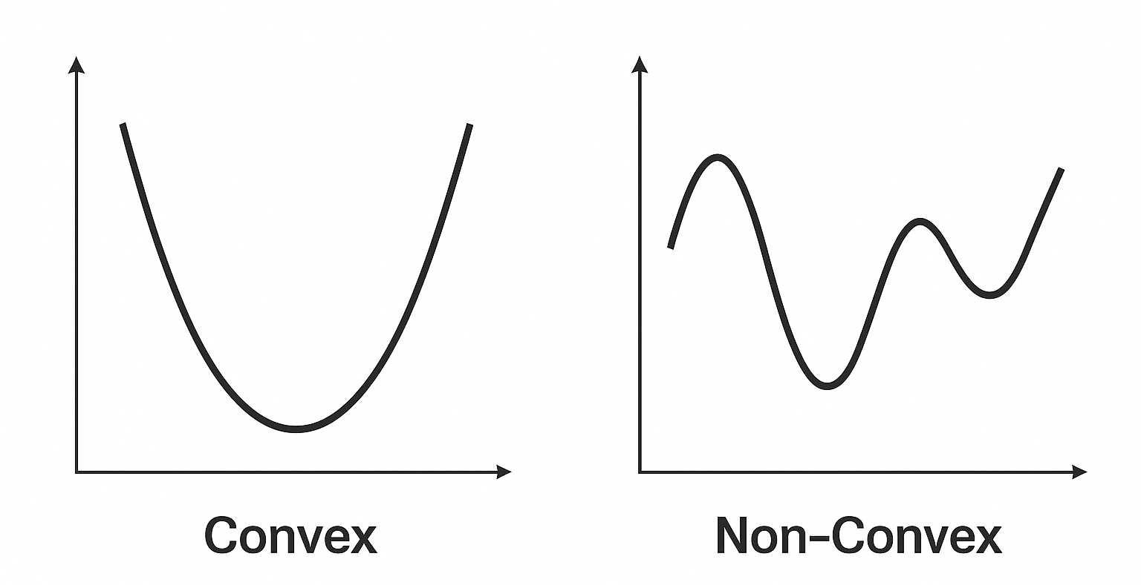
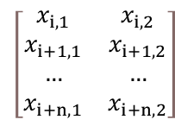


Optimization Theory Example: Non-convex Optimization of Neural Network
More hidden layers could model more complex patterns, but would do the same thing.
What is a neural network?
A neural network is a mathematical model inspired by the human brain. It’s made up of layers of simple units called neurons, which are connected together and learn to recognize patterns by adjusting weights and biases during training.
What does "non-convex" mean?
Non convex functions may contain many minimum points.
Sometimes the absolute minimum is not needed as other minimums might be good enough for analysis
Hidden Layer(s)
Input Layer
Output Layer
w_{1a}
w_{2a}
b_{a}
$$x$$
w_{1b}
w_{2b}
b_{b}
$$\left[\begin{matrix}x_{i,1} & x_{i,2} \\ x_{i+1,1} & x_{i+1,2} \\ … & … \\ x_{i+n,1} & x_{i+n,2}\end{matrix}\right]$$
$$activation(z)$$
w_{1c}
w_{2c}
b_{c}
Data i instances
2 inputs
$$x$$
$$activation(z)$$
receives data (x)
passes to first hidden layer
w_{1d}
w_{2d}
b_{d}
outputs answer
may backpropagate to previous layer
takes input features (x)
applies weights (w) and sums
adds bias (b) to get (z)
passes thru activation function

Slide 17
Optimization Theory Example: Non-convex Optimization of Neural Network
Learning to Predict Student Readiness for Exams
Can we develop an algorithm to predict exam readiness based on the number of hours a student studied and the number of hours of sleep they got the night before the exam?
Student | Sleep Hours | Study Hours | Prepared
1 | 5.2 | 3 | TRUE
2 | 7 | 3.6 | TRUE
3 | 7.5 | 3.4 | TRUE
4 | 5.3 | 2.6 | TRUE
5 | 7.3 | 3.8 | TRUE
6 | 4.9 | 2.9 | TRUE
7 | 6 | 3.2 | TRUE
8 | 5.2 | 2.8 | TRUE
9 | 6.7 | 3.7 | TRUE
10 | 6 | 3 | TRUE
11 | 5 | 3.5 | TRUE
12 | 5.5 | 2.4 | TRUE
13 | 4.2 | 2.2 | FALSE
14 | 3.5 | 1.8 | FALSE
15 | 4.5 | 2.4 | FALSE
16 | 4.8 | 2 | FALSE
17 | 5.6 | 2.3 | FALSE
18 | 4.3 | 1.9 | FALSE
19 | 3.9 | 1.7 | FALSE
20 | 4.6 | 2.2 | FALSE
Studying usually has a stronger effect, so its weight might be higher.
Sleep also helps, but maybe a bit less directly, so it gets a lower weight.
Neurons in our Neural Network will:
Multiply each input by a random weight. (Each neuron will have a different weight, so it will learn different things.)
Add these up to get a weighted sum.
Add a bias
Pass the result through an activation function

Slide 18
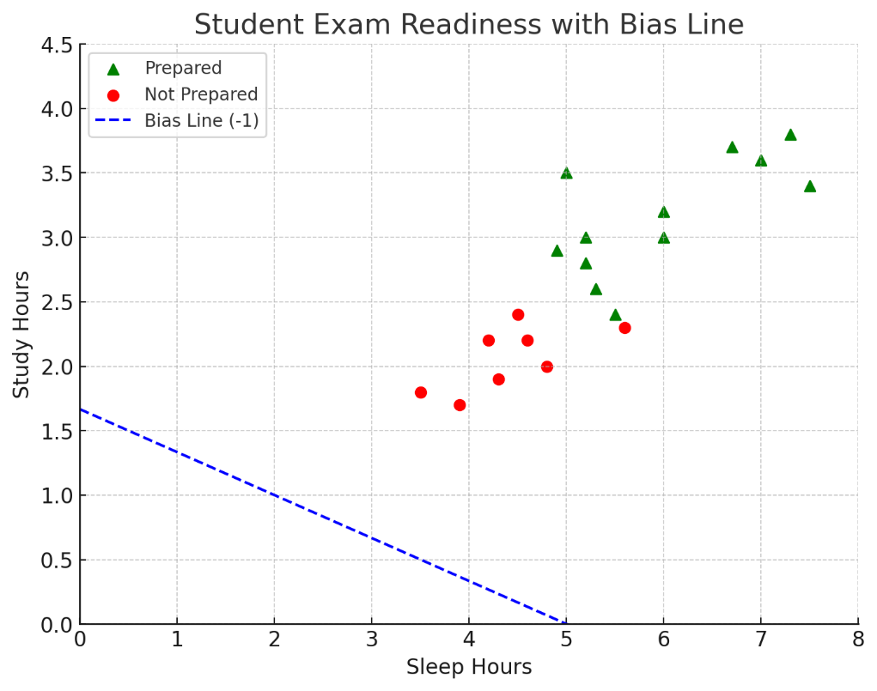
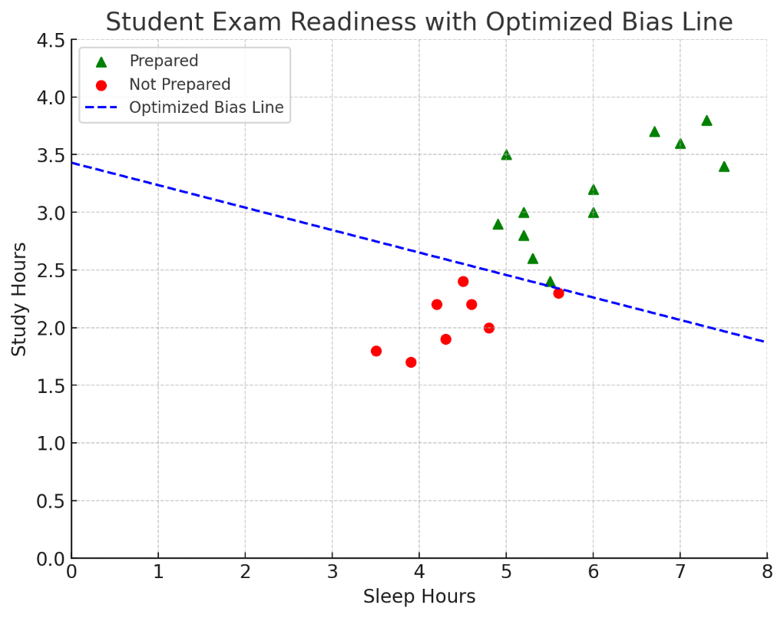
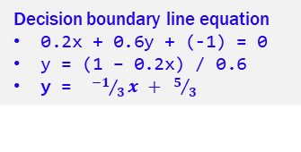
Optimization Student Preparedness
Decision boundary line equation
0.2x + 0.6y + (-1) = 0
y = (1 – 0.2x) / 0.6
y = ${−1}/3x + 5/3$
Neuron 1
Sleep hours weight = 0.2 (x axis)
Study hours weight = 0.6 (y axis)
Bias = -1
Neurons in our Neural Network will:
Multiply each input by a random weight. (Neuron 1 picked 0.2 and 0.6)
Add these up to get a weighted sum.
Add a bias
Pass the result through an activation function
The decision boundary line will separate the input space
Above the line, neuron thinks student = Prepared.
Below the line ➔ student = Not Prepared.

Slide 19
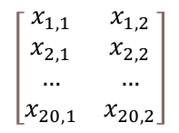
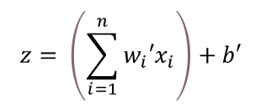
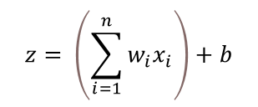


Optimization Student Preparedness: 20 students, 2 inputs
Neurons in our Neural Network will:
Multiply each input by a random weight. (Neuron 1 picked 0.2 and 0.6)
Add these up to get a weighted sum.
Add a bias, to calculate z value which is a vector of size n. (in this case 20)
Pass the result through an activation function
This is a highly simplified problem with two inputs that could be visualized in two dimensions
Input data: x (sleep hours) and y (study hours)
Weights: 0.2 and 0.6
But in reality, we will have many inputs (x₁, x₂, … x_{n}) and many weights (w₁, w₂, … w_{n})
$$\left[\begin{matrix}x_{1,1} & x_{1,2} \\ x_{2,1} & x_{2,2} \\ … & … \\ x_{20,1} & x_{20,2}\end{matrix}\right]$$
Data
Neuron 1
$$z= \left(\sum_{i=1}^{n}{w_{i}x_{i}}\right)+b$$
b
$$\left[\begin{matrix}w_{1} \\ w_{2}\end{matrix}\right]$$
Activation Function
activation(z)
Neuron 2
$$z= \left(\sum_{i=1}^{n}{w_{i}′x_{i}}\right)+b′$$
b'
$$\left[\begin{matrix}w_{1}′ \\ w_{2}′\end{matrix}\right]$$

Slide 20
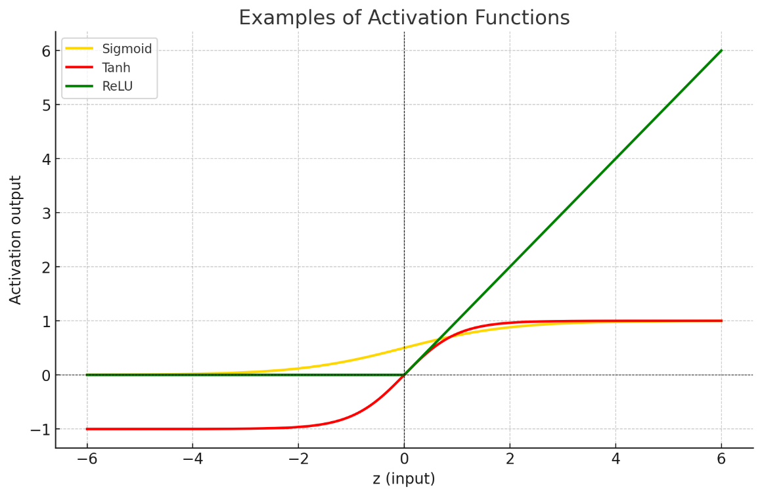




Optimization Student Preparedness
Not all decisions can be made on a linear model. This is overly simplified.
Activation functions introduce non-linearities into the network, allowing it to capture complex patterns and relationships in the data, e.g.:
Sigmoid for binary classifications (spam vs not spam)
TanH is like Sigmoid, but has a -1 to +1 range (emotional tone/attitude: "positive", "negative", "neutral"
ReLU used a lot in image recognition (positive values are not compressed)
Input (z) | Sigmoid Output | Tanh Output | ReLU Output
-2 | 0.119 | -0.964 | 0
-1 | 0.269 | -0.762 | 0
0 | 0.5 | 0 | 0
1 | 0.731 | 0.762 | 1
2 | 0.881 | 0.964 | 2
Neuron 1
$$z= \left(\sum_{i=1}^{n}{w_{i}x_{i}}\right)+b$$
Activation Function
activation(z)
Neuron
b
$$\left[\begin{matrix}w_{1} \\ w_{2}\end{matrix}\right]$$
Neuron 2
$$z= \left(\sum_{i=1}^{n}{w_{i}′x_{i}}\right)+b′$$
b'
$$\left[\begin{matrix}w_{1}′ \\ w_{2}′\end{matrix}\right]$$

Slide 21
Optimization Student Preparedness: 20 students, 2 inputs
Neurons in our Neural Network will:
Multiply each input by a random weight. (Neuron 1 picked 0.2 and 0.6)
Add these up to get a weighted sum.
Add a bias, to calculate z value which is a vector of size n. (in this case 20)
Pass the result through an activation function
Pass modified result forward to make the prediction
Calculate loss (a single value that represents how far off the prediction is from the actual label)
Backpropagate
compute how much each weight contributed to the error
how should the bias change?
Gradient Descent (optimization)
Gradient for each weight and bias
Use gradients to update weights and bias
Stop the training
The model stops the cycles of training when the machine learning engineer decides it has trained "enough"
Not all decisions can be made on a linear model. This is overly simplified.
Activation functions introduce non-linearities into the network, allowing it to capture complex patterns and relationships in the data.
Forward Pass (prediction)
Activation Function
activation(z)
Neuron
Backward Pass (backpropagation)

Slide 22
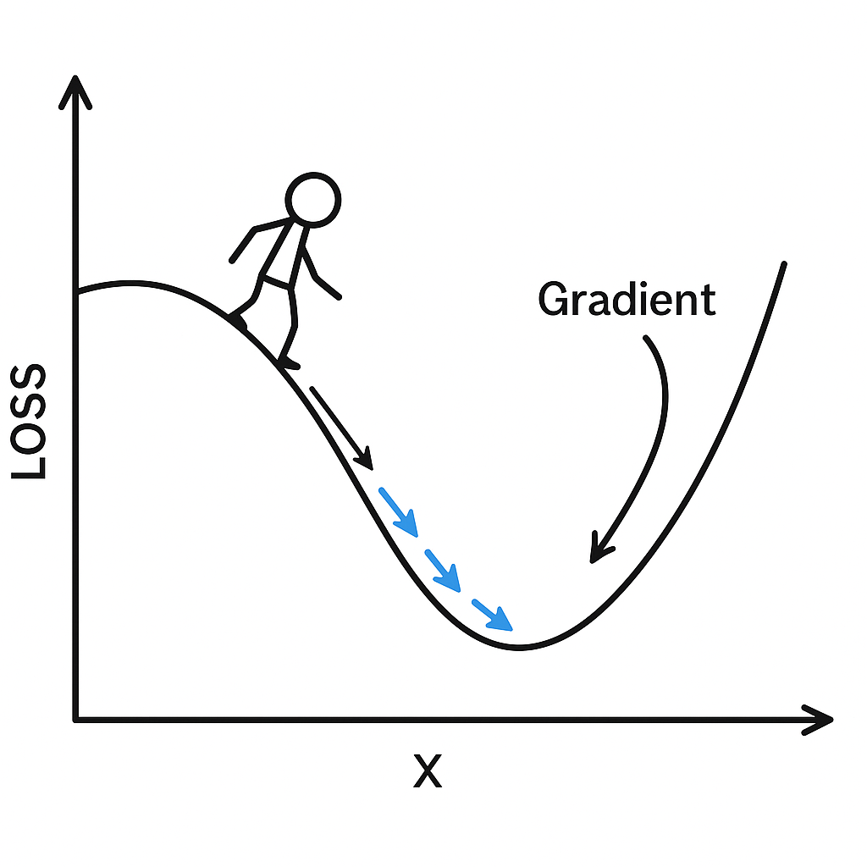
Calculus Example: Gradient Descent
Gradient descent is an algorithm used to find the minimum of a function. In machine learning, it's how models learn — by adjusting parameters to reduce error (or "loss")
Loss is a number that tells you how wrong your model’s prediction is compared to the actual answer. It measures the difference between what your model predicted and what it should have predicted.
loss = (actual - predicted)² = (225,000 - 295,258)² = 4,936,166,564
A derivative tells you the slope (or rate of change) of a function. The gradient is a collection of derivatives -- one per variable (in higher dimensions). In this case, only 2 dimensions.
 | Address | Bedrooms | Square Footage | Price (USD)
Actual data | 529 Fern Road | 3 | 1,216 | 225,000
Predicted data | 529 Fern Road | 3 | 1,216 | 295,258
You're standing on a hilly landscape (a graph of the loss function). You want to reach the lowest point (the best model).
You feel the slope under your feet (that's the gradient).
You take a small step downhill.
You do this again and again, gradually getting closer to the bottom.

Slide 23
Where is Machine Learning Going?

Slide 24
ML Techniques
Supervised Learning
Learning by training with labeled data that contains the actual correct output for any input.
Classification: Predict a discrete category.
Regression: Predict a continuous value.
Unsupervised Learning
Make use of data without labels; find hidden structures or patterns inside data.
Clustering: Group similar data points: customer segmentation
Algorithms: K-means, Hierarchical clustering
Dimensionality Reduction: Reducing the number of features while maintaining the most crucial information: example Principal Component Analysis.
Semi-Supervised Learning
Incorporate both labeled and unlabeled data for training. Improved accuracy of learning when acquisition of labeled data is expensive or time-consuming.
Reinforcement Learning
Train agent to make decisions based on rewards and penalties for desirable and undesirable behavior respectively. Broadly applied in robotics, gaming, and navigation.
Neural Networks and Deep Learning
Layers of interconnected nodes; good for complex tasks like image recognition and natural language processing.
Anomaly Detection
Detect unusual patterns that don't fit in with expected behavior typically used in fraud detection and network security.
Ensemble Methods
Combine multiple models to ↑ performance.
Bagging: Reduces variance by averaging predictions from multiple models e.g., Random Forest.
Boosting: Reduces bias by combining weak learners into a strong learner e.g., AdaBoost.

Slide 25
Things to Look Out For
Autonomous AI Agents
These agents can independently make decisions and carry out complex tasks, opening the door to fully automated business processes and personalized digital assistants.
Enhanced Internet Search
AI-enhanced search delivers smarter, more context-aware results, turning vague queries into meaningful answers and transforming how we explore information online.
Explainable AI (XAI)
XAI makes AI decisions transparent and trustworthy, allowing humans to understand, verify, and confidently use machine-driven insights in sensitive areas like healthcare and finance.
No-Code and Automated Machine Learning (AutoML)
AutoML empowers anyone – even without coding skills – to build powerful machine learning models quickly, democratizing AI development like never before.

