Slide 1
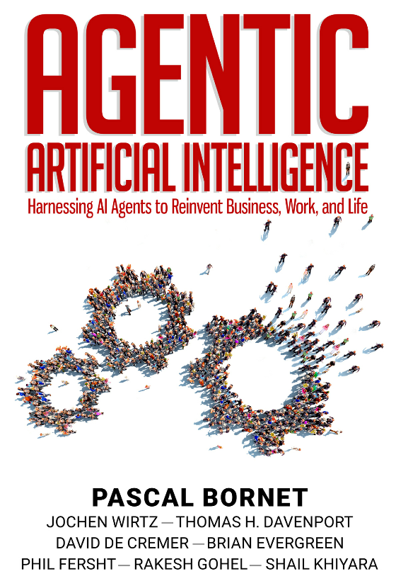
CS 00500 – Graduate Seminar
Lesson 4.2
The Rise of Agentic AI
Notes:
Replace this with your course title and your name/contact details.

Slide 2
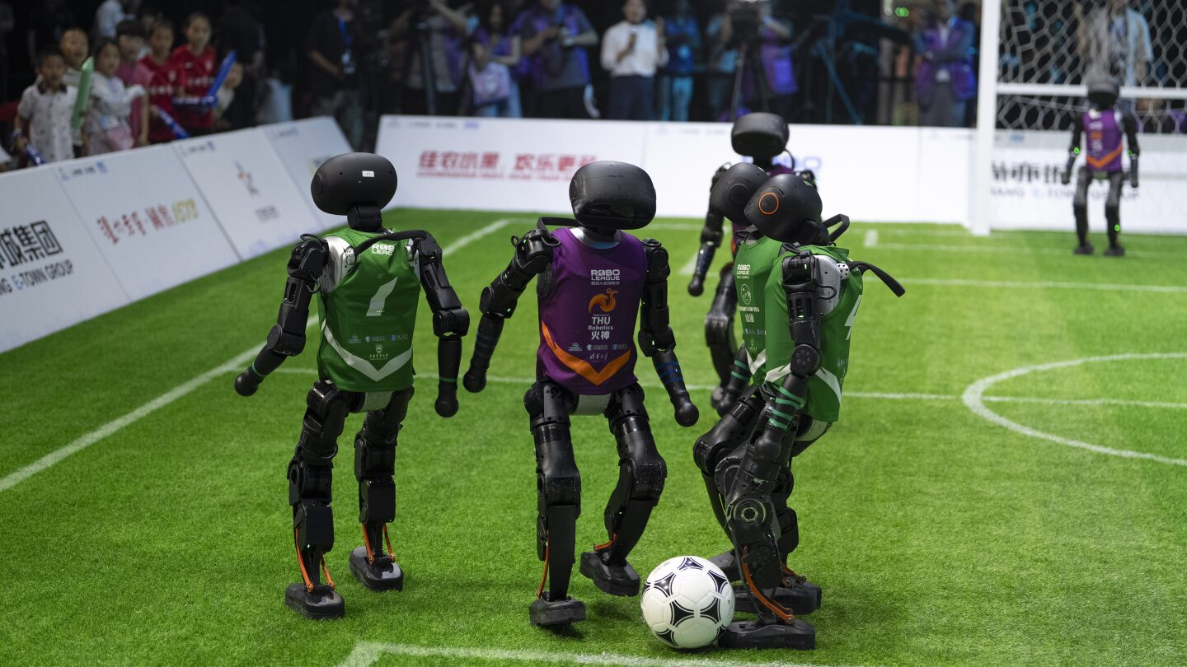
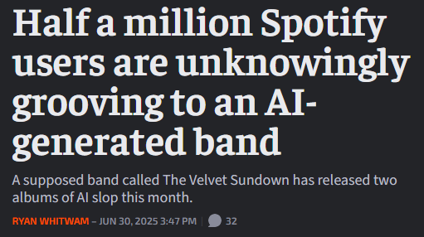
AI today
Four teams of humanoid robots faced off in fully autonomous 3-on-3 soccer matches powered entirely by artificial intelligence on Saturday night in China's capital in what was touted as a first in China and a preview for the upcoming World Humanoid Robot Games, set to take place in Beijing.
According to the organizers, a key aspect of the match was that all the participating robots operated fully autonomously using AI-driven strategies without any human intervention or supervision.
Associated Press. (2025, June 29). China’s humanoid robots generate more soccer excitement than their human counterparts. AP News. https://apnews.com/article/robots-foootball-china-ai-d49a4308930f49537b17f463afef5043
AI in the News
June 30, 2025
San Francisco Chronicle. (2025, June 30). Suspected AI band The Velvet Sundown tops 550k Spotify ... The Velvet Sundown, a suspected AI band, tops 500,000 listeners on Spotify in under a month. https://www.sfchronicle.com/entertainment/article/velvet-sundown-ai-band-spotify-500k-listeners-20400778.php
In a little less than a month, a band calling itself the Velvet Sundown has amassed more than 550,000 monthly listeners on Spotify. With two albums - "Floating On Echoes" and "Dust and Silence" - released in rapid succession in June, the group's sudden rise has been as mystifying as their digital footprint is sparse.
The group's bio is drenched in dreamlike metaphor, introducing its members as "vocalist and mellotron sorcerer Gabe Farrow," guitarist Lennie West, bassist-synth alchemist Milo Rains and percussionist Orion "Rio" Del Mar. But no trace of these supposed musicians exists online, not even a modest trail of interviews, performances or social media activity.
That is, until an Instagram account surfaced on Friday, June 27, bearing images critics have called "eerily AI-generated.“ Skeptics have raised red flags across Reddit and music journalism circles. On Spotify, all songwriting and production credits go solely to the band, a rare practice in today's collaborative industry.
There is no producer. There are no tour dates. There is no record label.

Slide 3



Somehow, the band has two albums out already, even though they've not been around for very long. Both share very similar covers, both were released in June 2025, and both feature identical track counts and run times within a minute of each other. Apparently, they're a very prolific group too, given there's a new album on the way on July 11th.
In a little less than a month, a band calling itself the Velvet Sundown has amassed more than 550,000 monthly listeners on Spotify. With two albums - "Floating On Echoes" and "Dust and Silence" - released in rapid succession in June, the group's sudden rise has been as mystifying as their digital footprint is sparse.
The group's bio is drenched in dreamlike metaphor, introducing its members as "vocalist and mellotron sorcerer Gabe Farrow," guitarist Lennie West, bassist-synth alchemist Milo Rains and percussionist Orion "Rio" Del Mar. But no trace of these supposed musicians exists online, not even a modest trail of interviews, performances or social media activity.
That is, until an Instagram account surfaced on Friday, June 27, bearing images critics have called "eerily AI-generated.“ Skeptics have raised red flags across Reddit and music journalism circles. On Spotify, all songwriting and production credits go solely to the band, a rare practice in today's collaborative industry.
There is no producer. There are no tour dates. There is no record label.

Slide 4
From Chess to ChatGPT
Integration of thousands to millions of transistors on a single silicon chip (VLSI or very large scale integration) to evaluate millions of chess positions per second.
Parallel processors to speed up calculations.
Brute-force search
Hand-coded chess knowledge
1997
Deep Blue beats chess grandmaster
Data and operations represented using vectors and matrices.
Backpropagation, i.e., a learning method that helps a neural network learn by figuring out how much each part of the network contributed to the error (wrong answer), sending this information backward through the network, and adjusting the weights so the network does better next time.
Loss functions, mathematical formula that tells a neural network how wrong its prediction is.
Optimization algorithms to reduce loss
2010s
Neural Networks
Tokenization – sentence split into tokens
Embedding – each token becomes a numerical vector
Transformer layers – attention + processing update the vectors based on context (attention is looking at all the other tokens in the sentence and deciding which words matter most to me right now?)
Output Model predicts next token based on final vectors
2017
Transformers and LLMs

Slide 5
From Rules to Reasoning
RPA is software technology that lets you create software robots (bots) that can mimic human actions on a computer to complete repetitive tasks.
Person defines rules and workflows (e.g., "if an email comes in with an invoice, open the file and enter the data into our accounting software").
Fragile: if a single screen changed or an exception occurred (like a missing field), the bot would get confused. RPA robots had no intelligence or judgment; they strictly followed the script.
RPA is great at doing tasks,
but it lacks any thinking.
So, companies began to augment RPA with AI technologies.
early
2010s
Robotic Process Automation
2016
Intelligent Automation
Machine learning, natural language processing, and computer vision added to RPA

Slide 6
…to Agentic AI
1997
Deep Blue beats chess grandmaster
Language models provide the brain – the ability to understand, reason, and plan.
Automation technologies provide the hands – the ability to execute actions in the real
AutoGPT is an open-source experimental tool that uses GPT (like GPT-4) to create an autonomous AI agent — meaning the AI can set its own goals, break them into tasks, and work through them with minimal human input.
It’s like giving GPT a mission and letting it figure it out.
2010s
Neural Networks
early
2010s
Robotic Process Automation
2017
Transformers and LLMs
2016
Intelligent Automation
Agentic AI

Slide 7
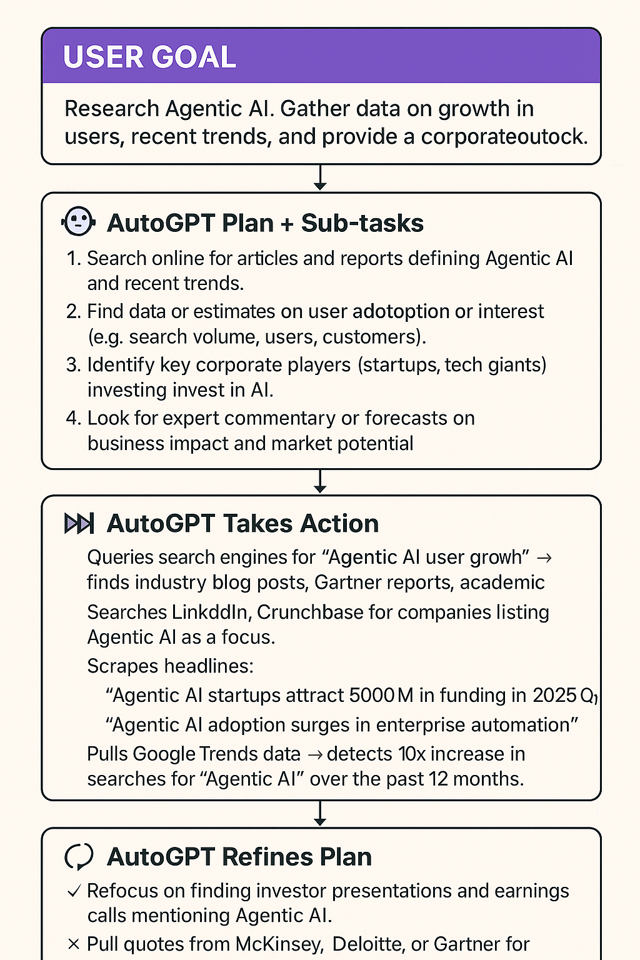

AutoGPT Simulated Flow
Much of agentic AI is wrapper agents around LLMs designed to autonomously pursue goals: they
  take a high-level goal from a user
  generate sub-tasks,
  execute them (often by issuing tool commands or even writing and running code),
  check the results,
  iterate until the goal is achieved.
business outlook.

Slide 8
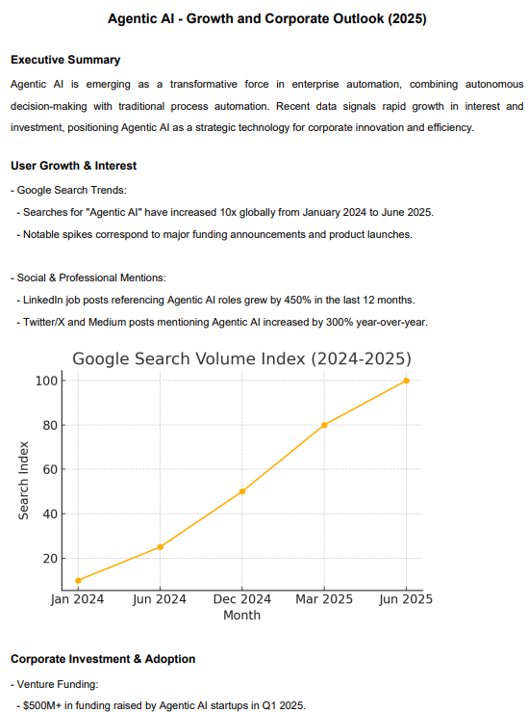
AutoGPT Simulated Output
business outlook.
http://jackmyers.info/gradsem/readings/Agentic_AI_Styled_Report.pdf

Slide 9
Other Examples
Telecom
  Customer calls in with an internet issue
  Agent listens, transcribes words, and understands the problem using a large language model.
  Agent troubleshoots:
    Remotely checks the modem
    Walks the customer through a reset if needed
    If issue persists, creates a service ticket or schedules a technician.
  By the end of the interaction, the problem is either resolved or seamlessly escalated, without human intervention.
  The AI doesn’t just provide answers—it takes action, managing the full lifecycle of a customer request.
Finance and Accounting
  “Digital analyst agent” that automates monthly budget variance analysis.
    Pulls data from the accounting system
    Identifies where spending deviated from plan
    Drafts explanations using natural language models.
  When it spots anomalies, such as an unusual expense, it flags them for human review.
  Over time, by learning from feedback, the AI improved its ability to distinguish between normal fluctuations and true red flags.
  Hours of manual effort eliminated!
  Like having a junior analyst who never sleeps, continuously crunches numbers and prepares insights.

Slide 10
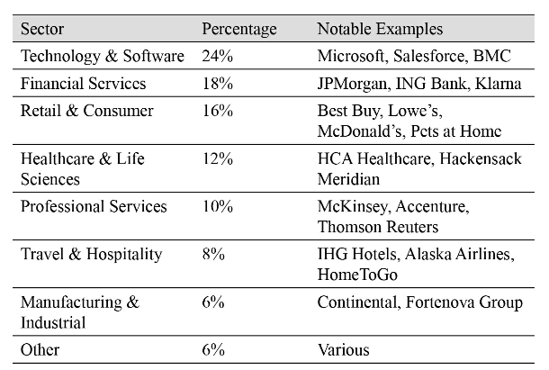
Early adopters of Agentic AI

Slide 11
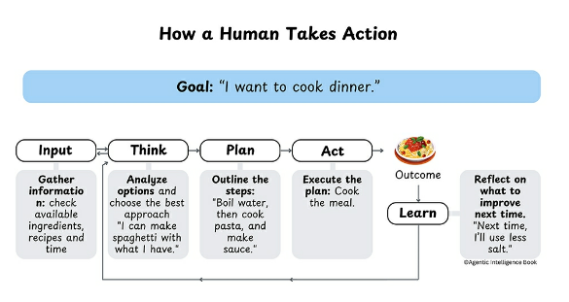
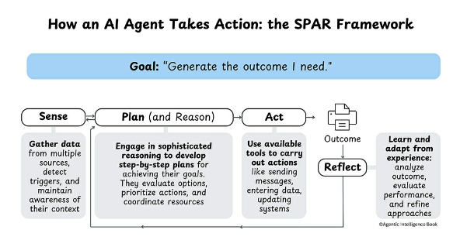
Thought Process: Humans vs Agents
The SPAR Framework is described in more detail here: http://jackmyers.info/gradsem/readings/The%20SPAR%20Framework.pdf

Slide 12
The Agentic AI
Progression Framework
Manual
(human only)
Level 1
Rule-Based Automation
At Levels 1 and 2, humans have to specify every action, but…
Level 2
Intelligent Process Automation
lvl | Agentic AI | Technologies | Self-driving car example | Sample instruction
3 | Agents generate content, plan, reason, and adapt in defined domains. | Large Language Models, memory systems, content generation tools, basic reinforcement learning. | Vehicles navigate highways but need human intervention in complex situations. | “Write and send an email using this information, adapting it to the recipient’s context.”
4 | Agents work autonomously within defined expertise, adapt strategies, and learn. | Advanced reasoning and planning, real-time adaptation, causal reasoning. | Self driving cars operate autonomously in specific conditions. | “Handle all client communications to ensure they’re well-informed.”
5 | AI systems handle any task, cross-domain learning, and self-adaptation; no human intervention. | Sophisticated memory systems, advanced learning mechanisms, safety protocols for autonomy. | Fully autonomous cars drive anywhere in all conditions. | “Grow sales thru customer satisfaction” - let the agent determine all necessary actions & communications.
Level 3
Agentic Workflows
Level 4
Semi-Autonomous Agents
Level 5
Fully Autonomous Agents

Slide 13
The Agentic AI
Progression Framework
Manual
(human only)
Level 1
Rule-Based Automation
lvl | Agentic AI | Technologies | Self-driving car example | Sample instruction
3 | Agents generate content, plan, reason, and adapt in defined domains. | Large Language Models, memory systems, content generation tools, basic reinforcement learning. | Vehicles navigate highways but need human intervention in complex situations. | “Write and send an email using this information, adapting it to the recipient’s context.”
4 | Agents work autonomously within defined expertise, adapt strategies, and learn. | Advanced reasoning and planning, real-time adaptation, causal reasoning. | Self driving cars operate autonomously in specific conditions. | “Handle all client communications to ensure they’re well-informed.”
5 | AI systems handle any task, cross-domain learning, and self-adaptation; no human intervention. | Sophisticated memory systems, advanced learning mechanisms, safety protocols for autonomy. | Fully autonomous cars drive anywhere in all conditions. | “Grow sales thru customer satisfaction” - let the agent determine all necessary actions & communications.
Level 2
Intelligent Process Automation
At Level 1, agents operate like well-programmed machines, following exact instructions with predictable outcomes.
Level 2 introduces basic decision-making capabilities but still within rigid parameters.
Level 3 represents a significant leap, with agents capable of understanding context and adapting their approach accordingly.
Levels 4 and 5 introduce increasingly sophisticated autonomous behavior, with agents capable of setting their own sub-goals and developing original strategies to achieve them.
Level 3
Agentic Workflows
Level 4
Semi-Autonomous Agents
Level 5
Fully Autonomous Agents

Slide 14
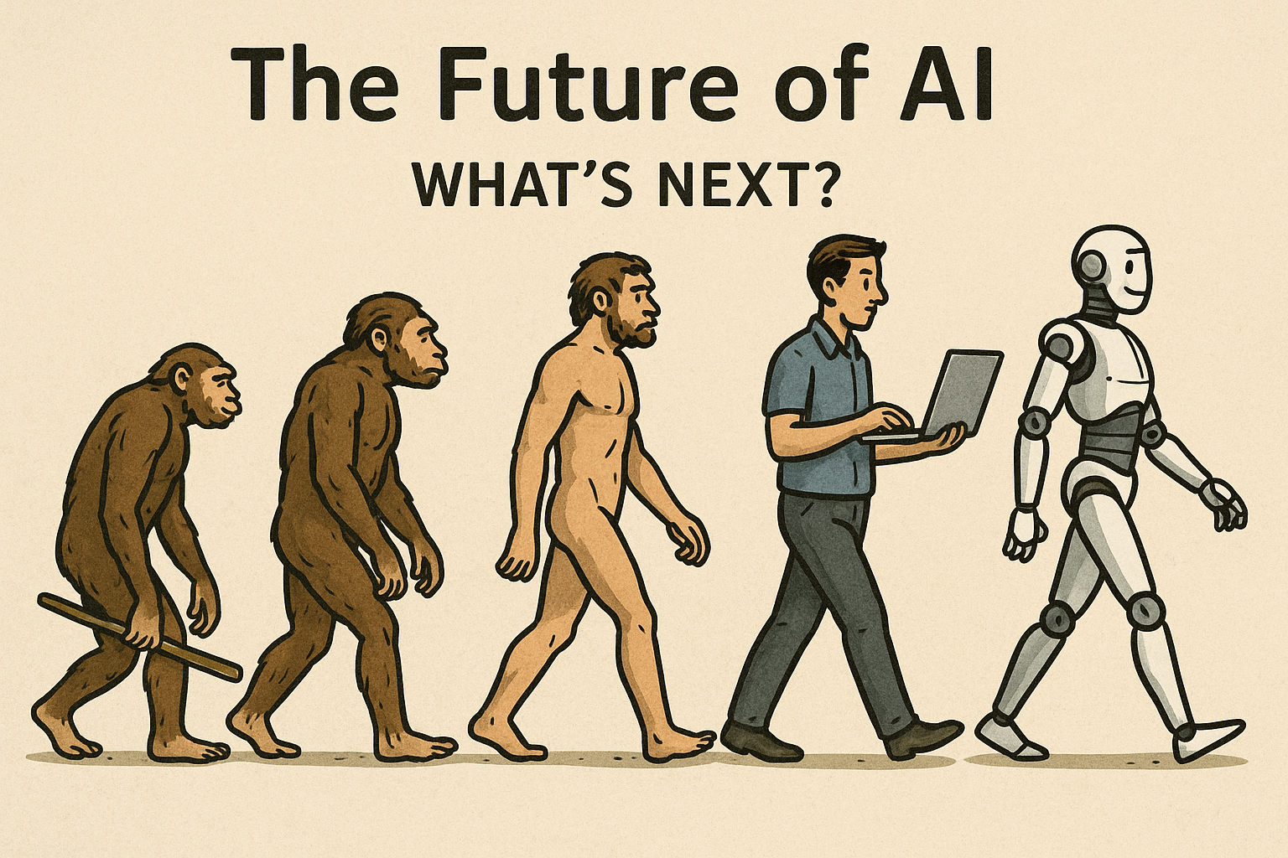
Where are we headed?
Multi-Agent Systems
Artificial General Intelligence

Slide 15
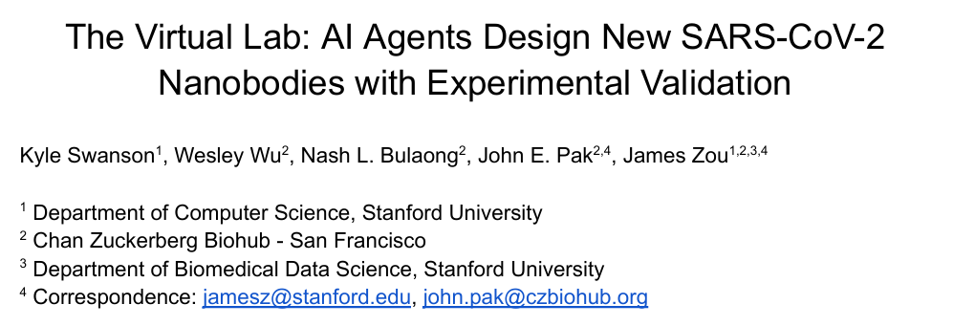


Multi-Agent Systems:
Modularity, SRP, Specialization
Modern business processes are incredibly complex -- many moving parts and interdependencies.
A cross-functional, end-to-end process like order-to-cash might involve thousands of specific tasks.
Breaking down processes into smaller, manageable pieces that individual agents can handle makes the overall system more manageable and maintainable.
Example: financial services
  Agent for natural language understanding
  (NLP models)
  Agent for compliance w/regulations
  (rule-based models)
  Agent for account information
  (text-to-SQL model like Text2SQL or
  gradient boosting model like XGBoost for predictive analytics)
The Virtual Lab consists of an LLM principal investigator agent guiding a team of LLM agents with different scientific backgrounds (e.g., a chemist agent, a computer scientist agent, a critic agent), with a human researcher providing high-level feedback. We design the Virtual Lab to conduct scientific research through a series of team meetings, where all the agents discuss a scientific agenda, and individual meetings, where an agent accomplishes a specific task.
The strength of the Virtual Lab comes from its multi-agent architecture, which empowers an AI-human scientific collaboration via a series of meetings between a human researcher and a team of interdisciplinary LLM agents. The different backgrounds of the various scientist agents leads to discussions that approach complicated scientific questions from multiple angles, thereby contributing to comprehensive answers.

Slide 16
Artificial General Intelligence
“AI systems that possess a reasonable degree of self-understanding and autonomous self-control, and have the ability to solve a variety of complex problems in a variety of contexts, and to learn to solve new problems that they didn’t know about at the time of their creation."
Cross-domain autonomous agent | AGI
Can act in multiple domains, often through modular, pre-programmed, or learned strategies. | Can learn entirely new domains without specific prior training.
May use separate subsystems for each domain, stitched together (multi-expert architecture). | Unified cognitive architecture that generalizes across tasks like a human.
May struggle with novel situations outside its training or design. | Can adapt to totally unfamiliar tasks and reason about them.
Cross-domain scope limited by its design and training data. | Scope limited only by general human-level intelligence limits (if at all).

Slide 17

"On the Measure of Inteligence"
François Chollet is a highly influential French AI researcher and software engineer, best known as the creator of the Keras deep learning library,
He earned a Diplôme d’Ingénieur (Master’s in Engineering) from ENSTA Paris in 2012, then joined Google in 2015, where he
eventually became a Senior Staff
Engineer
focused on
advancing
machine
learning
frameworks
and general
AI research.
From Chollet: Concepts of intelligence
Crystallized Intelligence:
Task-specific skills (narrow AI)
Fluid Intelligence:
General skill acquisition and adaptation to new problems
(hallmark of human intelligence).
Most AI evaluations assess crystallized skill, ignoring fluid intel
Abstract and Reasoning Corpus for Artificial General Intelligence (ARC-AGI) – a measure of efficiency of AI skill acquisition on unknown tasks.
From Krishnan:
Open AI’s o3 scored: 85%
(well above the 55% scored by any other AI
Also, in GPQA (Graduate-level Google-Proof Q & A Benchmark), which measures PhD level science questions, o3 achieved an accuracy of 87.7%.
on par with the human average score;
indicate o3 can solve challenging mathematical problems on its own

Slide 18
References
Kyle Swanson et al., 2024. “ The Virtual Lab: AI Agents Design New SARS-CoV-2 Nanobodies with Experimental Validation,” bioRxiv, November 12, 2024, http://www.biorxiv.org/content/10.1101/2024.11.11.623004v1.full.pdf
Chollet, F. (2019, November 25). On the measure of Intelligence. arXiv.org. https://arxiv.org/abs/1911.01547
Krishnan, V. (2025). From Artificial Intelligence (AI) to Artificial General Intelligence (AGI) – The road ahead. Journal of the World Federation of Orthodontists, 14(1), 1–2. https://doi.org/10.1016/j.ejwf.2025.01.002

