Slide 1
CS 00500 – Graduate Seminar Lesson 3.2 Large Language Models and Academic Integrity
ChatGPT and others
can we use i?
should we?
if so, how?
Notes:
Welcome the audience, introduce yourself, and explain that this presentation will explore what academic integrity means, why it matters, and how to uphold it.

Slide 2
ChatGPT
From Sydney Australia:
Chrysoula, a student in Sydney, Australia, initially used ChatGPT "very often to complete homework I deemed just tedious". A lot of her classmates were doing the same, she says. "Any time someone read a good answer out in class discussions, there was someone leaning over whispering 'Chat[GPT]?' "Everyone doubted the authenticity of everyone's answers." But as the year drew on, Chrysoula found her "critical and analytical thinking was slightly impaired". "I was beginning to form a dependence on the AI to feed me the knowledge to rote learn."

Slide 3
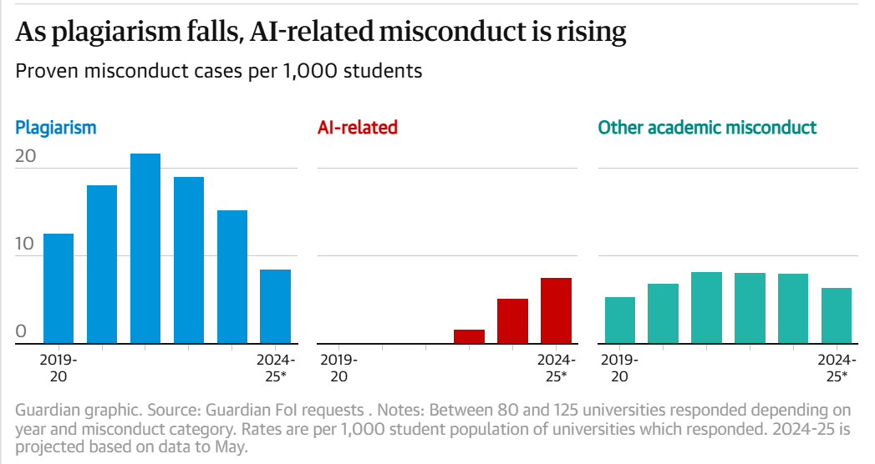
Cheating with AI is on the Rise
A Guardian survey of academic integrity violations found almost 7,000 proven cases of cheating using AI tools in 2023-24, equivalent to 5.1 for every 1,000 students.

Slide 4
Questions / Reflection
For the assignment, you must select/identiry an example scenario to discuss.
Here are some examples of scenarios
Using ChatGPT to generate ideas and outlines for an essay.
Asking Google Gemini to summarize an academic article and using that summary without further analysis or citation.
Using ChatGPT to answer homework questions in a take-home exam.
Asking ChatGPT to help code a solution for a programming assignment. Should ChatGPT write:
An entire program
A specific function
A programming construct (like a loop or a control block)
An SQL statement
A regular expression
etc…
Notes:
Let’s reflect and discuss. What does integrity mean to you personally?

Slide 5
OBVIOUS Scenarios Will Not Count DUPLICATED Scenarios Will Not Count
For instance:
Can I use ChatGPT to write a paper that discusses phishing attacks and how to conteract them?
Can I cut and paste my programming homework to ChatGPT and have it generate the code for me?
You need to have more nuanced scenarios
Also, you cannot REPEAT someone else's exact scenario.

Slide 6
Your Assignment
Describe the scenario you choose, and answer the following:
Is the use of AI acceptable in this scenario? Why or why not?
Is there a more appropriate way to complete the task while maintaining academic integrity?
If AI use is not acceptable, what are the potential consequences for the student's learning and academic development?
How would AI use in this scenario affect the student's long-term professional skills and career growth?
Finally, write a short reflection (300-500 words) discussing your thoughts on the role of AI in academia. The reflection should include:
Your stance on the ethical use of AI tools for academic purposes.
How you plan to ensure academic integrity in your own use of AI tools.
Insights into how cheating undermines your own learning and future career opportunities.
You should also identify, cite, and reflect on two thoughts from the external videos or articles presented.

Slide 7
References
https://www.abc.net.au/news/science/2023-11-22/how-high-school-students-used-chatgpt-2023-education-cheating/103108620
https://www.theguardian.com/education/2025/jun/15/thousands-of-uk-university-students-caught-cheating-using-ai-artificial-intelligence-survey

