Slide 1
CS 00500 – Graduate Seminar Lesson 3.1 The Importance of Academic Integrity
Academic dishonesty
Case studies
What you can do to preserve academic integrity
Notes:
Welcome the audience, introduce yourself, and explain that this presentation will explore what academic integrity means, why it matters, and how to uphold it.

Slide 2

The Importance of Academic Integrity
Academic integrity is the foundation of learning and scholarship.
It is essential for personal growth, trust, and community respect.
Integrity builds character for future academic and professional success.
Your reputation begins with the choices you make today.
Notes:
Academic integrity is the moral foundation of your educational journey and your future career. It encompasses honesty, fairness, and respect. By practicing integrity, you earn the trust of peers, faculty, and future employers. Your reputation begins today with the choices you make.

Slide 3

What is Academic Integrity?
Academic integrity is a commitment to honesty, trust, fairness, respect, responsibility, and courage.
It means presenting your own work and giving credit where it is due.
It binds us together as a trustworthy academic community.
Notes:
Academic integrity is much more than avoiding cheating. It’s how you approach your learning daily, with honesty, fairness, respect for others’ ideas, and responsibility for your actions. It’s the invisible contract that lets us trust each other in academia.

Slide 4

Why Academic Integrity Matters
Integrity ensures fair evaluation and meaningful academic credentials.
It protects the value of your degree and future opportunities.
It builds ethical habits essential for professional success.
It strengthens the academic community and society as a whole.
Notes:
Integrity ensures that your achievements reflect your true abilities. It protects the credibility of your degree. Practicing integrity now shapes your future professionalism and strengthens the community.

Slide 5

Examples of Academic Dishonesty
Plagiarism: using others’ ideas or words without credit.
Cheating: using unauthorized aids or copying work.
Fabrication: falsifying data, sources, or results.
Unauthorized collaboration: working together when not allowed.
Facilitation: helping others to cheat.
Notes:
Dishonesty takes many forms. Each harms fairness and trust within the academic community. It’s vital to recognize and avoid these actions.

Slide 6

Real-World Consequences of Dishonesty
Failing assignments or courses; possible suspension or expulsion.
Permanent disciplinary records can affect job and grad school prospects.
Loss of scholarships, honors, and leadership roles.
Damage to personal and professional reputation that is hard to repair.
Notes:
Academic dishonesty can bring serious penalties that follow you beyond school. Integrity protects your future.

Slide 7

Academic Integrity and Your Future Career
Employers value ethical employees who can be trusted with responsibility.
Academic dishonesty may raise red flags in background checks and recommendations.
Integrity forms habits that shape professional success and relationships.
Notes:
The habits you build now will shape your future. Employers prize integrity. Dishonesty can cost you opportunities.

Slide 8

The Ripple Effect of Academic Integrity
Your choices shape the environment for others.
Dishonesty weakens community trust and fairness.
Integrity inspires others to do the right thing.
A positive culture starts with individual actions.
Notes:
Your integrity (or lack of it) affects the academic culture around you. Choose to contribute positively.

Slide 9

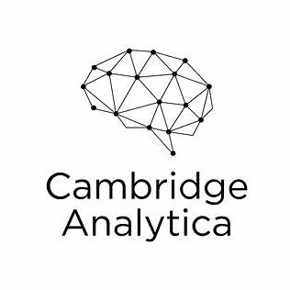


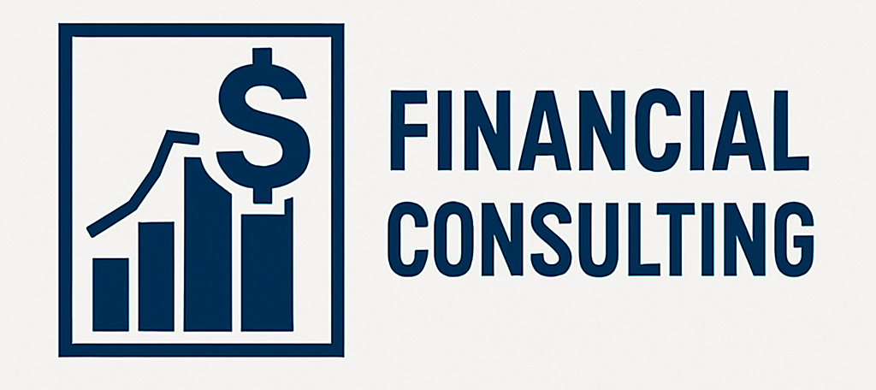
Case Studies: Integrity Forgotten
Theranos
Facebook and Cambridge Analytica
Enron
Financial Consulting Firms
Carreyrou, J. (2015, October 15). Hot startup Theranos has struggled with its blood-test technology. The Wall Street Journal. https://www.wsj.com/articles/theranos-has-struggled-with-blood-tests-1444881901
Cadwalladr, C., & Graham-Harrison, E. (2018, March 17). Revealed: 50 million Facebook profiles harvested for Cambridge Analytica in major data breach. The Guardian. https://www.theguardian.com/news/2018/mar/17/cambridge-analytica-facebook-influence-us-election
BBC News. (2006, June 15). Enron: The smartest guys in the room. http://news.bbc.co.uk/2/hi/business/4937790.stm
Beard, M. (2021, October 20). Consultants accused of reusing client work without permission. Financial Times. https://www.ft.com/content/b25c6c04-7622-4a3d-b18b-89f0a5cc6e64
Notes:
These examples show how honesty leads to growth while dishonesty can have lasting consequences.

Slide 10




Case Studies: Integrity Preserved
Pfizer / Moderna
Patagonia
IBM
Volkswagon
Pfizer Inc. (2020, November 20). Pfizer and BioNTech submit COVID-19 vaccine EUA request to the U.S. FDA. https://www.pfizer.com/news/press-release/press-release-detail/pfizer-and-biontech-submit-covid-19-vaccine-eua-request
McFadden, C. (2021, May 6). Patagonia: The most ethical company in the world? Interesting Engineering. https://interestingengineering.com/culture/patagonia-the-most-ethical-company-in-the-world
Marr, B. (2019, September 9). IBM’s open source Qiskit aims to make quantum computing more accessible. Forbes. https://www.forbes.com/sites/bernardmarr/2019/09/09/ibms-open-source-qiskit-aims-to-make-quantum-computing-more-accessible/
Hotten, R. (2015, December 10). Volkswagen: The scandal explained. BBC News. https://www.bbc.com/news/business-34324772

Slide 11

Personal Responsibility for Academic Integrity
Integrity is a daily choice made in small moments.
Pressure and stress do not justify dishonesty.
Your decisions define the kind of person you are becoming.
Notes:
Academic integrity is built in everyday choices, not just big moments. Stay true to your values.

Slide 12

Common Misconceptions
"Everyone cheats a little" — most students are honest.
"It’s only wrong if you get caught" — integrity is about your values.
"Accidental plagiarism doesn’t count" — intent doesn’t erase consequences.
Notes:
Don’t believe myths about cheating. Integrity matters even when no one is watching.

Slide 13

How to Maintain Academic Integrity
Plan ahead to avoid last-minute stress.
Ask for clarification when you are unsure.
Follow citation, collaboration, and academic rules.
Reflect regularly on your values and choices.
Notes:
Good habits and planning help you stay on the path of integrity.

