Slide 1
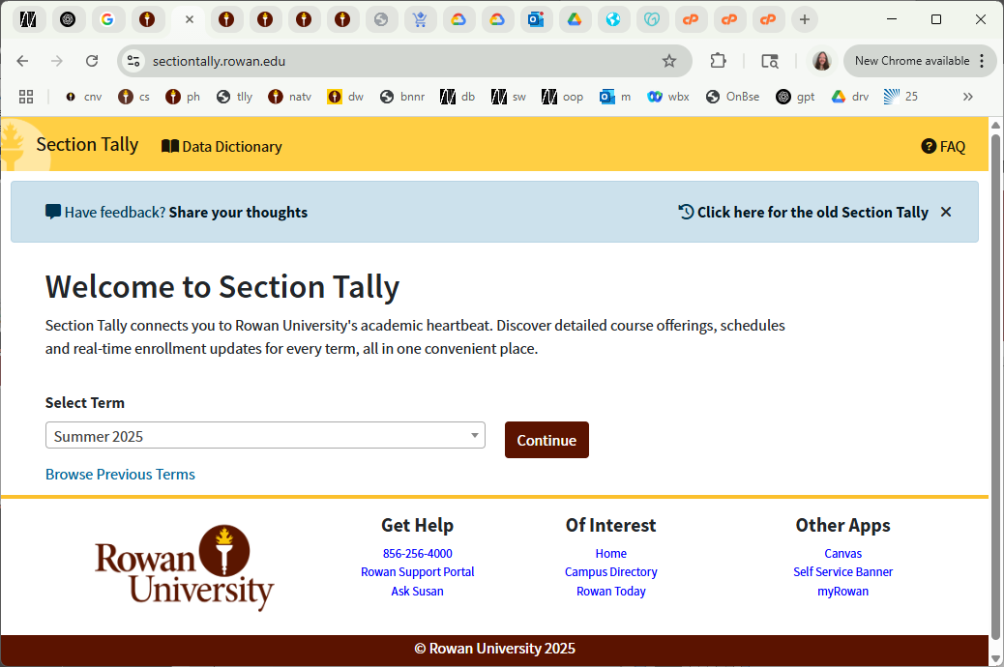
CS 00500 – Graduate Seminar
Lesson 2.4
DegreeWorks
Tracking your progress towards graduation
Notes:
Replace this with your course title and your name/contact details.

Slide 2
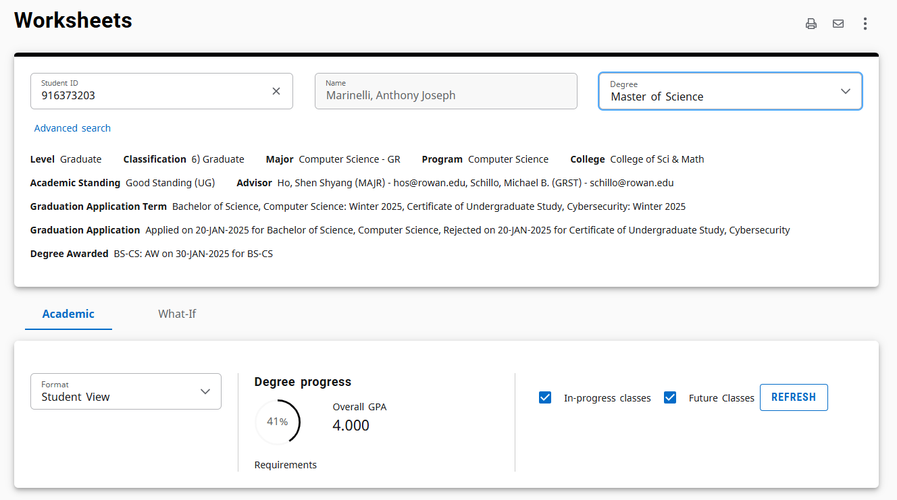
What is DegreeWorks?
It pulls data from Banner
and matches it against your program requirements.
Available from Self Service Banner: https://banner9.rowan.edu/ords/ssb
DegreeWorks is a web-based platform that shows you:
  What courses you’ve taken
  What requirements you’ve completed
  What requirements you still need
  Your overall progress toward graduation

Slide 3
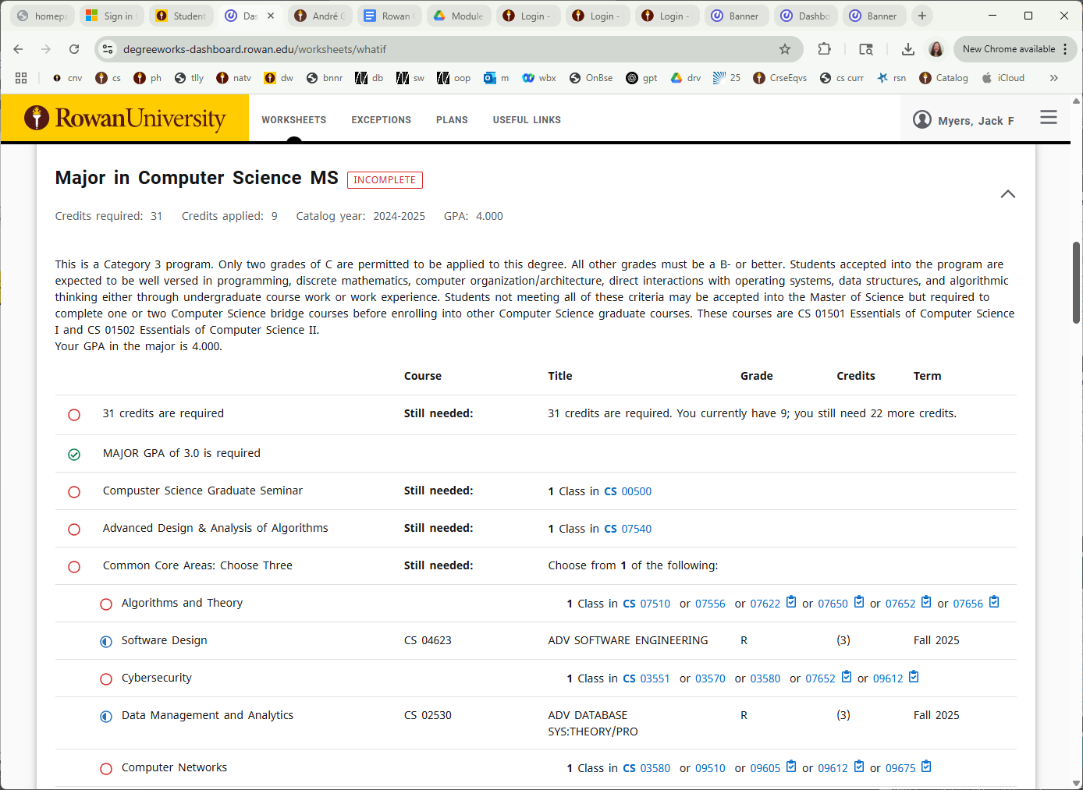
Completion
Student still needs to take this Graduate Seminar
Student is registered for these courses
These courses work for this requirement

Slide 4
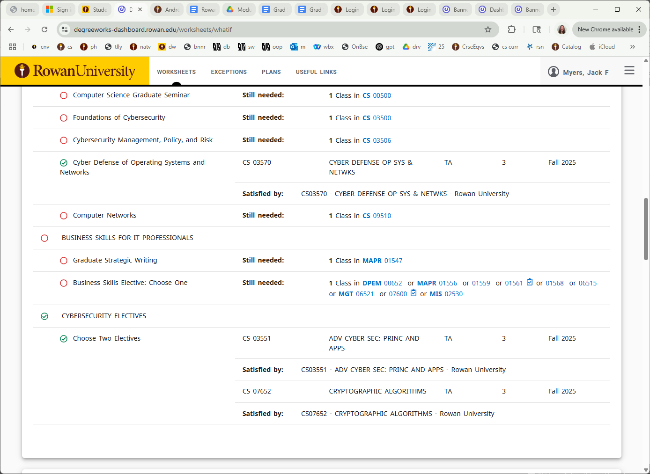
required course is fulfilled
major category is fulfilled

