Slide 1
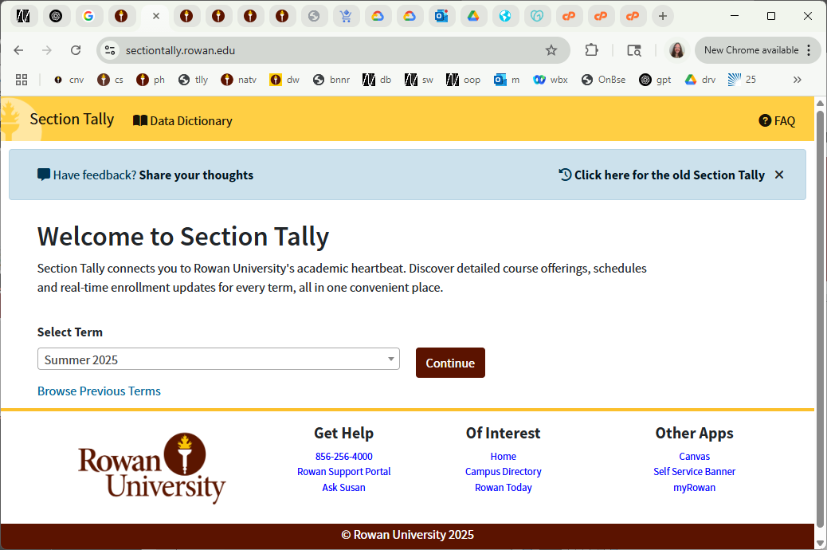
CS 00500 – Graduate Seminar Lesson 1.5 Section Tally
Locating courses in advance of registration
Notes:
Replace this with your course title and your name/contact details.

Slide 2
What is Section Tally?
A tool to help you plan for upcoming semesters.
A tool to assist you in knowing what classes to register for.
A tool that shows you the current enrollment of Rowan sections.

Slide 3
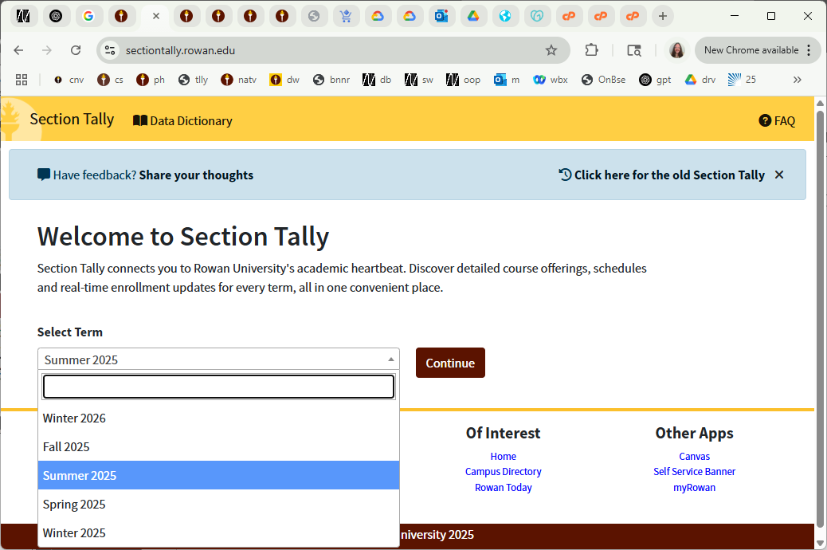
Selecting Your Term

Slide 4
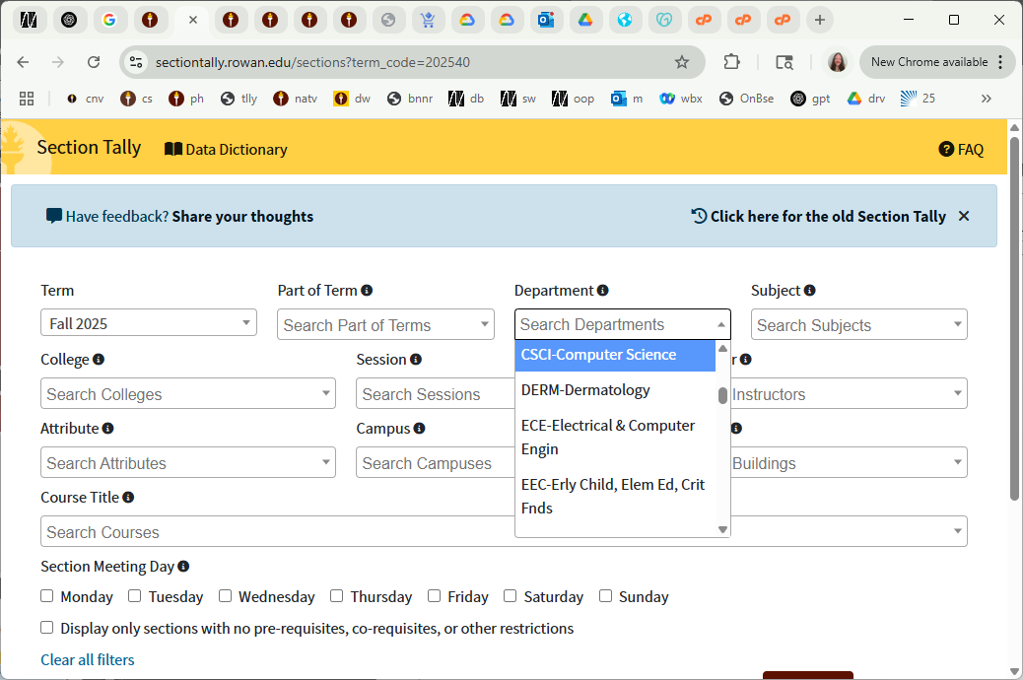
Find Computer Science Courses
choose Computer Science

Slide 5
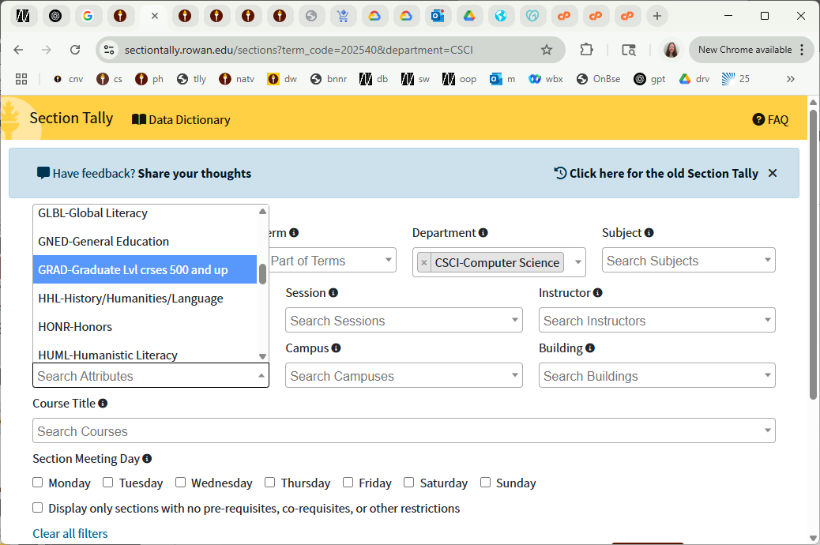
Find Computer Science GRADUATE Courses
choose GRAD

Slide 6
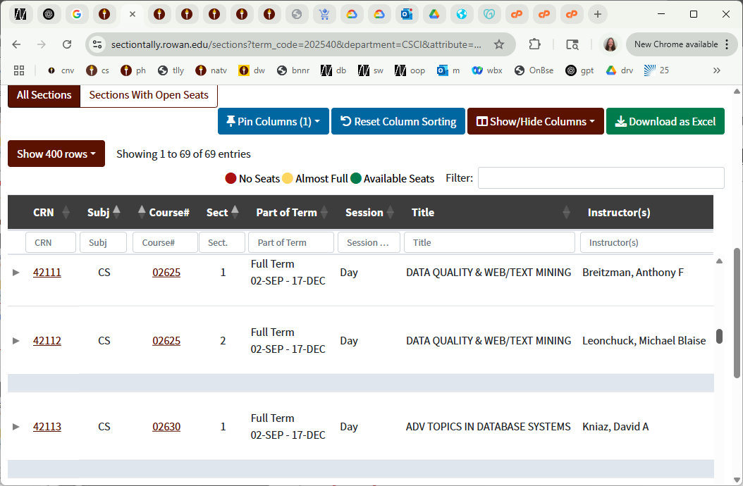
Display the Search Results

Slide 7
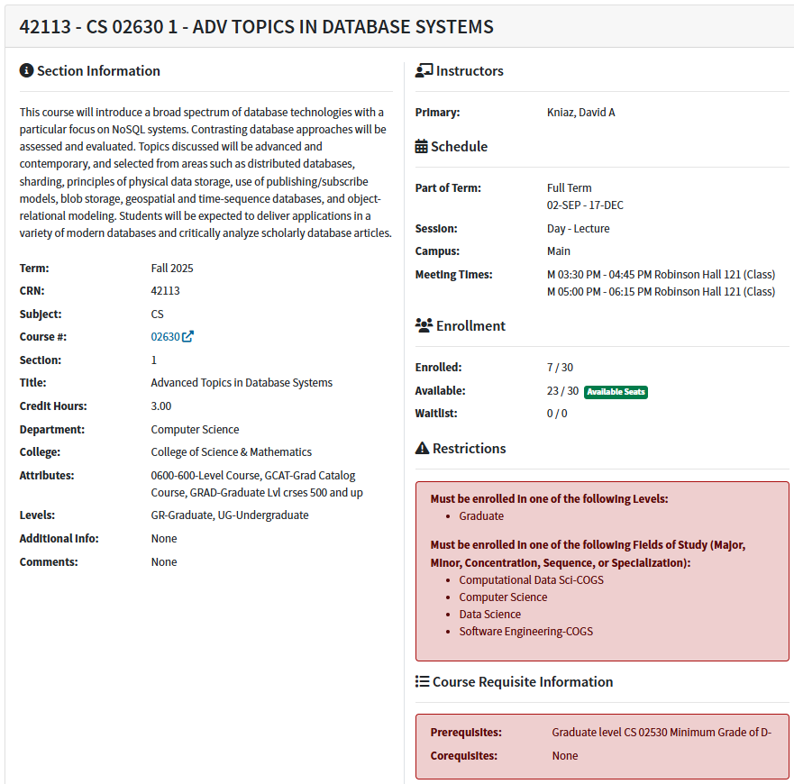
Click on the CRN to see full information on a section

Slide 8
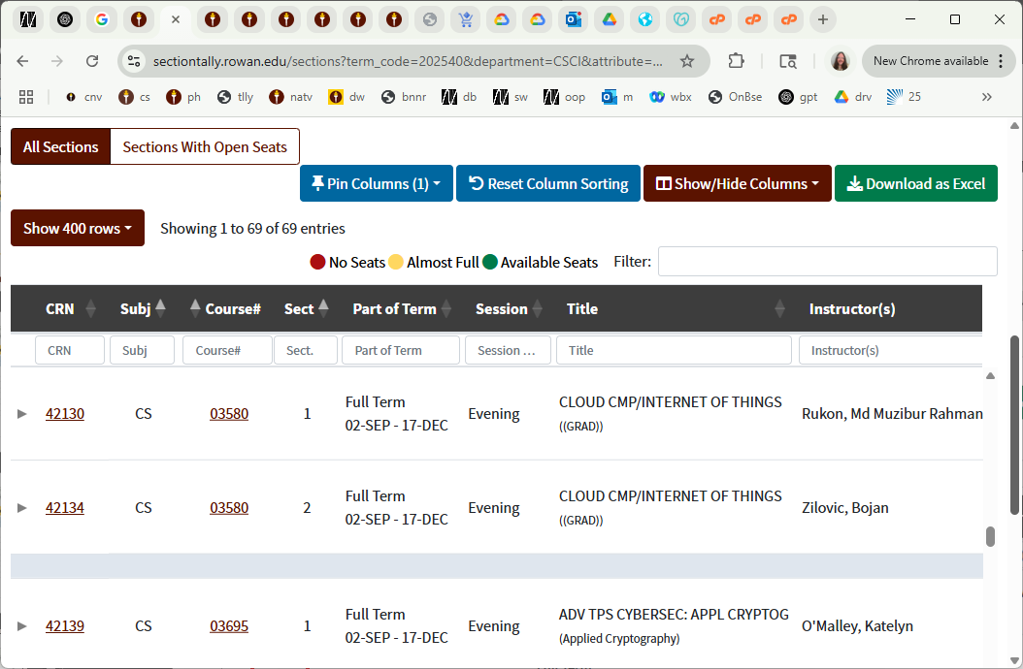
Clicking on a Course Hyperlink

Slide 9
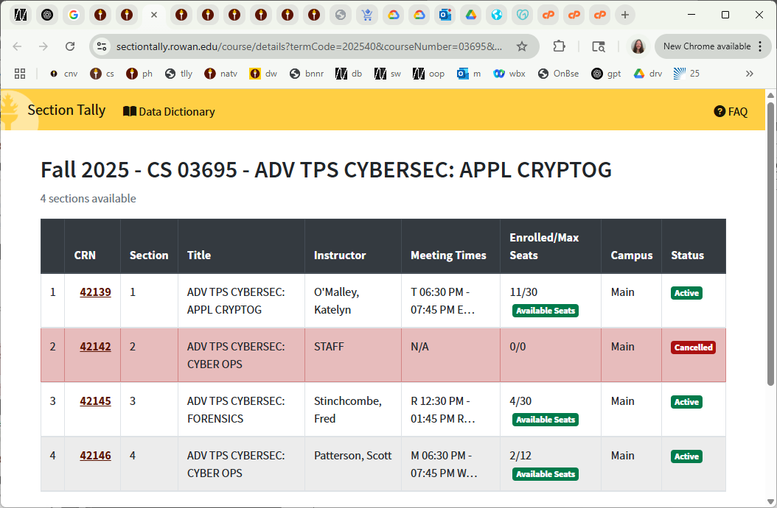
See all section of a course

Slide 10
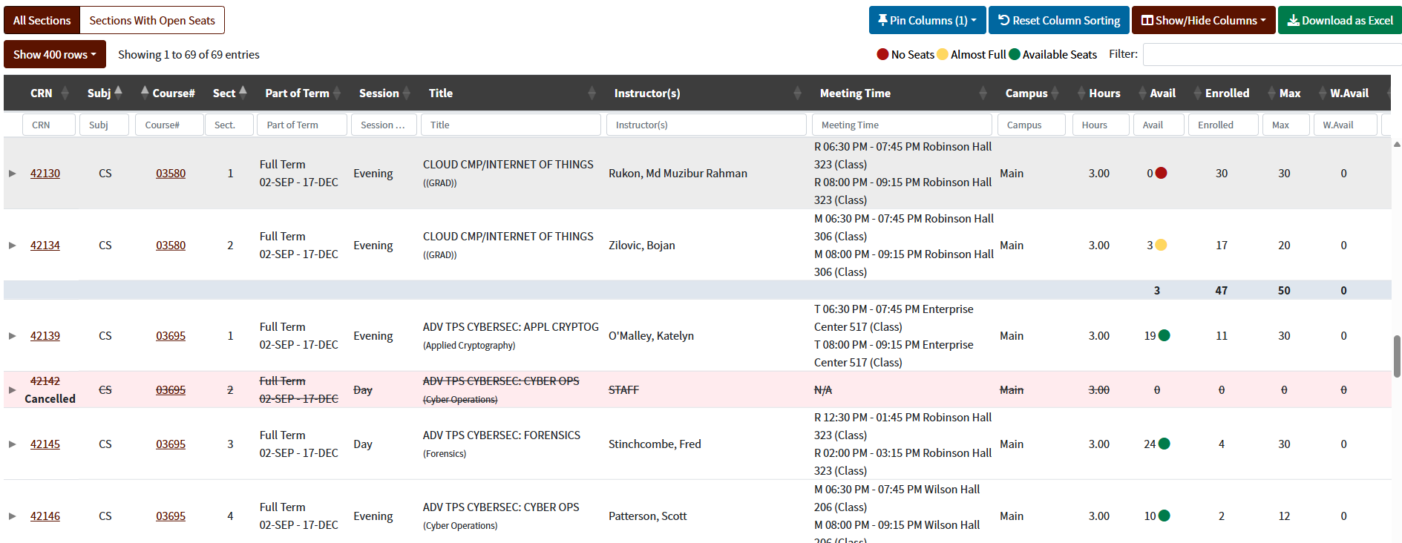
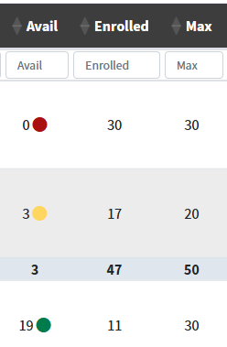
Checking Enrollment
Closeup of the Avail, Enrolled, and Max columns

Slide 11
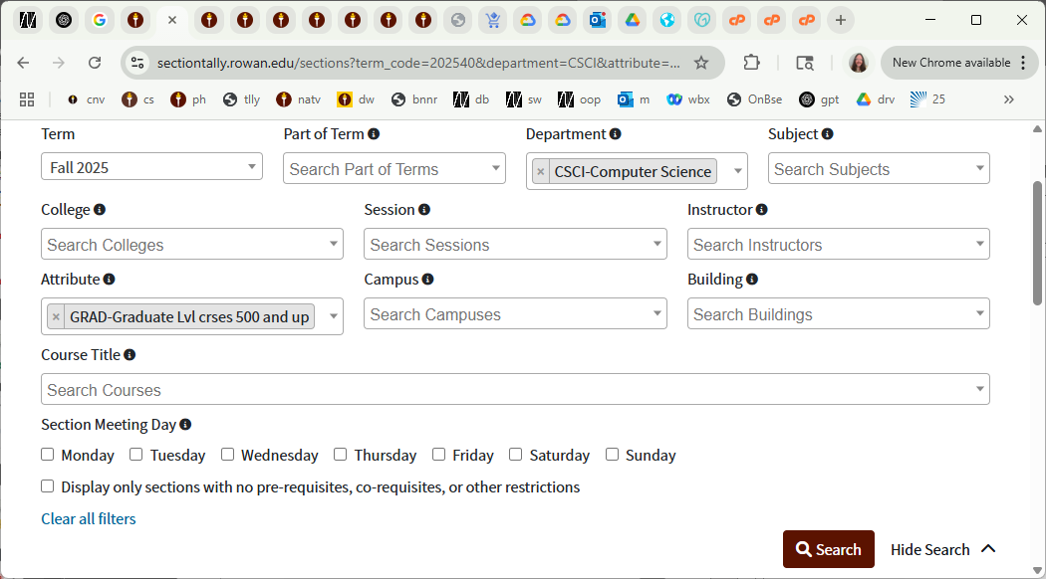
Search Filters

