Slide 1

CS 00500 – Graduate Seminar Lesson 1.4 Rowan Tools & Resources
Other resources to ensure your success!
Notes:
Replace this with your course title and your name/contact details.

Slide 2
Some important Rowan Resources
Resource | Purpose / Value | Hyperlink
Returning to Rowan | Are you coming back to Rowan and have questions? We have answers. | https://sites.rowan.edu/student-success/returning-to-rowan/
Student Sexual Misconduct / Title IX Reporting Form | Where/how to file sexual misconduct reports. | https://sites.rowan.edu/osec/titles/ix/ix-reporting.html
Reporting Student Discrimination, Harassment and Retaliation | Where/how to report discrimination, harassment, and retaliation. | https://sites.rowan.edu/osec/titles/vi/vi-reporting.html
Dean of Students Office Seeking Assistance | Centralized resource for seeking support with personal, academic, or financial challenges | https://sites.rowan.edu/deanofstudents/forms/
The Center for Well Being | Resource on fostering holistic health and personal growth | https://sites.rowan.edu/center-for-well-being/
ProfCents | Financial wellness resource offering guidance, tools, and support to handle finances. | https://sites.rowan.edu/student-success/profcents/
The Wellness Center | Health and wellness services, medical care, counseling, and health education. | https://sites.rowan.edu/wellness/
Rowan Writing Center | Individualized writing support and resources to develop writing skills. | https://ccca.rowan.edu/departments/writingArts/writingcenter.html

Slide 3
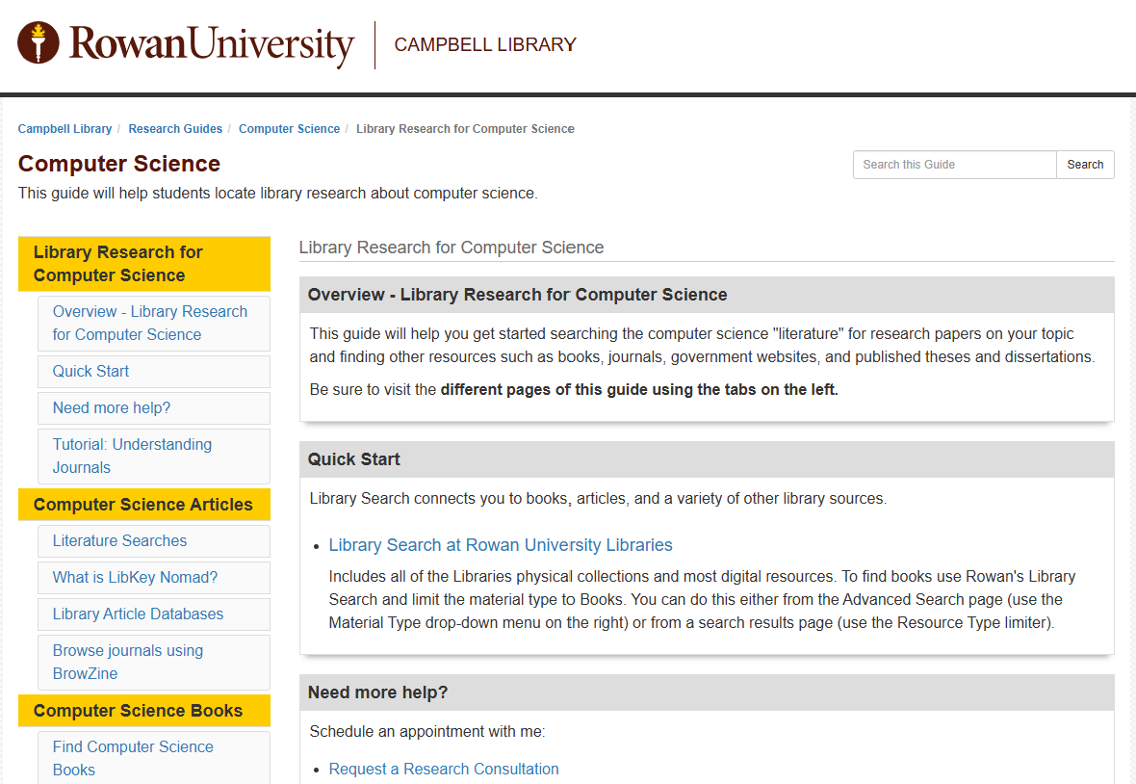
Computer Science Library Research Guide
Your guide to finding resources in computer science.
https://libguides.rowan.edu/ComputerScience

Slide 4
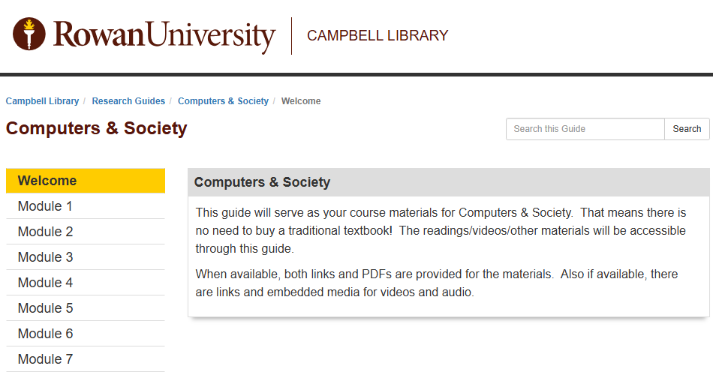
Computers & Society Library Research Guide
While developed for a specific undergraduate class, this guide has good information on ethical issues and social considerations on Computer Science that will be useful to you. --- even in Module 5 of this course "The Current State of Computer Science – an Ethical Perspective"
Module 1 – Professional Ethics
Module 2 – Ethics in Computing
Module 3 – 4th Amendment Considerations Right to Privacy
Module 4 – 1st Amendment Considerations Freedom of Speech
Module 5 – Intellectual Property
Module 6 – Technology's Impact on the Workforce; Cybercrime and Cybersecurity
Module 7 – Other big ideas: Robots, Tech Globalization, Data Ownership, Disinformation, etc.
https://libguides.rowan.edu/computers_society

Slide 5
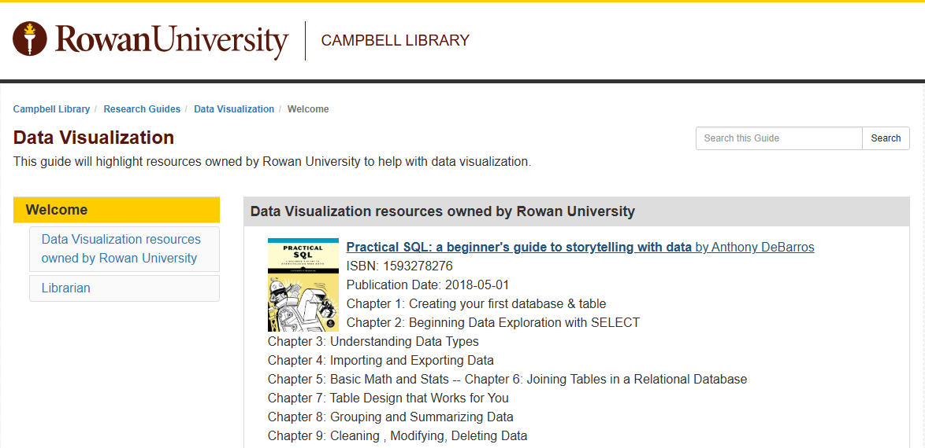
Data Visualization Library Research Guide
Data and Information Visualization

Slide 6
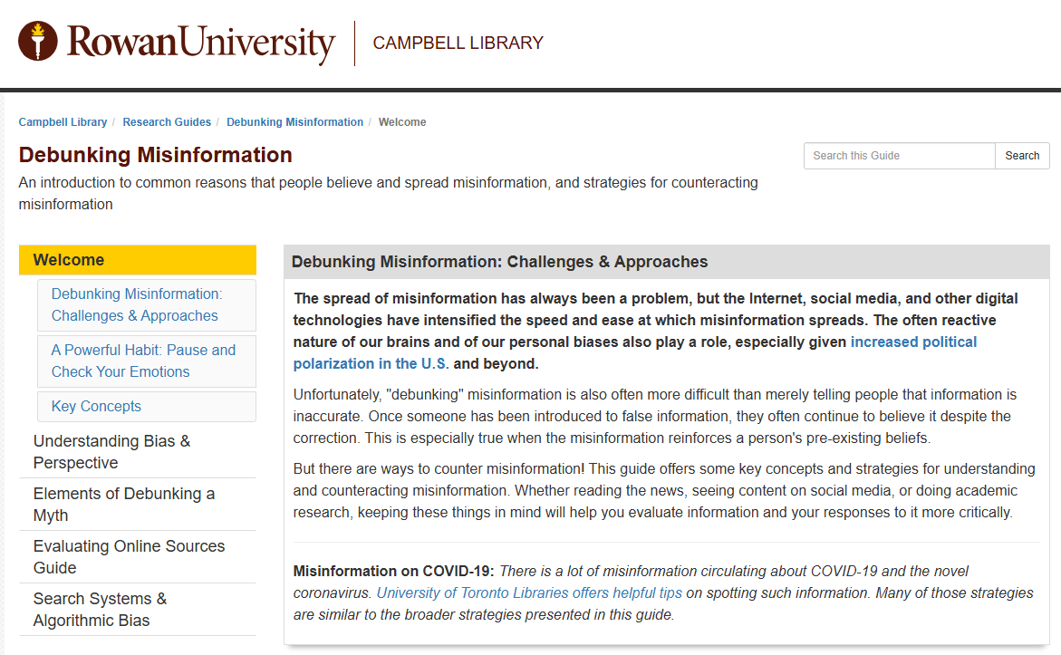
Debunking Misinformation Library Research Guide
https://libguides.rowan.edu/debunking

Slide 7
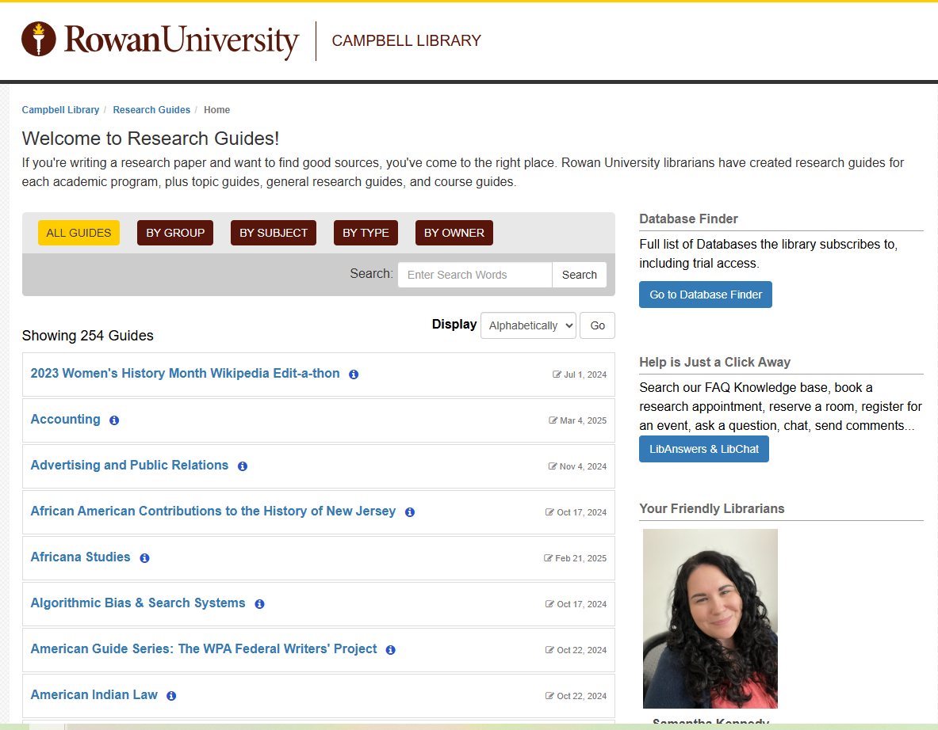

Plus many other Library Research Guides
https://libguides.rowan.edu/

