Slide 1
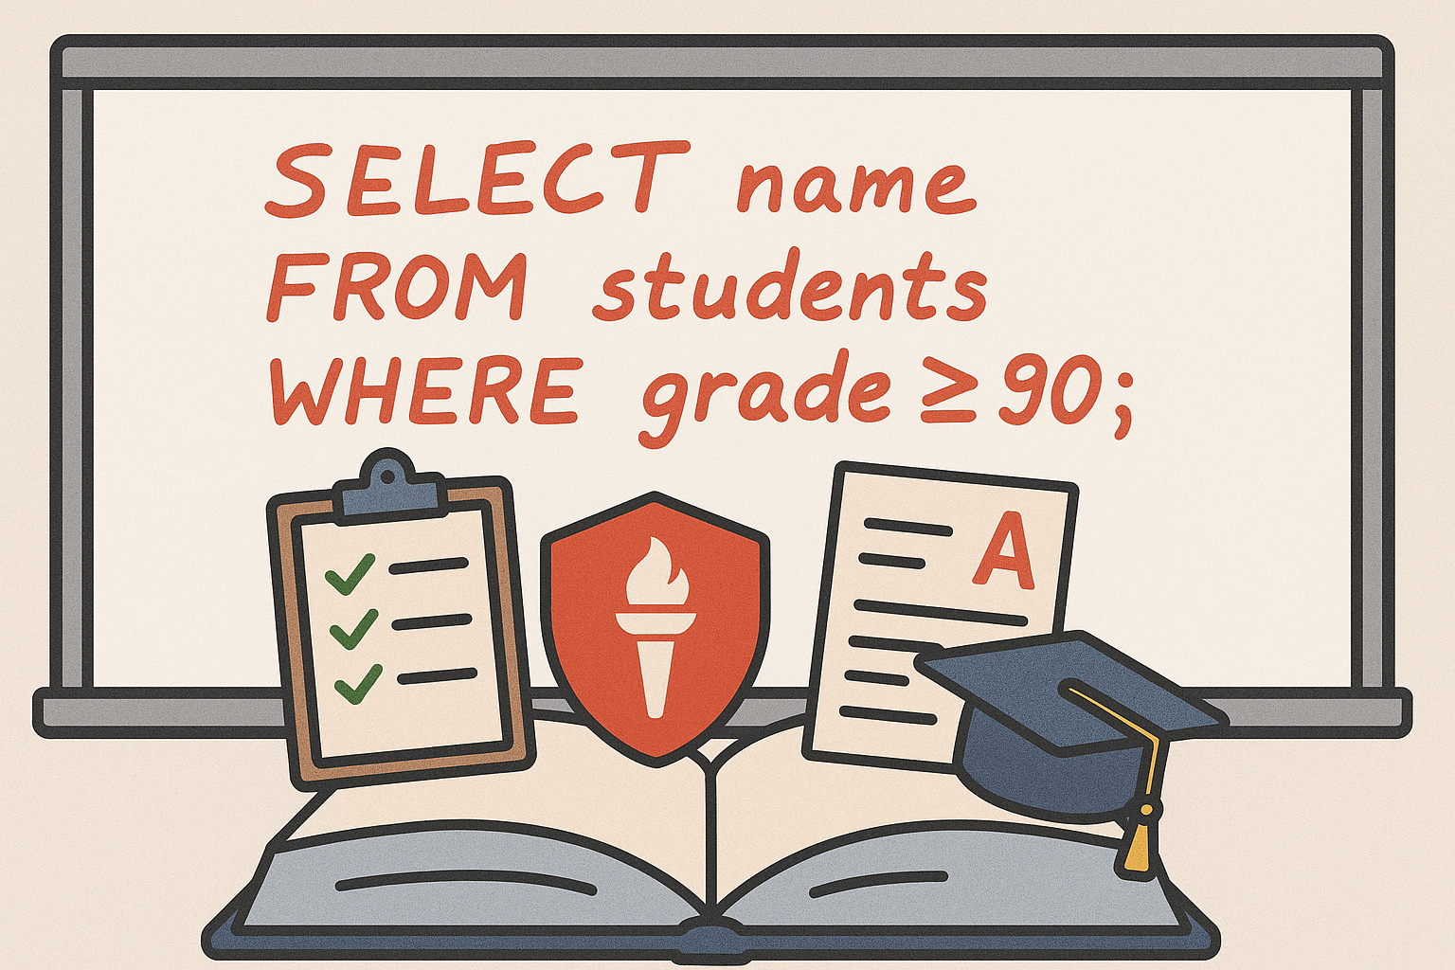
CS 00500 – Graduate Seminar Lesson 1.3 Academic Policies and Expectations
Policies
Online Courses
Academic Freedom and Syllabi
Grading
Notes:
Replace this with your course title and your name/contact details.

Slide 2
Policies

Slide 3
Policies and Syllabi
Rowan University has several policies that apply to all students matriculating at Rowan or taking a Rowan course.
Policies may be found here: https://confluence.rowan.edu/display/POLICY/Academic+Affairs
Other policies may also be applicable
Departmental Policies, for instance:
Number of times a course can be repeated
Whether laptop computers are required for students
Instructor Policies, for instance:
Attendance (perhaps more specific than the university's)
Late assignment submissions
Use your course syllabus as a guide to these other policies.

Slide 4
Attendance Policy
Students are expected to attend each meeting of each scheduled class for which they are officially registered and are responsible for knowing their instructors’ attendance policies as stated in the syllabus.
Students who are absent must inform their instructors of their absence and provide documentation. Students must consult with their instructors to determine what is considered acceptable documentation.
Notice to the instructor must be given before the missed class meeting.
In the case of rare and compelling circumstances, students should make every effort to discuss reasonable accommodations with their instructors in advance (if feasible) or as soon as possible afterward.
Online attendance
A student is officially considered “present” in the online portion of a course when a student has visited each page, tool, or assignment as is necessary to conduct class work by the end of each week.

Slide 5
Accommodation Policy
Rowan University will provide reasonable accommodations for anyone to obtain equal access to educational or occupational programs and activities.
Academic Success Center/Disability Resources (“Disability Resources”) provides accommodations and assistance to students with various documented disabilities in accordance with Section 504 of the Rehabilitation Act of 1973 and the Americans with Disabilities Act (ADA) of 1990.
Students who meet University admissions requirements (i.e., otherwise qualified to attend the University) are required to submit appropriate documentation so that the University can determine whether they qualify for reasonable accommodations.

Slide 6
Academic Integrity Policy
The integrity of academic programs is imperative to Rowan University's mission.
While acknowledging the social and collaborative nature of learning, the University expects that grades earned by students will reflect individual efforts and achievements.
Academic dishonesty, in any form including academic misconduct, cheating, plagiarism, and fabrication, will not be tolerated. Students who commit an act of academic dishonesty are subject to disciplinary sanctions up to and including expulsion from the university, e.g.:
Notation of Academic Integrity Violation on Transcript
Academic Integrity Probation
Any subsequent Academic Integrity Violation while in this status will likely result in suspension or expulsion from the university.
Suspension
The student is no longer a registered student, may not attend classes, nor receive grades for the period of the suspension
Expulsion

Slide 7
Classroom Behaviour Policy
All types of speech and behavior must be balanced with principles of appropriate classroom behavior.
Students share the responsibilities associated with maintaining a quality learning environment. Students who fail to adhere to the behavioral expectations outlined by the instructor (either in the syllabus or at the time the behavior occurs) may be subject to discipline in accordance with the procedures described in this classroom behavior policy.

Slide 8
Disruptive Behaviour
Disruptive Behavior: Any action, behavior or speech in which the evidence demonstrates a finding is more likely than not, that the conduct exhibited interferes or compromises the learning environment and hampers the instructor’s ability to teach and students to learn.
Disruptive behavior can be classified as and include, but is not limited to:
Persistent speaking without permission
Engaging in activities not related to the class
Inappropriate use of electronic devices
Sleeping in class that is unrelated to a documented medical or mental health diagnosis and/or accommodation
Chronically entering class late or leaving early that is unrelated to a medical or mental health diagnosis and/or accommodation
Eating/drinking in class without permission
Verbally confronting a faculty member or another student using utterances that have the effect of insulting or demeaning them in such a way that it causes disruption or interference with the classroom environment
Engaging in physical violence, threats, harassment, intimidation, bullying, coercion, and/or other conduct which threatens or endangers the health or safety of any person as described in the Student Code of Conduct.

Slide 9
Online Courses

Slide 10
Expectations of Students Taking Online Course
Courses have quality and rigor similar to that of a face-to-face class.
Frequent interaction/communication between students and the instructor is required.
Students are expected to participate in discussion with other students.
Some courses require students to work and interact in groups.
Hybrid courses will meet face-to-face several times during the course at a designated date, time, and location.
Some courses are offered at an accelerated pace, meaning that the same amount of work conducted during a full 15-week semester is conducted in a shorter time-frame.

Slide 11
Academic Freedom and Syllabi

Slide 12
Faculty have Academic Freedom
:
Academic freedom -- university instructors and professors have the autonomy to decide how best to teach their subject matter. This includes:
Choosing Course Content: selection of what topics, themes, and materials (e.g., textbooks, articles, films, case studies) are most relevant for their courses.
Deciding How to Teach: what teaching methods and styles that work best for their students and subject—lectures, discussions, labs, group projects, debates, etc.
Presenting Controversial or Challenging Ideas: students introduced to new, unpopular, or controversial ideas or perspectives, if relevant, and presented scholarly and respectfully.
Encouraging Open Dialogue: foster classroom environments where students are encouraged to question, debate, and discuss differing viewpoints.
Why is this important?
Faculty draw on expertise and professional judgment to create strong learning experiences.
Educational process is protected from outside interference, such as from politicians, special interest groups, or administrators who might try to dictate what can or can’t be taught.
Intellectual growth encouraged by exposing students to a wide range of ideas and helping them learn critical thinking skills.

Slide 13
What Academic Freedom Means
Academic freedom gives instructors the right to design their own methods of assessing student learning — for example, deciding on the types and number of exams, essays, projects, and how much each counts toward the final grade.
Professors can set their own grading standards (within the framework of the department and university policies), deciding what constitutes an A, B, C, etc., and what skills or knowledge are most important.
One section of a course may differ from another section, especially when it comes to grading weight, deadlines, and some customized content.
Online courses typically have much less variation than face to face courses.

Slide 14
Syllabi are Important!
While many students tend to “gloss over” syllabi, they are actually very important documents that deserve your attention.
Syllabi specify the expectations and responsibilities of faculty and students with respect to a given course, constituting an enforceable agreement.
They contain:
Instructor's office hours and contact information
Meeting times and locations
A course description and statement of course objectives
The proposed topical outline, where appropriate
Course requirements (e.g., readings, research group work, presentations)
The criteria and procedures for evaluating student performance including the availability of a pass/no credit option
The attendance policy, within the parameters of the existing University policy
Additional departmental or instructor policies as well as appropriate University-wide policies

Slide 15
Grading

Slide 16
Grading
:
Letter Grade | Grade Points | Value
A | 4.0 | Excellent
A- | 3.7
B+ | 3.3
B | 3.0 | Good
B- | 2.7
C+ | 2.3
C | 2.0 | Fair
C- | 1.7 | Failure
D+ | 1.3
D | 1.0
D- | 0.7
F | 0.0
P | Pass
NC | No Credit
IN | Incomplete
Category 3: To maintain Minimum Satisfactory Academic Progress in and to successfully graduate from a Category 3 program students must:
Earn no more than two total C grades of any combination of “C+” or “C.” (C- grades are not acceptable.)
Earn no grades lower than a “C”
Earn an official cumulative GPA (according to matriculation level) of at least 3.000 on Rowan’s 4.000 scale
Grades are not “given” by professors.
Grades are “earned” by students.
Bartering for grades is not appropriate.

