Slide 1

CS 00500 – Graduate Seminar Lesson 1.1 Introduction
Welcome!
About this course
What we'll cover
Notes:
Replace this with your course title and your name/contact details.

Slide 2
CS 00500 – Graduate Seminar
This zero-credit course is designed to orient and prepare graduate students for success in their graduate studies. It will provide useful information on the details, processes, and nuances of the student’s graduate programs. It will also be used to encourage research and will include graduate seminar presentations by student researchers. Students will learn a holistic understanding of the current state of computing via attendance of talks by invited speakers and by “journal club”-style discussions of published peer reviewed research.

Slide 3
Course Objectives
At the completion of the course, students should be able to:
articulate the details, processes, objectives, and nuances of their graduate programs, including administrative requirements and academic expectations;

Slide 4
Course Objectives
At the completion of the course, students should be able to:
articulate the details, processes, objectives, and nuances of their graduate programs, including administrative requirements and academic expectations;
incorporate techniques, processes, learnings and best practices to prepare for graduate study and beyond;

Slide 5
Course Objectives
At the completion of the course, students should be able to:
articulate the details, processes, objectives, and nuances of their graduate programs, including administrative requirements and academic expectations;
incorporate techniques, processes, learnings and best practices to prepare for graduate study and beyond;
critically analyze computing trends and the current state of computing through discussions, readings, and reflections on technologies relevant to their chosen area of focus;

Slide 6
Course Objectives
At the completion of the course, students should be able to:
articulate the details, processes, objectives, and nuances of their graduate programs, including administrative requirements and academic expectations;
incorporate techniques, processes, learnings and best practices to prepare for graduate study and beyond;
critically analyze computing trends and the current state of computing through discussions, readings, and reflections on technologies relevant to their chosen area of focus;
competently engage with research via review and discussion on peer-reviewed literature, to enhance their ability to conduct scholarly inquiry.

Slide 7
Course Modules
Module 1 – Introduction
Orientation, policies, tools, resources, preparing for graduate study
Module 2 – Your Graduate Program
Specific details about your chosen course of study
Module 3 – Academic Integrity
Plagiarism, allowable collaboration, use of generative AI in academic settings
Module 4 –State of Computer Science
Key emerging technologies, tech trends, relevance to careers and modern life
Module 5 – Ethics in Computer Science
Modern issues, ethical frameworks, considerations for your field of study
Module 6 – Using Published Literature
Abstratcing information from or producing research papers, critical analytic skills
Module 7 – Academic Communications
Mastering academic writing and presentations
Module 8 – Career Planning
Preparing for academic or industry careers, mastering technical interviews

Slide 8
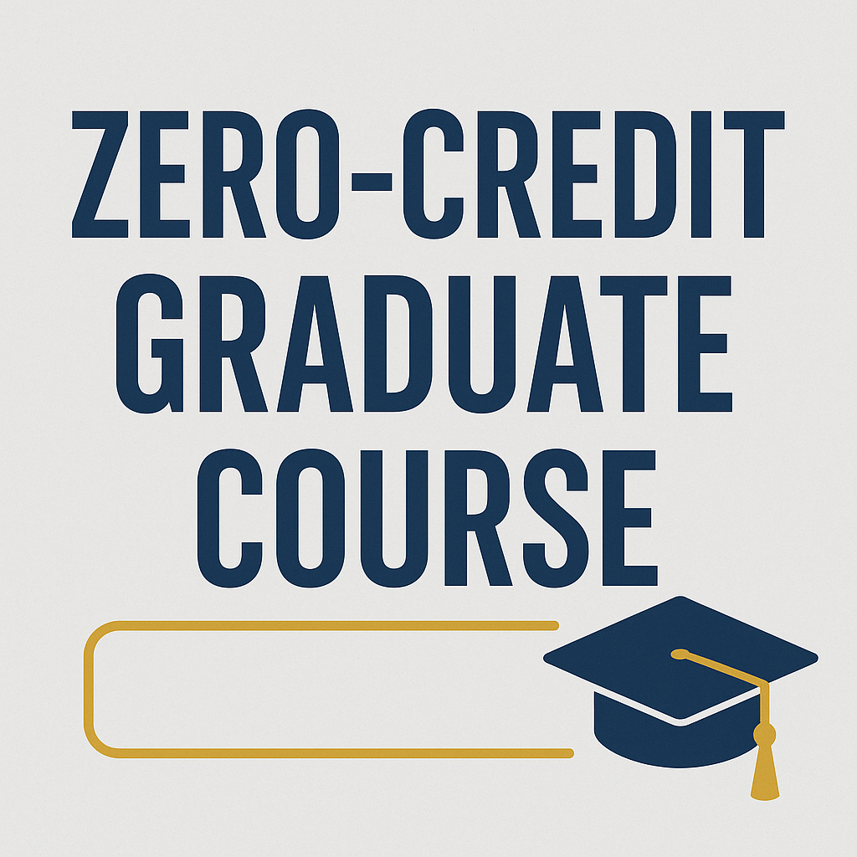
A Zero Credit Course?

