Slide 2
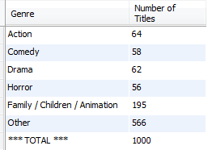
Count and UNION can be Powerful
Use the modified Sakila database to produce statistics on the categories of movies. Produce the report below:
Wait, how many movies are in the database?
Do these numbers add up?

