Slide 1
Concepts of
Computing
Technologies
Cybersecurity Planning and Management:
Managing Patch and Change Control
Notes:
Replace this with your course title and your name/contact details.

Slide 2
Change Management
The goal of change management is to implement new IT services with minimal disruption to the existing IT service infrastructure.
Change management is regarded as a highly critical process that must be executed with care and accuracy.
IT experts will often point out how much can go wrong when change management is mishandled.
The results of poor change management could include excessive downtime, data errors that take a long time to repair, unclear assignment of responsibility, compliance breaches, and several other negative effects.

Slide 3
Types of Change
Normal changes
  Application upgrades, implementation of new infrastructure…
Standard (or routine) changes
  Low impact changes, e.g., add additional memory, add another server to the database farm…
Emergency changes
  when current circumstances pose a major threat to business operations and must be changed as soon as possible.
  e.g., data center outage, firing of key executive
Full or abbreviated adherence to SDLC
Adherence to approved standard procedure
Fix now;
document later

Slide 4







Release Management
Maintenance
Planning
Implementation
Analysis
Release Management goes through the entire SDLC.
Integration
& Testing
Design
Development
Release Management Best Practices. Plutora Blog. Updated 20-Sep-2018. https://www.plutora.com/blog/release-management-best-practices

Slide 5
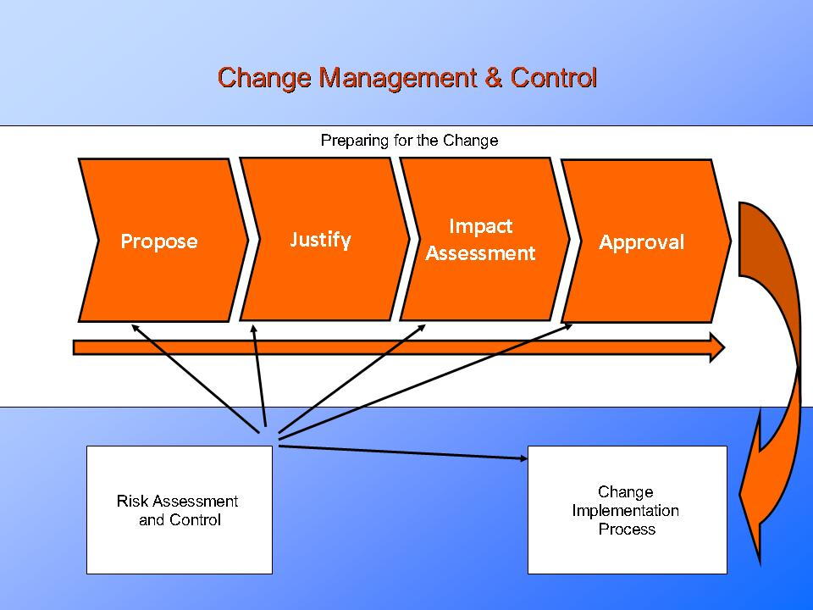
A look at a Change Management process
This sample shows the stages of managing changes and the role of Risk Assessment
http://www.presentationeze.com/blog/product-process-change-management-control/

Slide 6
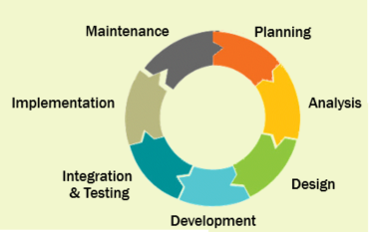
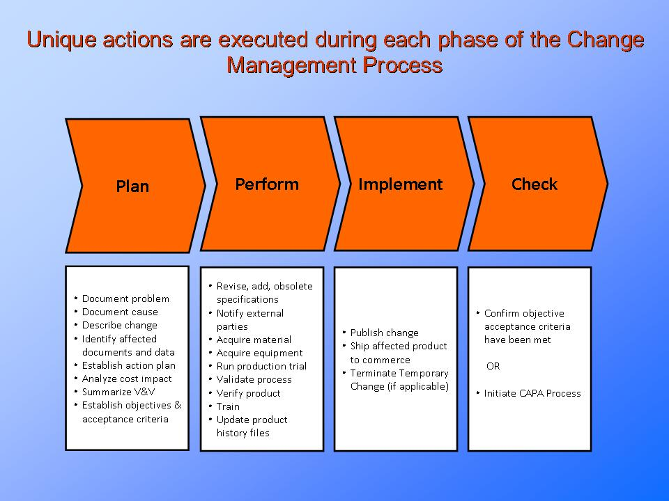
A look at a Change Management process
Key steps that need to occur in the SDLC to ensure quality.
http://www.presentationeze.com/blog/product-process-change-management-control/

Slide 7
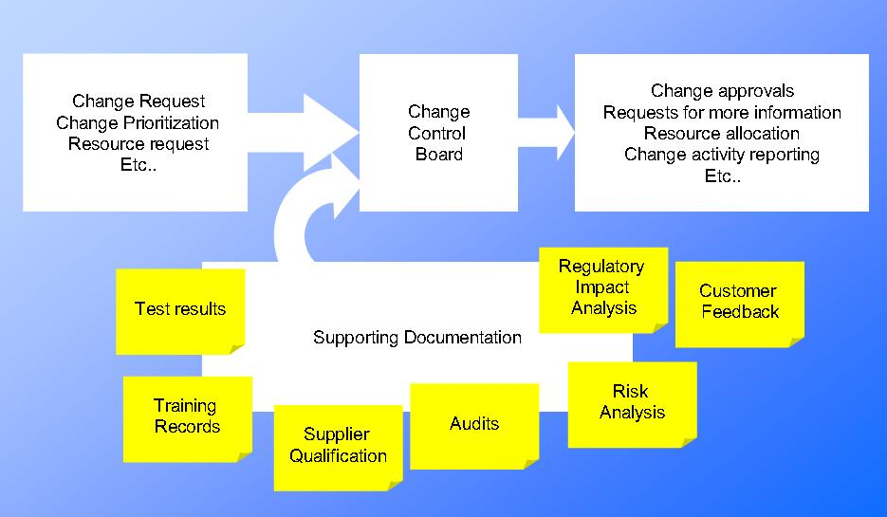
Change Boards
A Change Control Board (CCB) or Change Assessment Board (CAB) can also be useful for ensuring quality
Assesses a proposed change and develops a change planning process.
At times, this subprocess can execute autonomously via the authority of the CAB; otherwise, it may need to advance to another level of authority, such as IT management, in order to receive authorization.
Technology, ClydeBank. ITIL For Beginners: The Complete Beginner's Guide To ITIL (p. 88). ClydeBank Media LLC. Kindle Edition.
http://www.presentationeze.com/blog/product-process-change-management-control/

Slide 8
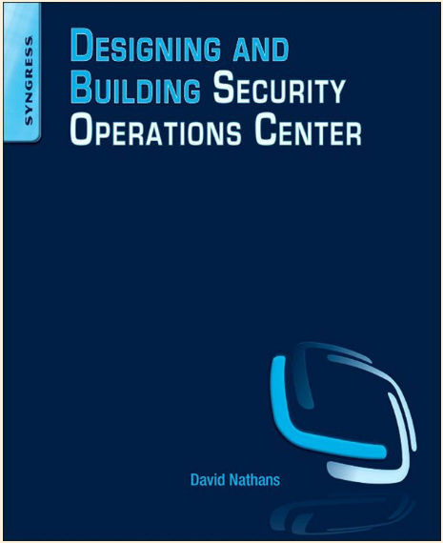
Unpatched Systems Can Exasperate Vulnerabilities
Read chapter 8 on Metrics and see what a Security Operations Center (SOC) can do to ensure patch management is successful

Slide 9
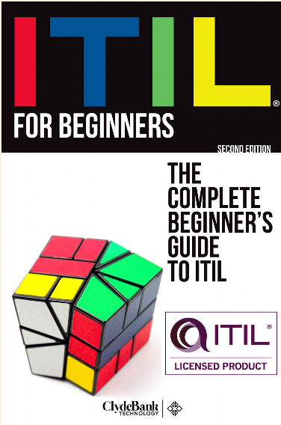
More about Change Management in ITIL
Finally, we begin to dive into the Service Transition lifecycle phase of ITIL.
Make sure you understand all of the subprocesses and KPIs for the following processes:
  Change Management
  Change Evaluation
  Transition Planning and Support
  Release and Deployment Management
Covered in Chapter 5 of the text book.

