Slide 1
Concepts of Computing Technologies Cybersecurity Planning and Management: Information security management
Notes:
Replace this with your course title and your name/contact details.

Slide 2
Information Security Management from the ITIL perspective
As its name implies, information security management (ISM) protects the data entrusted to the care of the IT department, ensuring continual confidentiality, integrity, and security of said information.
In most organizations, the information security management ITIL process will be a component piece in a wider security management scheme.

Slide 3
Operational, Tactical, and Strategic Planning and Management
Strategic
Short to medium-term focus
6 month to 1+year time span
Sub-system decisions are made
Annual budgets provide finance/cost basis
Strategic plan detail transformed into an operational plan
Day-to-day decision making
Operations controlled against standards and rules
Control via weekly/monthly reports
The implementation of the operational plan
Tactical
Medium to long-term focus
1 to 5+ year time span
Overall 'structural' decisions
Trade-offs between company functions
Trade-off with other organizations
Corporate financial plans and policies
Policy decisions developed into a strategic plan
Operational
Source: lifecycle-performance-pros.com (http://https://www.youtube.com/watch?v=wbdoSZcBkzY)

Slide 4

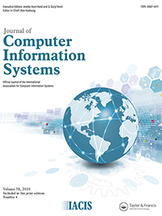
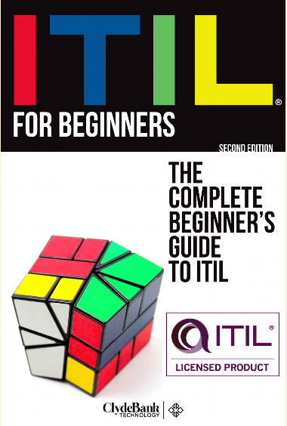
Supplemental Material
You will watch a video which also describes Operational, Tactical and Strategic elements of business strategy
You will explore how ITIL handles this topic area
You will read a journal article that applies these concepts to Information Security

