Slide 1
Concepts of Computing Technologies Storage Management: Data Protection: RAID
CH 3
Notes:
Replace this with your course title and your name/contact details.

Slide 2
SLED
Stands for Single Large Expensive Disk
Was standard in many hosts (late 1980s) but had two main problems:
Could not meet increasing performance needs of other physical host components
If drive failed, all data is lost

Slide 3
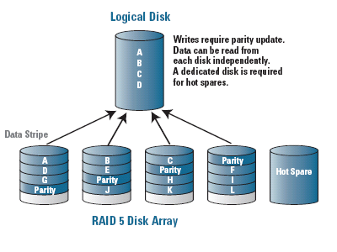
RAID
Stands for Redundant Arrays of Inexpensive Disks
A data storage virtualization technology that combines multiple physical disk drive components into one or more logical units for the purposes of data redundancy, performance improvement, or both.
Comes from paper written by Dr.’s David A. Patterson, Garth Gibson, and Randy H. Katz titled “A Case for Redundant Arrays of Inexpensive Disks”
Introduces solution to increase efficiency and protect data

Slide 4
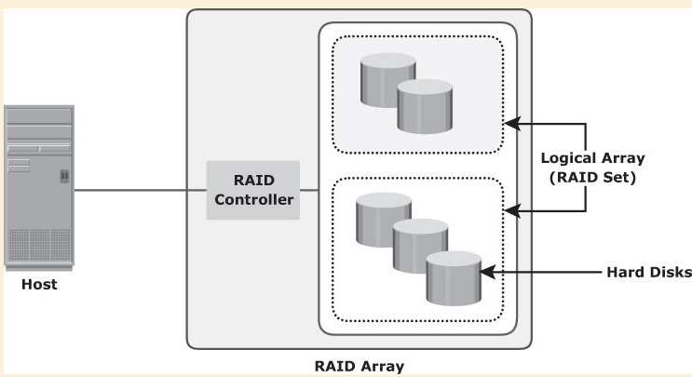
RAID Implementation
Software RAID
Uses host-based software to provide RAID functions
Implemented at OS level
Cannot Support All RAID levels
Affects system performance
Does not use a dedicated hardware controller to manage the RAID array.
Hardware RAID
Uses specialized hardware controller
The external RAID controller is an array-based hardware RAID –an interface between the host and disks.
Presents storage volumes to the host, and the host manages these volumes as physical drives.

Slide 5
RAID Array
Enclosure that containers drives, hardware and software that is used to implement RAID
Drives in array are in sub-enclosures, which holds a fixed number of drives
Logical arrays – subset of disks in RAID array

Slide 6
RAID Levels
Striping
Strip: one of a predefined number of addressable disk blocks
Stripe: aligned strips that span across all disks
Strip Size: number of blocks in a strip
Stripe width: number of data strips in a stripe
Mirroring
Data is stored on two different drives
Requires 100% extra disk space
Parity
Protect striped data without mirroring
Requires 25% extra disk space
Parity recalculated every time data is changed, affecting performance of RAID controller in use
Key Term
Striping
a technique to spread data across multiple drives (more than one) to use the drives in parallel. All the read-write heads work simultaneously, allowing more data to be processed in a shorter time and increasing performance, compared to reading and writing from a single disk.
Key Term
Strip
In RAID, a predefined number of contiguously addressable disk blocks
RAID-5 provides data redundancy by using parity. Parity is a calculated value used to reconstruct data after a failure. While data is being written to a RAID-5 volume, parity is calculated by doing an exclusive OR (XOR) procedure on the data. The resulting parity is then written to the volume. The data and calculated parity are contained in a plex that is "striped" across multiple disks. If a portion of a RAID-5 volume fails, the data that was on that portion of the failed volume can be recreated from the remaining data and parity information.

Slide 7
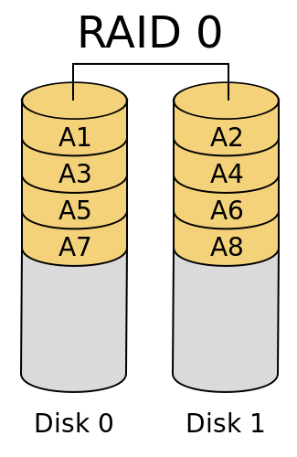
RAID 0
Data is striped across all drives in RAID setup
Requires at least two drives
Storage amount is equal to amount of storage across all drives in setup
Good read and write performance
If one drive fails, all data is lost
Used in applications that need high I/O throughput

Slide 8
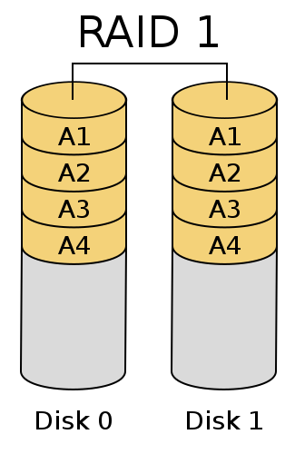
RAID 1
Mirror data to all drives in RAID setup
Requires at least two drives
If one drive fails, data is safe on second drive
Total storage of drives is equal to the data being mirrored from first drive

Slide 9
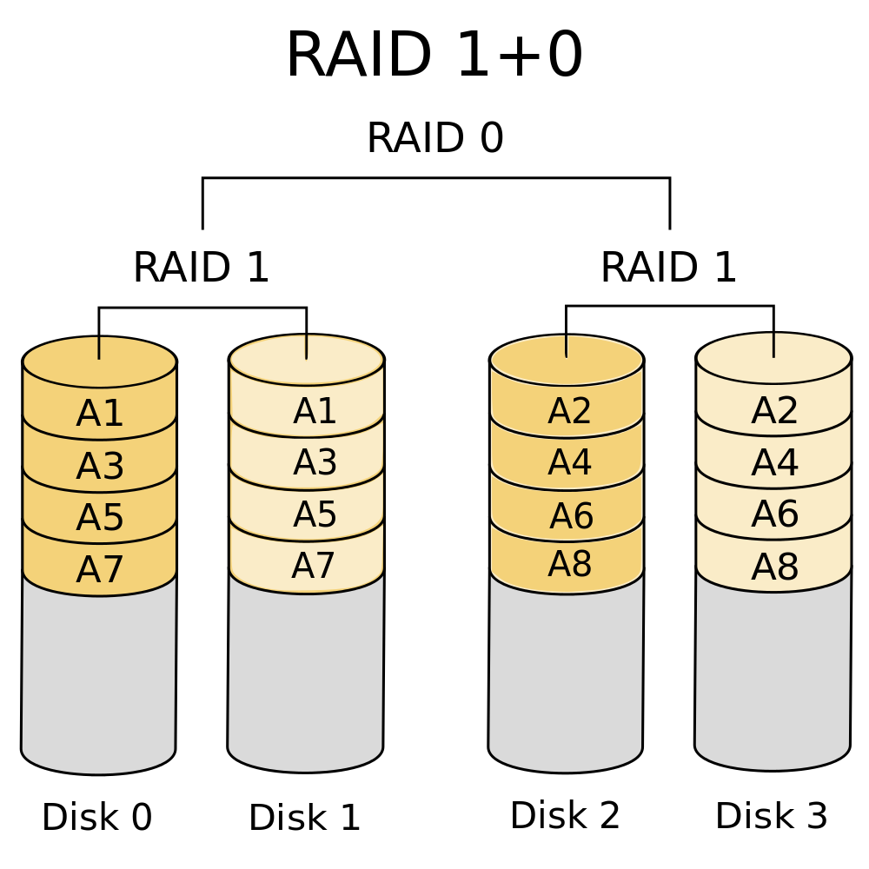
RAID 10(1 + 0)
Striped Mirror
Nested RAID
A RAID 0 Setup of disks in RAID 1
Combines efficiency of RAID 0 and reliability of RAID 1
Used for data base applications that require high rates I/O interaction, random access, and high availabilty

Slide 10
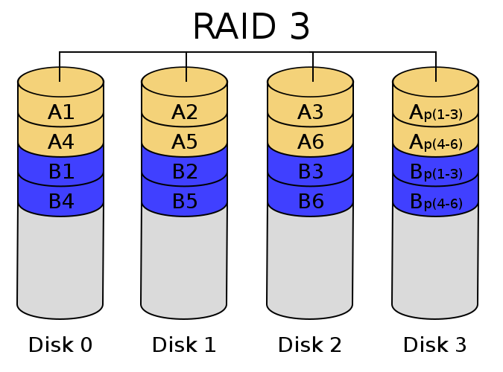
Raid 3
Stripes data for high performance and uses parity
Parity info stored on dedicated drive, allowing data to be rewritten in case of drive failure
Reads and writes across all disks, work in parallel
Requires at least 3 drives
Storage efficiency depends on number of drives in setup:
n = number of drives in setup

Slide 11
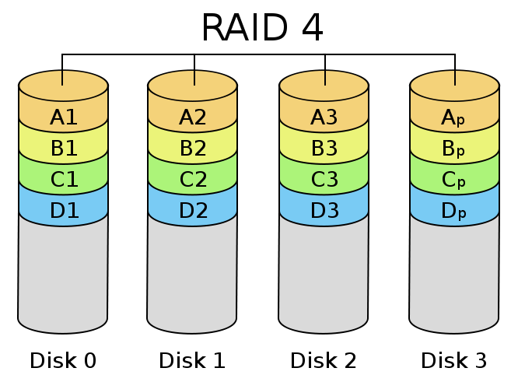
RAID 4
Parity data is stored on separate disk:
Creates write bottleneck fixed in next level of RAID
Storage efficiency depends on number of drives in setup:
n = number of drives in setup

Slide 12
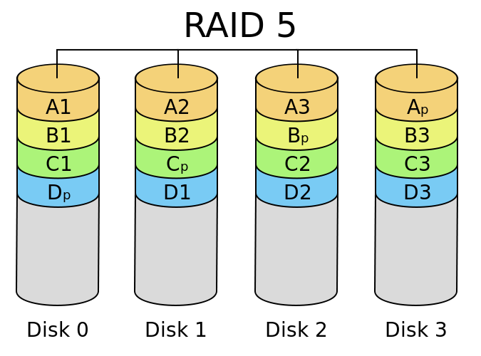
RAID 5
Uses striping to read and write data
Disks can be independently accessed
Parity data is written across all disks instead of a dedicated disk
Used for tasks such as messaging and data mining
Storage efficiency depends on number of drives in setup:
n = number of drives in setup

Slide 13
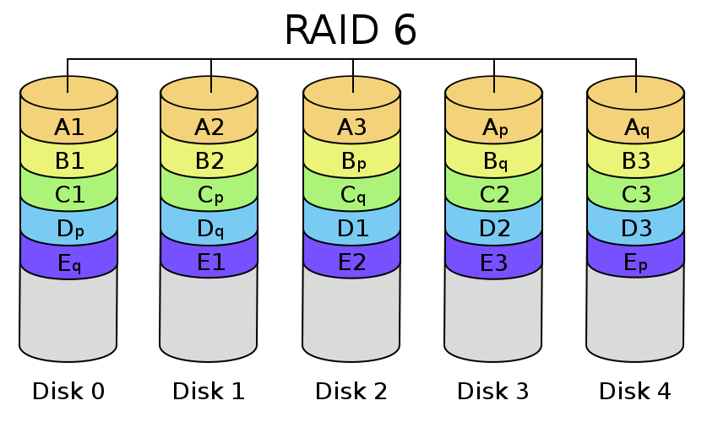
RAID 6
Similar to RAID 5 accept uses second parity element
Requires 4 disks
2 drives can fail and data can be safe
Higher write penalty as compared to RAID 5
Storage efficiency depends on number of drives in setup:
n = number of disks in setup

Slide 14
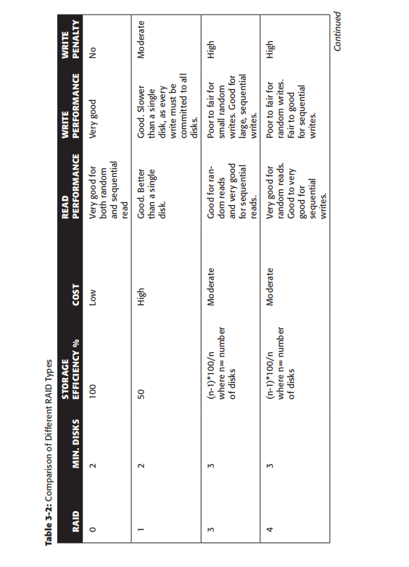
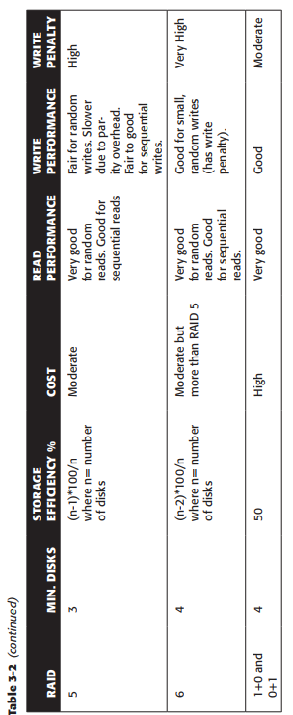
RAID Table

Slide 15
References
EMC Education Services. 2009. Information storage and management: storing, managing, and protecting digital information 2nd ed., Indianapolis, IN: Wiley.

Slide 16
Pictures
“Standard RAID Levels.” Wikipedia, Wikimedia Foundation, 10 Dec. 2017, en.wikipedia.org/wiki/Standard_RAID_levels.
“Nested RAID Levels.” Wikipedia, Wikimedia Foundation, 10 Dec. 2017, en.wikipedia.org/wiki/Nested_RAID_levels.

