Slide 1
Concepts of Computing Technologies Storage Management: Object-Based Storge
Notes:
Replace this with your course title and your name/contact details.

Slide 2
Why Object Based?
Recent studies have shown that more than 90 percent of data generated is unstructured.
This growth of unstructured data has posed new challenges to IT administrators and storage managers.
With this growth, traditional NAS, which is a dominant solution for storing unstructured data, has become inefficient.
Data growth adds high overhead to the network-attached storage (NAS) in terms of managing a large number of permissions and nested directories.
In an enterprise environment, NAS also manages large amounts of metadata generated by hosts, storage systems, and individual applications. Typically this metadata is stored as part of the file and distributed throughout the environment. This adds to the complexity and latency in searching and retrieving files.

Slide 3
Object-Based Storage Devices (OSDs)
Object-based storage is a data storage architecture that manages data as objects, as opposed to other storage architectures like file systems which manage data as a file hierarchy, and block storage which manages data as blocks within sectors and tracks.
Object-Based Storage
a way to store file data in the form of objects based on its content and other attributes rather than the name and location.
Key Term
An OSD is a device that organizes and stores unstructured data, such as movies, office documents, and graphics, as objects.
Object-based storage provides a scalable, self-managed, protected, and shared storage option.
OSD stores data in the form of objects. OSD uses flat address space to store data. Therefore, there is no hierarchy of directories and files; as a result, a large number of objects can be stored in an OSD system

Slide 4
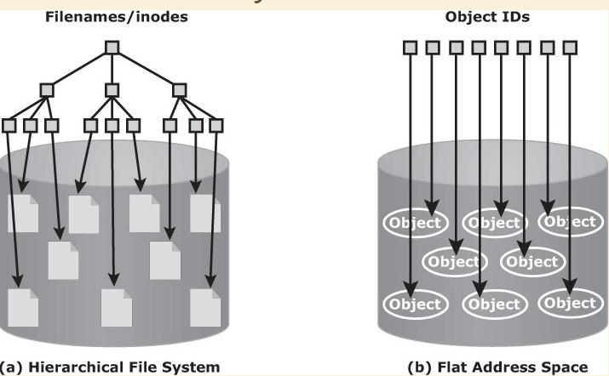
OSD compared to Hierarchical Systems
Each object stored in the system is identified by a unique ID called the object ID. The object ID is generated using specialized algorithms such as hash function on the data and guarantees that every object is uniquely identified.

Slide 5
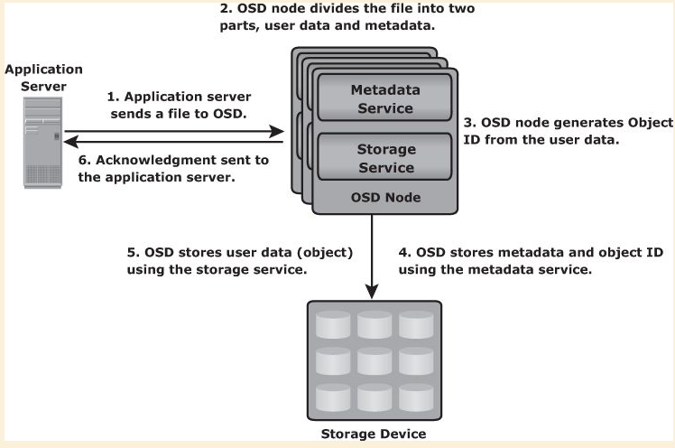
How OSD works
After an object is stored successfully, it is available for retrieval.
A user accesses the data stored on OSD by the same filename.
The application server retrieves the stored content using the object ID.
This process is transparent to the user.

