Slide 1
Concepts of Computing Technologies Intelligent Storage Systems Part 2
Notes:
Replace this with your course title and your name/contact details.

Slide 2
Intelligent Storage System Overview
The components of an intelligent storage system work together to optimize the time to process I/O requests
Intelligent storage systems need to periodically increase their storage capacity to accommodate the growing amount of data being stored
Storage systems must be able to provide quick data access to hosts as well as efficiently manage unnecessary data
Cache the most frequently accessed data
Cache management and prefetch algorithms are ways to implement this property
Cache data protection is essential to preserving data integrity and avoiding data loss.

Slide 3
Storage Provisioning

Slide 4
Storage Provisioning
Storage provisioning is the process of assigning storage resources to hosts based on requirements of host applications.
Storage provisioning can be done in 2 ways
Traditional storage provisioning
Virtual storage provisioning
Notes:
Storage provisioning is the process of assigning storage resources
There are two types - traditional storage provisioning and virtual storage provisioning

Slide 5
Traditional Storage Provisioning
In traditional storage provisioning, physical disks are grouped together and a RAID level is applied to form RAID sets.
Logical units are made from these RAID sets by dividing the available capacity on the physical disk into smaller units via partitioning.
Each logical unit is assigned a unique ID called a logical unit number (LUN). LUNs provide a layer of abstraction by hiding RAID set information.
LUNs are assigned to hosts for their storage requirements after partitioning.
LUNs for Traditional Storage Provisioning are referred to as thick, whereas LUNs for Virtual Storage Provisioning are thin.
All physical storage is completely allocated to a thick LUN upon creation
Notes:
For traditional storage provisioning, physical disks are grouped together to form RAID sets
The available capacity on these RAID sets are then divided into smaller parts called logical units.
Each logical unit is identified by a unique logical unit number that can be assigned to hosts for storage provisioning.
LUNs for Traditional Storage Provisioning called thick LUNs, and LUNs for Virtual Storage Provisioning are thin LUNs
When a thick LUN is created, all of the physical storage is allocated to that logical unit. This will be contrasted with thin LUNs from virtual provisioning.

Slide 6
LUN Expansion: MetaLUN
MetaLUN is a method to expand thick LUNs that require additional capacity or performance by combining two or more LUNs. A MetaLUN consists of a base LUN and 1 or more component LUNs.
MetaLUNs can be concatenated or striped.
Notes:
MetaLUN is a methods that allows the capacity or performance of a thick LUN to be expanded.
A MetaLUN is formed by combining two or more LUNs, and MetaLUNs can be concatenated or striped.

Slide 7
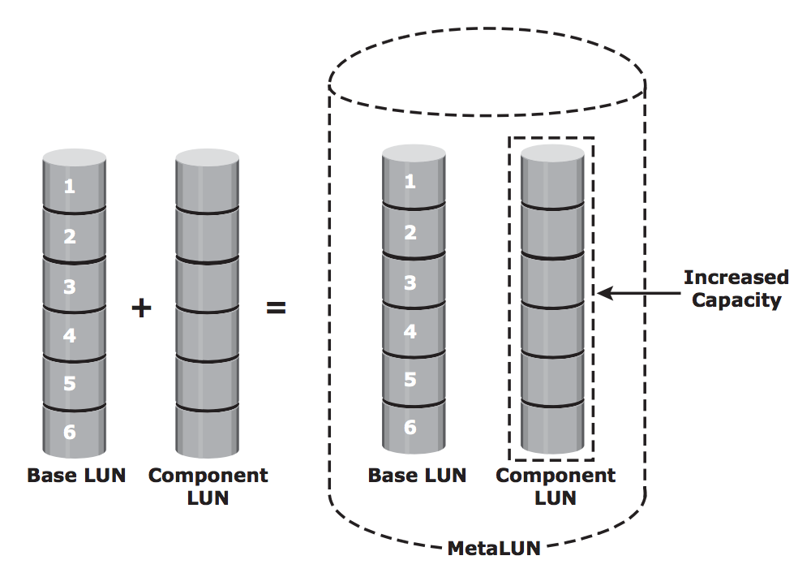
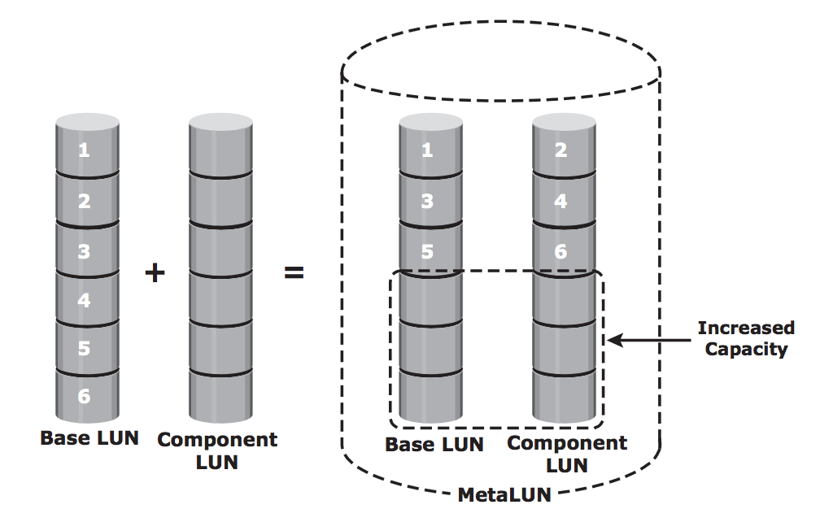
MetaLUN
Concatenated expansion adds additional capacity to the base LUN. It is quick, but doesn’t provide performance benefits.
Striped expansion spreads out data out across base LUN and component LUN(s) to increase capacity and performance.
Concatenated MetaLUN
Striped MetaLUN
Notes:
A concatenated expansion is done quickly by adding additional LUNs to a base LUN to increase capacity
A striped performance adds additional LUNs to a base LUN and then spreads data across the LUNs to increase both performance and capacity

Slide 8
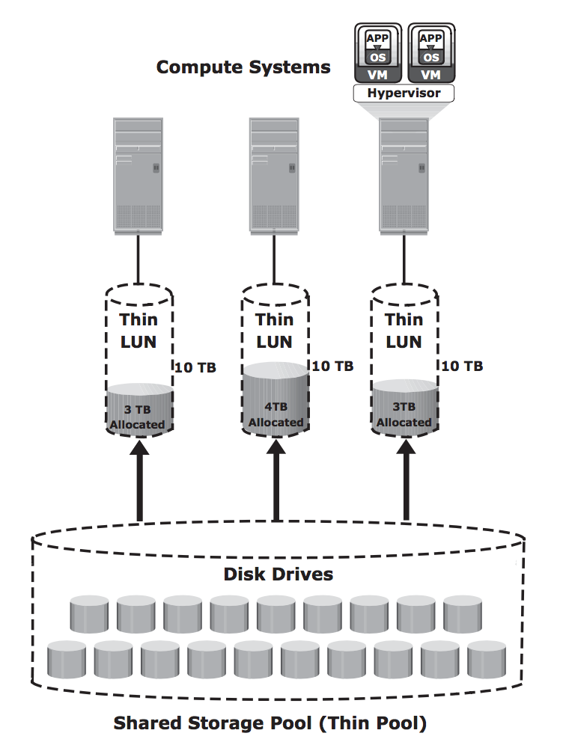
Virtual Storage Provisioning
Virtual provisioning allows for the creation of a virtual LUN with more capacity than what is physically allocated to it.
Thin LUNs do not require physical storage to be completely allocated to it upon creation
Physical storage is allocated to a host on an on-demand basis
Allocation of storage comes from a shared pool of physical disks, which may be shared by several thin LUNs
Virtual provisioning increases storage efficiency as shared pools and thin LUNs may be easily expanded
Notes:
Virtual storage provisioning creates a virtual LUN, known as a thin LUN, with more capacity than what is physically allocated to it.
Compared to a thick LUN, physical storage do not have to be completely allocated to a thin LUN upon creation. Physical storage is allocated to a thin LUN only when necessary.
The physical storage for the thin LUN comes froms from a pool of physical disks that is shared by multiple thin LUNS.
This is shown in the image where several thin LUNs are assigned to hosts and physical capacity is allocated from a shared pool of disk drives.
The shared pool of physical disks and thin LUNs may be easily expanded

Slide 9
Traditional vs Virtual Provisioning
In traditional provisioning, physical capacity is completely allocated upon creation of a thick LUN.
If most of the allocated capacity is not used, then the storage capacity utilization is lower and resources are wasted.
Virtual provisioning addresses this issue
Since physical storage is only allocated from a shared pool to thin LUNs when requested, there is no allocated storage space that is unused
The remaining storage capacity in the shared pool may be used for other purposes
Notes:
Traditional provisioning is often inefficient since physical capacity is completely allocated to a thick LUN when it is made and there may be a large amount of unused storage capacity.
In contrast, virtual provisioning addresses this issue and there is no unused allocated storage space since physical capacity is only allocated on demand

Slide 10
Use cases
Both thick and thin LUNs have benefits, but there are cases where one may be more suitable
Thin LUNs provide greater storage efficiency and are more suitable for applications where space consumption is difficult to predict.
Thick LUNs offer full control for precise data placement and are more suitable for applications where predictable performance is valued over storage space efficiency
Both thin and thick LUNs may be used in the same storage array
Notes:
Thin and thick LUNs each have their use cases for various applications and environments, and they may both be used in the same storage array.

Slide 11
LUN Masking
LUN masking is a process that gives data access control by defining which LUNs that a host can access
LUN masking is implemented on the storage array and ensures that LUNs are accessible only to designated host
This increases data security and prevents unauthorized use in a shared data storage environment
Without LUN masking, several hosts may see and modify each other's data
Notes:
LUN masking is a security measure that controls data access. Through LUN masking, hosts are only able to access the LUNs that are assigned to them.

Slide 12
Types of Intelligent Storage Systems

Slide 13
Types of Intelligent Storage Systems
There are two primary categories of intelligent storage systems
High-end storage systems, also known as active-active arrays
Midrange storage systems, also known as active-passive arrays

Slide 14
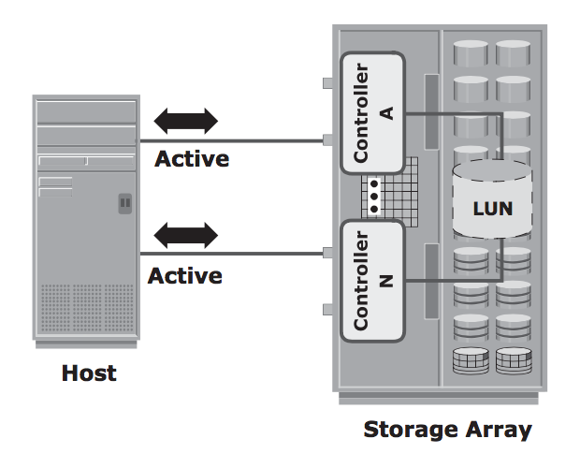
High-end storage systems
High-end storage systems (active-active arrays) are targeted towards large enterprise applications
They are designed with a large number of controllers and cache memory
High-end systems have active-active configuration in which the host can perform I/O to its LUNs through any available controller on the storage array
Notes:
High end storage systems, also known as an active-active array, have an active-active configuration, meaning that hosts can connect to the storage system through any front end controller.

Slide 15
Capabilities of High-end systems
To address enterprise storage needs, high-end systems provide:
Large storage capacity
Large amounts of cache for optimal I/O servicing
Fault tolerance architecture
Multiple front-end ports and interface protocols to serve many hosts
Multiple back-end controllers to manage disk processing
Scalability to support increased performance and storage capacity requirements
Notes:
High end systems provide capabilities such as large storage capacity and cache, fault tolerance, etc.

Slide 16
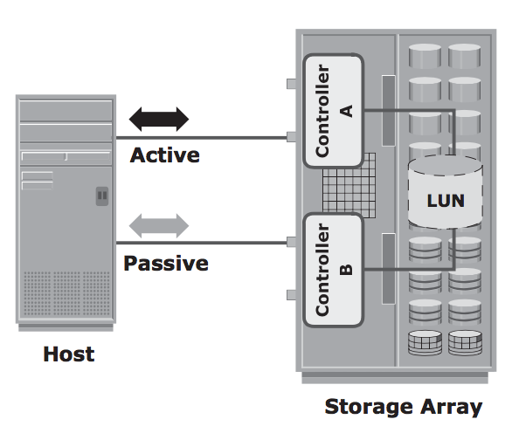
Midrange storage systems
Midrange storage systems (active-passive arrays) are better suited for small to medium sized enterprise applications
Midrange storage systems have active-passive configuration in which the host can only perform I/O to a LUN through one controller.
The other paths to the LUN remain passive and no I/O activity is performed through that path
If the main controller fails, the passive controller may be used as a backup
Notes:
Midrange storage systems, also known as active-passive arrays, have an active-passive configuration in which a host can only connect to one active front end controller. The other controller is “passive” and serve as a backup in case the active controller fails.

Slide 17
Midrange storage systems
Compared to high-end storage systems, midrange storage systems have:
Less storage capacity and cache
Fewer front-end ports, therefore these systems cannot serve as many hosts
Midrange storage systems provide optimal storage solutions at a lower cost than high-end storage systems
Midrange storage systems are redundant in that they have two controllers, where one may act as backup during controller failure
Backup controllers ensure consistent high performance
Notes:
Midrange storage systems are limited in terms of storage capacity, cache, and availability.
However, they provide optimal and consistent storage solutions at a much lower cost than high-end systems.

Slide 18
References
EMC Education Services. 2012. Information storage and management: storing, managing, and protecting digital information 2nd ed., Hoboken, NJ: Wiley.
Yang, Jui-Pin, and Ying-Chin Chen. “A Novel Information Lifecycle Management Scheme for a Web-Based Database System.” Journal of Scientific & Industrial Research, Feb. 2017, pp. 85–89, nopr.niscair.res.in/bitstream/123456789/39833/1/JSIR%2076%282%29%2085-89.pdf.

