Slide 1
Concepts of Computing Technologies Intelligent Storage Systems Part 1
Notes:
Replace this with your course title and your name/contact details.

Slide 2
Objectives
By the end of this lesson, you should be able to:
Identify the main components of an intelligent storage system
Understand cache operations, management and data protection in intelligent storage systems
Identify the key differences between traditional storage provisioning and virtual storage provisioning
Explain logical unit numbers and their context within traditional and virtual storage provisioning
Understand what MetaLUNs are and how they are used in intelligent storage systems
Describe the types of intelligent storage systems

Slide 3
Intelligent Storage Systems

Slide 4
Intelligent Storage System
An intelligent storage system is a feature-rich RAID array with highly optimized I/O processing capabilities
They have a large amount of memory called cache memory and utilize algorithms to meet I/O requirements of modern applications
Intelligent Storage Systems have 4 main components
Front End - interface between the storage system and host.
Cache Memory- temporarily holds data to reduce I/O service times.
Back End - controls data transfer between Cache and Physical Disks
Physical Disks - provides persistent, non-volatile data storage
Notes:
Briefly state what an intelligent storage system is and its main components

Slide 5
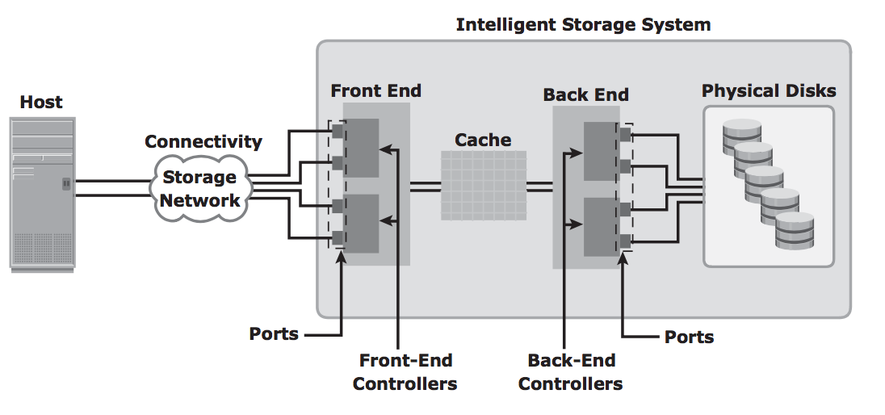
Components of an Intelligent Storage System
Notes:
This is a an overview of an intelligent storage system. Here is the front-end, the cache, the back end, and the physical disks.

Slide 6
Front End
The front end consists of front-end ports and front-end controllers.
Front-end ports allow hosts to connect to the storage system
Front-end controllers sends data to and from cache
A front end has multiple front-end controllers to ensure high availability of the system
Each front-end controller has multiple ports that allow many hosts to connect to the intelligent storage system.
Notes:
The front end consists of front-end ports which allow storage hosts to connect to the storage system and front-end controllers that communicate with the cache.
Intelligent storage systems allow for high availability of the storage system by having redundant front-end controllers.

Slide 7
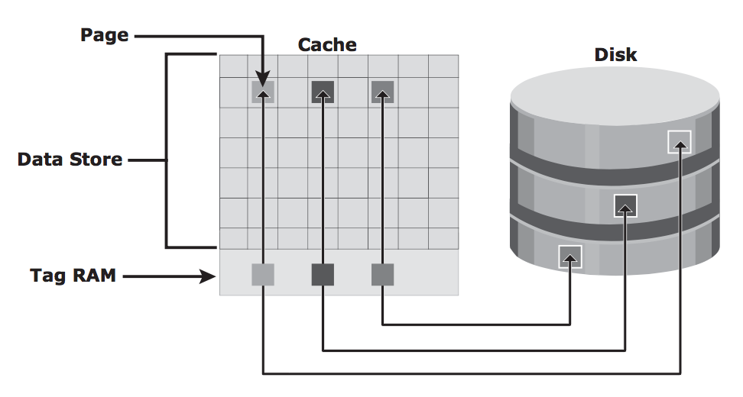
Cache
Cache memory temporarily holds data to reduce service time for I/O requests.
Data access from cache is fast since it avoids the mechanical overhead of accessing data from disks.
The intelligent storage system should cache most frequently accessed data in order to improve overall response time.
Generic cache structure
Notes:
The cache is the most important part of the intelligent storage system as it reduces time to service I/O requests.
Data access from cache memory is very fast compared to data access from the physical disks.
A generic cache structure consists of pages, a data store, and tag RAM

Slide 8
Cache
Cache is organized into small units of memory called pages
Cache is made up of a data store and tag RAM
The data store contains pages and holds data, while tag RAM tracks the location of the data in the data store and its corresponding location in the disk
Each tag RAM entry also contains information such as whether the whether data in cache has been written to the disk, when the data was last requested by the host, etc.
Notes:
The cache is the most important part of the intelligent storage system as it reduces time to service I/O requests.
Data access from cache memory is very fast compared to data access from the physical disks.
A generic cache structure consists of pages, a data store, and tag RAM

Slide 9
Cache Operations
Cache has two operations - Read and Write
When a host issues a read request, the system uses tag RAM to determine if required data is in cache
Read cache hit - The requested data is found in cache and is sent back to host. This is very fast as it avoids disk operations.
Cache miss - The requested data is not found in cache, so the back end has to get the data from the disk. The data is placed in cache in case it’s needed again and then sent back to the host through the front end. Cache misses increase I/O service time.
Notes:
Cache has two main operations : read and write.
When the storage system receives a read request from the host, the system checks if the requested data is located in the cache data store.
If the data is located in the cache, it is immediately send back to the host. This is known as a read cache hit.
If the data is not located in the cache, the back end has to fetch the requested data from the physical disk. It is then placed in cache and sent back to the host. This is known as a cache miss, and is significantly slower compared to a read cache hit.

Slide 10
Cache Operations
Write operations using cache is faster than writing data directly to disks
Write operations can be implemented in two ways
Write-back cache - data is placed in cache and an acknowledgement is sent back to host. Later on, the data from several writes are committed to the disk all at once. This is much faster than writing to disk each time, but any uncommitted data may be lost if cache fails.
Write-through cache - data is placed in cache, committed to the physical disk, and an acknowledgement is sent back to host. This is slower, but risk of data loss is low since all data is written to disk as it arrives.
Notes:
Writing to cache can be implemented in two ways : write-back cache and write-through cache.
For write-back cache, the data is placed into the cache and the host is notified that the write request has gone through. Later on, the data from several write requests are written to the disk all at once. This is faster than write-through cache, but risky if cache fails.
For write-through cache, the data is placed into cache and then immediately written to the disk. The host is then notified that their write request has gone through. The risk of data loss is low, but comes at the cost of speed.

Slide 11
Prefetch Algorithm
In sequential read requests, a contiguous set of memory blocks is retrieved from the disk and placed into cache.
For sequential reads, all the requested data are adjacent to each other in memory.
Blocks that have not been requested yet may also be placed into cache to anticipate read requests
When the host requests for these blocks, the read operations will be read cache hits and response time will be reduced.
Intelligent storage systems offer fixed and variable prefetch sizes
Fixed prefetch - The storage system prefetches a fixed amount of data
Variable prefetch - The storage system prefetches an amount that is a multiple of the size of the host request
Notes:
Prefetch algorithms allow for faster read operations since a contiguous set of memory blocks are placed into cache. This is especially efficient for sequential read requests as the data are right next to each other.
Blocks that have have not yet been requested may also be placed into cache. When a host eventually requests for data from those memory blocks, the read operations will be cache hits.

Slide 12
Cache Management
When the cache data store is filled up, some pages have to be freed up to avoid performance issues.
Various algorithms are used in intelligent storage systems to manage available pages and pages that may be freed up.
Least Recently Used Algorithm - Assumes that pages which haven’t been accessed in a long time will not be requested. LRU identifies pages that haven’t been accessed in a while and either frees them up or marks them for reuse
Most Recently Used Algorithm - Assumes that pages which have been recently accessed will not be requested for awhile. MRU identifies those pages that have been recently accessed and frees them up or marks them for reused
Notes:
When the data store of a cache is full, some pages have to be freed up so new data can be cached.
There are various algorithms, but the most popular are the Least Recently Used Algorithm and the Most Recently Used Algorithm.
Least Recently Used is based on the assumption that pages which have not been accessed in a long time will not be requested
Most Recently Used is based on the assumption that pages which have been recently accessed will not be requested for a long time.

Slide 13
Cache Management
Intelligent storage systems need to manage dirty pages (data placed in cache but not yet written to disk)
Flushing is the process of committing data from cache to disk so cache pages can be freed up.
Watermarks are levels set in cache to manage flushing process. They are based on how full the cache is.
High watermark - cache utilization level where high-speed flushing of data occurs
Low watermark - cache utilization level where storage system stops flushing of data
Notes:
When we consider write-back operations with cache, intelligent systems often have to manage dirty pages, which are data that have been placed in cache but not yet written to the physical disk.
Flushing is the process of writing the data from cache to the physical disks.
There are watermark levels set within cache that manage the flushing process. A high watermark indicates a large amount of dirty pages, so high-speed flushing occurs
For low watermarks, the storage system stops flushing

Slide 14
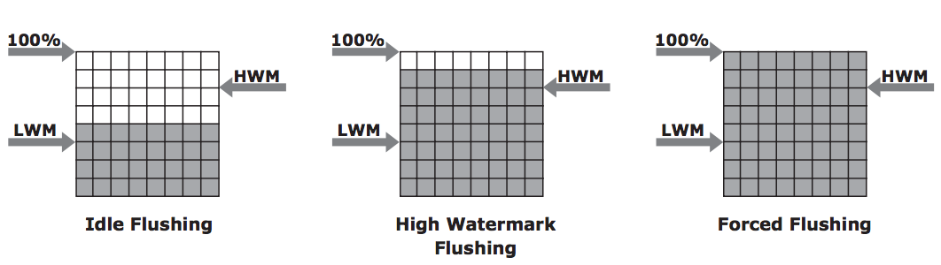
Cache Management
There are three modes of flushing
Idle flushing - Flushing occurs continuously when cache utilization level is between high and low watermark
High watermark flushing - High watermark flushing occurs when cache utilization hits high watermark. The storage system assigns additional resources to help flushing and I/O processes are affected.
Forced flushing - Forced flushing occurs when cache utilization hits 100%. The storage system assigns resources to prioritize cache flushing and I/O processes are significantly affected.
HWM = High Watermark
LWM = Low Watermark
Notes:
So we have three modes for flushing: idle flushing, high watermark flushing, and forced flushing.
Each of these correspond to a watermark level and the corresponding rate at which flushing occurs.
A visual representation is available in the next slide.

Slide 15
Cache Data Protection
Cache is volatile memory and any cache failure will result in losing data that has not been committed to disk or inaccurate data.
Cache mirroring and cache vaulting can help minimize risk
Cache mirroring - Each write to cache is held in 2 different memory locations on 2 memory cards. If one cache fails, the write data is still safe in the other location. Only writes are mirrored because if cache fails, data can still be read from the disk, so there is no data loss.
In cache mirroring, the data in the two different memory locations must be identical at all times. This is called cache coherency.
Cache vaulting - Cache vaulting addresses the risk of data loss due to power failure.
During a power failure, the contents of cache are dumped into a set of physical disks called vault drives. When power is restored, the content of vault drives are written to cache and then to disk.
Notes:
Although cache is fast, it is considered volatile memory as data is only stored in there temporarily. Any data located in cache that has not been committed to the disk will be lost if cache fails.
Cache mirroring and cache vaulting are ways to prevent data loss.
Cache mirroring helps address cache failure. Each write write to cache is stored into two different locations, so there is a backup cache in case one cache fails. However, the data in both memory locations must be identical at the same time.
Cache vaulting helps address power failures. During a power failure, all cache content are dumped onto physical disks called vault drives. Once power is restored, the data is taken from the vault drives and stored accordingly.

Slide 16
Back End
The back end is an interface that controls data transfer between cache and physical disks. It has two components:
Back-end ports - connected to physical disks
Back-end controllers - communicates with disks when performing read and write operations
Intelligent storage system back ends have many controllers, each with multiple ports, to ensure high data protection and availability.
Notes:
The back end of an intelligent storage system handles the data transfer between cache and physical disks.
Back ends have back end ports that connect to disks and back end controllers that can communicate with disks.
Like front end, there are multiple back end controllers to ensure high availability

Slide 17
Physical Disk
Physical disks are connected to the back-end storage controller through back-end ports.
Physical disks are non-volatile memory and provide persistent data storage.
An increasingly exponential amount of data needs to be stored, and intelligent storage systems have to increase their capacity periodically to accommodate this data explosion
Notes:
Physical disks provide persistent data storage for a storage system.
Intelligent storage systems have to be able to increase their capacity periodically to keep up with the exponential amount of data that needs to be stored.

Slide 18
References
EMC Education Services. 2012. Information storage and management: storing, managing, and protecting digital information 2nd ed., Hoboken, NJ: Wiley.
Yang, Jui-Pin, and Ying-Chin Chen. “A Novel Information Lifecycle Management Scheme for a Web-Based Database System.” Journal of Scientific & Industrial Research, Feb. 2017, pp. 85–89, nopr.niscair.res.in/bitstream/123456789/39833/1/JSIR%2076%282%29%2085-89.pdf.

