Slide 1
Concepts of Computing Technologies Storage Management Overview
Notes:
Replace this with your course title and your name/contact details.

Slide 2
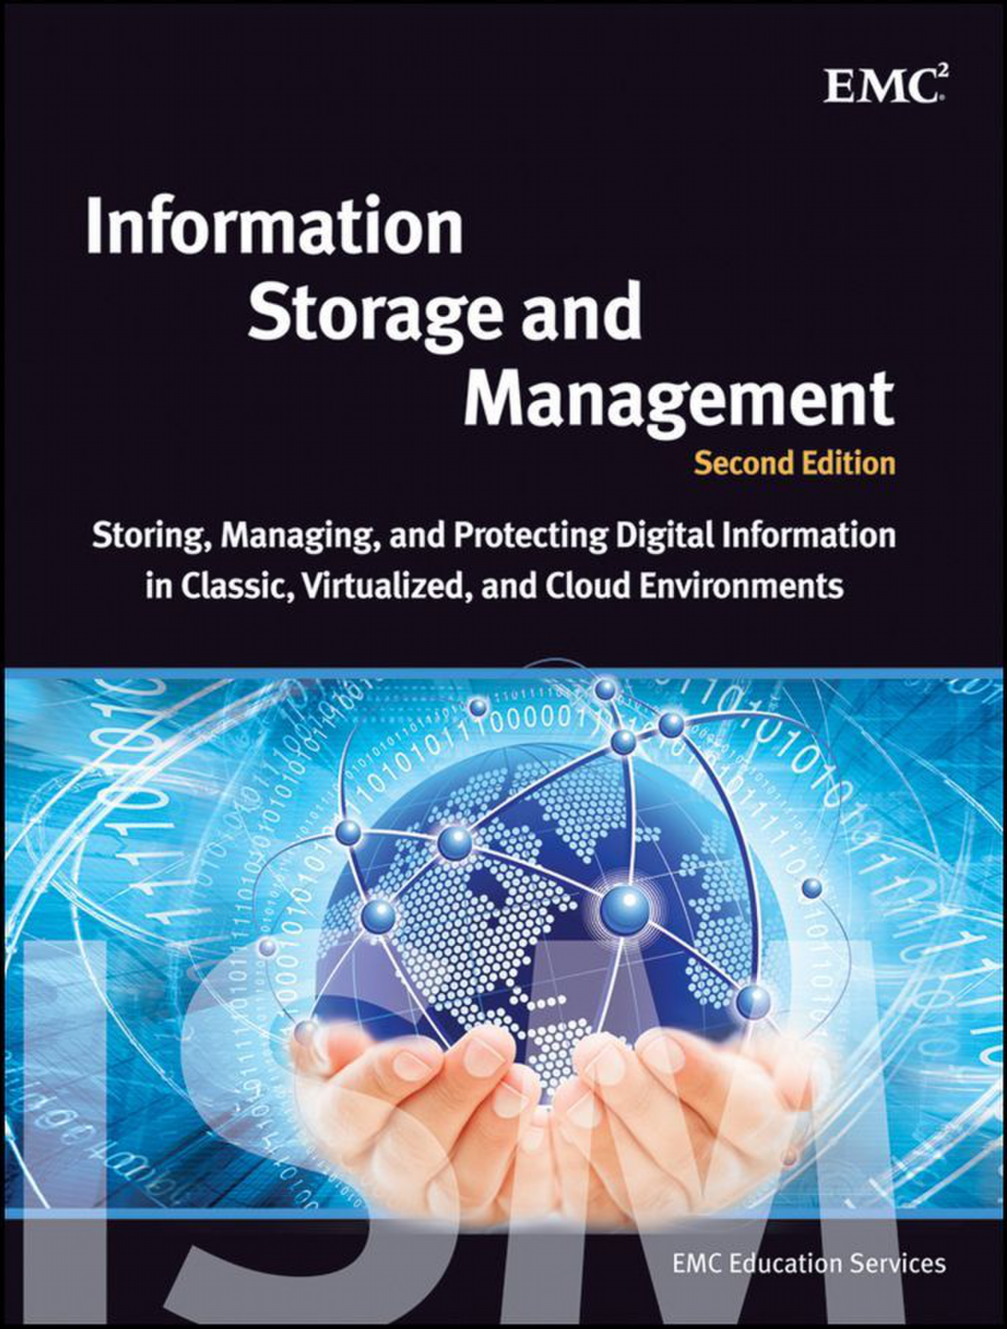
Textbook Reference
Material for this module primarily comes from EMC Education Services. 2012. Information storage and management: storing, managing, and protecting digital information 2nd ed., Hoboken, NJ: Wiley.
Notes:
Replace this with your course title and your name/contact details.

Slide 3
Did You Know?
More than 570 websites are created every minute
Every minute, 24 hours of video is uploaded to YouTube
350,000 tweets are sent per minute 5 million tweets are sent per day
16,000,000,000,000,000,000,000
16 zettabytes (16x10²¹) of unique data created worldwide in 2016
90% of the world's data has been created in the last couple of years
The amount of new Technical Information is doubling every two years

Slide 4
Need to manage data as an institutional asset
Organizations usually maintain one or more data centers to store and manage information.
In traditional data centers, the storage resources are typically dedicated for each of the business units or applications.
Key Term
Data Center
a facility that contains information storage and other physical information technology (IT) resources for computing, networking, and storing information

Slide 5
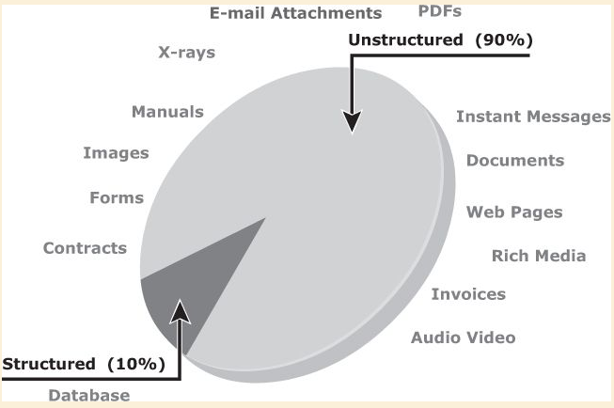
Don't think of Data as "What we find in a Database:

Slide 6
"Big Data"
Big data is a new and evolving concept, which refers to data sets whose sizes are beyond the capability of commonly used software tools to capture, store, manage, and process within acceptable time limits.
It includes both structured and unstructured data generated by a variety of sources
Business application transactions
Web pages
Videos
These data sets typically require real-time capture or updates for analysis, predictive modeling, and decision making.
Images
Email
Social Media, etc.

Slide 7
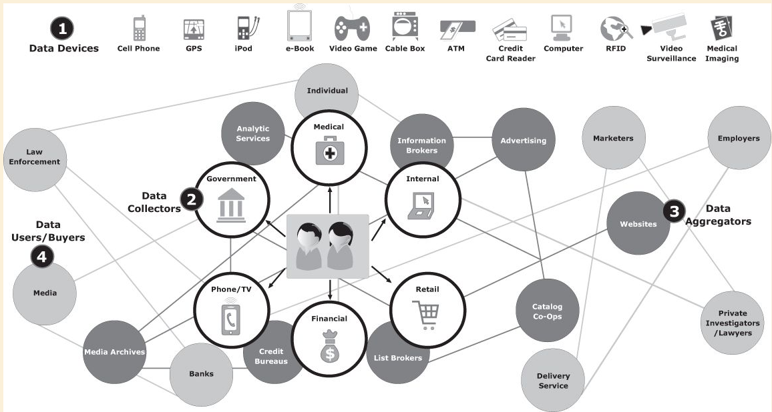
Big Data Ecosystem
Ecosystem
Devices that collect data from multiple locations and also generate new data about this data (metadata).
Data collectors who gather data from devices and users.
Data aggregators that compile the collected data to extract meaningful information.
Data users and buyers who benefit from the information collected and aggregated by others in the data value chain.

Slide 8
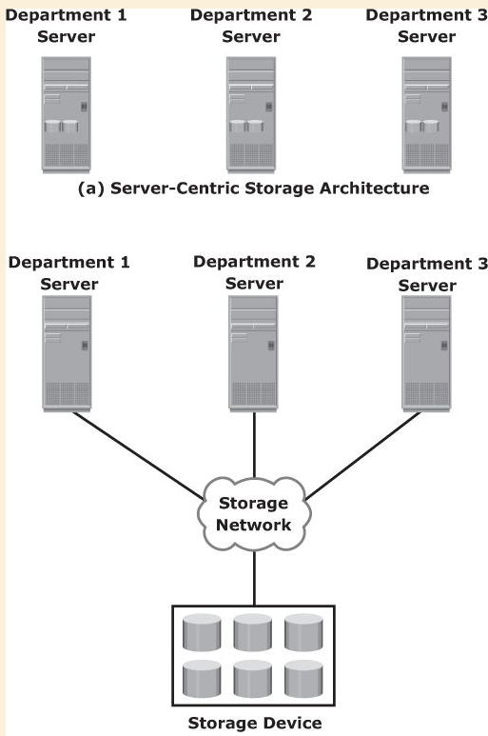
Evolution of Storage Architecture
Storage was typically internal to a server that could not be shared with any other servers.
This approach is referred to as server-centric storage architecture
In this architecture, each server has a limited number of storage volumes
The proliferation of departmental servers in an enterprise resulted in unprotected, unmanaged, fragmented islands of information and increased capital and operating expenses.
Storage evolved from server-centric to information-centric architecture

Slide 9
Key Characteristics of a Data Center (1)
Availability: A data center should ensure the availability of information when required. Unavailability of information could cost millions of dollars per hour to businesses, such as financial services, telecommunications, and e-commerce.
Security: Data centers must establish policies, procedures, and core element integration to prevent unauthorized access to information.
Scalability: Business growth often requires deploying more servers, new applications, and additional databases. Data center resources should scale based on requirements, without interrupting business operations.
Performance: All the elements of the data center should provide optimal performance based on the required service levels.

Slide 10
Key Characteristics of a Data Center (2)
Data integrity: Data integrity refers to mechanisms, such as error correction codes or parity bits, which ensure that data is stored and retrieved exactly as it was received.
Capacity: Data center operations require adequate resources to store and process large amounts of data, efficiently. When capacity requirements increase, the data center must provide additional capacity without interrupting availability or with minimal disruption. Capacity may be managed by reallocating the existing resources or by adding new resources.
Manageability: A data center should provide easy and integrated management of all its elements. Manageability can be achieved through automation and reduction of human (manual) intervention in common tasks.

Slide 11
Managing a Data Center
Managing a data center involves many tasks. The key management activities include the following:
Monitoring: It is a continuous process of gathering information on various elements and services running in a data center. The aspects of a data center that are monitored include security, performance, availability, and capacity.
Reporting: It is done periodically on resource performance, capacity, and utilization. Reporting tasks help to establish business justifications and chargeback of costs associated with data center operations.
Provisioning: It is a process of providing the hardware, software, and other resources required to run a data center. Provisioning activities primarily include resources management to meet capacity, availability, performance, and security requirements.

Slide 12
Virtualization
Key Term
Virtualization
a technique of abstracting physical resources, such as compute, storage, and network, and making them appear as logical resources.
Virtualization has existed in the IT industry for several years and in different forms, e.g.:
Virtual memory used on compute systems
Partitioning of raw disks.
Virtualization also enables centralized management of pooled resources.
Virtual resources can be created and provisioned from the pooled physical resources.
Capacity can be added to or removed from the virtual resources without any disruption to applications or users.
Virtualization enables pooling of physical resources and providing an aggregated view of the physical resource capabilities.
Storage virtualization enables multiple pooled storage devices to appear as a single large storage entity.
Compute virtualization allows the CPU capacity of the pooled physical servers to be viewed as the aggregation of the power of all CPUs (in megahertz.)
utilization of IT assets;
◉ procurement/management costs, energy, physical space
Notes:
For example, a virtual disk of a given capacity can be created from a storage pool or a virtual server with specific CPU power and memory can be configured from a compute pool. These virtual resources share pooled physical resources, which improves the utilization of physical IT resources.

Slide 13
Cloud Computing
In today's fast-paced and competitive environment, organizations must be agile and flexible to meet changing market requirements.
This leads to rapid expansion and upgrade of resources while meeting shrinking or stagnant IT budgets.
Cloud computing, addresses these challenges efficiently by enabling individuals or businesses to use IT resources as a service over the network.
It provides highly scalable and flexible computing that enables provisioning of resources on demand. Users can scale up or scale down the demand of computing resources, including storage capacity, with minimal management effort or service provider interaction.
Cloud computing enables consumption-based metering; therefore, consumers pay only for the resources they use, such as CPU hours used, amount of data transferred, and gigabytes of data stored.
Cloud infrastructure is usually built upon virtualized data centers, which provide resource pooling and rapid provisioning of resources. Information storage in virtualized and cloud environments

Slide 14
References
EMC Education Services. 2012. Information storage and management: storing, managing, and protecting digital information 2nd ed., Hoboken, NJ: Wiley.

