Slide 1
Concepts of
Computing
Technologies
Storage Management:
Storage System Environment
Ch. 2
Notes:
Replace this with your course title and your name/contact details.

Slide 2
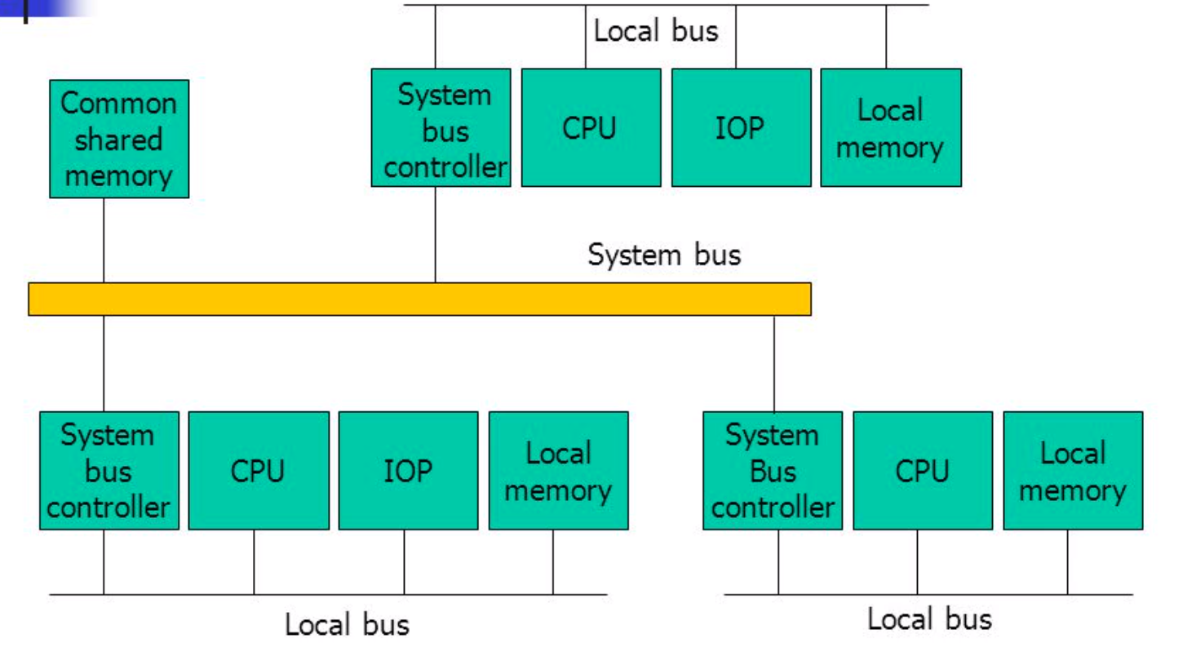
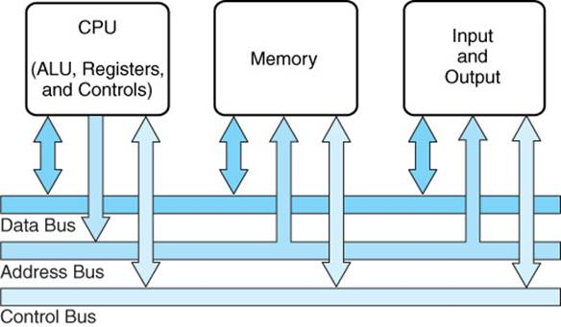
Components of Connectivity
Bus – collection of paths that facilitates data transmission from one part of a host to another
  Physical components communicate by sending bits
System Bus – carries data from processor to memory
Local Bus –
Connects directly
to the processor
and carries data
between
peripheral
devices

Slide 3
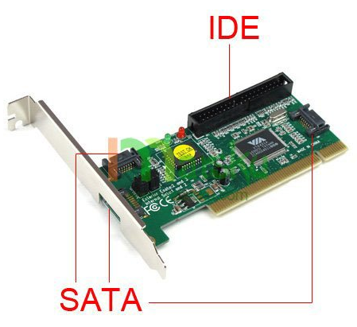
Components of Connectivity
IDE/ATA
  Integrated Device Electronics/Advanced Technology Attachment
  IDE – Allows motherboard to communicate with controllers connected to it
  ATA – Allows motherboard to connect to storage devices attached to it
  SATA
    Serial ATA
    Designed to replace normal ATA
IDE/ Serial ATA is a popular interface protocol standard used for connecting storage devices, such as disk drives and CD-ROM drives.
SATA revision 3.0 provides a data transfer rate up to 6 Gb/ s.

Slide 4
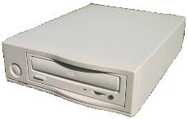
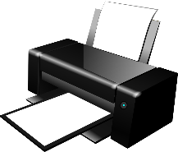
Components of Connectivity
SCSI (Small Computer System Interface)
  Faster than IDE/ATA
  More expensive, so less common on
  consumer computers
  SCSI has emerged as a preferred
  connectivity protocol in high-end
  computers.
  Supports parallel transmission and
  offers improved performance, scalability, and compatibility compared to ATA.
  SCSI supports up to 16 devices on a single bus and provides data transfer rates up to 640 MB/s (for the Ultra-640 version).
  Serial attached SCSI (SAS) is a point-to-point serial protocol that provides an alternative to parallel SCSI.
  A newer version of serial SCSI (SAS 2.0) supports a data transfer rate up to 6 Gb/ s.
CPU
Memory
Access to host memory
SCSI Host Adapter
SCSI Device Controller
Hard Disk
SCSI-Bus
SCSI Device Controller
CD ROM
drive
SCSI Device Controller

Slide 5
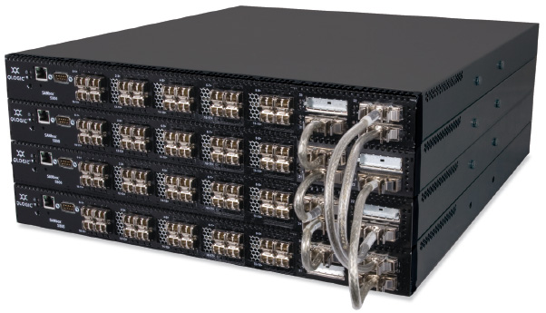
Components of Connectivity
Fibre Channel is a widely
used protocol for high-speed
communication to the storage
device.
The Fibre Channel interface
provides gigabit network
speed. It provides a serial
data transmission that
operates over copper wire
and optical fiber. The latest
version allows transmission
of data up to 16 Gb/s.
Internet Protocol (IP) IP is a network protocol that has been traditionally used for host-to-host traffic. With the emergence of new technologies, an IP network has become a viable option for host-to-storage communication. iSCSI and FCIP protocols both leverage IP for host-to-storage communication.

Slide 6
Storage
Uses either magnetic, optic or solid state media
  Magnetic – Disk, Tape
  Solid State – Flash memory, Solid State Drive
  Optic – Optical disk
Either volatile or non-volatile
  Volatile – loses all data when power is lost
  Non volatile – data is safe when power is lost

Slide 7
Storage
Random Access Memory
  Allows direct access to any memory location
  Can have data written to and read from
  Volatile – needs a constant source of power, or else data stored is erased
Read-Only Memory
  Only allows data to be read from
  Non-volatile – data stored is kept on power loss

Slide 8
Storage
The storage device can be internal and (or) external to the host.
In either case, the host controller card accesses the storage devices using predefined protocols, such as IDE/ ATA, SCSI, or Fibre Channel (FC). IDE/ ATA and SCSI are popularly used in small and personal computing environments for accessing internal storage.
FC and iSCSI protocols are used for accessing data from an external storage device (or subsystems).
External storage devices can be connected to the host directly or through the storage network.
When the storage is connected directly to the host, it is referred as direct-attached storage (DAS)

Slide 9
Accessing data
Data can be accessed over a network in one of the following ways: block level, file level, or object level.
In general, the application requests data from the file system (or operating system) by specifying the filename and location. The file system maps the file attributes to the logical block address of the data and sends the request to the storage device. The storage device converts the logical block address (LBA) to a cylinder-head-sector (CHS) address and fetches the data.

Slide 10
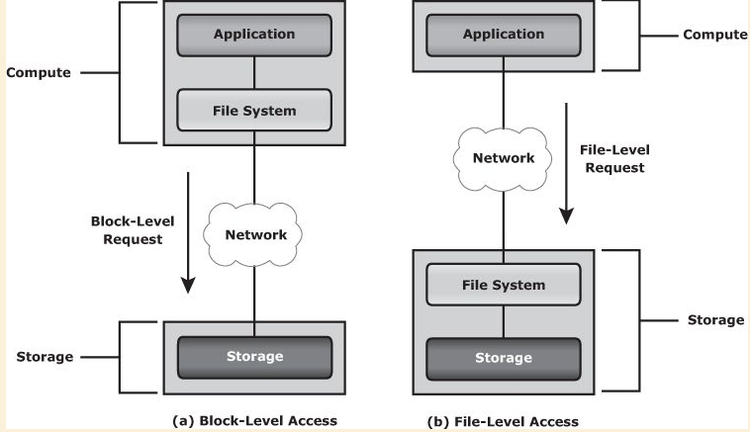
Accessing data
Three access methods:
  Block-level access: the file system is created on a host, and data is accessed on a network at the block level
  File-level access: the file system is created on a separate file server or at the storage side, and the file-level
  request is sent over a
  network,
  Because data is
  accessed at the file
  level, this method has
  higher overhead than
  block level access.
  Object-level access is
  an intelligent evolution,
  whereby data is accessed
  over a network in terms
  of self-contained objects
  with a unique object ID.

Slide 11
Direct-Attached Storage (DAS)
DAS is an architecture in which storage is connected directly to the hosts.
The internal disk drive of a host and the directly-connected external storage array are some examples of DAS.
Although the implementation of storage networking technologies is gaining popularity, DAS has remained suitable for localized data access in a small environment, such as personal computing and workgroups.
DAS is classified as internal or external, based on the location of the storage device with respect to the host.
In most cases, communication between the host and the storage device takes place over a SCSI or FC protocol.

Slide 12
DAS Pros and Cons vs.
Storage Network Architectures
PROs
Lower initial investment
Simple configuration
Easy and rapid deployment.
Easy storage management -- fewer management tasks
Less hardware and software elements to set up and operate.
CON
Does not scale well.
  A storage array has a limited number of ports, which restricts the number of hosts that can directly connect to the storage.
  When capacities are reached, the service availability may be compromised.
  DAS does not make optimal use of resources due to its limited capability to share front-end ports.
  Unused resources cannot be easily re-allocated, resulting in islands of over-utilized and under-utilized storage pools.
. Information Storage and Management: Storing, Managing, and Protecting Digital Information in Classic, Virtualized, and Cloud Environments (Kindle Locations 991-997). Wiley. Kindle Edition.
. Information Storage and Management: Storing, Managing, and Protecting Digital Information in Classic, Virtualized, and Cloud Environments (Kindle Location 991). Wiley. Kindle Edition.

Slide 13
Flash Drives
Flash drives, also referred as solid state drives (SSDs), are drives that deliver ultra-high performance required by performance-sensitive applications.
Flash drives use semiconductor-based solid state memory (flash memory) to store and retrieve data.
Unlike conventional mechanical disk drives, flash drives contain no moving parts; therefore, they do not have seek and rotational latencies.
Flash drives deliver a high number of Input/Output operations per second (IOPS) with very low response times.
Also, being a semiconductor-based device, flash drives consume less power, compared to mechanical drives.
Flash drives are especially suited for applications with small block size and random-read workloads that require consistently low (less than 1 millisecond) response times..

Slide 14
References
EMC Education Services. 2012. Information storage and management: storing, managing, and protecting digital information 2nd ed., Hoboken, NJ: Wiley.

