Slide 1
Concepts of Computing Technologies Risk Management Processes
Notes:
Replace this with your course title and your name/contact details.

Slide 2
Risk Management Lifecycle
Resource Profiling Describe the resource and rate risk severity (Business owner)
Risk Assessment Identify and rate threats, vulnerabilities, and risks (Information Security Department)
Risk Evaluation Decision to accept, avoid, transfer or mitigate risk (Information Security Department and Business Owner)
Document Document risk decisions including exceptions and mitigation plans (Information Security Department and Business Owner)
Risk Mitigation Implement mitigation plan with specified controls (Resource custodian)
Validation Test the controls to ensure the actua risk exposure matches the desired risk levels (Information Security Department)
Monitoring and Audit Contiunually track changes to the system that may affect the risk profile and perform regular audits (Information Security Department and Business Owner)
Resource Profiling
Risk Assessment
Risk Evaluation
Document
Risk Mitigation
Validation
Monitoring and Audit

Slide 3
Resource Profiling
Resource Profiling
Risk Assessment
Risk Evaluation
Document
Risk Mitigation
Validation
Monitoring and Audit
Resource Profiling Describe the resource and rate risk severity (Business owner)
Before any risk assessment can be performed, you must first assign sensitivity ratings for the resources in question. An e-commerce organization, for example, is going to value the systems associated with their Web presence most highly, whereas a brick and mortar retail chain might prioritize the point-of-sale systems in each store
Formalize them into levels of importance to your organization and use this information to prioritize any subsequent analysis work
Gather the following information about each asset or asset class:
General Description
Function and Features
Information Classification
Criticality to Organization
Applicable Regulations
User Community

Slide 4
Risk Assessment
Resource Profiling
Risk Assessment
Risk Evaluation
Document
Risk Mitigation
Validation
Monitoring and Audit
Risk Assessment Identify and rate threats, vulnerabilities, and risks (Information Security Department)
Superset of activities for taking vulnerability data, mapping it to likely threats, evaluating the severity for the given environment, and articulating the risk(s) that might result.
This is NOT the same as a Vulnerability Assessment (please read textbook)
Needs to account for any compensating controls that already exist. These controls may not neutralize the vulnerability, but they reduce the inherent
By the end of the risk assessment stage, the risk exposure should be determined for each threat/vulnerability pair.
The combination of the likelihood that the threat will exploit the vulnerability, and the severity of the exploit, combined with the sensitivity of the asset itself yields the risk exposure rating.

Slide 5
Risk Evaluation
Resource Profiling
Risk Assessment
Risk Evaluation
Document
Risk Mitigation
Validation
Monitoring and Audit
Risk Evaluation Decision to accept, avoid, transfer or mitigate risk (Information Security Department and Business Owner)
After you have assessed all the risks, you also need to weigh and prioritize them, so that you can make well-informed decisions about which risks need to be addressed, and to what degree it is appropriate to mitigate the risks.
As discussed earlier, there are several options for addressing a risk: accept, avoid, transfer, share or reduce. Shifting the responsibility or liability for a risk to another
You need to have some idea about what it would take to mitigate the risks. At this stage, a detailed mitigation plan unnecessary, but there should be enough information to be able to estimate the cost of mitigation.
Balanced mitigation cost estimates against the likely cost of not implementing the recommended control.

Slide 6
Document
Resource Profiling
Risk Assessment
Risk Evaluation
Document
Risk Mitigation
Validation
Monitoring and Audit
Document Document risk decisions including exceptions and mitigation plans (Information Security Department and Business Owner)
For each risk finding document:
Why a rating was given
Compensating controls considered
Business justification
Mitigation plans—long- and short-term
If you choose to address a risk with some kind of mitigation plan, the business owner needs to document:
The agreed upon steps
Target dates,
Responsible parties.

Slide 7
Risk Mitigation
Resource Profiling
Risk Assessment
Risk Evaluation
Document
Risk Mitigation
Validation
Monitoring and Audit
Risk Mitigation Implement mitigation plan with specified controls (Resource custodian)
Mitigation of risk can happen in one of three ways:
Reduce the likelihood of occurrence
Limit the severity of the impact
Decrease the sensitivity of the resource.
Key Term
Risk Mitigation
limiting the likelihood or effects of the risk exposure in some way.
vs.
Key Term
Risk Remediation
the actual removal or patching of the vulnerability.

Slide 8
Validation
Resource Profiling
Risk Assessment
Risk Evaluation
Document
Risk Mitigation
Validation
Monitoring and Audit
Validation Test the controls to ensure the actual risk exposure matches the desired risk levels (Information Security Department)
Verify the adequacy of these controls through active testing or review.
Ways to test:
Vulnerability scanning
Penetration testing
Configuration review.
Intent is to detect any areas where the controls don’t satisfactorily mitigate the risk or may have been misconfigured.
Often organizations will establish a certification and accreditation (C&A) process to formally document the controls and validation of those controls before the application/system is allowed to “go live” or be released

Slide 9
Monitoring and Auditing
Resource Profiling
Risk Assessment
Risk Evaluation
Document
Risk Mitigation
Validation
Monitoring and Audit
Monitoring and Audit Contiunually track changes to the system that may affect the risk profile and perform regular audits (Information Security Department and Business Owner)
Constant monitoring and auditing
Assessing a risk
Tracking the mitigation
Evaluating an exception request
Monitoring for new and changing risk exposures.
Sometimes a planned reassessment of risks are required:
Significant resource changes
Changes to the threat landscape
Shifts in business focus
Changes to the regulatory or legal requirements
Detected weaknesses in current controls
A predetermined period of time has passed

Slide 10
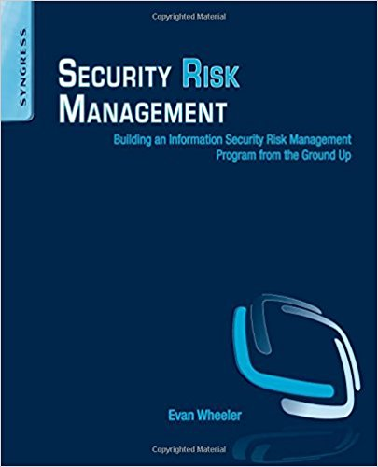
Further Processes Covered in Chapter 4
Be sure to read Chapter 4 for a more in-depth look at some Risk Management Processes

Slide 11
References
Wheeler, Evan. Security Risk Management: Building an Information Security Risk Management Program from the Ground Up. Elsevier Science.

