Slide 1
Concepts of
Computing
Technologies
Directory and Access Management:
Managing the OU Structure and Delegating Control
Notes:
201820-CS99310 - ADV LEARN ASST SEMINAR COM SCI (Section 1)
John Pansera
panseraj3@students.rowan.edu

Slide 2
Objectives
By the end of this lesson, you should be able to:
Manage the OU structure
Know how to delegate control to other users

Slide 3
Managing the OU Structure
The OU structure can be managed using Active Directory Administrative Center (ADAC), Active Directory Users and Computers (ADUC) MMC, and PowerShell.
The complete syntax for creating a new OU can be viewed with this command:
  Get-Command New-ADOrganizationalUnit -Syntax
Here is an example for creating a new OU called “Computers”
  New-ADOrganizationalUnit –Name “Computers” –Description “Computers OU”
“-Description” defines the description for the new OU. When no path is defined, it will be created under the root.
Here is an example command to review the details of an OU:
  Get-ADOrganizationalUnit –Identity “OU=Computers,DC=example,DC=com”

Slide 4
Delegating Control
Administrators can delegate control based on OUs.
  This provides control to individuals or groups to manage objects within OUs.

Slide 5
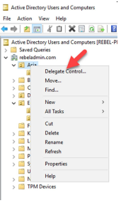
Delegating Control - Example
First, login to the domain controller as the Domain Admin.
Then open ADUC.
After that, right click on the OU and click Delegate Control.

Slide 6
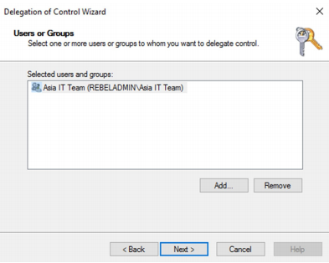
Delegating Control - Example
Then, when the wizard is opened up select the individuals or group that you want to provide delegated control to.

Slide 7
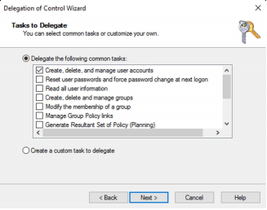
Delegating Control - Example
Next, select which kind of control to provide.
These are predefined sets of permissions from Microsoft, but custom ones can be created if needed.

Slide 8
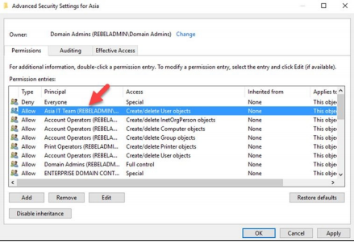
Delegating Control - Example
After you complete that process, you can review the delegated permission under the OU security settings.

Slide 9
References
EMC Education Services. 2012. Information storage and management: storing, managing, and protecting digital information 2nd ed., Hoboken, NJ: Wiley.
Francis, Dishan. Mastering Active Directory: Automate Tasks by Leveraging PowerShell for Active Directory Domain Services 2016. Packt Pub., 2017.

