Slide 1
Concepts of
Computing
Technologies
Directory and Access Management:
Group Policies and OU Design Models
Notes:
201820-CS99310 - ADV LEARN ASST SEMINAR COM SCI (Section 1)
John Pansera
panseraj3@students.rowan.edu

Slide 2
Objectives
By the end of this lesson, you should be able to:
Know what Group Policies are
Know the OU Design Models

Slide 3
Designing the OU Structure
There are 3 reasons for creating an OU:
  Organizing Objects
  Delegating Control
  Group Policies
Organizational units can accomplish domain functions, so less domains are required.
Throughout the OU hierarchy, the following are inherited:
  User Rights
  Group Policies

Slide 4
Organizing Objects
An Active Directory controller supports having almost 2,000,000,000 objects!
It is better to have smaller groups for easier management.

Slide 5
Delegating Control
You can delegate the administration of a set of objects to people or groups using OUs.
These individuals then have control over managing objects in that OU, under the privileges defined by the Domain/Enterprise Admins.

Slide 6
Group Policies
Group Policies can be used to apply rules.
  These rules can be used to manage application, security, and system settings of AD objects.
Since each object in Active Directory has different requirements, group policies can be used to apply rules to each of them.
Group policies can be bound to the organizational units.
  Groups of objects can be separated into different OUs based on what group policies they need.
It is important to consider Group Policy inheritance.
Notes:
The most common reason for OUs is placing objects in them that have different group policy requirements.

Slide 7
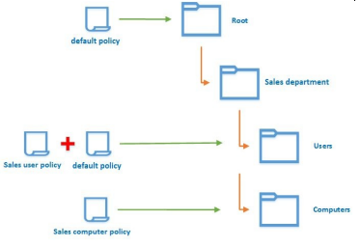
Example Group Policy
Here is an example group policy. It has a default policy, which is inherited down the tree to the other OU levels.
The Users OU has a group policy called Sales user policy linked to it along with the default policy.
There is also a group policy called Sales computer policy linked to the Computers OU.

Slide 8
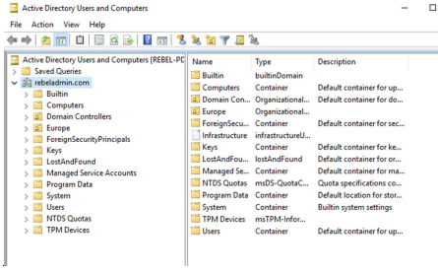
Containers Versus OUs
The Domain Controllers folder is the only default OU in the AD environment.
Containers can also contain objects, such as the Computers and Users containers.
All default user accounts and security groups are stored in the Users container.
The only difference between containers and OUs is that group policies cannot apply to containers.
Here is a picture of the ADUC MMC.
The folders that you see are both OUs and containers.

Slide 9
OU Design Models: The Container Model
A container has large administrative boundaries.
Mainly applicable to small businesses
  This is because there are limited administrative/security requirements over the AD objects.
Advantages | Disadvantages
Easy to implement | Less control
Fewer group policies | Less security
Easy to change | Less extensibility

Slide 10
OU Design Models: The Object Type Model
Active Directory contains different types of objects, including:
  Users
  Groups
  Computers
These different types of objects can be grouped into separate OUs.
Advantages | Disadvantages
Flexibility | Complexity
Easy management of AD objects | Structural changes are difficult
Extensibility | N/A
Use of group policies | N/A

Slide 11
OU Design Models: The Geographical Model
One of the most common models for large organizations.
Based on the geographical location of the branch offices.
This model is mainly used to delegate administration control.
Advantages | Disadvantages
Delegated control | Extensibility
Repetitive | Operation limitations
Maintain standards | N/A

Slide 12
OU Design Models: The Department Model
This OU Design Model is based on the hierarchy of the departments of an organization.
Users and resources related to each department will be categorized together.
Advantages | Disadvantages
Distributed delegated control | Object locations will be difficult to match with the structure
Minimum structure changes | Limitation of applying company-wide settings
Less complex | N/A

Slide 13
References
EMC Education Services. 2012. Information storage and management: storing, managing, and protecting digital information 2nd ed., Hoboken, NJ: Wiley.
Francis, Dishan. Mastering Active Directory: Automate Tasks by Leveraging PowerShell for Active Directory Domain Services 2016. Packt Pub., 2017.
Dias, J. “A Guide to Microsoft Active Directory (AD) Design.” 29 Apr. 2002, e-reports-ext.llnl.gov/pdf/240226.pdf.

