Slide 1
Concepts of
Computing
Technologies
Directory and Access Management:
User Accounts
Notes:
201820-CS99310 - ADV LEARN ASST SEMINAR COM SCI (Section 1) – Spring 2018
Mantas Pileckis
Email: pileckism7@students.rowan.edu

Slide 2
Objectives
By the end of this lesson, you should be able to:
Basic information about introducing a new User
Understand some of the administrative tasks in Active Directory
Understand how to create a template
Understand the purpose of the template
Minimize errors in user creation

Slide 3
User Accounts
In Active directory the most common administrative task is creating and managing user accounts.
A User account contains much more than a Username and Password. Additionally it holds data such as group memberships, roaming profile path, home folder path, login script info, remote dial in permissions and many more.
When creating a new User account, we need to define values for all of its attributes. When the number of attributes and features associated with an account is increased, the amount of possible mistakes is also increased.

Slide 4
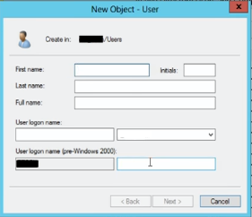
User Accounts
When defining a new user in our infrastructure, we can create them anywhere we would like to start of. Active Directory has no problem with re-allocating these user objects at any time.
Usually the new user information consists of First Name, Last Name, Log On name and a password.
  Passwords contain a few options such as :
  User cannot change password
  Password never expires
  Disabled account
  User must change password at next logon
(pg 353).

Slide 5
User Accounts : Common Attributes
Many of the User Accounts may contain common attribute values, but there are a few attributes that have to contain unique or non null values by default :
*AD – Active Directory
*OU – Organizational Unit
Attribute | Description | Value
First Name | User’s First Name | Unique Within OU
Last Name | User’s Last Name | Unique Within OU
User Logon Name | User’s Logon Name | Unique Within AD
Password | User’s Password | No need to be unique
Profile Path | User’s roaming profile path | Recommended to be unique

Slide 6
User Accounts : Templates
A good practice to decrease the number of mistakes in a user creation process is to use templates.
Templates are best used in a situation where Organizational Unit contains many Users. In this situation we can define one user and call it “User_Template”, for example. Then we can set up “User_Template” with privileges and attributes that will apply to many Users within that Organizational Unit.

Slide 7
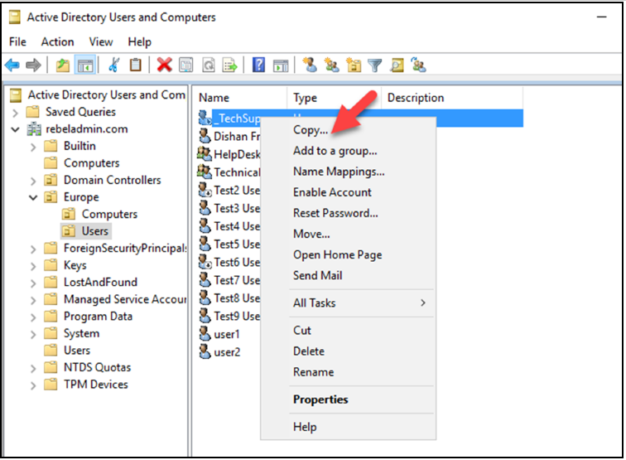
User Accounts : Template
After we have created a template we can copy it in the directory and
adjust the attributes
related to that object
and lastly enable it.
Therefor we have
decreased the amount
of possible mistakes
during the new user setup
process.
(pg 353).
Notes:
Francis, Dishan. “User Accounts." Mastering Active Directory: Automate Tasks by Leveraging PowerShell for Active Directory Domain Services 2016. Birmingham: Packt Pub., 2017. 354.

Slide 8
User Accounts : Templates
Few things to consider when creating a templates :
  Do not copy user accounts as templates : Templates should be a baseline, it should never be copied from another user account, other uses might have unique privileges and attribute values even if they are under the same Organizational Unit.
  Disable Account : No one should use template account to authenticate. When creating the template, make sure to set it as disabled account. (When copying the template for a new user creation, we can change the status of the account).
  Security groups : We can also define the security group for a template, there for every user created using that template, will be added to the security group automatically.

Slide 9
Service Accounts
Service accounts are recommended to use when installing application or services in infrastructure. It is a dedicated account with specific privileges which are used to run services, batch jobs, and management tasks.
In most infrastructures, service accounts are typical user accounts with the Password never expires option.
Only one Managed Service Account can be used in one computer. It cannot be shared between multiple computers.

Slide 10
Group Managed Service Accounts
Regular service accounts can only be used on the designated station (computer) at which it is linked.
Group Managed Service Accounts provides the functionality of sharing the Service Account between multiple hosts.
Group Managed, and regular service accounts share the same functionalities, but it extends its capabilities to host group levels and as well has the following capabilities:
  No Password management
  Supports sharing across multiple hosts
  Can be used to run scheduled tasks
  Uses Microsoft Key Distribution Center to create and manage the passwords for the Group Managed Service Accounts. (Querries from the domain controllers to retrieve the latest password).

Slide 11
References
Francis, Dishan. Mastering Active Directory: Automate Tasks by Leveraging PowerShell for Active Directory Domain Services 2016. Birmingham: Packt Pub. 2017.

