Slide 1
Concepts of
Computing
Technologies
Directory and Access Management:
Object Attributes
Notes:
201820-CS99310 - ADV LEARN ASST SEMINAR COM SCI (Section 1) – Spring 2018
Mantas Pileckis
Email: pileckism7@students.rowan.edu

Slide 2
Objectives
By the end of this lesson, you should be able to:
Have a basic understanding of object attributes.
Have the tools to create a custom attribute.
Have understanding of some of the basic syntax in active directory.

Slide 3
Object Attributes
Each Object in Active Directory is an instance of an Object Class and therefor each object belongs to a certain Object class.
Object Class is a grouping of attributes and properties that describes an object.
Objects can have attributes which are common for other objects in the same class.
Some attributes have unique values which make objects unique under the same class.
The set of attributes defines an Object within an Object class.

Slide 4
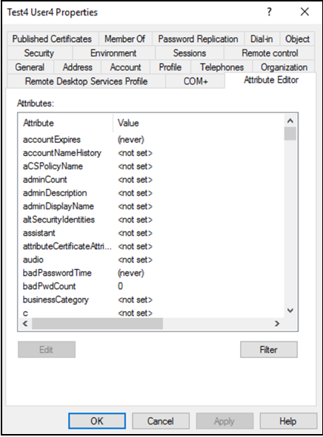
Object Attributes
Active Directory does a well job of
describing the selected objects
and their attributes with a listed view for
each object we select.
We are able to view, add, edit and
Remove values from some attributes in
this view.
Most of the attribute names do no match
with the names that you will create in the
wizard (will discuss in the following slides).
(pg 342).
Notes:
Francis, Dishan. "Object Attributes." Mastering Active Directory: Automate Tasks by Leveraging PowerShell for Active Directory Domain Services 2016. Birmingham: Packt Pub., 2017. 343.

Slide 5
Custom attributes
In Active Directory, we are allowed to add custom attributes.
Custom attributes can be used for many cases, these are few common uses of custom attributes:
  Last user to logon to a computer
  Last time the user logged on that computer
  Hardware Manufacturer of that computer
  Hardware model of the computer
  Serial number of the computer
Creating an attribute in active directory is a simple task to do, but it is not reversible.
If a custom attribute was created in Active directory, it cannot be removed.

Slide 6
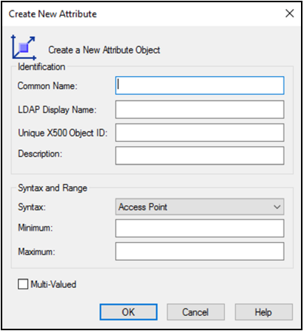
Custom Attributes : Create
Any time we will want to create a custom attribute, we will be prompted with an appropriate window in which we will have to follow the syntax rules and define our values.
  Here we need to define the details about the
  custom attribute using proper syntax.
(pg 348).
Notes:
Francis, Dishan. "Object Attributes." Mastering Active Directory: Automate Tasks by Leveraging PowerShell for Active Directory Domain Services 2016. Birmingham: Packt Pub., 2017. 348.

Slide 7
Custom Attributes : Create
  Common name (CN) –
  Name of the object (Letters, Numbers, Hyphens).
  LDAP Display Name –
  Custom reference to the object (CN by default).
  Unique X500 Object ID –
  Object identifier value (Required for all attributes).
  Description –
  Simple description of the attribute.
  Syntax –
  The storage representation of the object (Data Type).
  .
(pg 348).
Notes:
Francis, Dishan. "Object Attributes." Mastering Active Directory: Automate Tasks by Leveraging PowerShell for Active Directory Domain Services 2016. Birmingham: Packt Pub., 2017. 348.

Slide 8
Custom Attributes : Syntax
This is the list of the most commonly used syntax in active directory :
Along with the syntax, it is also possible to define minimum or maximum values. If the minimum and maximum values are not defined, it will take the default values of Active Directory.
Syntax | Description
Boolean | True or False
Unicode String | A large String
Numeric String | String of digits
Integer | 32-Bit numeric value
Large Integer | 64-Bit numeric value
SID | Security identifier value
Distinguished name | String value to uniquely identify object

Slide 9
References
Francis, Dishan. Mastering Active Directory: Automate Tasks by Leveraging PowerShell for Active Directory Domain Services 2016. Birmingham: Packt Pub. 2017.

