Slide 1
Concepts of
Computing
Technologies
Directory and Access Management:
Managing Active
Directory Objects
Notes:
201820-CS99310 - ADV LEARN ASST SEMINAR COM SCI (Section 1) - Spring 2018
Brennan Ringel
Email: ringelb8@students.rowan.edu
Email2:brennanringel@gmail.com

Slide 2
Objectives
By the end of this lesson, you should be able to:
Understand some tools and methods to manage Active Directory objects
Create, modify, and remove objects in Active Directory
Be able to find objects in Active directory
Notes:
The things we need to represent in active directory are created and saved as objects, so it is important to know how this works (and how to do it). Here, we will only be covering built-in tools on Windows Server Systems.

Slide 3
Tools and Methods to Manage Objects

Slide 4
Active Directory Administrative Center

Slide 5
Active Directory Administrative Center (ADAC)
The Active Directory Users and Computers MMC is the most commonly used tool to manage Active Directory environments.
  This tool is built in to the system from the early version of Active Directory and has continued to the latest.
ADAC, a built-in PowerShell command-line interface technology.
  (It is built in to all Microsoft Servers as of AD DS 2008 R2.)
ADAC is a built-in PowerShell command-line interface technology (built in as of Microsoft 2008 and up).
(Francis)
Notes:
To access the ADAC console, you can type dsac.exe in a PowerShell command line or the Run box:

Slide 6
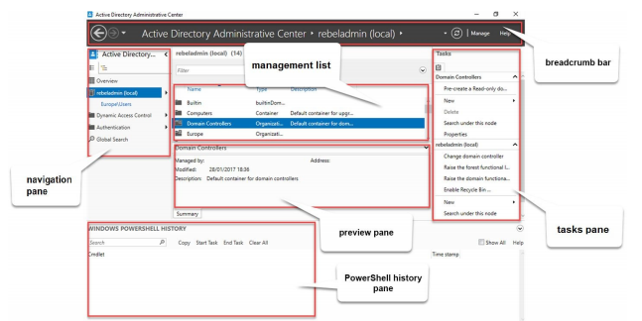
Active Directory Administrative Center (ADAC)
(Francis)

Slide 7
ADAC Tools (1)
Breadcrumb bar
  This is similar to a file navigation bar.
  This can be used to navigate to different containers directly. In order to navigate to a specific container, you need to use its distinguished name. It can also be used the other way around, to find out the distinguished name of a container.
Management list
  This is similar to the file navigation section of your computer. Just like you can see and navigate through folders to find files, containers, objects contained in the containers, object search results, and so on are displayed in the management list.
(Francis)

Slide 8
ADAC Tools (2)
Navigation pane
  This is similar to the left side of windows file explorer where you can access all of your drives. Using it, you can navigate to different containers in your domain. This can also be used to upgrade the domain and forest functional levels and enable the Active Directory Recycle Bin. Using the navigation pane, we can add objects such as users, groups, organizational units, or computers to the directory.
Tasks pane
  The tasks pane will list down the administrative tasks associated with the objects you select, such as moving objects, password resets, properties, and deletion.
PowerShell history pane
  All tasks performed in ADAC are executed as PowerShell commands.
  This pane will show all executed commands, which is good for reuse.
  The PowerShell history pane also allows us to search for commands.
(Francis)

Slide 9
ADAC Tools (3)
Using the tools in ADAC you can
  Create users, groups, computer accounts, and organization units
  Manage users, groups, computer accounts, and organization units
  Remove users, groups, computer accounts, and organization units
  Manage Active Directory objects from other trusted domains
  Filter Active Directory objects using queries
(Francis)
Notes:
These things can be done directly in the powershell, but ADAC gives us a nice GUI to work with.

Slide 10
Creating, modifying, and removing objects in Active Directory
Notes:
These are the most commonly performed management tasks in an Active Directory environment.

Slide 11
Creating Active Directory Objects
When creating objects, values need to be provided according to the object’s type.
Objects have attributes that are mandatory, and those that are not. Mandatory attributes must be provided, and non-mandatory ones can be left out.
Organizations may decide that some custom attributes need to be added to an object’s type.
(Francis)

Slide 12
Creating User Objects
Creating new users can be done with the New-ADUser cmdlet in PowerShell.
To view the syntax of the command along with accepted data types, type in the command :
  Get-Command New-ADUser -Syntax
In order to create a new user account using PowerShell, you must at least pass a value for -Name. This will create a disabled user account. Undefined attributes can be defined later, however, a user account can not be enabled without defining a password first.
  To define a password, you can use the Set-ADAccountPassword -Identity cmdlet, and to enable an account, you can use the Enable-ADAccount - Identity cmdlet.
(Francis)

Slide 13
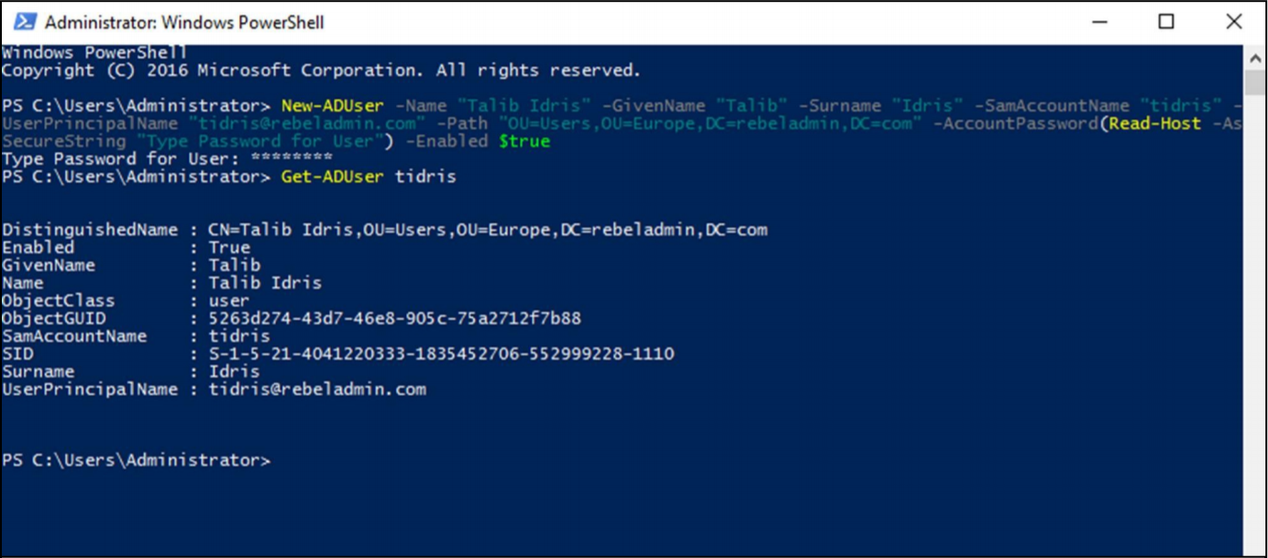
Creating User Objects (Example)
(Francis)
Notes:
Note how when we add new users, the field value is followed by the field name. For example, we have -Name followed by “Talib Idris” which denotes we are making an account for Talib Idris. Remember that this field (-Name) must be included when creating new User objects.

Slide 14
Creating User Objects (Example (Parameters Explained))
-Name: This parameter defines the full name.
-GivenName: This parameter defines the first name
-SurName: This parameter defines the surname.
-SamAccountName: This parameter defines the username.
-UserPrincipalName: This parameter defines the UPN for the user account.
-Path: This defines the OU path. The default location for rebeladmin.com is CN=Users,DC=rebeladmin,DC=com. If you do not define the -Path value, it will create the object under the default container.
-AccountPassword: This will allow the user to input a password for the user, and the system will convert it to the relevant data type
-Enabled: This defines whether the user account status is enabled or disabled
(Francis)
Notes:
Here are the parameters we used in the previous example, as well as a definition of what each parameter takes.

Slide 15
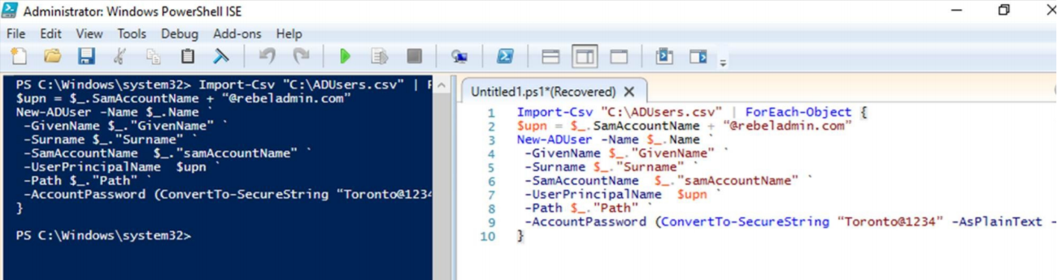
Creating Multiple User Objects at once
The Import-Csv cmdlet can be used to import multiple users from a CSV file. Here is an example of it being used:
(Francis)
Notes:
Note how the temporary value $upn is created using $upn = $_.SamAccountName + "@rebeladmin.com", and that it is then used to set the -UserPrincipalName field. Also note that all account passwords are set to the same value “Toronto@1234” here. As mentioned before, the values for the passwords can be changed using the Set-ADAccountPassword -Identity cmdlet

Slide 16
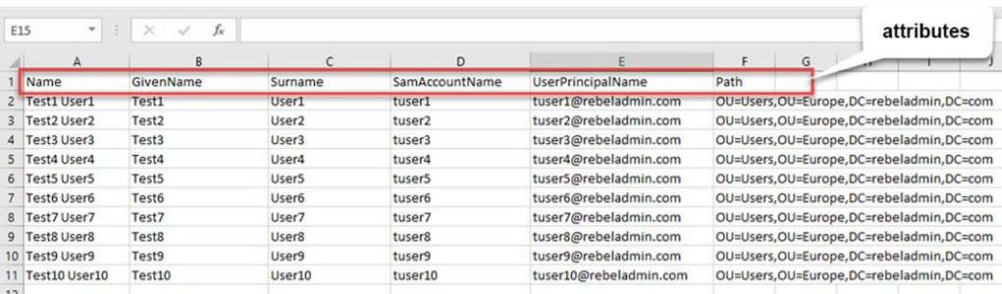
Creating Multiple User Objects at once (continued)
Here is an example csv that can be used with the command from the previous slide:
(Francis)

Slide 17
Creating Computer Objects
When a desktop computer or member server is joined to a domain, it will create a computer object in Active Directory.
In order to create a computer object, we can use the New-ADComputer cmdlet. The full syntax of the command can be viewed by entering Get-Command New-ADComputer -Syntax at the PowerShell command line.
Like users, you must at least define a name when creating a computer object.
(Francis)

Slide 18
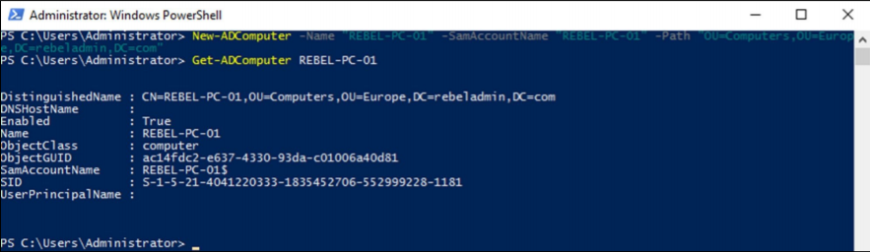
Creating Computer Objects in Powershell
Here is an example of the New-ADComputer cmdlet being used:
(Francis)
Notes:
While we can import many computer objects using the Import-Csv cmdlet that we used when mass importing users, it is rarely needed.

Slide 19
Modifying Active Directory Objects
After creating objects, we may need to set or change certain attributes.
In order to do this, we must modify the active directory object.
We can use the Set-ADUser cmdlet to change and add attribute values to existing AD user objects
(Francis)

Slide 20
Modifying Active Directory Objects Examples
Set-ADUser tidris -OfficePhone "0912291120" -City "London"
Set-ADUser tidris -OfficePhone "0112291120"
This can also be done for computer objects
  Set-ADComputer REBEL-PC-01 -Description "Sales Computer"
(Francis)
Notes:
(Bullet 1) Here we’re adding values for the -OfficePhone and -City attributes for user tidris.
(Bullet 2) Here, we overwrite the previously assigned OfficePhone value.

Slide 21
Modifying Active Directory Objects Examples (2)
In the last 2 examples, the exact user account was defined. However, we can combine the Set-ADUser cmdlet with the Get-ADuser cmdlet which will allow us to search for objects first and push the changes to those
Get-ADUser -Filter {City -like "London"} | Set-ADUser -City "Kingston"
This can also be done for computer objects
  Get-ADComputer -Filter {Name -like "REBEL-PC-*"} | Set-ADComputer -Location “M35 Building”
(Francis)
Notes:
(Bullet 2) In this example, I search for all the users in the directory who have the City value defined as London and change it to Kingston.

Slide 22
Removing Active Directory Objects
When removing Active Directory Objects, it is most important to find the exact object that you need to remove.
The Remove-ADUser cmdlet is used to remove AD user objects. To see the full syntax, type Get-Command Remove-ADUser -Syntax at the PowerShell command line.
The Remove-ADComputer cmdlet can be used to remove computer objects from the directory.
(Francis)

Slide 23
Removing Active Directory Objects Examples
Remove-ADUser -Identity "dzhang"
  This will remove the user object called Zhang from the directory.
Get-ADUser -Filter {Name -like "Test1*"} | Remove-ADUser
  Combining the cmdlet with a search query helps us to find objects before deleting them. Here we look for the user object whose name starts with Test1, and remove it.
Remove-ADComputer -Identity "REBEL-PC-01"
  Similar to Remove-ADUser, this will remove the REBEL-PC-01 computer object.
Get-ADComputer -Filter * -SearchBase 'OU=Computers,OU=Europe,DC=rebeladmin,DC=com' | Re
  Similar to combining with a search query for removing users, we can do the same for removing computer objects. In this command, we search for computers in the given OU and remove them from the directory.
(Francis)
Notes:
(Bullet 1) It will ask for confirmation before actually removing the object.
*sidenote at end of slide*
ADAC and ADUC tools can also be used to remove objects from a directory. They can also be used with a search function to locate specific objects and then delete them.

Slide 24
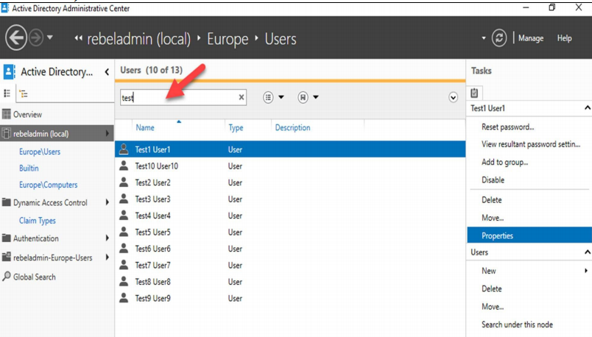
Finding Objects in Active Directory
Using ADAC’s built in filter box in the management list, we can filter quickly on something we’re searching for.
(Francis)

Slide 25
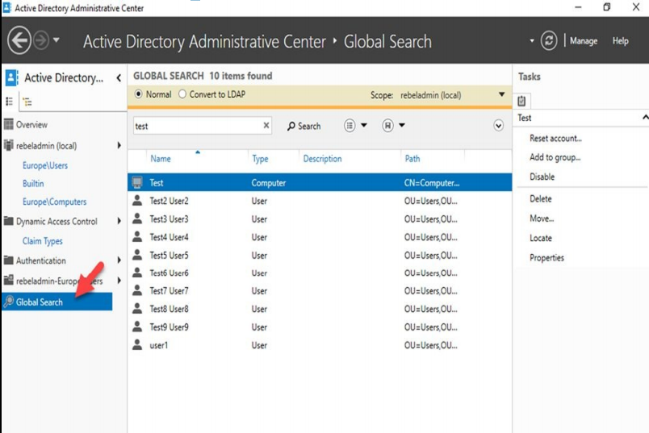
Finding Objects in Active Directory
ADAC also has a feature called Global Search, which can be used to search for objects in the entire directory. This allows a typical text-based search or advanced LDAP-based queries:
(Francis)

Slide 26
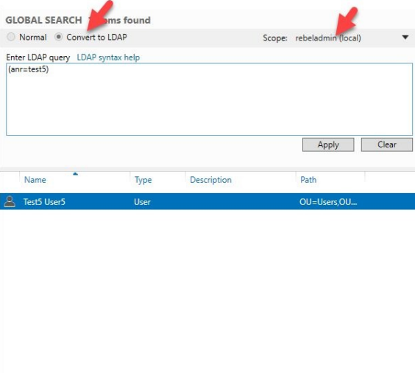
Using LDAP Based Queries
In a Normal search, you can use any text pattern. This can be a complete or partial value.
In an LDAP search, we need to use exact syntax.
We can generate an LDAP query from a Normal search sing the convert to LDAP option.
(Francis)

Slide 27
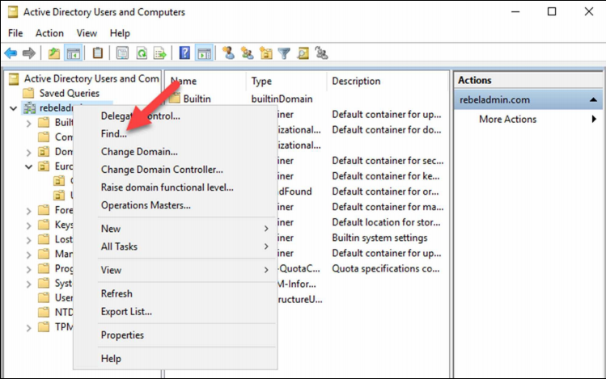
ADUC Search
In ADUC, object search functions are very limited compared to ADAC and PowerShell. However, the find option allows us to locate objects in the directory.
(Francis)

Slide 28
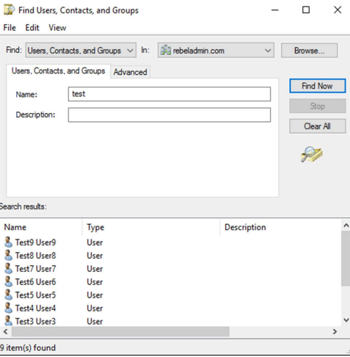
ADUC Search (more find)
Find allows us to do a text-based search as well as an advanced search based on attributes and their values. It also allows to define the search scope.
(Francis)

Slide 29
Finding Objects using PowerShell
The Get-ADUser and Get-ADComputer cmdlets can also be used to retrieve specific attribute values from filtered objects.
Get-ADUser -Identity user1 - Properties *
  This will get all attributes and values associated with user1.
Get-ADUser -Filter {City -like "Kingston"} -Properties Name,UserPrincipalName,Modified | select-object Name,UserPrincipalName,Modified | Export-csv -path C:\ADUSerList.csv
  This is how to export data to a CSV file for future use.
The Search-ADAccount cmdlet can also be used to search for Active Directory objects based on account and password status
  Search-ADAccount -LockedOut | FT Name,UserPrincipalName
(Francis)
Notes:
Search-ADAccount -LockedOut | FT Name,UserPrincipalName can be used to filter accounts that are locked out. This command will list down all the locked-out accounts with name and UPN.

Slide 30
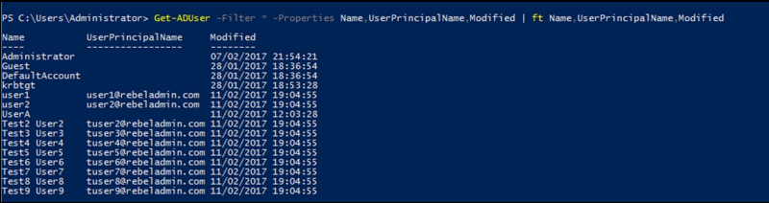
Finding Objects using PowerShell
GetADUser -Filter * -Properties Name,UserPrincipalName,Modified | ft Name,UserPrincipalName,Modified
  This shows the Name, UserPrincipalName, and Modified for all the users, as seen below.
(Francis)

Slide 31
References
Francis, Dishan. Mastering Active Directory: Automate Tasks by Leveraging PowerShell for Active Directory Domain Services 2016. Packt Pub., 2017.

